Slide 1
Measuring outcomes and proving value for money
Research network workshop
Monday 7th October 2024

Slide 2
Agenda
Time | Item | Lead
13:00 | Lunch | Marcus Green
13:30 | Welcome, introductions and meeting the Evaluation Ambassadors | Marcus Green
13:45 | Evaluation plan recap and outcomes measurement | Marcus Green
14:00 | Logic model examples | Marcus Green
15:00 | Break | Marcus Green
15:15 | Value for money | Marcus Green
15:45 | Conclusions and close | Marcus Green
Notes:
Build in discussion slides + add references to tool kit

Slide 3
Introductions: Getting to know each other
10mins
Introduce yourself and your role

Slide 4
When to start your evaluation and begin recording data
It is best practice and will make your life much easier to plan and build the foundation of your evaluation before you start your project.
Your plan should cover activities that help you to:
Ensure key stakeholders are on side, aware of the process and realistic expectations are set
Work with owners of existing data and local analysts
Ensure data collection mechanisms are in place to allow you to record activity and agreed outcomes as they happen.
Start your project early
Integrate the evaluation plan into the project design to give your project the best chance of realising and measuring its outcomes.
See ‘Start with Why’ in the Evaluation Toolkit
The ultimate purpose of collecting data is to provide a basis for action or a recommendation
W. Edwards Deming

Slide 5
Planning your evaluation
Evaluation questions
Set out the key questions you need answering that you can use to evaluate your intervention
Designing evaluation
Design your evaluation such that it answers your evaluation questions
Analysing collected data
Analyse your collected data to evaluate the impact of your intervention
Data and measurement
Identify your intended outcomes, decide your measures and what data to collect
Do this alongside designing your intervention
Resourcing evaluation and managing stakeholders
Engage, support and communicate expectations with all stakeholders needed for resourcing evaluation (i.e., in terms of data recording, data collection and data management)
Align on timeframe for realising outcomes
Sharing findings with audience
Share intervention findings from your data analytics in appropriate format for each group of stakeholders

Slide 6
Outcomes to measures to measurement

Slide 7
Discussion: data and measurement
5mins
Please raise your hand to discuss:
What has your experience been of thinking through intended outcomes for a project?

Slide 8
Logic model framework for evaluation
Directions: Start with the problem statement (1), then agree the goal/aim as the long-term outcomes (2), work backwards to populate the model (3), work forwards using an ‘if-then’ logic to test the model (4). Gap-analysis. Iterative development. Review and update as necessary.
Considerations: Common understanding and agreement on (1&2), define outcome timescales, multiple stakeholders perspectives on (1-4), SMART, success/failure and intended/unintended consequences.
See the ‘Start with Why’ in the Evaluation Toolkit
Rationale for intervention (1)
This is the justification for the programme/intervention. For example, what is the nature and scale of the problem being addressed? What will happen if nothing is done?
Inputs
Outputs
Outcomes – Impact
Inputs
Participants
Activities
Outputs
Short-term
Medium-term
long-term (2)
What we need/invest in?
Who we reach/involve?
What we do?
What we create?
Results — In terms of learning
Results — In terms of changing action
Results — In terms of change to the conditions
The resources available or required to deliver the work.
The stakeholders involved in the programme /intervention and those with an interest in the long-term outcomes.
The activities undertaken as part of the programme /intervention.
Maybe referred to as process measures.
Directly related to/ resulting from activity.
Delivering to the intended audience at the intended ‘dose’ of action.
Changes observed in awareness, attitudes, knowledge, skills, functioning, outlook, etc.
Changes observed in behaviour, practice, condition, and decision-making, etc.
These follow on from changes observed in the short-term.
The final desired impact of the programme/intervention. At a population or system-level impacts.
Relates closely to the original rationale.
Relative weights on multi-faceted aims.
Populate the model (3)
‘if-then’ logic test (4)
Assumptions
External Factors

Slide 9
Make sure your metrics are SMART
S
Specific
What do I want to accomplish?
M
Measurable
How will I know when it is accomplished?
A
Achievable
How can the goal be accomplished?
R
Realistic
Does this seem worthwhile?
T
Timebound
When can I accomplish this goal?

Slide 10
Outputs vs outcomes: Menti task
Log in to: menti.com
Code: 9378 7295
Outputs vs outcomes task:
You will be given a list of outputs and outcomes, please select which ones are outcomes.

Slide 11
Logic model examples

Slide 12
Logic model: The Wallington Community Garden
Rationale for intervention (1)
This is the justification for the project. For example, what is the nature and scale of the problem being addressed? What will happen if nothing is done?
Inputs
Outputs
Outcomes – Impact
Inputs
Participants
Activities
Outputs
Short-term
Medium-term
long-term (2)
What we need/invest in?
Who we reach/involve?
What we do?
What we create?
Results
Results
Results
Charitable investment from Nature Hubs and Queens Fund.
Green Space donated by Sutton Housing Partnership for minimum of 3 years
Tools donated by Wicks of Croydon
Garden shed donated by Cranstoun
Initial planting soil donated by Mitcham Waste
Waste wood and used pallets sourced for free or donated
A Facilitator from the Sutton PCN 4 hours per week
Volunteers from Sutton community organisations, Cranstouns, Sutton Nightwatch, local schools, Trinity Church, local womens refuge.
Clearance
Building raised beds
Building garden furniture
Creating a remembrance section
Building decking for peace garden section
Building accessibility pathways
Painting flower pots
Planting fruit, veg, flowers
Installing bird feeders
Growing veg and flowers
General garden maintenance
Mural painting
Creating sustainable watering systems
An open to all community space for relaxation , to improve health and wellbeing by creating community group discussion areas. A peaceful space to meet up with friends
Providing an open garden and nature space that can be tended to by anyone in the community that are perhaps isolated, general gardening opportunities for those not fortunate enough to have their own garden or can’t afford an allotment space.
Improved engagement with service users of community organisations
Creating trust and open dialogue with service users
Allowing expression of ideas and developing a project strategy for the garden
Providing a platform for volunteers to be directly involved in the growth of the garden.
Bringing people together that might otherwise feel isolated in a non-biased and non-judgmental environment
Working together to create the garden space through manual work which promotes physical activity and mental stimulation through allowing further expression and ideas
Growth of the garden allowing for community group activities e.g carol services, children’s activities
The garden will be ultimately maintained long-term by those in the community that have contributed to its growth. This will provide a sense of purpose, pride in creating a community space, bringing people together and working together for a common purpose
An outdoor healthy space to hold community work groups

Slide 13
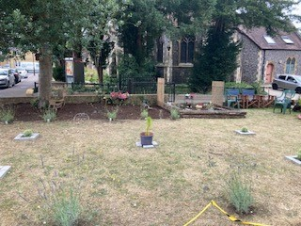
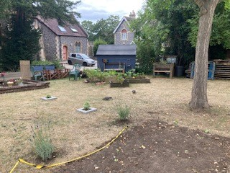
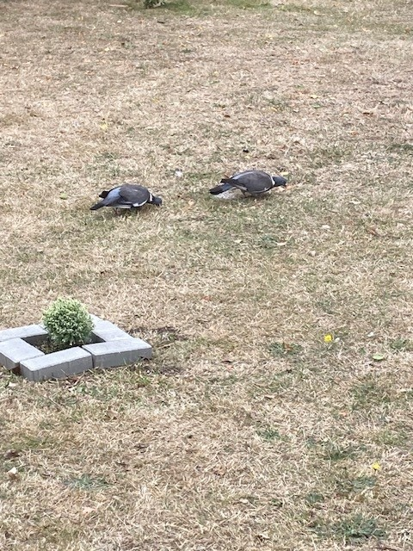
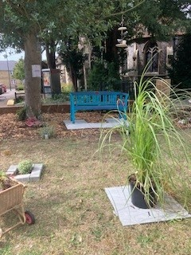
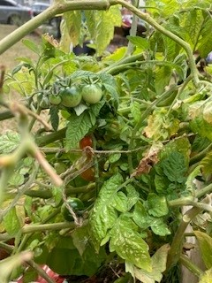
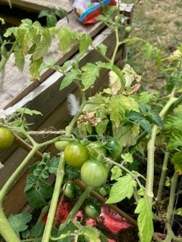
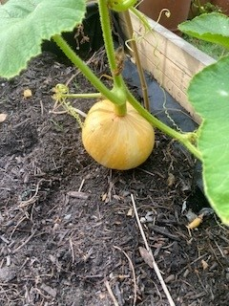
Pictures from the Wallington Community Garden (first steps)

Slide 14
Group task: your turn to populate a logic model!
Task
Work in groups and fill out the logic model considering the following components:
Inputs: What resources are needed for the project?
Participants: Who will be involved in the project?
Activities: What actions will the project take?
Outputs: What immediate results will happen from the activities?
Short-term outcomes: What changes will happen soon after the project?
Medium-term outcomes: What changes will happen in the medium-term?
Long-term outcomes: What changes will happen in the long run?
Guiding questions:
What inputs are required for the project to work?
Who are the participants and target groups involved in the project?
What activities will take place to make the project successful?
What outputs (measurable results) will happen as a direct result of the activities?
What short-term outcomes do you expect to see soon after the project starts?
What medium-term outcomes will occur as the project progresses?
What long-term outcomes do you hope will happen over time?

Slide 15
Logic model: your turn to populate a logic model!
Scenario: Single parent support
Project goal: Increase confidence, empowerment and reduce isolation in single parents
Inputs
Outputs
Outcomes – Impact
Inputs
Participants
Activities
Outputs
Short-term
Medium-term
long-term (2)
What we need/invest in?
Who we reach/involve?
What we do?
What we create?
Results
Results
Results
What resources are needed for the project?
Who will be involved in the project?
What actions will the project take?
What immediate results will happen from the activities?
What changes will happen soon after the project?
What changes will happen in the medium-term?
What changes will happen in the long run?

Slide 16
Logic model: your turn to populate a logic model!
Scenario: Eat well programme for students
Project goal: Provide university students with the skills and knowledge to create healthy, easy and economic meals
Inputs
Outputs
Outcomes – Impact
Inputs
Participants
Activities
Outputs
Short-term
Medium-term
long-term (2)
What we need/invest in?
Who we reach/involve?
What we do?
What we create?
Results
Results
Results
What resources are needed for the project?
Who will be involved in the project?
What actions will the project take?
What immediate results will happen from the activities?
What changes will happen soon after the project?
What changes will happen in the medium-term?
What changes will happen in the long run?

Slide 17
Logic model: your turn to populate a logic model!
Scenario: Menopause support group
Project goal: Provide community support and resources for women going through the menopause
Inputs
Outputs
Outcomes – Impact
Inputs
Participants
Activities
Outputs
Short-term
Medium-term
long-term (2)
What we need/invest in?
Who we reach/involve?
What we do?
What we create?
Results
Results
Results
What resources are needed for the project?
Who will be involved in the project?
What actions will the project take?
What immediate results will happen from the activities?
What changes will happen soon after the project?
What changes will happen in the medium-term?
What changes will happen in the long run?

Slide 18
Logic model: your turn to populate a logic model!
Scenario: Loneliness reduction programme
Project goal: Enable social connectedness amongst those who experience isolation and loneliness in the community
Inputs
Outputs
Outcomes – Impact
Inputs
Participants
Activities
Outputs
Short-term
Medium-term
long-term (2)
What we need/invest in?
Who we reach/involve?
What we do?
What we create?
Results
Results
Results
What resources are needed for the project?
Who will be involved in the project?
What actions will the project take?
What immediate results will happen from the activities?
What changes will happen soon after the project?
What changes will happen in the medium-term?
What changes will happen in the long run?

Slide 19
Logic model: your turn to populate a logic model!
Scenario: Digital basics for older people
Project goal: Increase confidence and capability with digital basics in older people - helping to connect with family members and support with day-to-day activities
Inputs
Outputs
Outcomes – Impact
Inputs
Participants
Activities
Outputs
Short-term
Medium-term
long-term (2)
What we need/invest in?
Who we reach/involve?
What we do?
What we create?
Results
Results
Results
What resources are needed for the project?
Who will be involved in the project?
What actions will the project take?
What immediate results will happen from the activities?
What changes will happen soon after the project?
What changes will happen in the medium-term?
What changes will happen in the long run?

Slide 20
Discussion: data and measurement
10mins
Please raise your hand to discuss:
How did you find using the logic model?
Can you see this process supporting you in the future to design and evaluate a project?

Slide 21
Value for money

Slide 22
Discussion: value for money
5mins
Please raise your hand to discuss:
What is your understanding of value for money?

Slide 23
Value for money is….
“Obtaining the most useful (utility), most effective, and least wasteful (efficient) outcome from your service or purchase”
Proof of Concept Report. London; 2011.
National Institute for Clinical Excellence

Slide 24
How to demonstrate impact and value for money: Menti task
Log in to: Menti.com
Code: 9378 7295
You will be given a series of multiple-choice questions. For each question, select which term best matches the description.

Slide 25
What are the steps to measuring value for money?
Step 1
Step 2
Step 3
Step 4
Have a clear sense of what value is and to your audience
Agree how you will measure value and the resource cost of your project
Ensure that you evaluate the outcomes of your project
Calculate value for money and report this to your audience

Slide 26
What are the steps to measuring value for money? An example - cost benefit analysis
How to measure value for money (VfM)
Why do we need to prove VfM?
Value/outcomes
Resources
= Value for money
There are finite resources in health and welfare systems against a backdrop of a growing, older and more unhealthy population.
Example: 4,000 health and wellness checks were completed by Community Health Navigators in Sutton
£100,000 worth of A&E attendances and emergency admissions avoided
An example
£100,000 return
Intervention costs £50,000
x2 ROI or £50,000
financial saving
=
Results can be expressed per intervention or participant

Slide 27
Discussion: value for money
5mins
Please raise your hand to discuss:
What has your experience been of trying to demonstrate value for money?

Slide 28
Accessing the Evaluation Toolkit

Slide 29
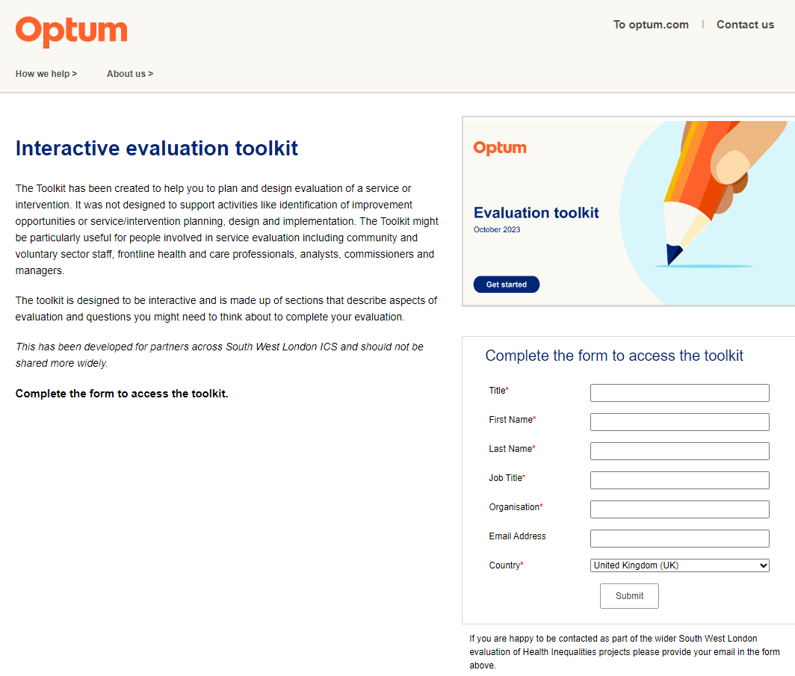
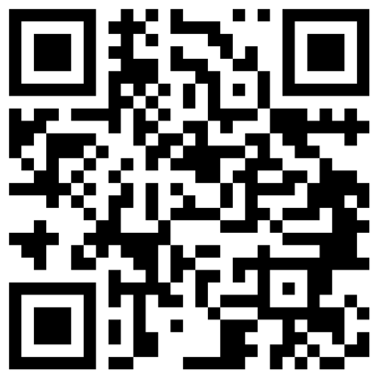
How to access the Evaluation Toolkit
Simply visit - https://info.optum.co.uk/evaluation-toolkit
The landing page describes what the Toolkit is and its purpose
There is a form to fill in before you can access the Toolkit
The Evaluation Toolkit is for partners across South West London to access. Please do not share more widely as this has been purpose-built for South West London
Scan QR code to access

Slide 30
Please share you feedback with us!
Thank you for attending today’s workshop. Please follow the link below or scan the QR code to provide your feedback.
https://forms.office.com/e/aYDwpKvi42

Slide 31
Outputs vs outcomes: Task
Assign each of the below statements as either an output or outcome
50 surveys were completed by participants.
Increased awareness of the research findings among the community.
A peer-reviewed article was published.
Improved practices in the field based on the research.
A presentation was delivered at a conference.
Participants demonstrated greater understanding of the topic.
Outputs: The tangible products or services delivered by the research project (e.g., published articles, completed surveys).
Outcomes: The changes or benefits that result from the outputs (e.g., increased awareness, improved practices).

Slide 32
Outputs vs outcomes: Answers
Outputs:
Outcomes:
50 surveys were completed by participants.
A peer-reviewed article was published.
A presentation was delivered at a conference.
Increased awareness of the research findings among the community.
Improved practices in the field based on the research.
Participants demonstrated greater understanding of the topic.
Outputs: The tangible products or services delivered by the research project (e.g., published articles, completed surveys).
Outcomes: The changes or benefits that result from the outputs (e.g., increased awareness, improved practices).

Slide 33
Quiz – match the term with the description (slide 5 for answers)
Social return on investment
Determines the cost of an action relative to the increase in output/outcome (not expressed in monetary units).
1
Cost effectiveness
Compares the total costs of a programme/project with its benefits, using a common metric (most commonly monetary units), which enables you to calculate the net cost or benefit associated with the programme.
2
Cost benefit analysis
The optimal use of resources to achieve intended outcomes.
3
Cost utility analysis
A framework for measuring non-financial value, particularly social and environmental impact, relative to resources invested.
4
Value for money
5
Compares the relative costs and outcomes (in non-monetary terms) of two or more courses of action.

Slide 34
Quiz – answers
Social return on investment
A framework for measuring non-financial value, particularly social and environmental impact, relative to resources invested.
4
Cost effectiveness
Compares the relative costs and outcomes (in non-monetary terms) of two or more courses of action.
5
Cost benefit analysis
Compares the total costs of a programme/project with its benefits, using a common metric (most commonly monetary units), which enables you to calculate the net cost or benefit associated with the programme.
2
Cost utility analysis
Determines the cost of an action relative to the increase in output/outcome (not expressed in monetary units).
1
Value for money
The optimal use of resources to achieve intended outcomes.
3
Notes:
Reduce/simplify descriptions and number descriptions

