Slide 1
Bid Writing Taster - Turning Visions into Funded Projects
Kate Scott (Kingston University)
Alison White (Health Innovation Network South London, SWL ICB)

Slide 2
Introduction to Bid Writing
Part 1. 10 – 10:45
Notes:
Overview covering what bid writing is and the key components that funders look for
Tips on how to define and articulate your vision effectively for a bid, aligning with organizational goals - Alison White
How to tailor your proposal to meet the needs and interests of different funders – analysing your audience
Advice on staying resilient through the process
Interactive activity and feedback - Writing a vision statement for a bid or for your organization as a whole
10-10.45
10-10.10- Thinking pairs – 10 mins
10.10- 10.25- What kind of writing- kate, Alison – planning/process
10.25- AW – vision statement – 20 mins –individuals. Audience specify – people who want to find out what you do – may need to be adapted for the actual bid
10.45-11am – break
11am-45- story telling
11.45-12 – break
12-12.45 - process
12.45-1pm – wrap up Q&A if time

Slide 3
Thinking Pairs: Bid-Writing
What is your experience of bid-writing (if any)?
What do you find easy?
What do you find not-so-easy?
What questions do you have?
What do you want to get better at?
What worries you about the bid-writing process?
Where have you gone wrong in the past?
What have you learned from your bid-writing experiences?
Notes:
3 minutes each way in pairs, and then one go-around of contributions onto whiteboard/flipchart
One key exp. From the list

Slide 4
Before you start writing!
Agree a plan which makes effective use of the time available
Assign roles to a small bid team which has appropriate knowledge, capacity and availability
Establish a bid tracker, to monitor your progress in satisfying the bid submission and compliance requirements and define a version control protocol
Notes:
AW
Following publication of the tender, schedule a kick-off meeting to:
Step one is planning - Being organised can really help smooth the process and save time in the long run.... – so before you start writing any answers take a step back
Get a team in place (not everyone will have a team) - but keep it small – do people have the knowledge to help? Do they have capacity? Are they available on key dates?
Establish a bid tracker to make sure you have assigned all the questions and tasks.
Define a version control process –using a shared document if possible will save time further down the line....

Slide 5
Roles within a bid-writing team
Notes:
AW – one way, not every team will have all these roles etc

Slide 6
Reading and Understanding the Call and the Funder
Understand the Funder
Understand the Call
What are they looking for?
What are they keen to fund?
What are their:
Priorities
Values
Style
Vocabulary
Previously funded projects
What will they be assessing proposals on?
Check that you understand:
The questions
The evaluation criteria
Formatting requirements
Policy re. appendices and hyperlinks
Seek clarification if necessary
Notes:
hared-
•Funding calls are often written in a particular way. They can be dry, concise, and technical and therefore require you to read them well
•Make sure you understand the key terms, buzzwords and the exact purpose and focus of the grants. This may take a few readings!
•As grants are competitive you need to make sure that your bid makes an immediately clear case for its suitability and its strength. Ideally, the reader must read your bid and think, yes, this is perfect and exactly what we are looking for!
KS-
Look on their website – phone them up and ask!
Priorities -
Values - what do THEY care about?
•What are the hopes, fears, concerns and desires of your audience?
•What do they already know?
•What sort of evidence or argument would they find most convincing?
Different donors expect different kinds of language, emphasis, skills and detail
Research – look at what they have funded previously
•Public funding body: (e.g. lottery, Arts Council) accessible, clear, impactful, social conscious, inspiring, some technical detail
•Other: private, smaller donor, local council: bespoke – do your research, look at former bids, look at donor priorities and the way they write their own copy.

Slide 7
Understand the rules of the game!
Notes:
AW- there maybe this detail – need to think about the criteria and spend time looking at this – will be different for different bids
Putting your self in the role of the assessor and the reviewer needs to think like this too
Think about the assessor – sometimes they make it clear different perspectives – feedback from citizens versus the experts – different ways for different audiences
Business etc

Slide 8
Prepare for failure
Most bids are rejected
Funding tends to stack
Get feedback
Tenacity and growth
Notes:
KS-
Most bids do not get funded and it is very likely that the first bids you write are rejected. This is fine and normal. You need to remember:
•Funding tends to stack: once you have received funding for one thing, your applications start to look much stronger and it is easier to get more money. The first step is the hardest and most important!
•Get feedback: each donor has specific things in mind and you may not have ticked the right boxes for them – always reach out and ask for feedback on a failed (or successful) application so you can learn how to improve
•Tenacity and growth: it can take time to work out the best way to pitch your project, who is most likely to fund it, and you will probably need time to learn this before you succeed

Slide 9
Vision Statement: Selling your vision
What?
What are you offering and what is unique it?
How and when will it be evaluated?
Why?
How is the proposal different / innovative.
Does it provide a solution / save money?
Return on investment if possible.
Why you?
What is different to your competitors?
Think through your win themes
Why now?
What makes this work timely, relevant, and urgent?

Slide 10
Some examples ...
Vision | Organisation
To accelerate the world's transition to sustainable energy. | Tesla
Our mission is to empower every person and every organization on the planet to achieve more. | Microsoft
To establish XXXXXX as the premier purveyor of the finest coffee in the world while maintaining our uncompromising principles while we grow. | Starbucks
Provide an important service to the world by instantly delivering relevant information on virtually any topic | Google
Speeding up the best in health and care, together | Health Innovation Network
To create economic opportunity for every member of the global workforce | LinkedIn
Our vision is for XXXXXXXXXXX to be sought after by students and staff as a place to further their ambitions and to have impact on our communities. Our students and staff will be sought after for their skills, knowledge and ability to innovate. | Kingston University
Notes:
Some of these are ike marmite....

Slide 11
Your Turn! Create Your Vision!
Individually (or in pairs if working on the same opportunity):
Write in 100-200 words a pitch / selling point to promote your service/project to a commissioner
Remember that this is just a first draft. It does NOT have to be perfect (yet!). Try not to over think it!
Notes:
Print out of vision statements -
Draft – first go on paper
Individuals – can share/discuss with partner/table etc – read the room
Don't over think it – we will be coming back to it – no the finished article-it’s a first draft
Don't have to share if you don't want too etc

Slide 12
Persuasion Through Storytelling
Part 2: 11 – 11:45
Notes:
How to use storytelling to engage funders and make your proposal stand out.
Group activity and feedback - Participants will work in groups to create a story around a research idea, practicing how to create a narrative that highlights the importance and impact of their work.

Slide 13
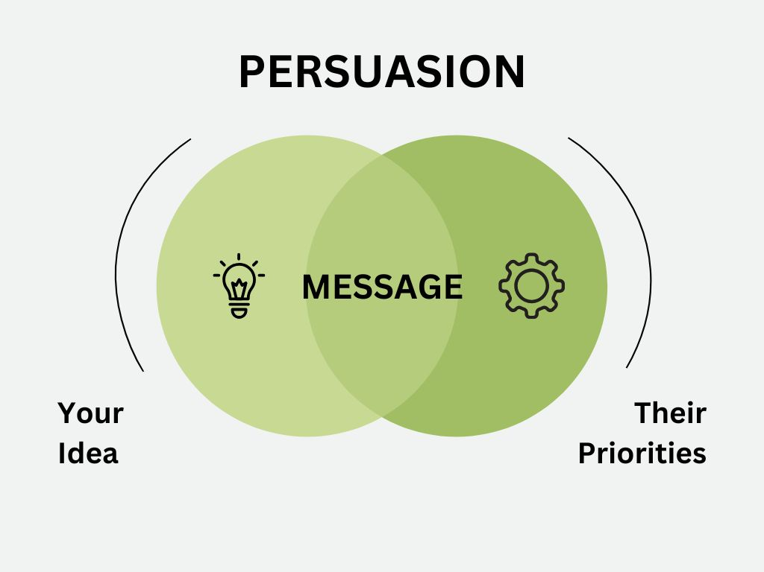
Notes:
KS -
Persuasion is all about connecting what the funder is looking for with what you are offering.

Slide 14
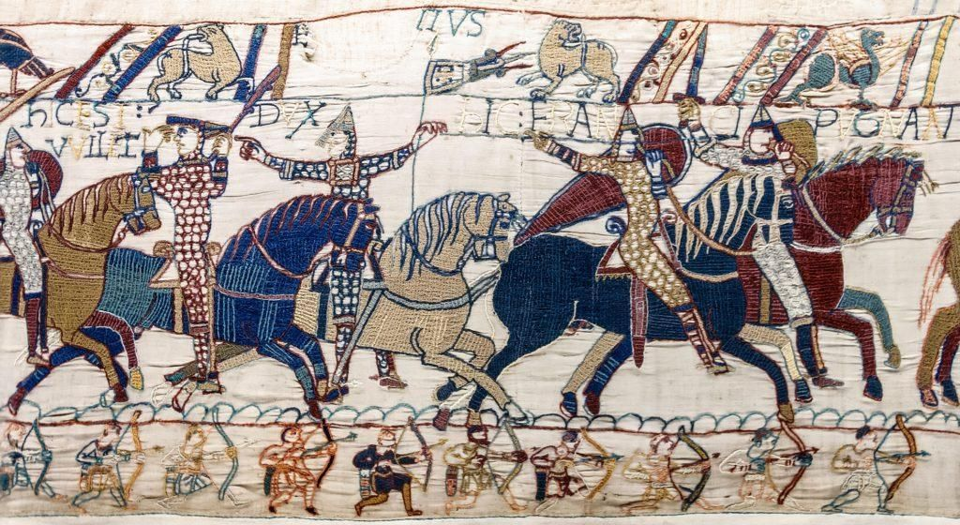
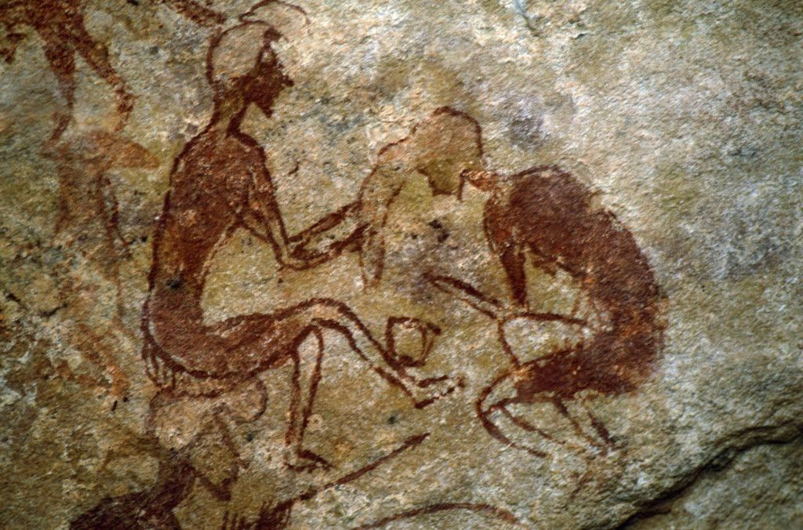
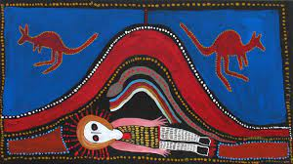
Storytelling …
… is universal
… is a key way in which we understand the world
… allows us to connect with diverse groups of people
… organises information and messages in recognisable and relatable structures:
Overcoming the monster
Rags to riches
Rebirth
Voyages, quests or journeys
Notes:
KS-
Why am I talking about storytelling and stories.
There are many many aspects of communication that we could talk about (and, indeed, I do talk about these in other sessions – but today we only have a relatively short time together, so I’m going to talk with you about something that lies at the heart of all good, effective communication – storytelling
Ok, you might be thinking – this is supposed to help my business - why are we talking about stories? Didn’t I leave that behind in my school English classes?
Every society and cultural tells stories
We are told stories from the moment we are born
And we spend an incredible amount of our time on this earth engaging with stories – think about what you might have done for pleasure or relaxation in the last week – did you listen to song or watch a movie, perhaps you read a book or went to the theatre even – perhaps you had a gossip with friends over a coffee or told them about your recent holiday – these all involve storytelling. We love stories!
It turns out that most stories follow relatable and recognisable patterns and structures – we won’t go into these in detail today, but here are some of the common ones – and the ones that are most useful to businesses.
Overcoming the monster – think of Dracula, or Jaws, or any alien or war movie
Rags to riches – Cinderella, the ugly duckling, great expectations
Rebirth – someone changes their ways and becomes a better person – A Christmas Carol, Groundhog day, beauty and the beast
Voyages, quests or journeys – Alice in wonderland, Lord of the Rings, Raiders of the lost arc, Watership Down…
So now you might be thinking – ok, but what has this got to do with boosting my business?
Stories help us to connect with people – we recognise ourselves in stories and they can help make complex and abstract things more understandable and relevant to our lives.
Stories are memorable – the messages that they communicate stay with us – so being relevant, memorable, relatable and connecting with a large audience – these are all things that most businesses need to do every day in one way or another.

Slide 15
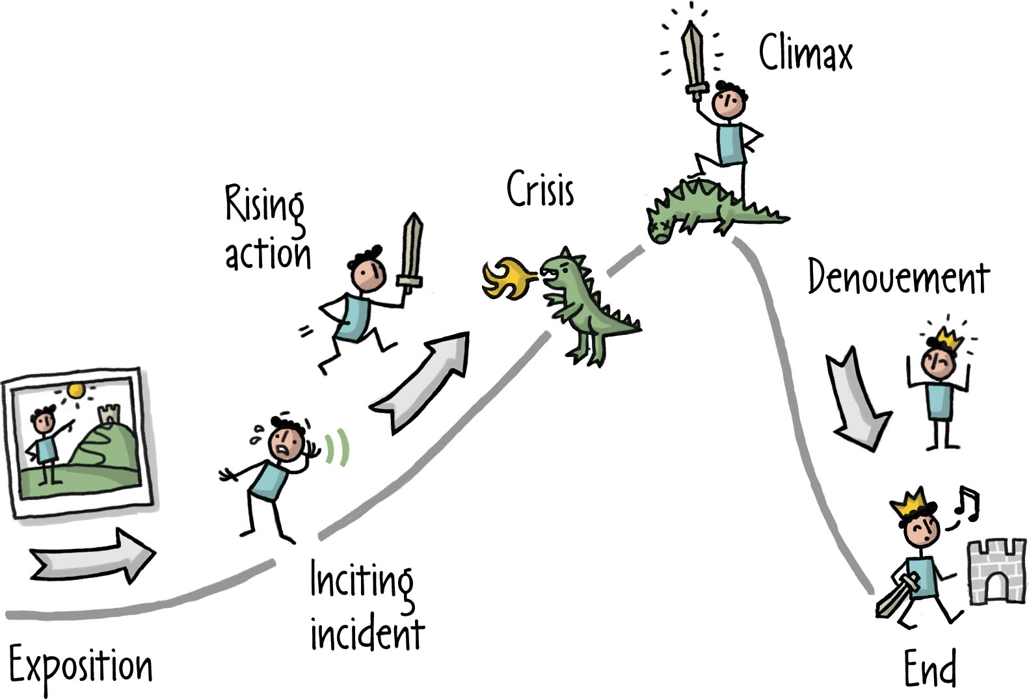
What is a story?
Exposition, Inciting Incident, Rising Action, Crisis, Climax, Falling Action, End. From Rosenfeld Media. Licensed CC BY.
Notes:
KS-
What is a story? All of those stories that we’ve just mentioned follow the same broad pattern – they are a -
A structured series of events with connection, characters, tension, and conflict.
They start with some background – some scene setting. Then something happens that starts things rolling – the inciting incident. Then our main character (usually our hero) has a serious of adventures and challenges – they face problems and set back, but they grow, and at some point we reach a climax – the monster is slayed, they quest is fulfilled, or the ugly duckling turns into a swan – and this changes things- in the final act we move towards a new normal where things are different (and in happy stories at least) better in some way.
How is this all relevant to your business? Presumably, whatever you offer to your clients or customers, you want it to improve their lives in some way – you want it to take them from their status quo to a new normal - a new normal where they use your product or service or engage with your organisation and life is better for it. You can communicate that via a story. Perhaps YOU are the hero, or your product, or perhaps you customer is the hero – but framing this in terms of a story does those things we talked about earlier- it makes it relevant, relatable and memorable …
So – now I want to hear YOUR stories…

Slide 16
Thinking Pairs: What is your story?
What motivated you to start your company?
Why did you create your product/s or create your solution/s? Do they respond to a particular problem?
What conflicts or challenges have you faced? How did you overcome them?
Notes:
Here are some prompts to respond to:
•What motivated you to start your company?
•Why did you create your product/s or create your solution/s? Do they respond to a particular problem?
•What conflicts or challenges have you faced? How did you overcome them?
•What do you see as your next steps?

Slide 17
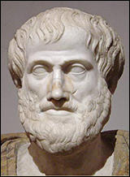
Stories for Persuasion
Ethos
Pathos
Logos
Notes:
Ok now keep those stories in mind – the one you’ve written and those that you’ve seen from other people – we are going to think about some strategies we can make to develop those stories – focusing particularly on making them persuasive =
Perhaps you want to persuade a client to sign up with you, or a collaborator to work with you, or a funder to give you money. We all need to use our stories to persuade at some point – and to think about how we might do this – we are going back to Ancient Greece – and this chap – Aristotle
Aristotle’s three modes of persuasion describe the types of techniques that we can use to help our reader/audience to agree with us.
Ethos – pathos – and logos –
The three mustakeers of persuasion!

Slide 18
Stories for Persuasion
Notes:
KS-
Very broadly –
Head, heart and reputation.
I’m going to talk through each in a little more details, and while I do so, think about whether you used any of this in your stories -

Slide 19
Ethos
Trust
Reputation
Credibility
Why should people believe you?
What should they work with you?
Why should they take your advice?
Why should they do business with you?
Notes:
Ks-
Ethos is all about trust – reputation and credibility. It’s all very well saying amazing things and telling amazing stories, but if people don’t believe you or don’t trust you, then none of that is going to make a different.
Establishing ethos is about answering these questions for your audience
Examples

Slide 20
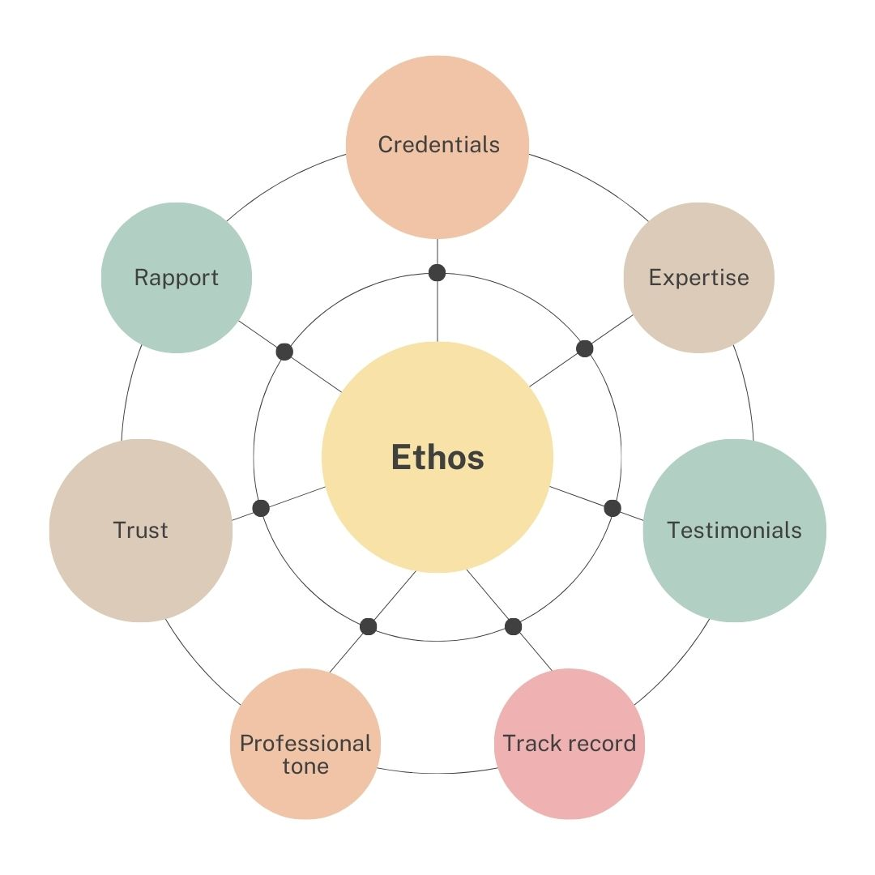
Ethos
Notes:
KS-
How can we establish ethos -
Remember that you don’t have to be perfect – by telling the audience about yourself, you are telling them your story, and YOU are the hero of that story.
Heroes aren’t perfect –remember that an important part of the story was the hero suffering setbacks and they facing challenges – however, they keep going and they (usually) triumph in the end.

Slide 21
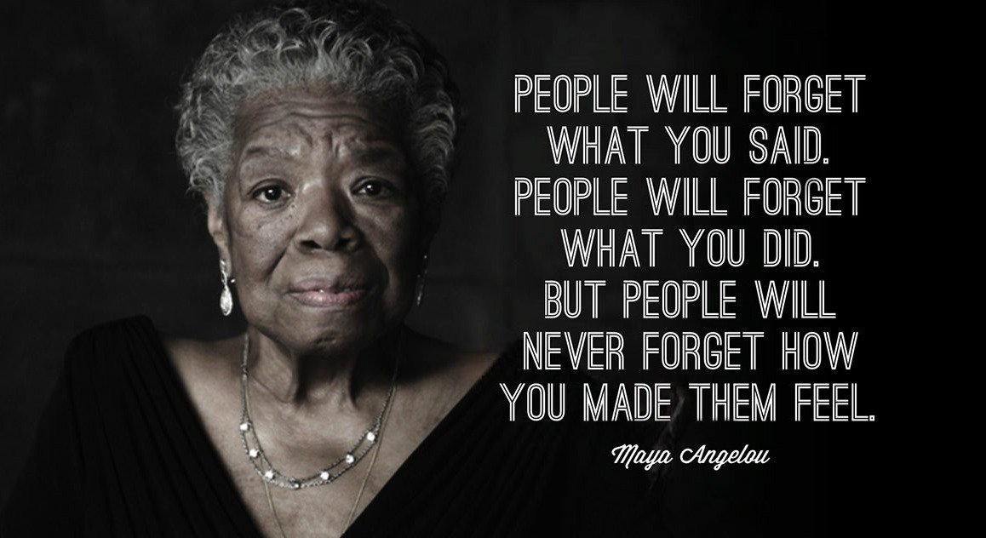
Pathos
Notes:
KS-
Pathos is about creating an emotional response in your audience
This means you need to think about your audience and what will engage with them. What will make them laugh, cry or be moved in some way.
Pathos is getting your audience to feel.
Pathos is not just sadness. It can also be joy, anger, guilt, excitement or any other emotion.

Slide 22
Pathos and storytelling
Notes:
https://youtu.be/y9mRJyHjqUw
KS-
Telling stories is a key tool in creating pathos

Slide 23
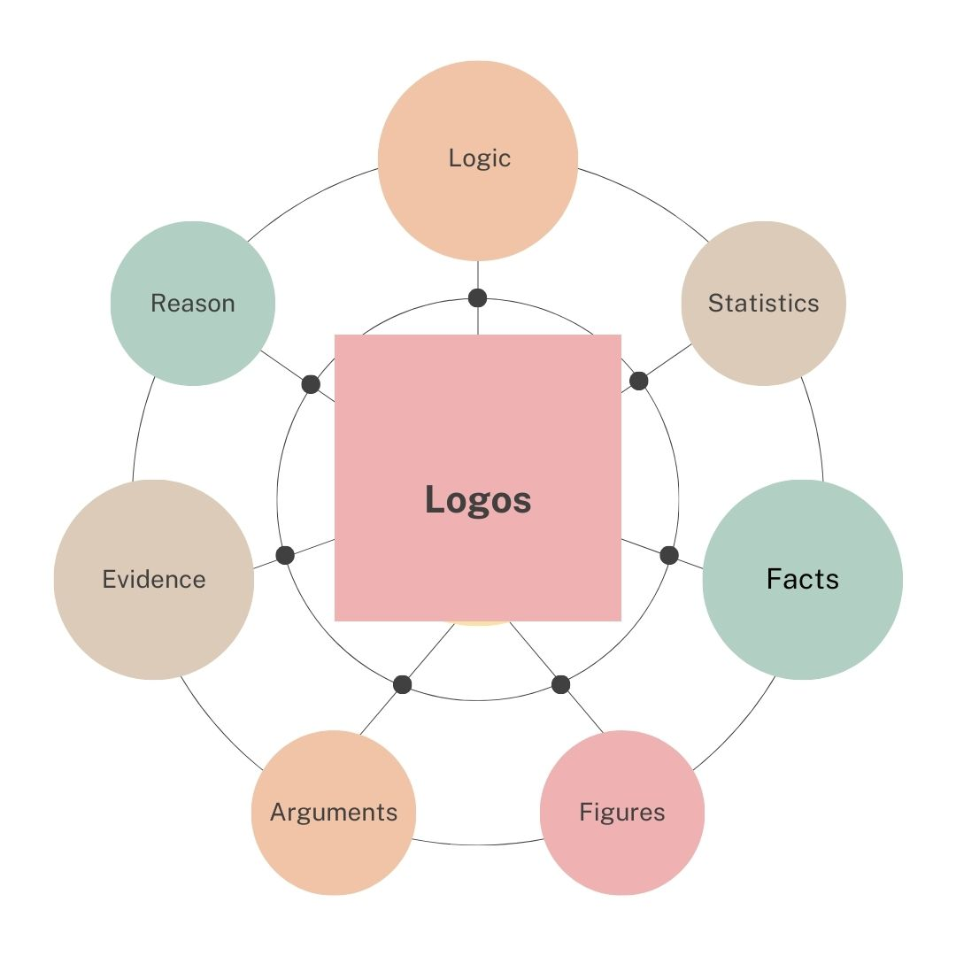
Logos
Notes:
KS-
Logos – is the persuasive technique that appeals to our brains – it is about building arguments, and giving statistics and facts and figures – persuading people with logic.

Slide 24
Buy my old car because …
Ethos
… I’m John Smith and hundreds of satisfied customers have bought old cars from me.
Logos
… yours is broken and mine is the only one on sale.
Pathos
… otherwise, this cute little kitten, afflicted with a rare disease, will die in agony, because my car is the last asset I have in the world, and I am selling it to pay for kitty’s medical treatment.
Notes:
KS-
(if time – get people to do this) if not just talk it through.
Imagine you were trying to sell an old car –
Choose a strategy – , logos pathos or ethos – head, heart or reputation – what might you do sell your car.
Have a think and, if you feel brave – share your idea in the chat.
Now these strategies are going to be appropriate in different contexts – some people will be more persuaded by logic than others, some situations will call for pathos – emotion – where it might not be as appropriate in every context. We may find that we have a preferred strategy that we like to use – however, it can be useful to think about how might incorporate elements of these into your messaging, and fill any gaps – again, this is about being in control of our storytelling and making conscious choices about the messages we put out into the world. This 3 way division is one model we can use to do this – there are many others!

Slide 25
Make your vision persuasive
Revisit the vision statement you drafted earlier
Did you use any of the strategies?
Choose one of the strategies:
Logos (head)
Pathos (heart)
Ethos (reputation)
Redraft to incorporate your chosen strategy.
Notes:
KS-
Ok - so now it’s YOUR turn – look again the story you wrote earlier (or at someone else’s story if you prefer).

Slide 26
Polishing Your Bid
Part 3: 12-12:45
Notes:
Editing for Clarity
The 3 C's (Compliant, Complete, and Compelling)/10 C's of a strong bid
Top/practical tips to aligning your content with word count requirements, maintaining consistency and avoiding common pitfalls
Share examples of real-life bids to highlight what works and what doesn’t – Alison White
Interactive Activity and feedback - Hands-on analysis and critical review of bid examples
I like the idea of 3 Cs, but I wonder if we could make them Compliant (which could include complete in it) and Compelling, with Clear as the last one?

Slide 27
The Three* Cs of Good Communication
Compliant
Complete
Compelling (and Clear)
*Okay, it's 4 really, but 3s are more memorable!

Slide 28
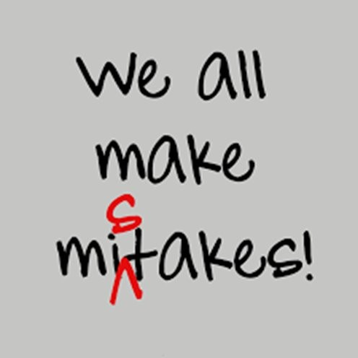
Compliant (and correct)
Use the commissioner’s language - echo the words used in the question and specification
Abide by word limits
Answer the question!
Notes:
Complient with all the stated instructions and submission requirements – including required attachments, word/character limits any other formatting instructions....

Slide 29
"The Exam Question"
Read the questions
Read them again!
Answer THOSE questions (not the questions that wish they had asked!)
Keep your answers related to and relevant to the questions that have been asked
Go back to the questions as you redraft and edit your answers.
Repeat the language of the question back in your answers
Focus on what matters to the funder (not just what matters to you!)
Notes:
KS-
•Don’t focus necessarily on what excites you about your project – tailor everything to the aims of the funder try to excite them by making it clear how your project fulfils their goals!

Slide 30
Complete (and coherent)
Every answer should stand alone.
The whole application should hold together as one narrative
Assume no prior knowledge!
Make it as easy as possible for the reviewer to find the information they need

Slide 31
Compelling (and clear)
Speak in benefits, not just features.
Explain why what you have written is important.
Be decisive.
'Appointment will be provided within five working days', rather than 'We aim to provide an appointment within five working days'.
Where possible use active, rather than passive sentences
‘Guy’s and St Thomas’ treats two million patients each year’ rather than ‘two million patients each year are treated by Guy’s and St Thomas
Highlight explicitly any added value.
‘Of additional benefit…’ or ‘exceeding the service requirements…’
Keep It Simple ...

Slide 32
Make it easy ...
Short words and short sentences make your writing clearer, simpler and more direct.
In case of an emergency, please utilize the exit by the stairs.
Desist in the name of endearment
BE careful!
It is very rare for two words in English to be pure synonyms.
If you use a more unusual, less everyday word, make sure you are aware of the meaning, including connotations (usual – bizarre – exceptional)

Slide 33
Cut out Jargon
Avoid using words or phrases which hide their meaning behind trendy and vague business jargon.
“We are the market-leading service provider in the entertainment space offering state-of-the-art value-added solutions to stakeholders around the globe”
“We are the world’s biggest cinema chain” (Raja 2018).

Slide 34
Cut out Flowery Language
An example from Geroge Orwell:
Objective considerations of contemporary phenomena compel the conclusion that success or failure in competitive activities exhibits no tendency to be commensurate with innate capacity, but that a considerable element of the unpredictable must invariably be taken into account.
People aren’t necessarily born successful.

Slide 35
Avoid rambling
Due to the fact that it is important to understand the target audience I have decided that it is crucial to think about who will benefit from this product.
The reason I chose to proceed with my initiative in this way is because I believe I will be able to reach my objectives and connect with the most beneficiaries within reason and will be able to conduct some further updates to policy and procedural approaches to the issue based on the results of this initial action.

Slide 36
What might the problems be?
We are writing to inform you that the purpose of this letter is to indicate that if we are unable to mutually benefit from our seller/buyer relationship, with satisfactory payment, then we have no alternative other than to sever the relationship. In other words, unless the account is handled in 45 days, we will have to change your terms to a permanent cash on delivery basis. Due to the fact that your account is past due for the amount of £1,500, the privilege of buying on credit will in the future no longer be available because we can longer provide that service until your unpaid balance is paid.
Notes:
NB – I've just pasted some materials across here for now – not necessarily saying we should use them all!

Slide 37
Unnecessary and empty phrases
We are writing to inform you that the purpose of this letter is to indicate that if we are unable to mutually benefit from our seller/buyer relationship, with satisfactory payment, then we have no alternative other than to sever the relationship. In other words, unless the account is handled in 45 days, we will have to change your terms to a permanent cash on delivery basis. Due to the fact that your account is past due for the amount of £1,500, the privilege of buying on credit will in the future no longer be available because we can longer provide that service until your unpaid balance is paid.

Slide 38
Keep it Simple, Stupid
Never use an unusual word, if a more familiar one will do.
Never use a long word, if a short one will do.
If you can cut a word out, cut it out.
If you can use diagrams/flow charts/tables rather than words
Keep your sentences short and to the point.
Avoid jargon and abbreviations
Avoid flowery language
Avoid rambling
Never use a word it you aren’t 100% sure of the meaning, or if you can’t pronounce it!
Edit, edit, edit
Read written communication out loud
Notes:
There is one final message I want to leave you with – as I said earlier – storytelling and indeed communication is universal and we are generally very good at it. But for some reason when we come to write things down many people suddenly feel they need to not only tell a story or convey a message, but that they have to impress by using long words, and complex sentences – we can easily overengineer our communication – so the final message I want to leave you with in this section – is this…
Communicate the ideas as simply and clearly as you can – write to communicate, not to impress.
Edit – average piece of writing – whether it’s a newspaper article you read, a book or something else -has been through 7 rounds of editing – and that is professional writers who do nothing else all day – so you should also edit your communications.
Practical- AW check earlier

Slide 39
Edit, edit, edit, (edit, edit, edit edit)
Revisit your vision statement once again
Edit for clarity
Can you cut out any words?
Can you make any sentences shorter?
Can you simplify the language?
Get feedback from your colleagues.
Read it out loud.

Slide 40
Questions and Discussion
Notes:
Recap the main messages/key takeaways from the session, including exam-style questions to keep in mind: "Answer what has been asked," "Cover why the funder should care" and "Connect with storytelling"
Q&A
Add contact details to this page

Slide 41
Before You Go!
Kate Scott
Kingston University
South London Creative and Digital Innovation Cluster
Kate.Scott@kingston.ac.uk
Alison White
Health Innovation Network South London, SWL ICB
Alison.White@swlondon.nhs.uk
Notes:
https://forms.office.com/e/MLEU8VNDvx

