Slide 1
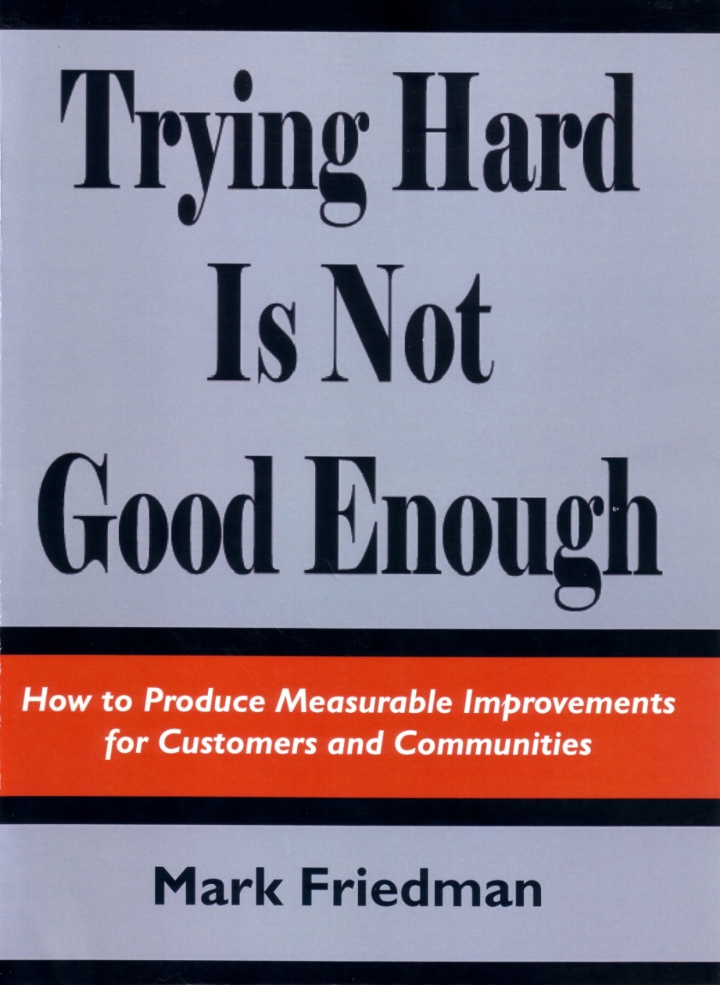
Evaluation of Projects- OBA Model
Nadine Wyatt
Health & Social Care Programme Lead
Sutton Council & NHS South West London ICB - Sutton Place
Outcomes Based Accountability: A refresher - Research Matters (assemblyresearchmatters.org)

Slide 2
Table of Content
Introduction to OBA Model Slides 3 – 15
Outcome Ladder (progress descriptors) Slides 16- 20
Optum Evaluation Workshop Slides 21 - 25

Slide 3
Outcomes Based Accountability
Focus on outcomes; the ends not the means
Distinction between Population Outcomes and Service Performance;
Inclusive process that encourages the participation of children, families and communities;
Plain language, common sense and easy to understand;
Flexible and can be adapted to suit different circumstances;
Good track record and used successfully in Children’s and Adults’ Services and commissioning.

Slide 4
Rationale
Critical to demonstrate clearly and convincingly how the commissioning strategy will improve the outcomes, or well-being of children and young people, especially those at risk of poor outcomes.
Need a firm basis upon which to evaluate the commissioning strategy’s contribution to improving outcomes:
Agree clear desired outcomes for target populations, and indicators to measure improvement in those outcomes
Develop performance measures for services which are linked to the achievement of those outcomes
The focus is on “effect” rather than “effort”.
Notes:
4

Slide 5
Key Concepts
Outcomes | A condition of well-being for children and young people, families and the community
Indicators | How we measure these conditions
Baselines | What the measures show about past and future trends
Outputs | The level, or quantity of service provided
Performance Measures | How we know if the service is working, e.g. how much? How well? Is anyone better off as a result?
Targets | For either Outcome Indicators or Performance Measures: what are we aiming for and by when? Be clear whether Outcome Targets or Performance Targets.
Source: Mark Friedman
Notes:
5
Indicators (or benchmarks) are data measures which help quantify the achievement of a result. They answer the question "How would we recognize these results in measurable terms if we fell over them?" So, for example, the rate of low-birthweight babies helps quantify whether we're getting healthy births or not. Key stage testing scores help quantify whether children are succeeding in school today, and whether they were ready for school three years ago. The crime rate helps quantify whether we are living in safe communities, etc.
NB Data is not the same as reality (NLP expression “The Map is not the Territory”) Don’t make data the sole purpose of your work or ignore your experience

Slide 6
Managing Performance using OBA
“All Performance Measures that have ever existed for any programme in the history of the universe involve answering two sets of interlocking questions….”

Slide 7
Programme Performance Measures
QUANTITY
QUALITY
How Much
did we do?
(number)
How Well
did we do it?
(percent)

Slide 8
Programme Performance Measures
Effort
How hard did we try?
Effect
Is anyone any better off?

Slide 9
Performance Measures
QUANTITY
QUALITY
How much engagement did we deliver?
No of engagement events this quarter
No of
How well did we
deliver it?
EFFORT
INPUT
No of engagement
Cause
How much change/effect did we produce?
What quality of change/effect did we produce?
EFFECT
OUTPUT
Effect
No of engagement
No of engagement

Slide 10
Performance Measures
Quantity
Quality
How much did we do?
How well did we do it?
Effect Effort
What difference did we make?
#
%

Slide 11
Not all Performance Measures are created equal…..
QUANTITY
QUALITY
How much did we do?
How well did we do it?
LEAST
important
Also Very
Important
EFFORT
Is anyone better off?
MOST
important
EFFECT

Slide 12
The Matter of Control
QUANTITY
QUALITY
How much did we do?
How well did we do it?
MOST
control
EFFORT
Is anyone better off?
LESS
control
EFFECT
PARTNERSHIPS
We have the least control over the most important matters

Slide 13
OBA EFFORT + EFFECT = IMPACT
How do we translate into a performance report card?

Slide 14
Performance Management Framework – Outcome Based Accountability Model
PERFORMANCE MEASUREMENT TOOL- Tracker/survey/feedback forms
PERFORMANCE REPORT CARD- Impact of service and evidence of change – quantitative and qualitative)-
14

Slide 15
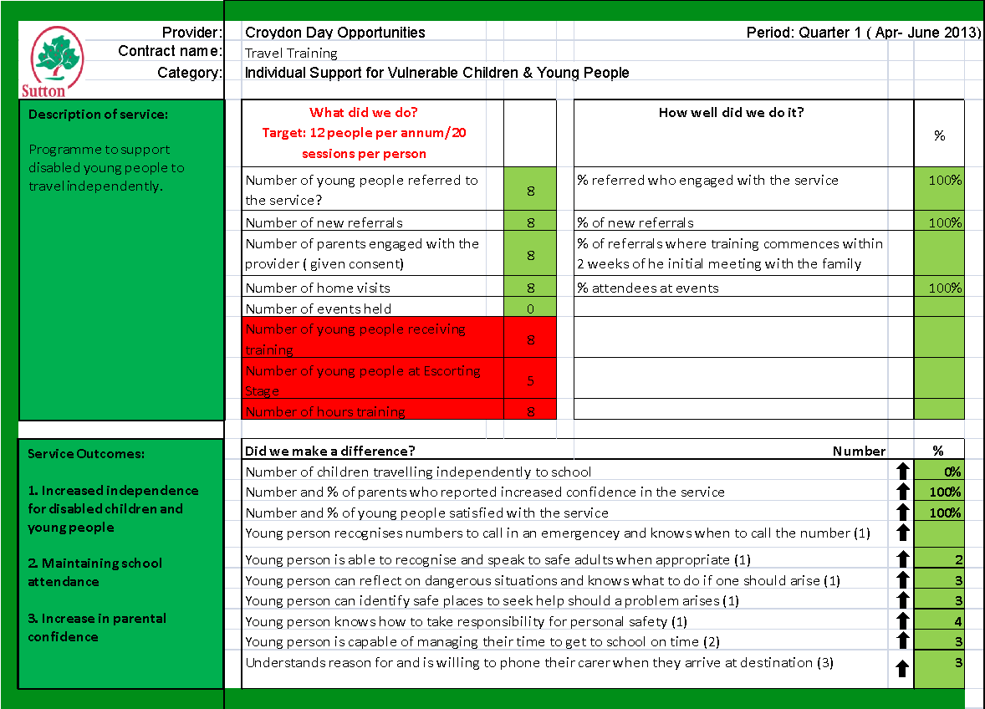
Performance Report Card
JAS Presentation - N Wyatt Dec 2103
15

Slide 16
How can we measure outcomes? Outcome Progress Ladder
London Borough of Sutton, Children Services 2016
Nadine Wyatt

Slide 17
Case Example
How can we measure outcomes for children services across Sutton Council?
Base outcomes and performance indicators on the Framework for Assessment of Children In Need & their Families- slide 17
Developed Progress Descriptors showing progress from 1-10 (Red, Amber, Green) to be able to measure movement
Information for all the Progress Descriptors were compiled with area professionals
Linked to a spreadsheet (case work only) to show overall progress.

Slide 23
Using OBA Model

