Slide 1
The Evaluation Toolkit and Introduction to the Programme of Support
31st October 2023

Slide 2
Agenda
Time | Item | Lead
(15 min) | Welcome, starting on a positive and objectives | Marcus Green, Optum
(15 min) | The Evaluation Framework Introduction to the programme of support for evaluating your local health inequalities projects | Marcus Green, Optum
(30 min) | Introducing the Evaluation Toolkit How you can access the Toolkit Demonstrating how the Evaluation Toolkit can support the planning and implementation of your evaluation A chance to hear from one of the local health inequalities projects on how the Toolkit may be able to support their evaluation | Marcus Green, Optum Nadine Wyatt, Health and Care Integration Programme Lead (Health Inequalities, Children and Young People and Frailty)
(20 min) | Reflections and potential application of the Toolkit for your local project Exploring the application of the Framework and Toolkit given any challenges you may be facing with evaluating your local health inequalities project | All
(10 min) | Wrap up Final thoughts Next steps | All

Slide 3
In the chat: Creating a positive ‘thinking environment’
10 mins
Start on a positive
In the chat, please introduce yourself, state your role and share something that happened this week that was positive (professionally or personally).

Slide 4
Objectives for the session
We will:
Introduce the programme of support from Optum as part of an Evaluation Framework for South West London
Present the Evaluation Toolkit and position how it will be useful to support the planning and implementation of evaluation for your local health inequalities projects
Help you to access and navigate the Evaluation Toolkit to get maximum value from it to support practical day-to-day evaluation of your health inequalities projects

Slide 5
Agenda
Time | Item | Lead
(15 min) | Welcome, starting on a positive and objectives | Marcus Green, Optum
(15 min) | The Evaluation Framework Introduction to the programme of support for evaluating your local health inequalities projects | Marcus Green, Optum
(30 min) | Introducing the Evaluation Toolkit How you can access the Toolkit Demonstrating how the Evaluation Toolkit can support the planning and implementation of your evaluation A chance to hear from one of the local health inequalities projects on how the Toolkit may be able to support their evaluation | Marcus Green, Optum Nadine Wyatt, Health and Care Integration Programme Lead (Health Inequalities, Children and Young People and Frailty)
(20 min) | Reflections and potential application of the Toolkit for your local project Exploring the application of the Framework and Toolkit given any challenges you may be facing with evaluating your local health inequalities project | All
(10 min) | Wrap up Final thoughts Next steps | All

Slide 6
Workshop | Content of the Session | Learning outcomes. By the end of this session attendees will… | Relevant Evaluation Toolkit section
Workshop 1: The Evaluation Toolkit and introduction to the programme of support 31st October 2023 | Finding your way around the Evaluation Toolkit Demonstrating how the Evaluation Toolkit can support practical evaluation of your health inequalities programmes How to access and use the Evaluation Toolkit in your day-to-day work An outline of the local programme of support available | Be aware of the Evaluation Toolkit and how it can support their local programmes of evaluation Be aware of the wider programme of support
Workshop 2: From data, to measures and measurement 7th November 2023 | Understanding how to conceptualise outputs and outcomes for your programmes of work Getting familiar with using a measurement checklist Understanding different types of measures and how to express them Learning how to assess measurability (mapping measures to available data) Balancing value with measurability Identifying the need to collect new data A focus on data and approaches to measuring health inequalities | Have reviewed some real examples from the logic model workshops and expressions of interest Have explored the best ways to practically measure outcomes for their local programmes Understand better how to define metrics that measure health inequalities
Workshop 3: Data sources for evaluation of health inequalities programmes 21st November 2023 | Local data and intelligence tools and their application in evaluation An introduction to other health and care data sources (including health and wellbeing status, quality, patient experience, utilisation, cost and organisational process measures) A focus on data sources across partnerships and for the wider determinants of health | Increase awareness of the types of data useful for local evaluation Hear information about the local availability of different types of data and data sources Get familiar with local resources and teams to support data collection, reports and analysis that can support evaluation of programmes
Start with Why
Why are you evaluating? What do you hope to show?
Measures
What data do you have and what do you need?
Measures
What data do you have and what do you need?

Slide 7
Workshop | Content of the Session | Learning outcomes. By the end of this session attendees will… | Relevant Evaluation Toolkit section
Workshop 4: Qualitative study methods 5th December 2023 | Introduction to qualitative data and analysis methods for evaluation Explore community-based participatory research and its application in participatory evaluation Understand how and when to apply these methods for intervention evaluation Gain an understanding of how qualitative methods complement quantitative methods in a mixed approach | Have a better understanding of how to collect qualitative data through engagement with communities Improve their knowledge about analysing qualitative data to evaluate programmes of work Understand more about how to blend quantitative and qualitative methods in practical programme evaluation
Workshop 5: Quantitative study methods 19th December 2023 | Introduce quantitative data and analysis methods for intervention evaluation Explore the routes from evaluation questions to hypothesis generation and testing Surveys, questionnaires, longitudinal data series and other formats Baselining, tracking, monitoring and following up Statistical analysis to disentangle causality from association | A better understanding of how to collect quantitative data where necessary Knowledge of how to analyse quantitative data in programme evaluation Knowledge of where to go for secondary data analysis to support evaluation
Workshop 6: Evaluation bias 9th January 2024 | An introduction to different forms of bias Outlining the links between evaluation design and bias Approaches to minimise bias in study design Ways to build in comparison and control groups | Have gained knowledge to support better design of programme evaluation Gained the ability to identify and mitigate potential biases in programme evaluation
Workshop 7: Value for money 23rd January 2024 | How is value understood and measured? Methods for quantifying value for money from intervention investment Identifying cost-saving opportunities How to prove that your intervention has delivered value for money Social return on investment methodology – reputable sources and use of financial proxies for outcomes | Understand the construct and measurement of value and how to demonstrate a return on investment through evaluation
Design
Best possible design of your evaluation
Design
Best possible design of your evaluation
Analysis
Bringing together your data
Drawing conclusions
So what?

Slide 8
Agenda
Time | Item | Lead
(15 min) | Welcome, starting on a positive and objectives | Marcus Green, Optum
(15 min) | The Evaluation Framework Introduction to the programme of support for evaluating your local health inequalities projects | Marcus Green, Optum
(30 min) | Introducing the Evaluation Toolkit How you can access the Toolkit Demonstrating how the Evaluation Toolkit can support the planning and implementation of your evaluation A chance to hear from one of the local health inequalities projects on how the Toolkit may be able to support their evaluation | Marcus Green, Optum Nadine Wyatt, Health and Care Integration Programme Lead (Health Inequalities, Children and Young People and Frailty)
(20 min) | Reflections and potential application of the Toolkit for your local project Exploring the application of the Framework and Toolkit given any challenges you may be facing with evaluating your local health inequalities project | All
(10 min) | Wrap up Final thoughts Next steps | All

Slide 9
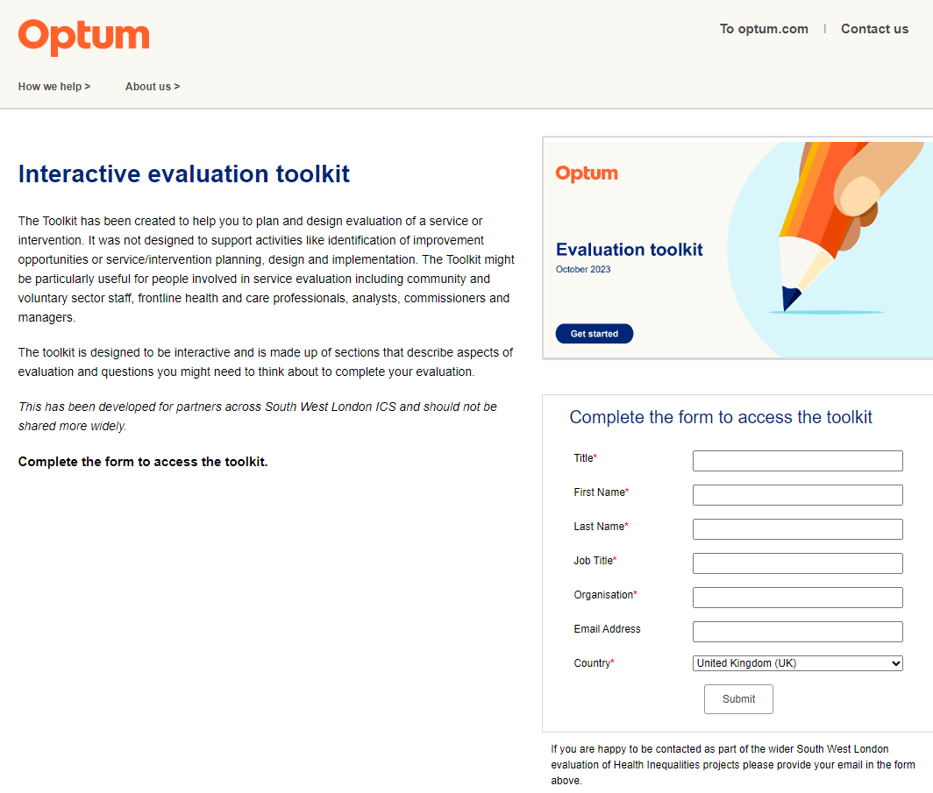
How to access the Evaluation Toolkit
Simply visit - https://info.optum.co.uk/evaluation-toolkit
The landing page describes what the Toolkit is and its purpose
There is a form to fill in before you can access the Toolkit
The Evaluation Toolkit is for partners across South West London to access. Please do not share more widely as this has been purpose-built for South West London

Slide 10
Welcome
This toolkit has been created to help you to plan and design evaluation of a service or intervention. It was not designed to support activities like identification of improvement opportunities or service/intervention planning, design and implementation. The toolkit might be particularly useful for people involved in service evaluation including community and voluntary sector staff, frontline health and care professionals, analysts, commissioners and managers.
The toolkit is designed to be interactive and is made up of sections that describe aspects of evaluation and questions you might need to think about to complete your evaluation.
You can also use the tabs at the top of each page to navigate to the section you want.
The next page shows how these sections should work in order when you are planning and implementing an evaluation.
Use the guide button to take you to additional information about a subject
Use the back arrow to return to where you were before
Use the forward arrow to navigate forward to the next page
Use the home button to return to this page
Terms are explained in the Glossary and there is a Resources tab above for further information and useful tools.
Why evaluate
Helping you to think about why evaluation is important and what questions you are trying to answer when you evaluate
Measures
More details on outcomes, measures and resources to help you collect information that will help you answer your evaluation questions
Things to think about
Questions to ask yourself before you begin to design an evaluation and resources to help you think through how to answer each
Design
How to go about designing the best possible evaluation to answer your questions with resources to help you in the design and planning stage
Analysis
Considerations and resources to support your thinking about analysis
Conclusions
Drawing conclusions from your evaluation
Resources
Further resources to support your evaluation
Guide
Glossary

Slide 11
Navigating the toolkit
Before you start (ideally)
Start with Why
Why are you evaluating? What do you hope to show?
Measures
What data do you have and what do you need?
Things to think about
What other considerations go into evaluation design?
Design
Best possible design of your evaluation
When you have some data
Analysis
Bringing together your data
Drawing conclusions
So what?

Slide 12
Agenda
Time | Item | Lead
(15 min) | Welcome, starting on a positive and objectives | Marcus Green, Optum
(15 min) | The Evaluation Framework Introduction to the programme of support for evaluating your local health inequalities projects | Marcus Green, Optum
(30 min) | Introducing the Evaluation Toolkit How you can access the Toolkit Demonstrating how the Evaluation Toolkit can support the planning and implementation of your evaluation A chance to hear from one of the local health inequalities projects on how the Toolkit may be able to support their evaluation | Marcus Green, Optum Nadine Wyatt, Health and Care Integration Programme Lead (Health Inequalities, Children and Young People and Frailty)
(20 min) | Reflections and potential application of the Toolkit for your local project Exploring the application of the Framework and Toolkit given any challenges you may be facing with evaluating your local health inequalities project | All
(10 min) | Wrap up Final thoughts Next steps | All

Slide 13
Discussion: Reflections and potential application for your local project
Please raise your Teams hand and use the teams chat to discuss:
Given any local challenges you may be facing, what are your thoughts and reflections on the potential application of the Evaluation Toolkit for your evaluation?

Slide 14
Agenda
Time | Item | Lead
(15 min) | Welcome, starting on a positive and objectives | Marcus Green, Optum
(15 min) | The Evaluation Framework Introduction to the programme of support for evaluating your local health inequalities projects | Marcus Green, Optum
(30 min) | Introducing the Evaluation Toolkit How you can access the Toolkit Demonstrating how the Evaluation Toolkit can support the planning and implementation of your evaluation A chance to hear from one of the local health inequalities projects on how the Toolkit may be able to support their evaluation | Marcus Green, Optum Nadine Wyatt, Health and Care Integration Programme Lead (Health Inequalities, Children and Young People and Frailty)
(20 min) | Reflections and potential application of the Toolkit for your local project Exploring the application of the Framework and Toolkit given any challenges you may be facing with evaluating your local health inequalities project | All
(10 min) | Wrap up Final thoughts Next steps | All

Slide 15
Lightbulbs from today
Use the Chat function or raise your hand to contribute to this open discussion
What’s been your lightbulb from today’s session?

Slide 16
Evaluation: How have we met the objectives of today’s session?
Log in to: Menti.com
Code: 9519 8895
Your views and feedback are important to us.
Please provide feedback via Menti regarding your experience in this session:
Scoring the session experience and outcomes (quantitative)
Feedback on what was good, and what would make this even better (qualitative)
Should you wish to discuss any part of your feedback, please contact:
laylabahramijovein@optum.com

Slide 17
Our Evaluation Journey
Evaluation Framework Workshop 1: The Evaluation Toolkit and Introduction to the
Programme of Support 31st October 2023
1400-1530
Virtual
Evaluation Framework Workshop 2: From Data, to Measures and Measurement
7th November 2023
1400-1530
Virtual
Evaluation Framework Workshop 3: Data Sources for Evaluation of Health Inequalities Programmes
21st November 2023
1400-1530
Virtual
Evaluation Framework Workshop 4: Qualitative Study Methods
5th December 2023
1400-1530
Virtual
Evaluation Framework Workshop 5: Quantitative Study Methods
19th December 2023
1400-1530
Virtual
Evaluation Framework Workshop 6: Evaluation Bias
9th January 2024
1400-1530
Virtual
Evaluation Framework Workshop 7: Value for Money
23rd January 2024
1400-1530
Virtual

Slide 18
Thank you and next steps

