Slide 1
From data, to measure, to measurement
Evaluation Framework Workshop 2
Marcus Green
7th November 2023

Slide 2
Agenda
Time | Item | Lead
(5 min) | Welcome and objectives | Marcus Green, Analytics Director, Optum
(10 min) | Why evaluate | Marcus Green
(15 min) | The importance of data | Marcus Green
(20 min) | Turning concepts into real, measurable outcome metrics | Marcus Green
(25 min) | Health inequalities and how to measure them | Marcus Green
(10 min) | Wrap up Final thoughts Next steps | Marcus Green
Notes:
Build in discussion slides + add references to tool kit

Slide 3
Objectives for the session
We will:
Set the context for why we need to evaluate interventions
Learn the importance of data, when and how to record data, and what to capture
Learn how to decide meaningful outcomes and the expectations for realising those outcomes
Focus on health inequalities and how to measure them

Slide 4
Why evaluate?

Slide 5
“Actions without intelligence is a form of insanity, but intelligence without action is the greatest form of stupidity in the world.”
Charles F. Kettering

Slide 6
The PHM cycle — making things stick through continuous learning and doing
Understanding Population Health and care needs
Descriptive analytics to understand the specific needs of the local population, the impact of wider determinants and to explore gaps in care and unwarranted variation.
Active monitoring and rapid improvement
Whole system impact assessment to measure net impact on population groups (utilisation, cost, outcomes and experience).
1
Opportunity analysis and targeting
Risk stratification and segmentation models to identify risk factors and the groups challenged by them, using advanced data mining techniques.
5
2
Design and begin to implement interventions
Design and implementation of multidisciplinary, cross-organisational interventions that are targeted at high-risk population segments through a bio-psycho-social approach.
4
3
Predictive system modelling
Future-facing financial modelling of unmitigated and mitigated system financial risk using person level costing data and mitigated scenarios.

Slide 7
Why evaluate?
Evaluation closes the loop
How will you know?
Evaluation in the real world
How will you know… if you are having a positive impact on your population?
How will you know… whether you should continue with your intervention, or if others should consider adopting it?
How will you know… that we are providing good value for the time it has taken to deliver?
How will you know… what to do differently next time?
Best practice
Qualitative and quantitative data available
12+ months of baseline data, participants inducted at same time
Experience & outcomes data as well as activity / economic measures
Randomised Control Trial (RCT) or control groups available
Real world
Limited data availability
Baseline data unavailable
Participants inducted based on clinical or impactability criteria rather than using RCT approach
Participants inducted when available rather than at same time
Many other limitations and considerations

Slide 8
The importance of data

Slide 9
“The ultimate purpose of collecting data is to provide a basis for action or a recommendation”
W. Edwards Deming

Slide 10
Data essentials checklist
If you want to evaluate an intervention, data is absolutely essential
It is vital that all stakeholders understand this from the very outset of your intervention
If data is not recorded or unobtainable, thorough evaluation will be very challenging
Meet with key business intelligence leads and data owners before projects begin to get foundations in place
Ensure clinical staff and others delivering the intervention have a mechanism for recording the intervention and coding individuals who receive the intervention

Slide 11
When to start your evaluation and begin recording data
It is best practice and will make your life much easier to plan and build the foundation of your evaluation before you start your intervention.
Your plan should cover activities that help you to:
Ensure key stakeholders are on side, aware of the process and realistic expectations are set
Work with owners of existing data and local analysts
Ensure data collection mechanisms are in place to allow you to record activity and agreed outcomes as they happen.
Start your intervention early
Integrate the evaluation plan into the project design to give your project the best chance of realising its outcomes.
See the ‘Start with Why’ in the Evaluation Toolkit
A well-designed intervention will include provision for evaluation from the outset. Building in data collection, feedback and measurement of outcomes and impact from the start can ensure that the evaluation is integrated into the design and execution of the intervention. This positions the evaluation as an integral part of the process and delivery rather than an interference competing for tight resources.
The Health Foundation
https://www.health.org.uk/sites/default/files/EvaluationWhatToConsider.pdf

Slide 12
Recording mechanisms
Ideal
Alternatives
Wherever possible, use pre-existing clinical recording systems:
GP systems (SystmOne, EMIS, etc)
Acute systems (PAS, EPRs, anything that feeds into SUS)
This means that clinicians can build recording of interventions into their day-to-day work without needing to change the way they work
This data will typically be available to local Business Intelligence teams at the ICB and in providers – it is a good idea to check in with them on data availability
Pragmatic short-term solutions like spreadsheets for clinicians to enter data. These are open to data-entry error, people not entering at all, deletion of files and other issues
Procuring a new recording system. This can be expensive, time consuming, and still may not be used by clinicians if it is not part of their regular routine

Slide 13
What to record
Date of intervention
NHS number
Measure/outcome
Demographics flag
(e.g. age/sex/ethnicity/geography/deprivation)
Long-term conditions
This is important to make sure that:
Data is recorded to indicate the implementation of an evaluation
Outcomes data is trackable over time
Improvements in health can be linked or attributed to the intervention
As much information as possible is available about the intervention you have designed that will inform decisions about its future
Notes:
Table

Slide 14
Discussion: recording data
Please raise your Teams hand and use the teams chat to discuss:
Do you currently record data on intervention participants?
Where is this data recorded?
What types of data do you record?

Slide 15
Turning concepts into real, measurable outcome metrics

Slide 16
Logic model framework for evaluation
Directions: Start with the problem statement (1), then agree the goal/aim as the long-term outcomes (2), work backwards to populate the model (3), work forwards using an ‘if-then’ logic to test the model (4). Gap-analysis. Iterative development. Review and update as necessary.
Considerations: Common understanding and agreement on (1&2), define outcome timescales, multiple stakeholders perspectives on (1-4), SMART, success/failure and intended/unintended consequences.
See the ‘Start with Why’ in the Evaluation Toolkit
Rationale for intervention (1)
This is the justification for the programme/intervention. For example, what is the nature and scale of the problem being addressed? What will happen if nothing is done?
Inputs
Outputs
Outcomes – Impact
Inputs
Participants
Activities
Outputs
Short-term
Medium-term
long-term (2)
What we need/invest in?
Who we reach/involve?
What we do?
What we create?
Results — In terms of learning
Results — In terms of changing action
Results — In terms of change to the conditions
The resources available or required to deliver the work.
The stakeholders involved in the programme /intervention and those with an interest in the long-term outcomes.
The activities undertaken as part of the programme /intervention.
Maybe referred to as process measures.
Directly related to/ resulting from activity.
Delivering to the intended audience at the intended ‘dose’ of action.
Changes observed in awareness, attitudes, knowledge, skills, functioning, outlook, etc.
Changes observed in behaviour, practice, condition, and decision-making, etc.
These follow on from changes observed in the short-term.
The final desired impact of the programme/intervention. At a population or system-level impacts.
Relates closely to the original rationale.
Relative weights on multi-faceted aims.
Populate the model (3)
‘if-then’ logic test (4)
Assumptions
External Factors

Slide 17
Ranking outcomes according to importance and measurability
5
Important but Unmeasurable
Important and Measurable
You can engage with a wider group to help you prioritise the outcomes in your logic model
Ask your stakeholders to help you by voting on the outcomes in your logic model (tools like EasyRetro are interactive and allow participants to vote with a thumbs up) – see the next slide for guidance on setting up a logic model board in EasyRetro
Ask your stakeholders to score each outcome on a scale of 1-5 for importance and measurability, where 5 is most important or most measurable, then place these on a 2x2 matrix
Outcomes with the most no. of votes and those that appear in the top right-hand corner of the matrix (i.e., considered both important and measurable) should be prioritised
Outcomes that have fewer thumbs up or appear in the bottom left-hand corner (i.e., considered both unimportant and unmeasurable) should be given lowest priority in evaluation
Outcomes that fall somewhere in between are pertinent for discussion with your stakeholders
See the ‘Start with Why’ in the Evaluation Toolkit
Importance
Unimportant and Unmeasurable
Unimportant but Measurable
0
Measurability
5

Slide 18
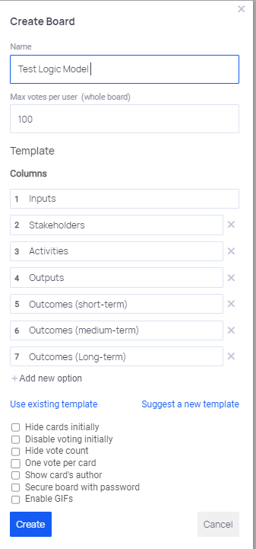
Setting up a logic model
Set up your logic model for free using Easy Retro, this tool allows you to share the model for free for other team members to collaborate.
Navigate to http://www.easyretro.io/
Sign up for a free account (you get 3 free boards)
Click ‘Add Board’
Choose ‘Custom Template’ for type of board
Name the Board (e.g., Test Logic Model)
Change Max votes per user to whatever number you want
Add columns (in order); Inputs, Stakeholders, Activities, Outputs, Outcomes (Short-term), Outcomes (Medium-term), Outcomes (Long-term)
Click ‘Create’
The output is an empty Board with the 7 Headers in place
Share the board for collaboration - use the “Share” button to copy the URL or crop the QR code
NOTE: The QR code can be shared in a meeting with your stakeholders to allow them to contribute live to the LOGIC model during the discussion and can be accessed by mobile phone or tablet

Slide 19
Measuring outputs and outcomes
Access the Evaluation Toolkit here
Consider
What outcomes do you want individuals to achieve through a specific action?
Are there readily available, routinely collected, measures that closely align to the outcomes you want individuals to achieve? If yes, see secondary data options below.
If there are no readily available measures, see primary data options below.
Guide
Primary data (collected first-hand) | Secondary data (collected already for other purposes)
Questionnaires/surveys | Administrative, e.g., GP consultation data, acute data (via Secondary Uses Service (SUS) or otherwise)
Interviews (telephone or face to face) | Patient satisfaction surveys
Focus groups | Historical data allowing for baselining (pre-intervention measurement)

Slide 20
Advantages and disadvantages of primary and secondary data
Access the Evaluation Toolkit here
 | Primary data | Secondary data
Advantages | Can be tailored to your outcomes Provides richer data about how an intervention is working Can provide insights on the intervention relatively quickly Data quality can sometimes be more easily controlled Validity can sometimes be more easily controlled Using surveys to collect quantitative data – principles and considerations When to collect qualitative data | More easily available Often quite comprehensive information on intervention participants Wide range of measures available Timely, established, and specific
Disadvantages | Time-consuming Resource-intensive Requires infrastructure | Measures may miss outcomes you want to evaluate Difficult to dig into why an intervention works Data quality can be variable Insights can take time to arise from available measures
Guide
Guide

Slide 21
Secondary data sources
Access the Evaluation Toolkit here
Publicly available secondary data sources
Office for Health Improvement and Disparities: Fingertips: Public health profiles - OHID (phe.org.uk)
Office for National Statistics: Home - Office for National Statistics (ons.gov.uk)
NOMIS: Nomis - Official Census and Labour Market Statistics (nomisweb.co.uk)
NHS England: Statistics » Statistical work areas (england.nhs.uk)
NHS England: Statistical publications, open data and data products - NHS Digital
UK Data Service: UK Data Service
Locally available secondary data sources
Contact for access or support via SWL’s Health Insights: isl.support@nhs.net

Slide 22
Quantitative measures
Access the Evaluation Toolkit here
Focus on what and how many (numeric), include administrative sources such as Hospital Episode Statistics/Secondary Uses Service, GP practice data, surveys, questionnaires and structured interviews.
Type of measure | Example | Pros | Cons
Counts | The number of people attending a chair-based exercise class per month | Simple to understand | Makes comparison over time or between populations more difficult, especially if your denominator (e.g., population size or number of hospital beds) varies
Rates | The number of people A&E attendances per 1,000 population | Allow comparison over time and between population groups | Need to be calculated You need to know the total population size to convert back to a count
Ratios | Standardised mortality ratio: observed mortality: expected mortality | They are easy to interpret and to calculate and illustrate the relative quantity of one item in relation to another of the same units | The units must be the same on both sides of the ratio i.e., number of available hospital beds to the number of occupied hospital beds
Percentages | The percentage of people aged 25-34 who were admitted to hospital in the last 12 months | Allow comparison over time and between population groups | Need to be calculated and the numerator and denominator are not obvious
Averages | The number of GP appointments per patient per year | Allow comparison over time and between population groups | Need to be calculated
Process measures | These are also known as outputs and capture activities or things that are created through a service or intervention e.g., the number of care plans that were created | Help to identify that an intervention is live and to determine which patients are in receipt of the intervention. The type of measurement typically falls into one of the five above. | Do not represent outcomes in and of themselves
Outcome measures | The intended outcomes of the intervention should align to the goals and objectives of your programme e.g., reduction in A&E attendances for diabetic patients (the process measure, HBA1C levels, is distinct from the outcome measure for this intervention) | Indicates whether the intervention has delivered an intended outcome. The type of measurement typically falls into one of the five above. | The challenge is attributing an outcome measure as a true outcome of your intervention i.e., it was caused by your intervention and would not have occurred without the intervention

Slide 23
Using surveys to collect quantitative data – principles and consideration
Access the Evaluation Toolkit here
Decide on how the survey will be administered e.g., online, by email, on mobile/device, on paper, interview led in person or over telephone
If digitally administered, think about the software you will use
Be clear on the purpose of the survey
Begin the survey with more straightforward questions that ease the respondent in
Ensure that every question relates to the overarching purpose
Design clear, concise and neutral questions
Make sure that all questions are direct and not convoluted
Try to avoid asking for two things in the same question
Try and use response scales where possible as these capture the intensity and direction of the response
Response scales should be balanced with equal number of response that are positive or negative e.g., excellent, very good, poor, very poor
Avoid yes/no and other binary type questions that limit the amount of data you collect
Keep the survey as short as possible
Consider pre-testing the survey before administering to your target population
Further reading
‘Writing an effective questionnaire’ – NHS England bitesize-guide-writing-an-effective-questionnaire.pdf (england.nhs.uk)
‘Guide to evaluation design, principles and practice’ – Midlands Decision Support Unit Guide to Questionnaires for Service Evaluation - Evaluation Works (nhsevaluationtoolkit.net)

Slide 24
Using surveys to collect quantitative data
Access the Evaluation Toolkit here
Aligning process/output and outcome measures to questions
For example, through a logic model process, a long-term outcome of an intervention is identified — "Improvement in patients’ overall wellbeing scores”. If there is no existing data to measure, monitor and evaluate according to patient wellbeing, then there is the option of collecting data quantitatively via survey
There are many available wellbeing scales; one of the more simply and widely used is the ONS4: Personal Well-being ONS4 measures - Evaluating wellbeing (whatworkswellbeing.org) as seen below:
For each of these questions I’d like you to give an answer on a scale of 0 to 10, where 0 is “not at all” and 10 is “completely”
Overall, how satisfied are you with your life nowadays?
Overall, to what extent do you feel that the things you do in your life are worthwhile?
Overall, how happy did you feel yesterday?
On a scale where 0 is “not at all anxious” and 10 is “completely anxious”, overall, how anxious did you feel yesterday?

Slide 25
Make sure your metrics are SMART
S
Specific
What do I want to accomplish?
M
Measurable
How will I know when it is accomplished?
A
Achievable
How can the goal be accomplished?
R
Realistic
Does this seem worthwhile?
T
Timebound
When can I accomplish this goal?

Slide 26
How often to record/measure
Ensure clinical/admin staff are recording activity as and when it happens
Any lag increases the likelihood of incorrect data being inputted, or worse still, no data being input at all
If recording and data systems exist that allow for regular data refreshes, then check to see the intervention is being recorded on a regular basis
Touch base with clinical/admin staff on a regular basis to ensure they are recording the activity without any issues

Slide 27
Discussion: measures and data
Please raise your Teams hand and use the teams chat to discuss:
How do you currently decide which measures are important for your evaluation?
Do you tend to rely on secondary data or do you have experience in collecting primary data for your evaluation?

Slide 28
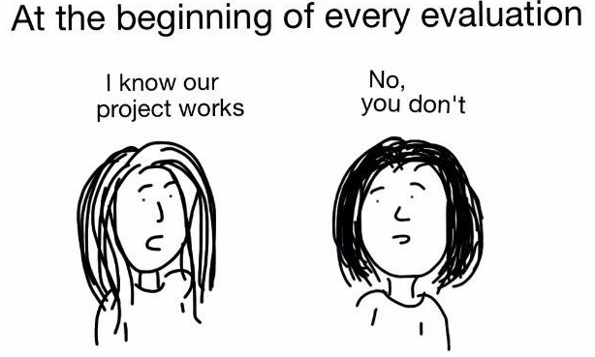
Realising outcomes
Managing expectations
Many senior stakeholders will expect to see immediate results. This is rare in any intervention, and PHM interventions are no exception, “In year savings” are largely unheard of.
Also, every stakeholder believes their intervention will be a huge success. This isn’t always the case – do not promise positive results. Be impartial.
Factor in
The time to deliver the intervention
Slow uptake of engagement
Time for the intervention to have impact
Lag time to record and transfer data

Slide 29
Outcomes
Short-term outcomes
Year 1
Normally too early to expect positive activity and financial changes
Instead, look for good case studies and softer qualitative results. Patient quotes and interviews go a long way to show initial successes
Better patient experience
This often wins hearts and minds and keeps faith in the intervention to ensure it continues until a more robust quantitative evaluation can be conducted
Medium-term outcomes
Year 2
Activity and financial changes may now be starting to happen but will be limited
However, clinical outcomes measures may be improving
Look to analyse changes in patient clinical readings, such as:
Blood pressure
HBa1C
BMI
Weight
Quality of Life measures
Long-term outcomes
Year 3
Three years should give enough time to do a full and conclusive activity and economic evaluation
Look to compare baseline levels with trends over the past 36 months
Ideally compare intervention cohort with a control group who did not or received a different intervention
Use a difference in differences approach between intervention and control groups to assess the impact of the intervention

Slide 30
Health inequalities and how to measure them

Slide 31
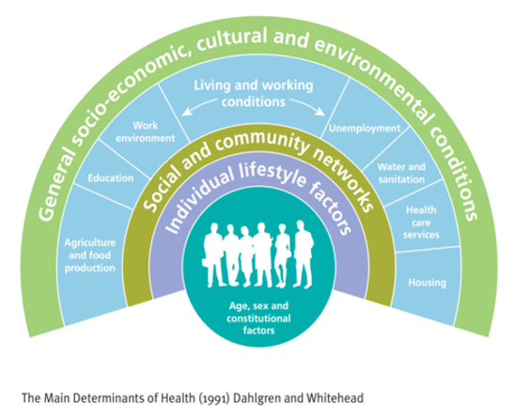
COVID-19 highlights importance of Health Inequalities… and PHM provides a toolset to help proactively understand and address them
Reducing Health Inequalities
Health inequalities are unfair and avoidable differences in health across the population, and between different groups within society. These conditions influence our opportunities for good health, and how we think, feel and act, and this shapes our mental health, physical health and wellbeing.
Examples of the characteristics of people/communities in each of these groups are below :
Socio-economic status and deprivation: e.g. employment & income, poor housing, poor education.
Protected characteristics: e.g. age, sex, race, sexual orientation, disability
Vulnerable groups of society: e.g. migrants; minority communities; rough sleepers and homeless people; and sex workers
Action on health inequalities requires improving the lives of those with the worst health outcomes, fastest.
Adapted from https://www.england.nhs.uk/ltphimenu/definitions-for-health-inequalities/
Source: Tony Ruth, Design in Tech, 2019.

Slide 32
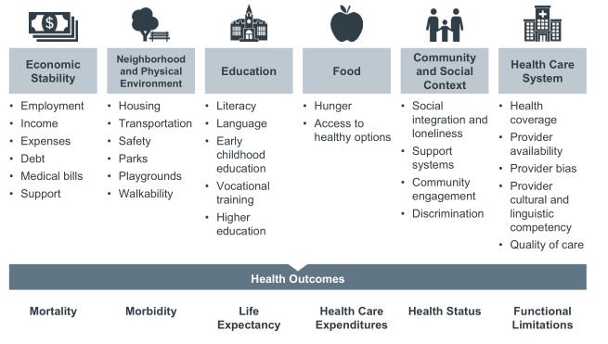
Social determinants of health
Most people spend a very small proportion of their lives in the health care system. Aside from annual checks, relatively healthy people may go for long periods without engaging with healthcare.
Additionally, the segments of the population with people who are most likely to end up in poor health do not always engage proactively with healthcare.
Source: Advisory Board, Social Determinants of Health

Slide 33
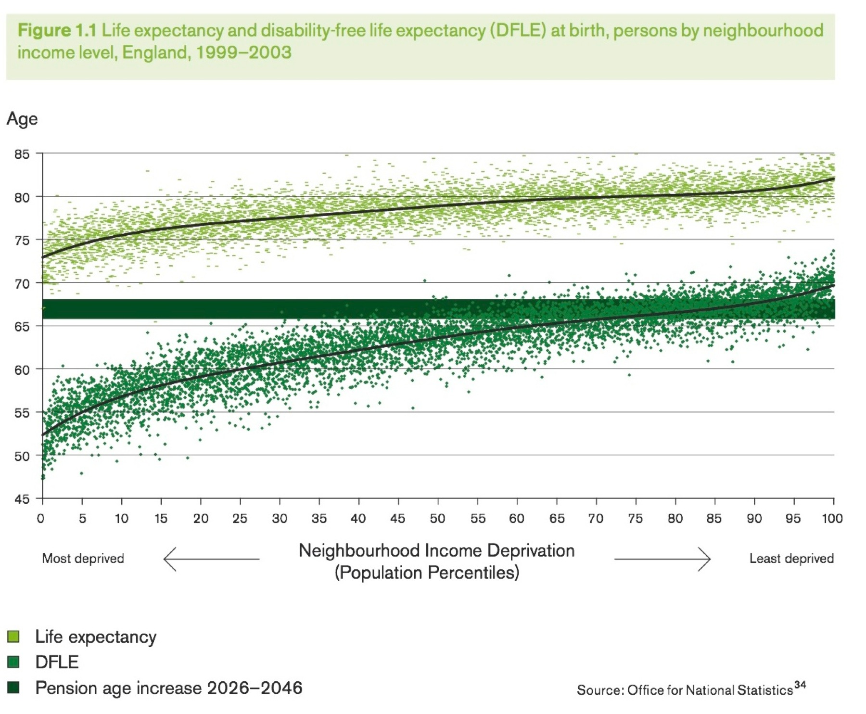
Social determinants directly affect health outcomes
Marmot Review in Brief
The Marmot Review into health inequalities in England proposes an evidence-based strategy to address the social determinants of health, the conditions in which people are born, grow, live, work and age and which can lead to health inequalities.
Source: Marmot Review http://www.instituteofhealthequity.org/resources-reports/fair-society-healthy-lives-the-marmot-review/fair-society-healthy-lives-full-report-pdf.pdf,
http://www.instituteofhealthequity.org/file-manager/MarmotIndicators2015/MarmotIndicators2017/life-expectancy-indicators-and-progress-since-the-marmot-review-september-revised.pdf

Slide 34
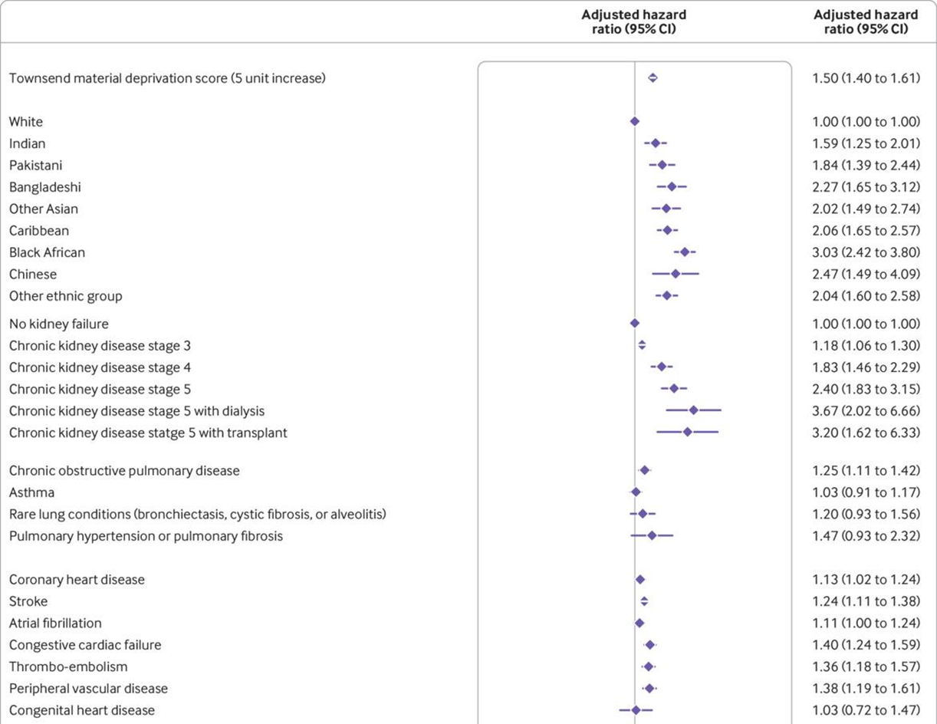
QCOVID risk prediction algorithm – deprivation vs clinical factors
Impact of deprivation
‘Adjusted hazard ratio (95% CI) of death from covid-19 in men in derivation cohort, adjusted for variables shown, deprivation, and fractional polynomial terms for body mass index (BMI) and age.’ From Living risk prediction algorithm (QCOVID) for risk of hospital admission and mortality from coronavirus 19 in adults: national derivation and validation cohort study https://www.bmj.com/content/371/bmj.m3731

Slide 35
QCOVID risk prediction algorithm – ethnicity vs clinical factors
Impact of Black African background
‘Adjusted hazard ratio (95% CI) of death from covid-19 in men in derivation cohort, adjusted for variables shown, deprivation, and fractional polynomial terms for body mass index (BMI) and age.’ From Living risk prediction algorithm (QCOVID) for risk of hospital admission and mortality from coronavirus 19 in adults: national derivation and validation cohort study https://www.bmj.com/content/371/bmj.m3731

Slide 36
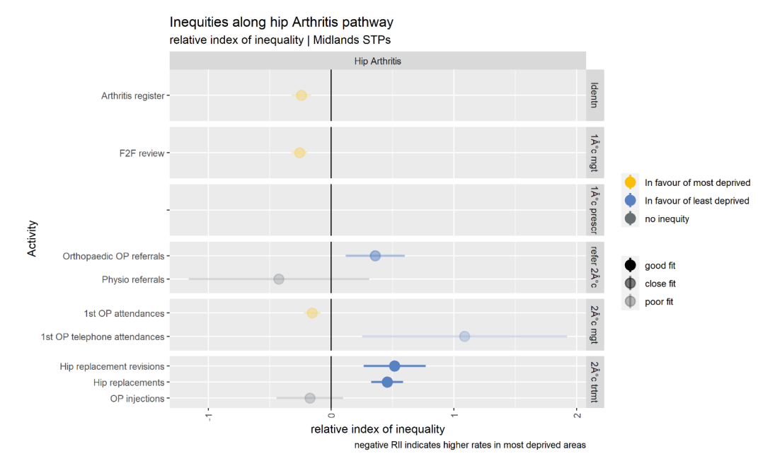
The Strategy Unit: Socio-economic inequalities in access to planned hospital care
Compared with those living in the least deprived areas, patients with hip arthritis living in the most
deprived areas are more likely to be identified by GPs and placed on an arthritis register. They are
also more likely to receive a face-to-face review in primary care and to be seen by a specialist in an outpatient setting.
Patients with hip arthritis living in the least deprived areas are, however, more likely to receive a telephone consultation from a specialist and to receive a hip replacement.
Source: https://www.strategyunitwm.nhs.uk/publications/socio-economic-inequalities-access-planned-hospital-care-causes-and-consequences

Slide 37
Practically, how do we measure health inequalities?
We can use the protected characteristics such as age, ethnicity, sexuality and socio-economic status to explore differences in health outcomes
A more straightforward way of measuring health inequalities is to quantify a gap in health outcomes between groups:
An example: The average number of comorbidities for individuals in the most deprived decile of the Index of Multiple Deprivation is 3.8 compared to 1.3 for those individuals in the least deprived decile – a health inequality gap of 2.5 comorbidities
An example: There are 210 premature (under the age of 75) deaths per 100,000 of the South East Asian population compared to 35 premature deaths per 100,000 of the White population – a health inequality gap of 180 premature deaths per 100,000 population
Further reading

Slide 38
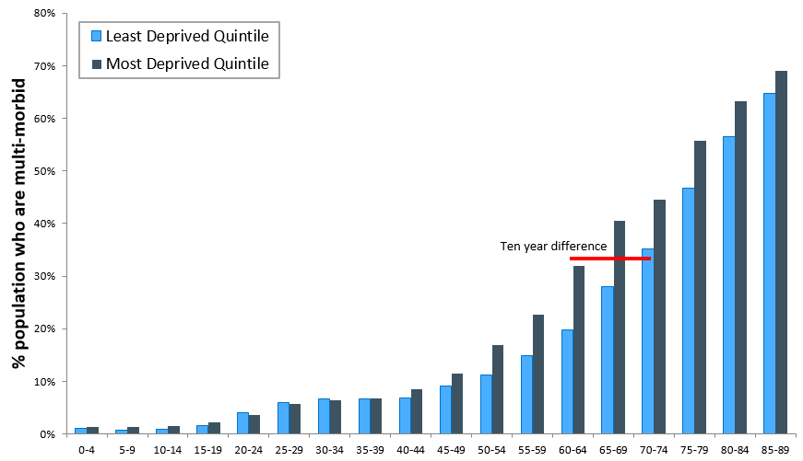
Another example of measuring health inequalities, by age

Slide 39
Discussion: measuring health inequalities
Please raise your Teams hand and use the teams chat to discuss:
How do you currently measure health inequalities?
Have you tracked changes in health inequalities as a result of your local projects?

Slide 40
Summary and next steps

Slide 41
Discussion: confidence measuring impact
Please raise your Teams hand and use the Teams chat to discuss:
How confident do you feel to measure the impact of your interventions?
What more support do you need?

Slide 42
Summary
Today we have:
Set the context for why we need to evaluate interventions
Understood how you can move from data, to measure to measurement
Learnt when and how to record data and what to capture
Learnt about the realisation of outcomes
Focused on health inequalities and how to measure them
Marcus Green
Population Health Analytics Director
marcus.green@optum.com
Joe Green
Population Health Analyst
You can access the Evaluation Toolkit for SWL using this form.
joe.green@optum.com
Notes:
Learning outcomes/objectives slide

Slide 43
Evaluation: How have we met the objectives of today’s session?
Log in to: Menti.com
Code:
Your views and feedback are important to us.
Please provide feedback via Menti regarding your experience in this session:
Scoring the session experience and outcomes (quantitative)
Feedback on what was good, and what would make this even better (qualitative)
Should you wish to discuss any part of your feedback, please contact:
laylabahramijovein@optum.com

Slide 44
Our Evaluation Journey
Evaluation Framework Workshop 1: The Evaluation Toolkit and Introduction to the
Programme of Support 31st October 2023
1400-1530
Virtual
Evaluation Framework Workshop 2: From Data, to Measures and Measurement
7th November 2023
1400-1530
Virtual
Evaluation Framework Workshop 3: Data Sources for Evaluation of Health Inequalities Programmes
21st November 2023
1400-1530
Virtual
Evaluation Framework Workshop 4: Qualitative Study Methods
5th December 2023
1400-1530
Virtual
Evaluation Framework Workshop 5: Quantitative Study Methods
19th December 2023
1400-1530
Virtual
Evaluation Framework Workshop 6: Evaluation Bias
9th January 2024
1400-1530
Virtual
Evaluation Framework Workshop 7: Value for Money
23rd January 2024
1400-1530
Virtual

