Slide 1
Data and analytical sources for evaluation of Health Inequalities programmes
Evaluation Framework Workshop 3
Marcus Green
21st November

Slide 2
Agenda
Time | Item | Lead
(5 min) | Welcome and objectives | Marcus Green, Analytics Director, Optum
(70 min) | Utilising Health Insights and other secondary data sources What is Health Insights? How do you access it? What training is available? Case studies of Health Insights supporting evaluation Future of analytics | SWL Business Intelligence Team
(15 min) | Reflections & Wrap up Final thoughts Next steps | Marcus Green, Analytics Director, Optum
Notes:
Build in discussion slides + add references to tool kit

Slide 3
Objectives for the session
We will:
Get familiar with local resources such as the BI team and their Health Insights tool as a source of data and analysis for your local evaluation
Hear about relevant case studies where Health Insights has supported local evaluations
Increase awareness of the sources of secondary data that might be useful for your local evaluation

Slide 4
Health Insights - Inequalities
South West London approach to Inequalities

Slide 5
Health Insights - Inequalities
What is Health Insights? The art of analytics from strategic oversight to patient level (15 minutes)
How do you access? What training is available? Surgery sessions. Local comms (GPNet, Providers) (10 minutes)
Case Studies
  Winter Warmth (10 minutes)
  Vaccinations (10 minutes)
  Short project reviews (5 minutes)
What is the future of Analytics? (5 minutes)

Slide 6
1. What is Health Insights?
What is Health Insights?
Who are the Analysts behind Health Insights?
What data and architecture do we have we have?
How do we approach inequalities?
What makes our approach special?
Quick demo – Proactive care

Slide 7
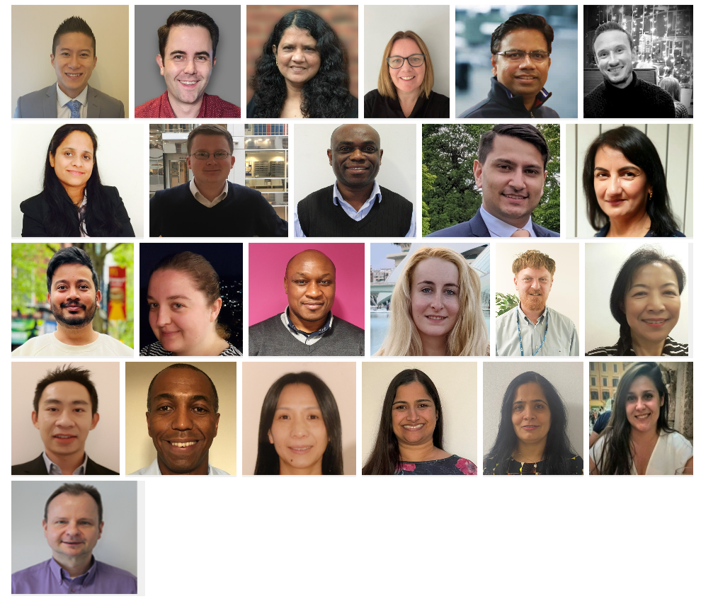
Business Intelligence & Insights.
Click here to access Health Insights
New users please contact : isl.support@nhs.net

Slide 8









South West London Approach to Population Health
Patient centered
Collaborative Platform
Patient Centric
Allowing appropriate access to back end, row-level assets within our Sandpit structure widens the pool of staff who can develop reporting solutions
Bringing this pool of experts together allows for the sharing of ideas, and re-use of knowledge and methods from across our footprint
Population Health has been implemented in many ways across the UK. The approach in SWL has been to put the patient at the centre of the model.
This means that all analysis can be drilled down to the most granular level: the patient
Accessible Analytics
Utilising the Microsoft stack to deliver analytics in a way that is consumable easily, on any platform, at any given time.
Secure patient level extraction
Patient at the Heart
Future Plan
Sky is the limit. We are driven by the requirements and opportunities of the system. One utopia could be to deliver live activity reports to Social Prescribers in order to support direct patient care.
Scalable Design
Working with the DSCRO, London Shared Services Central Analytics and Information Governance, we can add more data to Population Health in a modular, secure and governance approved way

Slide 9




Population Health Data Model
Sample of available datasets
Activity and pathways
Demographics
Children Social Care (WiP)
Adult Social Care(WiP)
Covid-19 data store
High Cost Drugs
Virtual Wards
London Ambulance Service
Prescribing (WiP)
Maternity
Quality and Performance
Primary Care
Acute Hospital Care
Community Providers
Mental Health Providers
IAPT
111
Referrals
Waiting lists
Gender
Age
Ethnicity
Deprivation
Crime and 999
Mortality
Workforce
Environmental and Accessibility
Segmentation and Artificial Intelligence
Weather and UV
Pollen Index
Traffic
Travel Times
Pollution
Risk Stratification (Re/Admission)
Frailty Index (Hospital and Primary Care)
Covid-19 outcomes
Mortality Index
Urgent and Emergency Care Prediction
Qrisk, Qcovid, QDiabetes

Slide 10

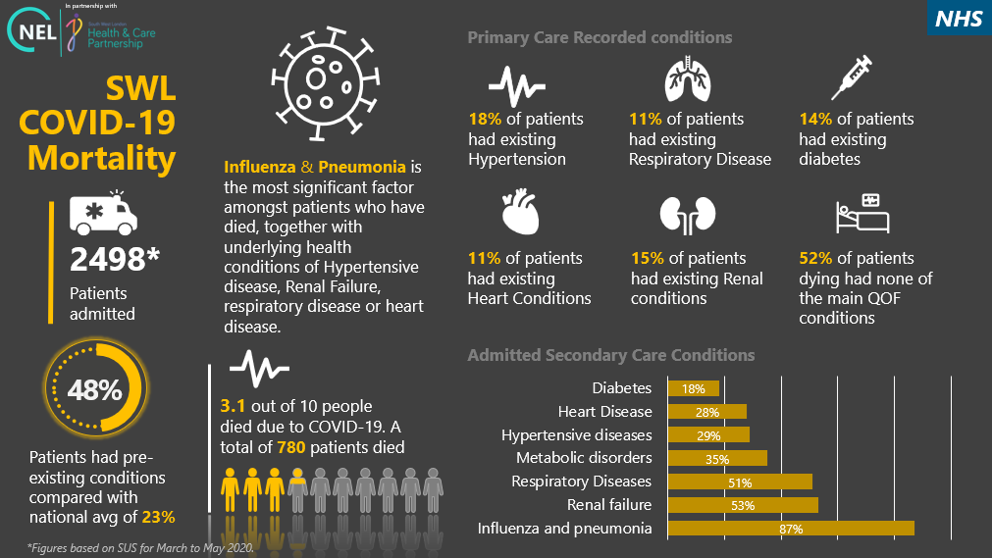
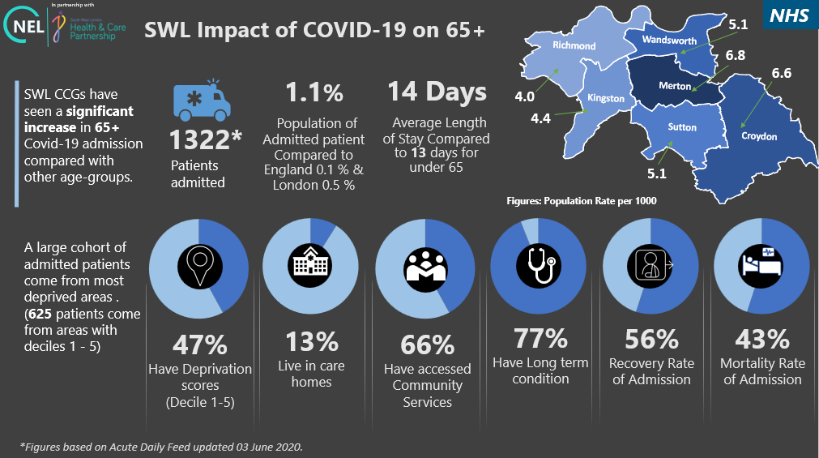

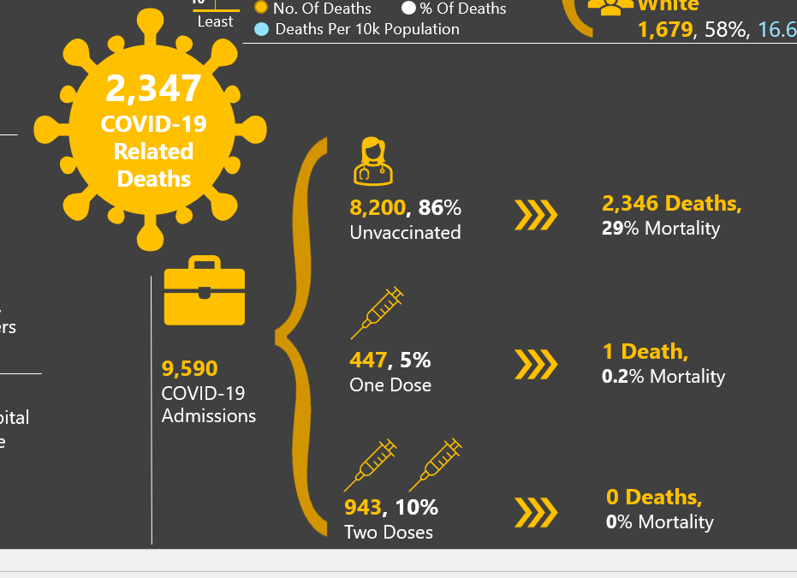
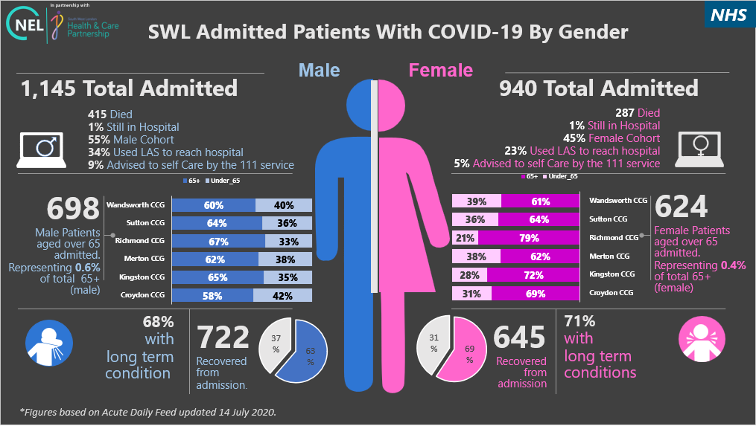
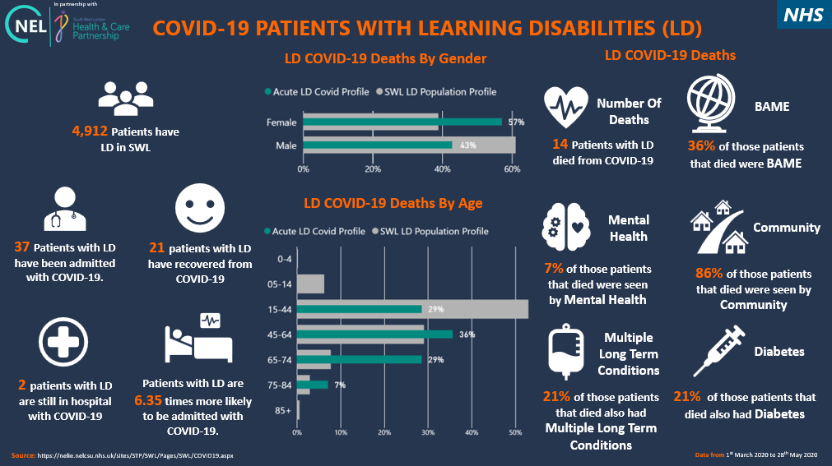

Infographics
Used by Surrey Downs Only
Building Towards
Empower decision making
Allow analysts to draw upon the resources of Health Insights to pull together coherent, concise and focussed messaging.
Opportunities: Focus task at hand, key facts in one place, SWL relevant modelling, as opposed to London/UK only level

Slide 11
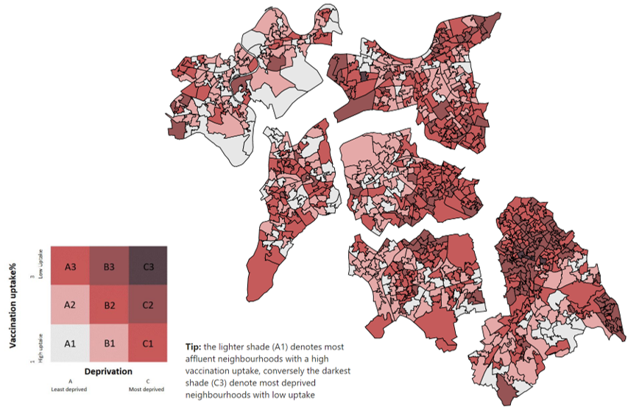
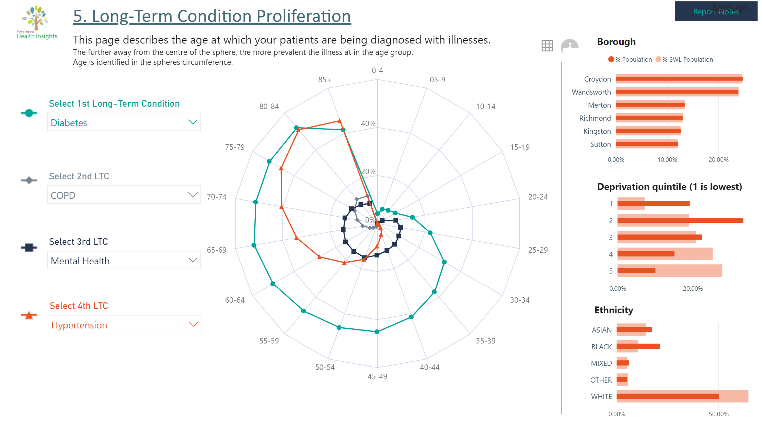
South West London Health Insights Platform
Used by Surrey Downs Only
Building Towards
Interactive Population Health Management
Health Insights is South West London’s Population Health Management Platform.
Acting as a knowledgebase, it hosts all research, self service reporting and documentation.
Health Knowledgebase
A site that contains the wealth of knowledge we have developed under Population Health Management.
Single sign-on, Role based access
Ease of use, web based, scalable, role and level of detail governed by user credentials
Interactive, visually appealing, self service
Simplicity of design, storytelling, intuitive narration
Insightful
Technology and analysts provide the structure, the user decides how deep they want to dive into the story
Depth of analysis
Infrastructure narrates risk algorithms and machine learning outputs, without needing to be an expert

Slide 12
Quick demo – Proactive care
Size at scale
Benchmark
Equity
Pathway
Service utilisation
Patient re-identification
Try it yourself: Population Health Management

Slide 13
2. Accessing Health Insights, training and requesting analytics
Visit us on https://susi.sharepoint.com/sites/SWL: Health Insights
Contact us: analytics@swlondon.nhs.uk
Virtual Surgery sessions (2nd and 4th Thursday every month 12:30 to 2pm: Click here to join the meeting :
Business Intelligence Newsletters – via comms and directorate leads
How-to guides
Request form

Slide 14
3i. Case Study – Vaccinations and Flu Programme

Slide 15



Problem statement
The uptake of the flu vaccine became imperative following the initial wave of COVID-19 and the health inequalities reported at the time in people diagnosed covid. SWL CCG wanted to limit any impact of flu on patients who caught covid prior to thwithe vaccine being available.
  1) Planning, re-designing pathways and prioritising care: The NHS were given their biggest challenge in flu vaccinations - to deliver vaccinations for up to 85% of the eligible , in the midst of a Covid-19 pandemic.
  2) Identify any local health and care inequalities, target opportunities to change: Working alongside the covid vaccine programme to target similarly non-compliant populations. Using patient health risk as a measure of success,
  3) Ease of access to information and data: Putting information in the domain of the programme and allocating a lead analyst to react to daily deep dives
premise

Slide 16

Stakeholders
  Data on the uptake of flu vaccines was available to SWL CCG, but there were problems in using this data from Immform - access was restricted to limited individuals in borough teams. This potentially restricted the information to only those in operational roles. Immform data was at an aggregate performance level, targeting pre-defined patient groups rather than at an individual patient level for the population, thus limiting our ability to create granular targeting opportunities.
  Additional work was required to enable us to prioritise care and ensure equity in approach.
Original state
Flu Programme Leads
Primary Care
Analysts
Programme leads are accountable for the delivery of the vaccine programme. They are responsible for identifying risks, opportunity to improve uptake and ensuring an equitable approach.
Vaccines are delivered in primary care to the eligible population. Primary care teams are responsible for contacting the eligible population and understanding any issues people had in obtaining the vaccine.
Analysts across SWL work with different sources of vaccine data. The variation of report used by various stakeholders, resulted in each stakeholder telling a slightly different story.
16

Slide 17



How health insights helped
Phase 1 – Proof of Concept
Phase 2 – National Database
Phase 3 – Operationalising
Collation of existing reports and newly available data, allowed a new Flu Vaccine Report to be drafted.
Aggregate reporting for SWL was streamlined and retargeted for the flu programme leads.
Gap analysis conducted between the GP practice and Immform data. This flagged a risk in reporting, and a lack of a single point of truth.
Access to the National Immunisations and Vaccines Systems (NIVS) obtained in 2021.
This data was triangulated with Health Insights to create a flu report which visualises the scale of the unvaccinated population and identifies opportunities for targeting
Identified similarities between the population profiles of those unvaccinated against flu and those unvaccinated against covid.
The Flu group were able to target areas where uptake is a concern and focus on specific population groups such as the homeless and housebound.
The flu report is now operational between September to February each year.
Key stakeholders: September to December- Primary Care teams, delivering the vaccine; December to February - CCG colleagues who improve access for the unvaccinated.
Initially refreshed daily, the report is now refreshed twice per week, in line with programme needs.
Ability to allow appropriate users to identify individual patients, further assisting with outreach work.
SWL region wide comparators allow us to identify need at a system level

Slide 18
impact
Patients vaccinated
18%
43%
USER RESPONSE AND PATIENT IMPROVEMENT
20/21
21/22
Feedback from the lead pharmacist, “the vaccination dashboard offers a tool to follow progress closely. It allows the CCG to focus on those areas where performance is weaker.” This has been imperative in resource planning to reach the challenging targets ranging between 75% - 85% vaccine uptake across patient cohorts.
The dashboard and its data has also been used to plan vaccine stock for flu seasons, and work has already begun to plan at a cohort level for the 2022/23 flu season.
Since the original ‘Capacity Tracker’ flu report, a care home lead in SWL, who looks at vaccines in care homes, has reported improved user experience in the new flu report.
Flu vaccines delivered in 2020/21 and 2021/22
Priority Groups by age | 2020/21 | 2021/22 | % change
65+ years old | 133,963 | 155,483 | 16%
50-64 years old | 87,320 | 128,874 | 48%
2-3 years old | 15,930 | 14,315 | -10%
Reception – year 7 school | 19,026 | 22,334 | 17%
Other ages & non-priority people | 58,590 | 80,742 | 38%
TOTAL | 314,829 | 401,748 | 28%

Slide 19
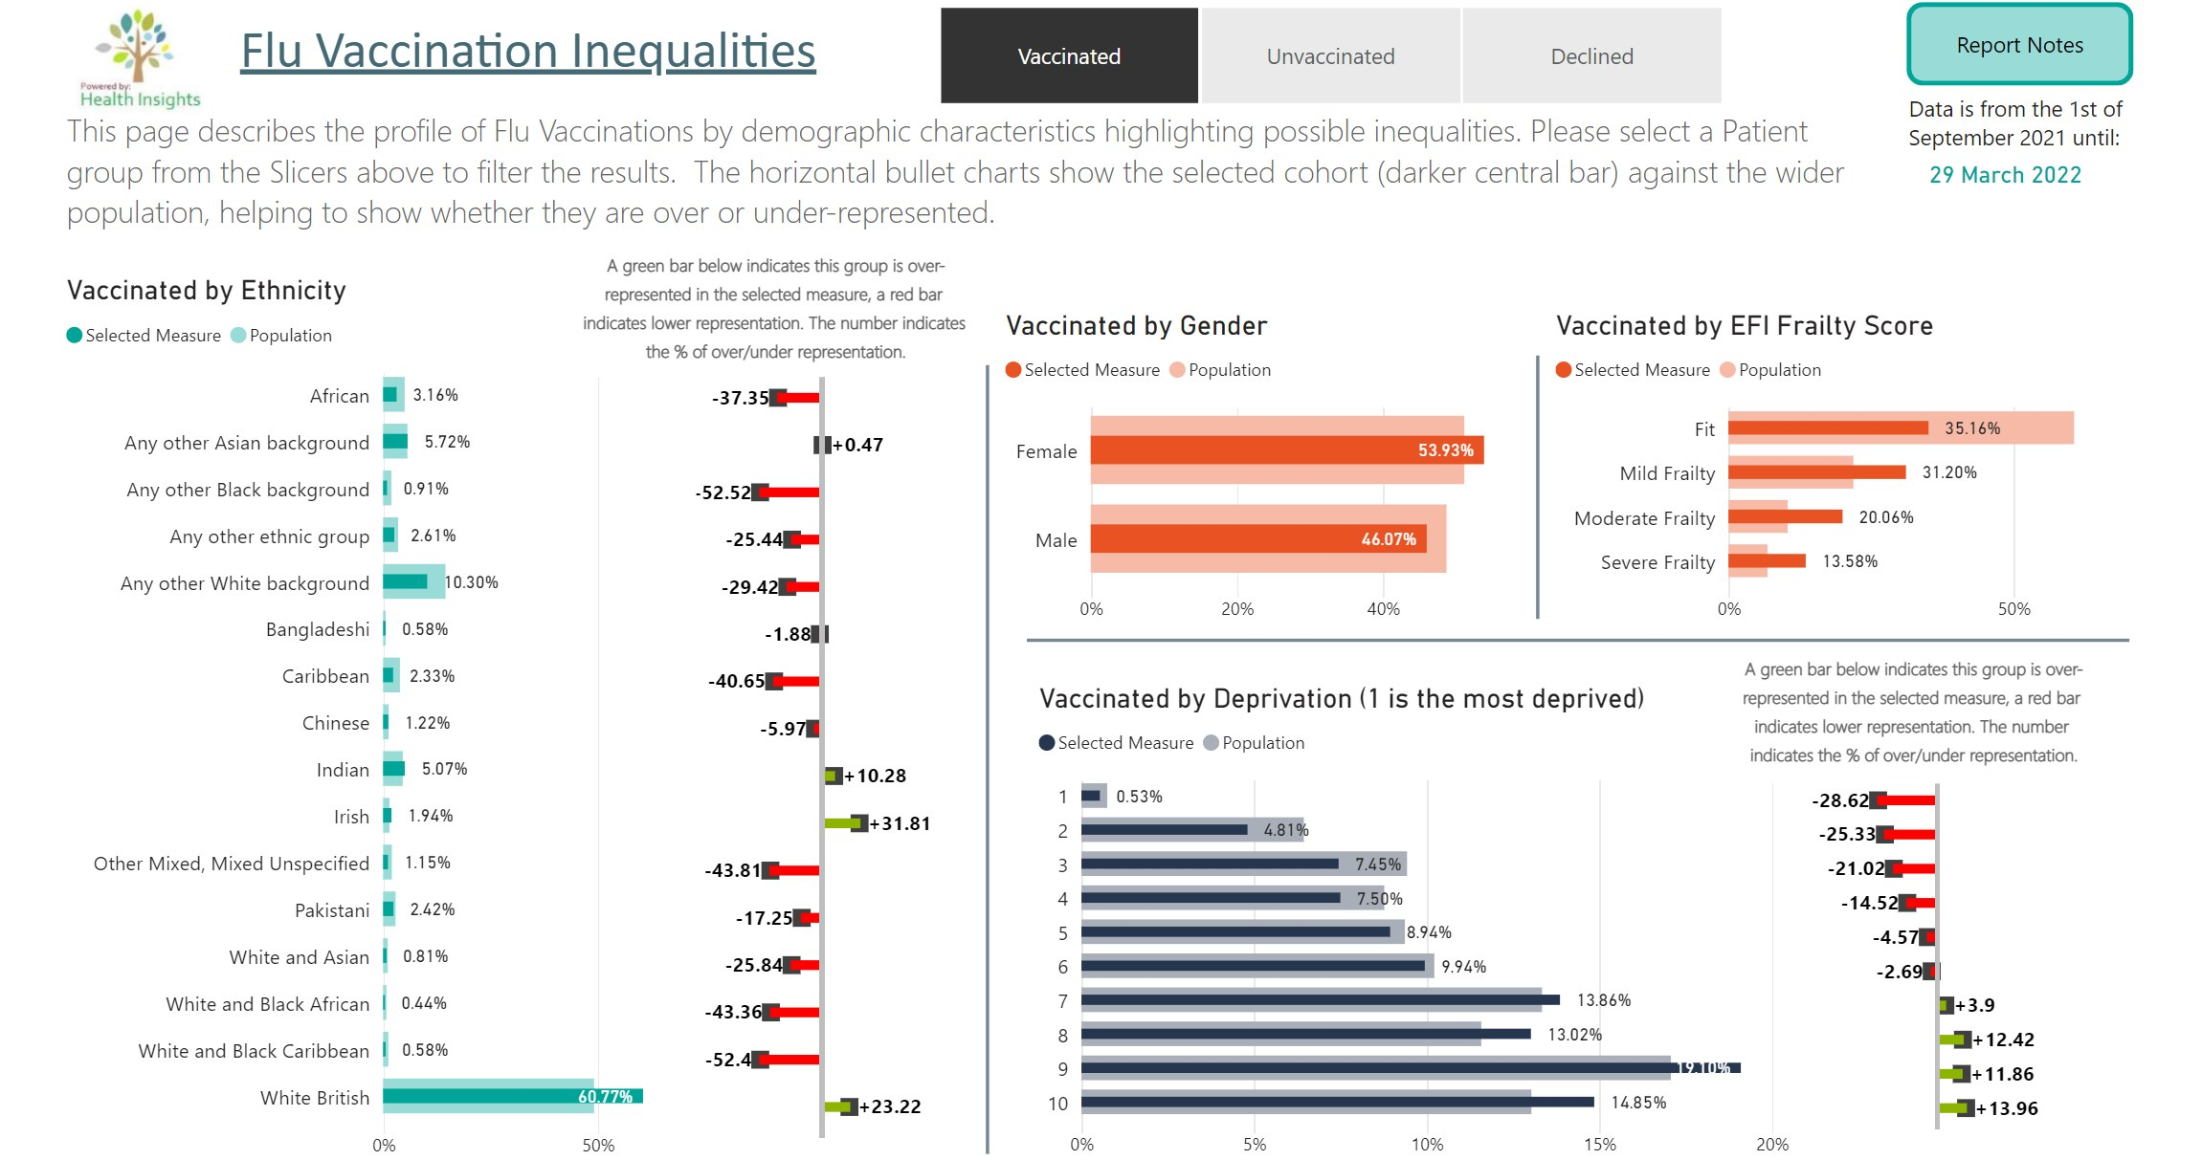
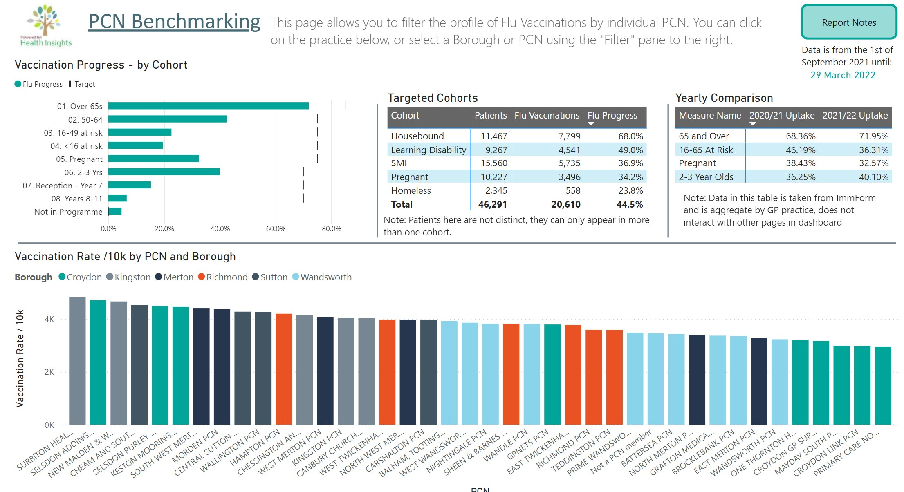
Visual outputs
Link to work: https://susi.sharepoint.com/sites/SWL/SitePages/Flu-Immunisation.aspx

Slide 20
3ii. Case Study – Winter Warmth

Slide 21


PHM Case Study
Winter Warmth
Investor Opportunity
Author: Nick Jones – Head Of Analytics – SWL BI
BI Analyst: Daniel Archer – Senior Lead Analyst – SWL BI
Key Stakeholders: Denise Madden - Deputy NHS Exec Lead for Kingston & Richmond Places
Sam Green - Head of Population Health Management Programme

Slide 22
Problem statement
There are a range of poor health outcomes associated with colder homes including an increase in respiratory infections, increase in heart attacks and strokes, increased incidence of anxiety and depression, poor infant weight gain, falls in the elderly, higher hospital admission and readmission rates. There is an overall increased risk of mortality and a slower recovery following discharge from hospital.
  1) Targeted outreach to the identified cohort using Re-Id tool
    PCN embedded Social Prescribers to offer bespoke support. This is in a bid to reduce preventable excess winter deaths and improve health and wellbeing.
    Local Authority teams to identify cohorts with poor-quality housing in need of retrofitting to improve energy efficiency. Other Local Authority services offered in order to reduce fuel poverty.
  2) Easy to access information and data.
    The data analytics will enable users to review the entire pathway of patients with medium to higher level winter risk scores. Socio-economic factors can be reviewed to determine the inequalities present.
premise
Notes:
Can the headings be incorporated & replaced by the statements under each heading?
1) Help plan services, redesign pathways, decide which patients to prioritise
2) Research into local health and care inequalities and opportunity to change
3). Easy to access information and data

Slide 23

Stakeholders
  The Health Insights data model already contained the majority of the data required for the workstream, e.g. Primary Care and Acute Providers. The BI team was missing information on the energy efficiency of homes and homes with fuel poverty in South West London. While we had risk algorithms for admissions and frailty, we needed to create a new risk score based on the factors that are greatly impacted by colder homes. A Re-ID tool was already made available to other workstreams, so was ready to be incorporated.
Original state
Kingston PCNS
Kingston Local Authority
Population Health Management
Analysts
Embedded Social Prescribers will use the list of re-identified cohorts to contact at risk patients to offer bespoke support. Primary Care leads were responsible for providing logic required for risk score.
Text messages sent to all medium risk cohorts to offer RBK resources. In addition, funding to potentially be utilised to improve energy efficiency by retrofitting poor quality housing for the cohorts
Leads on the governance behind the workstream. They will showcase the best practice being done at Kingston so similar interventions can get put in place across South West London. They’ll also Identify next steps that can be built in as shown by other regions.
Provide source data that is used across the workstream. Analysts utilise mutliple sources of data to produce a re-identification and population health management tool to Kingston and the wider ICS.
23

Slide 24
How health insights helped
Phase 1 – Proof of Concept
Phase 2 – Operationalising
This is the first time in South West London that NHS Healthcare data was linked to information on energy efficiency of housing in the 6 boroughs.
The amalgamation of data sources allowed the PCNs and Local Authority teams to target specific cohorts with health risks that are exacerbated by cold homes.
Population Health Management and transformation managers within the ICB were able to identify the inequalities surrounding fuel poverty and high winter risk scores.
Health Insights was used to risk stratify cohorts to receive new interventions.
High risk cohorts were referred by PCNs to Social Prescribers for intervention. (For example, referral for a Home Assessment, help with benefits, referral to falls clinic, linking in with local Food Banks and ‘Warm Spaces’)
Royal Borough of Kingston (RBK) had a separate scheme to retrofit those homes with poor insulation
Lower risk cohorts were sent SMS messages via iPLATO to signpost them to local support provided by RBK.

Slide 25
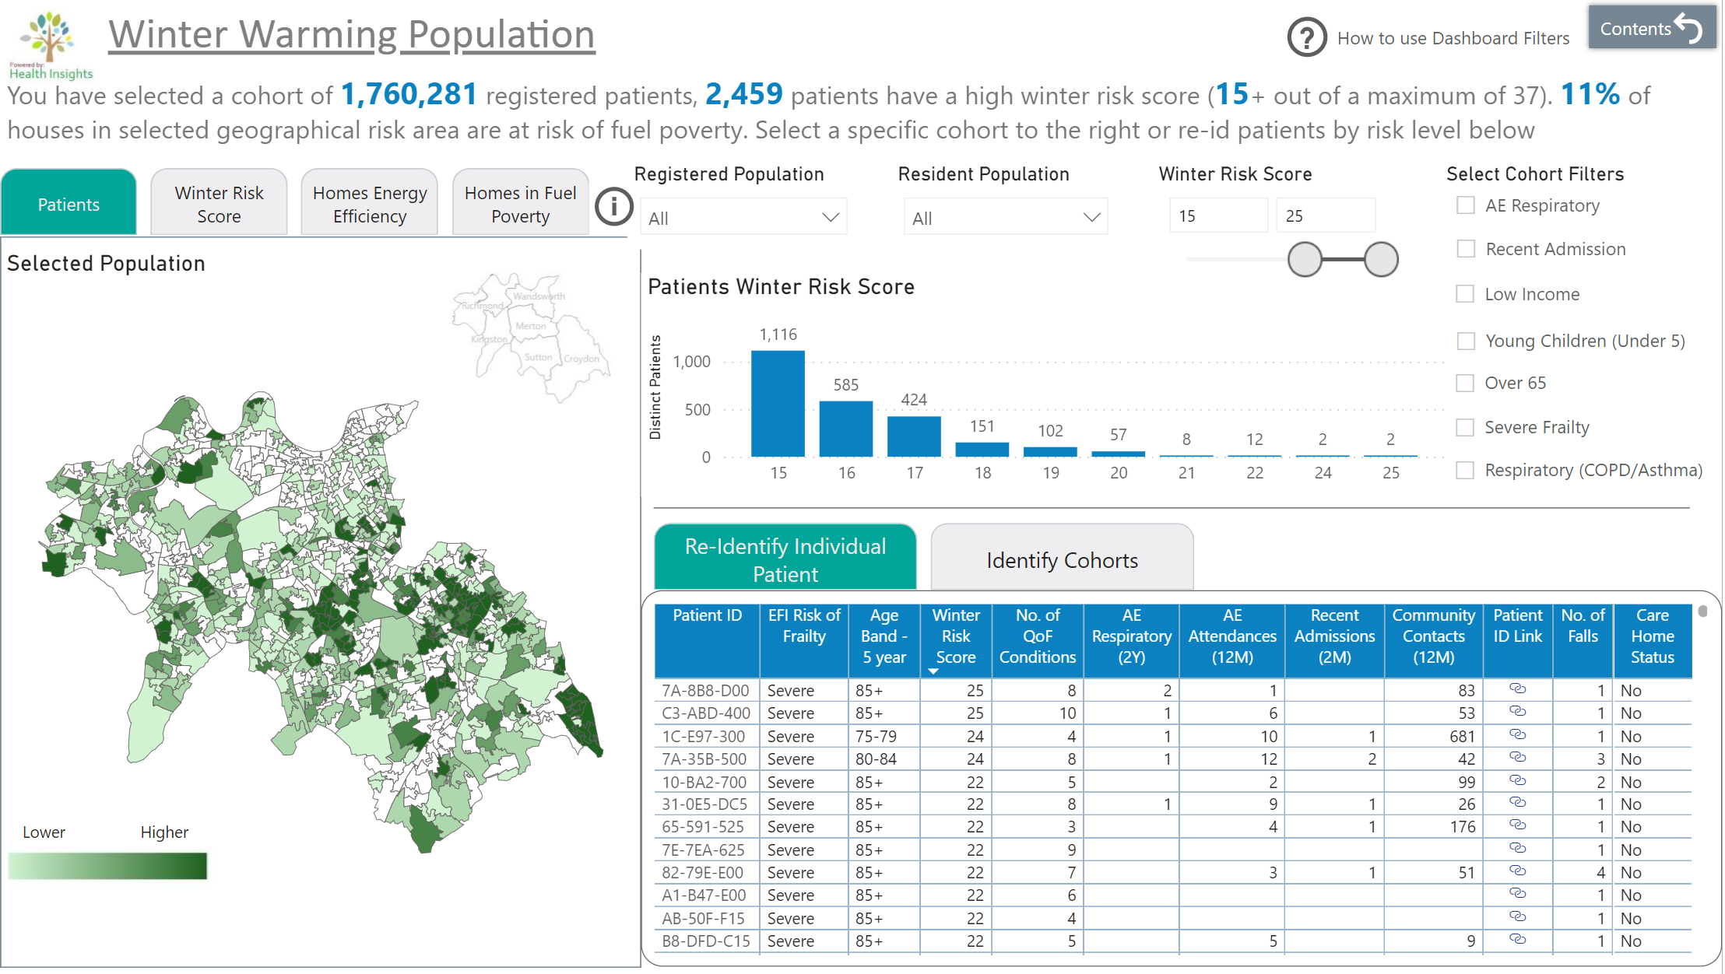
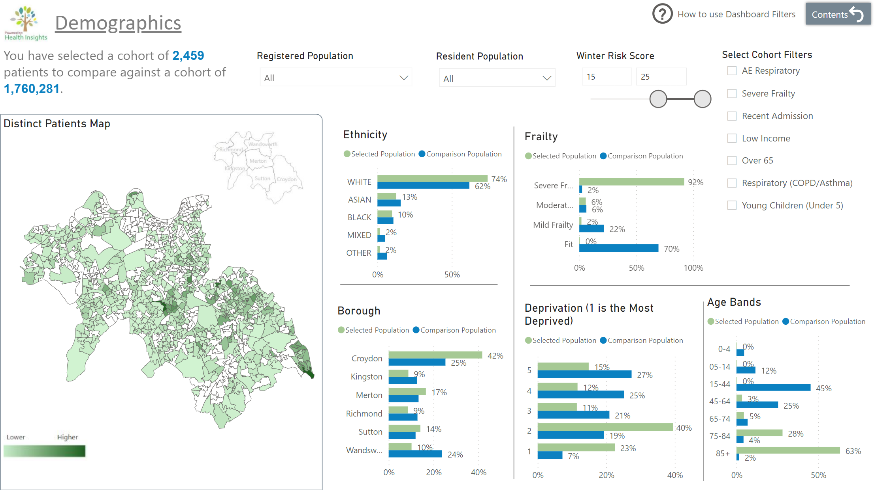
Visual outputs
Link to work: https://susi.sharepoint.com/sites/SWL/SitePages/Winter.aspx

Slide 26
Impact
As at April 2023:
  Using Health Insights, a cohort of 2,921 patients were risk stratified to receive interventions
  78 referrals made to Social Prescribing signposted to Thinking Works^{[1]} (for home winter warmth assessment), SW London Energy Advice Partnership (SWLEAP)^{[2]}, Richmond Aid Benefits Advice, employment support, befriending or OT assessments.
  60 referrals made to StayWell, 22% were either signposted or referred to Thinking Works, Local Authority Finance Teams, Staywell Teams, Citizens Advice Bureau or for a carers assessment.
  Review/evaluation will take place during Winter 2023.

Slide 27
3iii. Short Project reviews: Polio vaccinations

Slide 28
Short paper – Polio vaccinations
Polio Immunisation - Monitoring Polio Vaccination Efforts in SWL
Author: Merlyn Griffiths – merlyn.griffiths@swlondon.nhs.uk
Date Written: 25th October 2023
Go to dashboard →
Background
Poliovirus traces were found in north and east London sewage in early 2022.
The Polio specific vaccination and booster campaign was launched in Summer 2022 as part of a Public Health initiative, initially aimed at children under 5 before extending to children aged 5-9. SWL CCG wanted to limit the impact of polio on the local population and manage the risk of the virus spreading.
Stakeholders
Primary Care: Responsible for delivering the vaccines.
Population Health Management: Responsible for the delivery of an equitable and accessible vaccination programme
Dashboard Design
Using the Health Insights platform, the SWL BI team created a dashboard, based on GP vaccination data, that provided vaccination monitoring data for children under 5.
Dashboard Specifications
Data Source: Primary care and GP clinical systems, refreshed weekly.
The dashboard provides insights into:
The number and ages of children who had received the vaccination booster, by demographic.
Dates and locations of vaccinations.
Benchmarking figures by Borough, Primary Care Network and GP Practice.

Slide 29
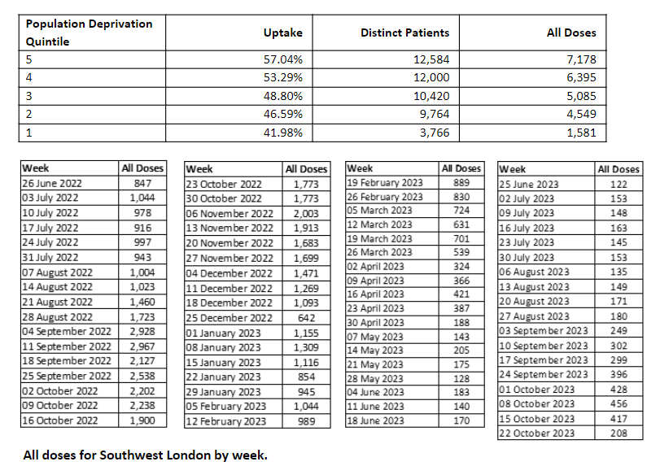
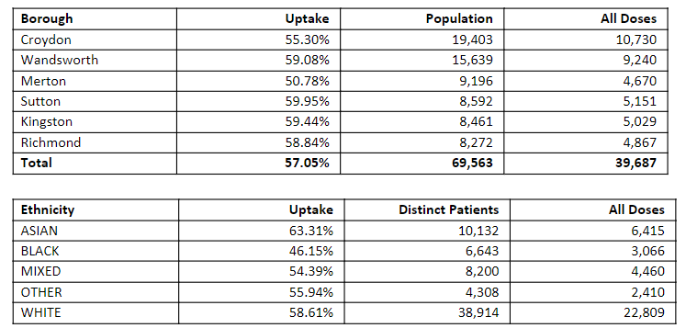
Short paper – Polio vaccinations (page 2)
Key Findings (between July 1st 2022 to October 13th 2023)
When looking at the eligible population (aged 1-4) we find the following.
The average percentage of eligible population uptake across SWL boroughs was 57%.
The percentage of eligible population uptake was greatest for children in the Sutton borough (60%) and least for children in the Merton Borough (51%).
The percentage of eligible population uptake was highest for children with an ‘Asian ethnic category’ (63%) and lowest for children with a ‘Black ethnic category’ (46%).
Uptake was highest among children aged 1 and 4.
The greatest number of doses were administered between the weeks of 04/09/22 and 11/09/22.
We do not have residence information for the majority of the 1 year olds and therefore they are excluded from the deprivation analysis. There is a negative correlation between population deprivation levels and uptake of the vaccination, the most deprived quintile has an uptake of 40% compared to 57% in the least deprived areas.
Outcomes
Following the roll out of the polio vaccination program in SWL, further programs have been developed to increase vaccination uptake. SWL launched a campaign in 2023 to increase the uptake of the MMR vaccine for under-vaccinated children, using local data to target and engage population groups with lower uptake.
Appendix

Slide 30
4. Future of Analytics
i. Self service : Data model
ii. Inequality Explorer : Correlation
iii. Statistical Process Control
iv. Predictive tools

Slide 31
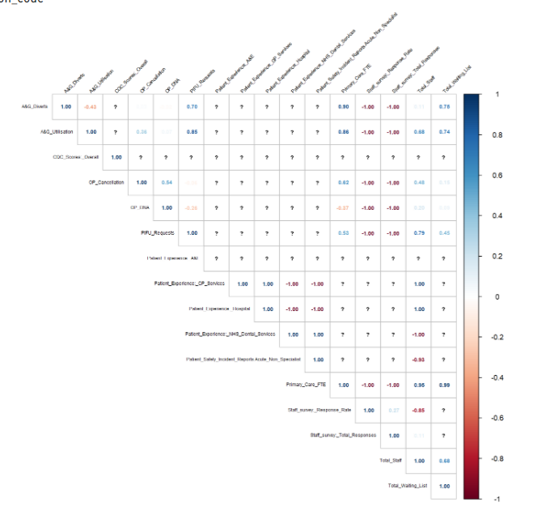
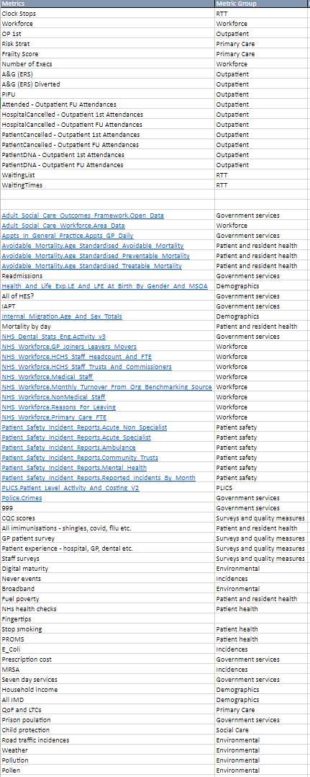
4i. Self Service – Data Model

Slide 32
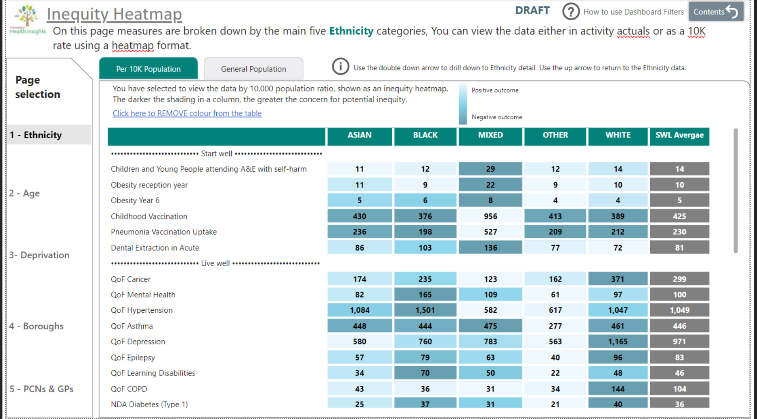
4ii. Inequality Explorer

Slide 33
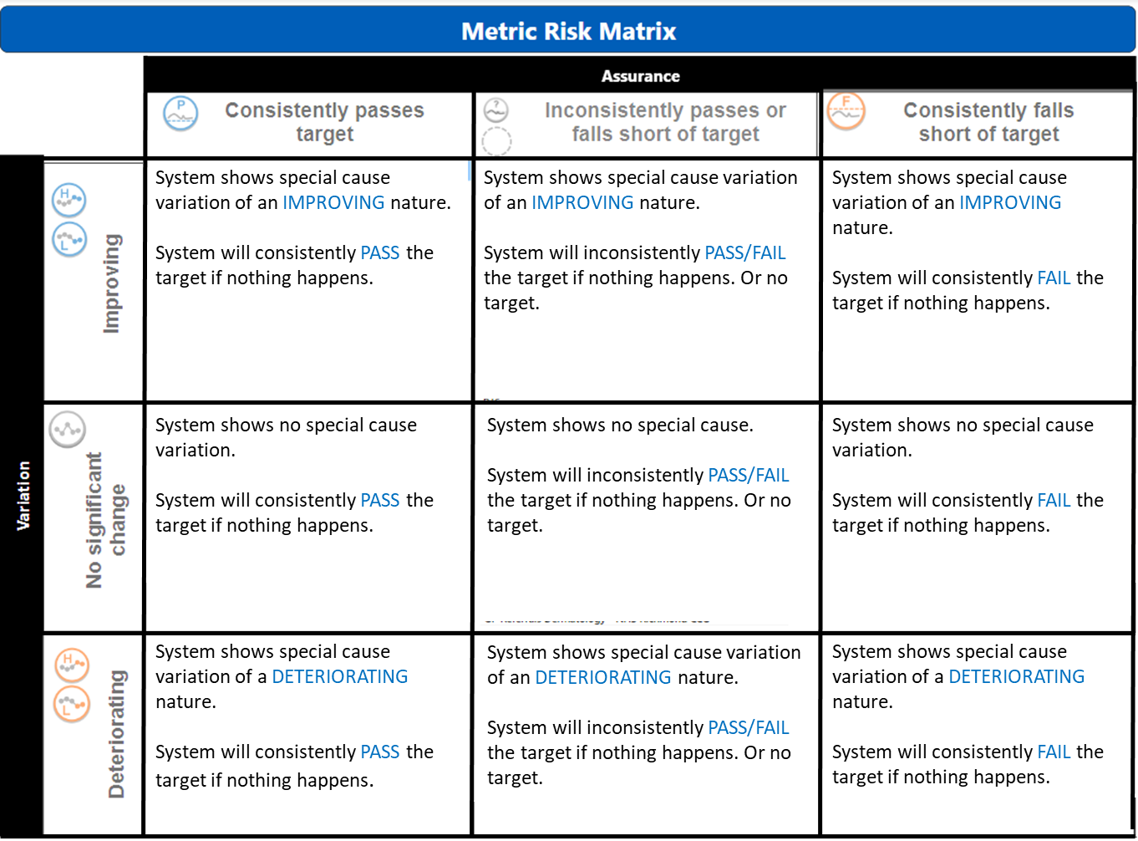
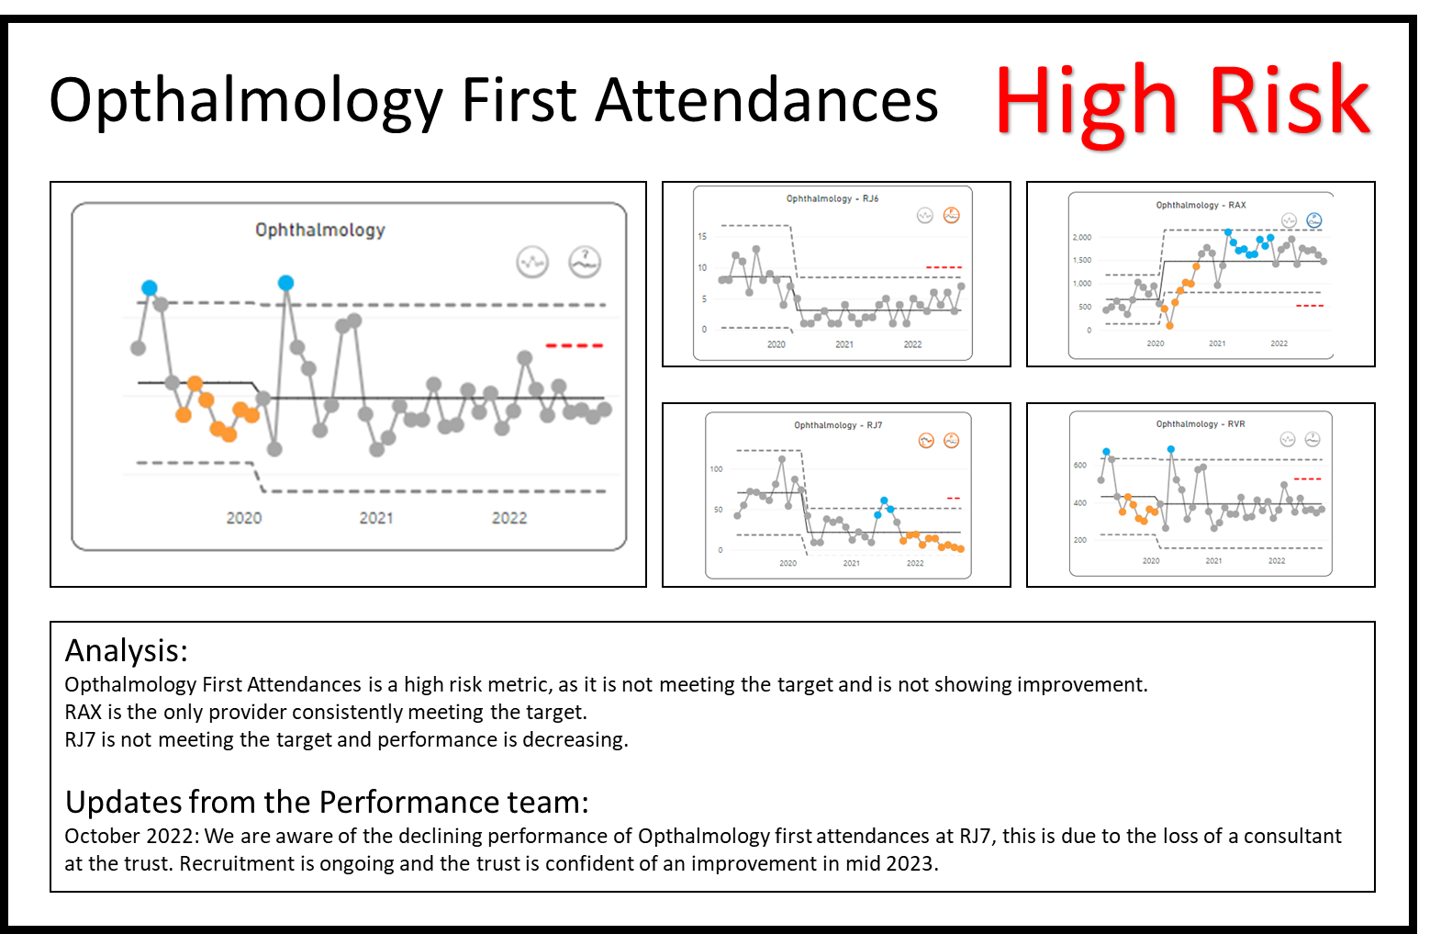
4iii. Future of Analytics – Statistical Process Control

Slide 34
4iv. Predictive and Statistical Tools
Using data to make decisions, not charts
Statistical modelling – R, Python
Analytics Academy - Training and upskilling South West London

Slide 35
Public and National Data Sets
Data availability is not limited to Health Insights, many public and national healthcare data sets are available to Community and Voluntary sector organisations/everyone
List of reputable data sources:
NHS Digital
Office for National Statistics (ONS)
Health and Social Care Information Centre (HSCIC)
Public Health England (PHE)
The King's Fund
Cancer Research UK
World Health Organisation (WHO)
UK Biobank
Local Authorities (need to check)
Mental Health Organisations

Slide 36
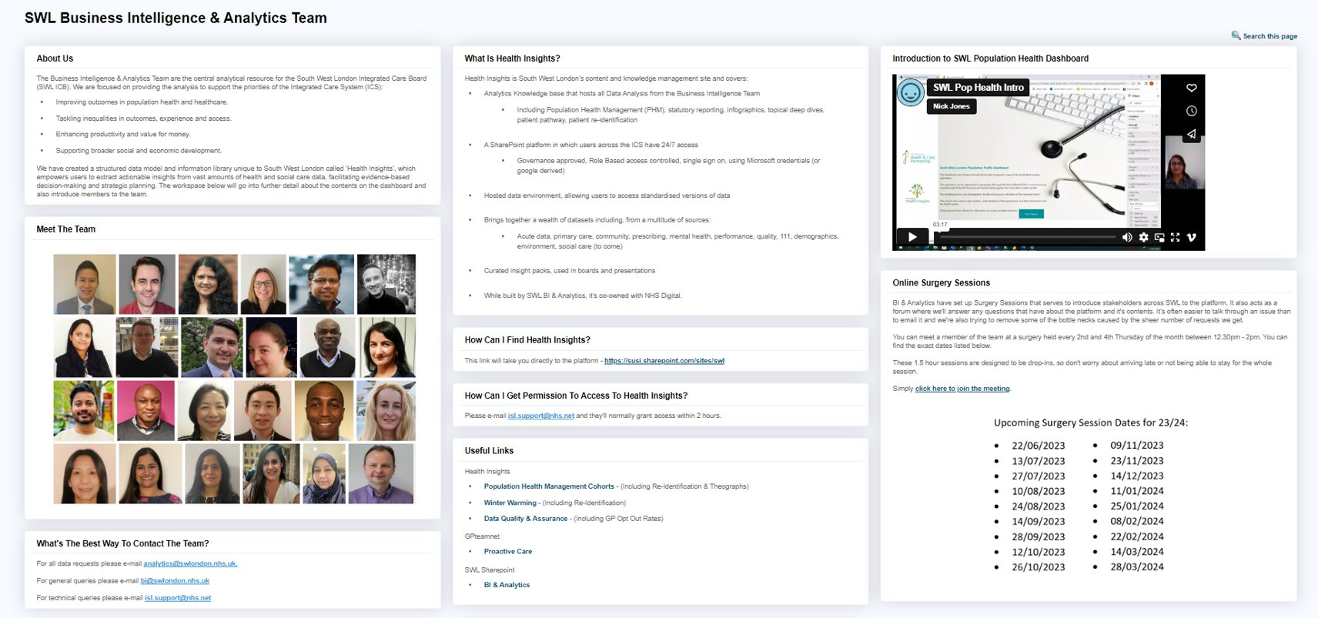
GP TeamNet Page
For all data requests: analytics@swlondon.nhs.uk
For general queries: bi@swlondon.nhs.uk
For technical queries: isl.support@nhs.net

Slide 37
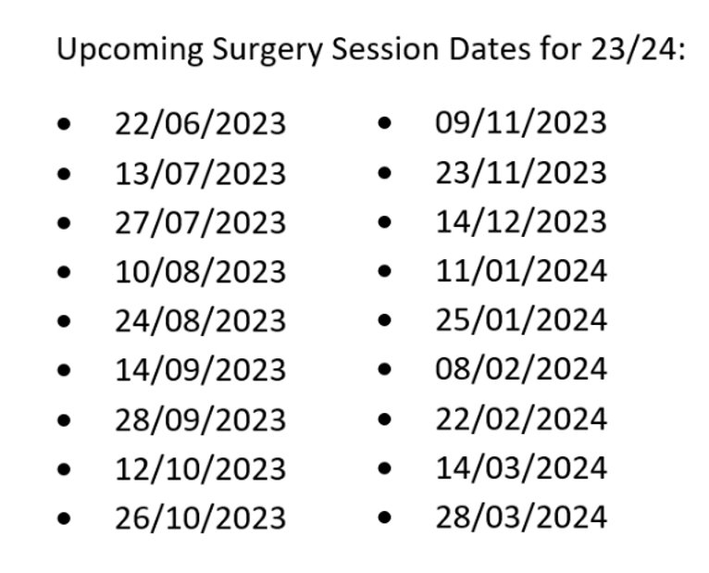
BI Team Surgery Sessions
The SWL BI Team host bi-weekly surgery sessions, allowing individuals to drop in during these sessions to ask any data or analytics related questions, seek guidance and advice on using Health Insights or needing any other data/analytics support.
Please use these sessions to interact with the BI Team.
For all data requests: analytics@swlondon.nhs.uk
For general queries: bi@swlondon.nhs.uk
For technical queries: isl.support@nhs.net

Slide 38
Summary and next steps

Slide 39


Summary
Today we have:
Increased awareness of the types of data useful for local evaluation
Heard information about the local availability of different types of data and data sources
Got familiar with local resources and teams to support data collection, reports and analysis that can support evaluation of programmes
Marcus Green
Population Health Analytics Director, Optum
marcus.green@optum.com
SWL Business Intelligence Team
You can access the Evaluation Toolkit for SWL using this form.
analytics@swlondon.nhs.uk
Notes:
Learning outcomes/objectives slide

Slide 40
Evaluation: How have we met the objectives of today’s session?
Log in to: Menti.com
Code: 99 17 34 9
Your views and feedback are important to us.
Please provide feedback via Menti regarding your experience in this session:
Scoring the session experience and outcomes (quantitative)
Feedback on what was good, and what would make this even better (qualitative)
Should you wish to discuss any part of your feedback, please contact:
laylabahramijovein@optum.com

Slide 41
Our Evaluation Journey
Evaluation Framework Workshop 1: The Evaluation Toolkit and Introduction to the
Programme of Support 31st October 2023
1400-1530
Virtual
Evaluation Framework Workshop 2: From Data, to Measures and Measurement
7th November 2023
1400-1530
Virtual
Evaluation Framework Workshop 3: Data Sources for Evaluation of Health Inequalities Programmes
21st November 2023
1400-1530
Virtual
Evaluation Framework Workshop 4: Qualitative Study Methods
5th December 2023
1400-1530
Virtual
Evaluation Framework Workshop 5: Quantitative Study Methods
9th January 2024
1400-1530
Virtual
Evaluation Framework Workshop 6: Evaluation Bias
16th January 2024
1400-1530
Virtual
Evaluation Framework Workshop 7: Value for Money
23rd January 2024
1400-1530
Virtual

