Slide 1
Qualitative Study Methods
Evaluation Framework Workshop 4
Marcus Green
5th December

Slide 2
Agenda
Time | Item | Lead
(5 min) | Welcome and objectives | Marcus Green, Analytics Director, Optum
(25 min) | Qualitative methods planning for evaluation | Marcus Green, Optum Nadine Wyatt, Health and Care Integration Programme Lead, NHS Sutton
(15 min) | Qualitative data collection methods | Marcus Green, Optum
(15 min) | Analysing qualitative data | Marcus Green, Optum
(20 min) | Qualitative approaches informing quantitative approaches | Marcus Green, Optum
(10 min) | Wrap up Final thoughts Next steps | Marcus Green, Optum

Slide 3
Objectives for the session
We will:
Introduce qualitative data and analysis methods for evaluation
Explore the role of community engagement in evaluation
Understand how and when to apply these methods for intervention evaluation
Gain an understanding of how qualitative methods complement quantitative methods in a mixed approach

Slide 4
Qualitative methods planning for evaluation

Slide 5
What are qualitative methods and why use them?
Community engagement can enrich PHM, empower local communities and improve outcomes
Qualitative methods add significant value in understanding population health and care needs and to intervention design, implementation and evaluation
There is statutory guidance that state that people and communities must be included in the planning and delivery of local health and care services
Qualitative evaluation looks to explore how or why something occurs
Qualitative evaluation focuses on an individual’s beliefs, experiences, attitudes, behaviours and interactions
Qualitative methods generate non-numerical data - such as written responses, interview transcripts, or videos - that are analysed and interpreted to highlight themes, patterns and concepts
These methods can help answer questions such as: why did some people from certain ethnic minority groups not come forward for the COVID-19 vaccine?
Working in partnership with people and communities: Statutory guidance

Slide 6
When to collect qualitative data
Access the Evaluation Toolkit
Qualitative methods focus on why and how (narrative). These might include focus groups, semi-structured or unstructured interviews and observational study, all which can be used to give depth on how and why an intervention is working and provide context and depth of insight that can be used to improve an intervention.
Going beyond the numbers
Qualitative methods help to:
Answer descriptive and exploratory questions
Explore different experiences related to diversity
Understand complex issues
Develop theories and test hypotheses
Understand the impact your intervention may have on participants
Determine the outcomes you may want to measure over a longer period
Give a voice to those who are less often heard.
Explains how and why
Gaining insights
Understand concepts, opinions and experiences

Slide 7
Logic model framework for evaluation
A logic model helps you start to think through the logical theory of change i.e., which outputs lead to which outcomes?
Further information on logic models can be found here: Using Logic Models in Evaluation- Jul16.pdf (strategyunitwm.nhs.uk)
Directions: Start with the problem statement (1), then agree the goal/aim as the long-term outcomes (2), work backwards to populate the model (3), work forwards using an ‘if-then’ logic to test the model (4). Gap-analysis. Iterative development. Review and update as necessary.
Considerations: Common understanding and agreement on (1&2), define outcome timescales, multiple stakeholders perspectives on (1-4), SMART, success/failure and intended/unintended consequences.
Rationale for intervention (1)
This is the justification for the programme/intervention. For example, what is the nature and scale of the problem being addressed? What will happen if nothing is done?
Inputs
Outputs
Outcomes – Impact
Inputs
Participants
Activities
Outputs
Short-term
Medium-term
long-term (2)
What we need/invest in?
Who we reach/involve?
What we do?
What we create?
Results — In terms of learning
Results — In terms of changing action
Results — In terms of change to the conditions
The resources available or required to deliver the work.
The stakeholders involved in the programme /intervention and those with an interest in the long-term outcomes.
The activities undertaken as part of the programme /intervention.
Maybe referred to as process measures.
Directly related to/ resulting from activity.
Delivering to the intended audience at the intended ‘dose’ of action.
Changes observed in awareness, attitudes, knowledge, skills, functioning, outlook, etc.
Changes observed in behaviour, practice, condition, and decision-making, etc.
These follow on from changes observed in the short-term.
The final desired impact of the programme/intervention. At a population or system-level impacts.
Relates closely to the original rationale.
Relative weights on multi-faceted aims.
Populate the model (3)
‘if-then’ logic test (4)
Assumptions
External Factors

Slide 8
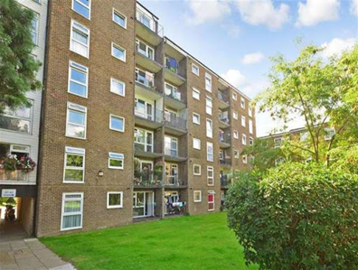
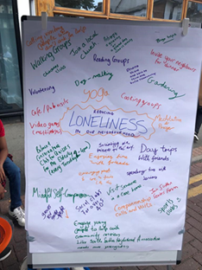
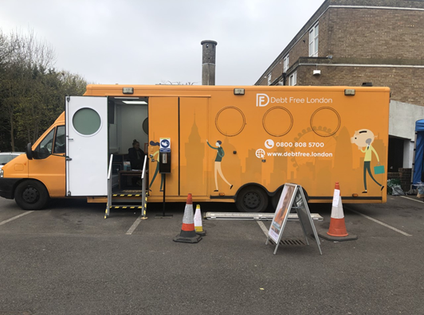
CHEAM & SOUTH SUTTON PCN INTEGRATED NEIGHBOURHOOD
Optimise – Empower – Include
THE LONELINESS PROJECT

Slide 9
3 Phases
Phase 1: Understanding loneliness better through interviews and analysis
Phase 2: Interventions to help reduce loneliness at the local neighbourhood level and creation of social hubs
Phase 3: Scaling up the loneliness project into a loneliness programme

Slide 10
Further questions used to explore loneliness
1. How long have you been feeling lonely? Was it triggered by a particular event or reason?
2. Is there a particular day or time in the week that you feel lonely eg weekends, evenings
3. How often do you see or speak to others eg family, friends, carers, neighbours, church, other?
4. Is there anything in particular that you feel would help you feel less lonely?
5. Would you be interested in being connected to a like-minded neighbour or community activity?
6. What sorts of activities interest you eg walking, green spaces/nature, arts activities, coffee mornings, quiz, bingo, educational talks, reading clubs, music, singing, cooking, sewing, gardening etc. (see mapping)
7. Would you be interested in volunteering to help others in the local community? Eg visiting or phoning a neighbour, joining your surgery’s patient participation group, helping out at community events etc.
8. Are you connected online via a phone or computer? If not, would you like to be? Would you like to learn how to use the NHS App? This may help you make appointments and access your medical records.
Notes:
Our questions used to explore loneliness in more detail

Slide 11
Understanding Loneliness
Loneliness can be triggered by life events eg bereavement, divorce, deteriorating health of self or partner, loss of job, pandemic but in some cases, there is no obvious trigger
In the survey, residents felt most lonely in the evenings
Many felt lonely despite speaking to or seeing family and friends regularly as it was the social connectedness they were missing
Some only saw a carer regularly and neighbours made a positive difference in many cases
There are different kinds of loneliness- loneliness related to not seeing family and friends, loneliness from not being in an intimate relationship and loneliness from not being involved in other group activities in the community.
The majority of residents (and carers) interviewed felt that meeting people and socialising (face to face where possible), would make a big difference to their lives.
Notes:
Holistic assessment: present areas

Slide 12
Thematic Analysis
Access to Care
Difficulty getting through to GP practice, lack of continuity of GP and carers, would like regular face to face appointments
Mental well-being support for families
While support for patients, there is a lack of support for their partner/children/grandchildren or they are unaware of it
Transport
Taxi-cards unreliable, dial-a-ride not practical for some, much more likely to go to activities if reliable transport options or if support to be accompanied
Podiatry
Community podiatry do not offer toenail cutting, expensive to pay for, leaving it can lead to pain, immobility, falls
Ear Syringing
Lack of access to general ear care and blocked ears with reduced hearing which has a major impact on participation in social activities
Form-Filling
Not sure how to access help for form-filling eg Blue Badge, Attendance and Disability Living Allowance, Taxi Cards so people often not applying for support that they could benefit from
Notes:
Holistic assessment: present areas

Slide 13
Discussion: qualitative methods
10 mins
Raise your hand on Teams or post in chat:
What experience do you have in using qualitative methods for evaluation?

Slide 14
Work through the measurement checklist, find out what data is already available and decide what data you need to collect
Step 1: Measurement Checklist
Can I create and agree an evaluation framework before my programme or intervention starts?
Am I clear about the outcomes I want to measure?
Will my outcomes enable me to demonstrate I have met the aims and objectives of the programme or intervention?
Do my outcomes align to at least one of the quintuple aims (better health, better experiences of care, cost-effective care, better staff experiences or improved health inequalities)?
Over what period of time do I anticipate to see change in outcomes or outputs ? Over a short period, (e.g., less than six months), intermediate period (6-12 months) or longer-term (over a year or more)?
Can I start my measurement before my programme or intervention begins so I have a baseline?
Can the people who go through my programme or receive my intervention be identified and tracked?
Can I take measurements repeatedly during my programme or intervention and in follow up?
Step 2: Talk to a local analyst – find out what data is already available for each of your outcomes
Step 3: Are there readily available, routinely collected, measures that closely align to the outcomes you want individuals to achieve?
I do not need to collect new data
Contact for access or support via SWL’s Health Insights Tool — isl.support@nhs.net
Example patient data:
Patient characteristics: age, sex, ethnicity, deprivation
Patient activity and clinical data: acute hospital, community health, mental health, IAPT, 111, referrals, waiting list
Other available secondary data sources
All the data I need is available for my outcomes
Next
Guide
I need to collect new quantitative data
I need some more data from things that can be quantified (e.g., activity, costs, diagnostic tests)
Next
I need to collect new qualitative data
I need some more data for things that can be described (e.g., experiences, thoughts, feelings, reflections)
Guide
Guide
Next

Slide 15
Qualitative data collection methods

Slide 16
Types of qualitative data collection methods
The following section focuses on semi-structured interviews, the most common method for collecting qualitative data for service evaluation. References and resources on other forms of qualitative data collection can be found here.
Open-ended questions in questionnaires/surveys
Focus groups
Data collection methods
Observations
Semi structured interviews
Guide
Case studies

Slide 17
A common approach: semi-structured interviewing – process steps and principles
The 2 'Ps' for successful semi-structured interviewing
Process
Use community engagement and data to inform intervention design
Design semi-structured interview questions or topic guide in line with what you are trying to learn or achieve from the interview
Undertake interviews
Transcription
Thematic coding
Generate a thematic map – themes, subthemes and relationships between them
Theory of change/logic model and causal mechanisms
Principles
Use open-ended questions to get descriptive answers
Specific ‘Why’ and prompt questions
Questions should help answer your evaluation questions
Use language that participants can easily understand
Keep questions as short as possible, ask clarifying and follow-up questions
Do not phrase questions as negative, keep neutral
Always ask important questions first
Be flexible with order
Know your guide backwards
Try for natural conversation and use active listening
Can be undertaken by telephone, face to face, or virtually
Are typically 45-75 mins long but this depends on the topic matter and the participant

Slide 18
Example interview questions for understanding physical activity behaviour change
What did you do as part of the programme?
How did you incorporate this into your day-to-day life?
How are things now regarding your physical activity habits?
For those who describe increased/regular physical activity engagement:
For those who describe an initial increase but then a decline in physical activity levels:
For those who describe no change in physical activity levels:
What has helped you to make these changes?
Have there been any challenges to you staying active?
Why have you made these changes?
Has anyone else helped you to stay active?
Did you have to make changes to other parts of your life to incorporate more physical activity?
How does your activity impact on you? Prompt — how does it make you feel?
Does it affect any other areas of your life?
In what way is physical activity important to your everyday life?
Why do you think your activity levels reduced?
Would you like to be doing anything differently?
If yes – what are the main things that prevent you from doing so?
How do your physical activity habits compare to times before the programme?
Would you like to be doing anything differently?
If yes – what are the main things that prevent you from being more active?
Grimmett el al, 2020; “Exploring maintenance of physical activity behaviour change among people living with and beyond gastrointestinal cancer: a cross-sectional qualitative study and typology,” BMJ Open Vol.10 (10): e037136

Slide 19
Example interview questions for healthy eating behaviour change
Defining Healthy Eating We often hear a lot about healthy eating. Can you share your thoughts on what you describe a healthy food choice to be? How important is it for you to make healthy food choices?
Perception of own food choice Every day we make food choices. How would you describe the food choices you are making currently? Can you describe from your experiences, times in your life where your food choices have changed?
Drivers of food choice Thinking broadly, what do you think influences people to make healthy food choices? Thinking about your own food choices and experiences, if you were to choose the top three things that influence you to make healthy food choices, what would they be?
Barriers of food choice Again, thinking more broadly, what do you think interferes with people making healthy food choices? Can you share your thoughts on what you think interferes with you making a healthy food choice? Do you have any thoughts or suggestions as to how these [barriers] can be addressed?
Mete et al, 2019; “What is healthy eating? A qualitative exploration,” Public Health Nutrition Vol. 22 (13): 2408-2418

Slide 20
The importance of community engagement in understanding need, designing and implementing interventions and evaluation
Community engagement has been defined as:
“Building active and sustainable communities based on social justice, mutual respect, participation, equality, learning and cooperation. It involves changing power structures to remove the barriers that prevent people from participating in the issues that affect their lives.” (NICE, 2008)
The role of community engagement
Understanding issues and their causes
Can support:
User-centred intervention co-design
User-centred implementation
User-centred evaluation design
Discover situational factors (context)

Slide 21
Methods for qualitative data collection in relation to community engagement
Information gathering
(Internet searches, site visits to identify local service providers and events where the community frequent) – attend events and get to know the local area, communities and stakeholders
Measure the impact
Of your community engagement
‘Go-along interviews’
Identified individuals show you around their neighbourhoods, tell you about local people and introduce their lives
Community working groups
Organised via the community champion
Snowball sampling
Community representatives help to identify and engage individuals within the community – including those who are not in touch with formal services
Community focus groups
Organised via the community champion
Community champions (or ‘influencers’)
Well-connected individuals who may believe in the rationale for intervention and can help recruit

Slide 22
Analysing Qualitative data

Slide 23
Analysing qualitative data
Qualitative data is non-numerical and unstructured. It could include text, such as open-ended responses to survey questions or user interviews, audio, photos and video, which all need to be transcribed into text files ready for coding and analysis. Coding is the process of labelling your data.
You can then identify themes in the data.
Codes and subcodes can then be analysed to understand the relationship between them.
Further information on other forms of qualitative analysis can be found here.
Grounded-theory building
Guide
Thematic analysis
Guide
Guide
Methods of qualitative analysis
Framework analysis
Observation methods
Ethnographic studies

Slide 24
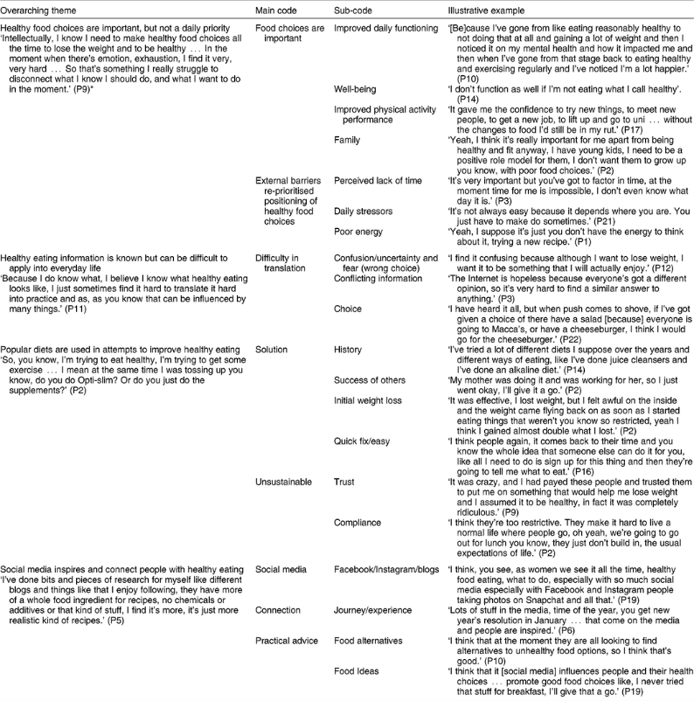
Coding and theme generation
Step-by-step approach
Step 1: Follow your plan as to whether you want to collect qualitative data before, during or after your intervention
Step 2: Decide whether you will use deductive or inductive coding. Deductive coding - you create a list of predefined codes, and then assign them to the qualitative data. Inductive coding is creating codes based on the data itself and labelling them as you go – see below
Step 3: Read through the data to give yourself an overview. Now assign a set of codes to statements and sections of text
Step 4: Repeat step 3, adding new codes and revising the code description as often as necessary
Step 5: Once all the text and transcribed data has been coded, go through everything again, check for inconsistencies and make sure nothing has been overlooked
Mete et al, 2019; “What is healthy eating? A qualitative exploration,” Public Health Nutrition Vol. 22 (13): 2408-2418

Slide 25
Example themes related to healthy eating
Disease processes
Emotions and psychological well-being
Social interaction
Support
Self-monitoring/ self-managing
Confidence
Motivation
The role of ageing
Incorporating physical activity into everyday life
Engagement
Competing demands
Activation
Health behaviour change
Staying power
Relationship and trust with health coach/dietician
Experience of intervention

Slide 26
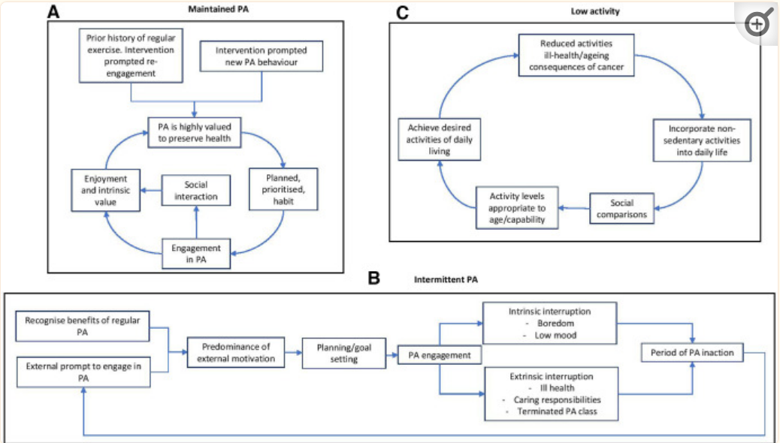
Thematic map analysis
Step-by-step approach
Step 1: Lay out all the themes identified from the coding exercise
Step 2: Establish whether the data illustrates no relationship, a correlation or a possible causal relationship between the themes, using the data that you have collected (this can be tested through controlled statistical analysis)
Step 3: Map out links between themes
Step 4: Review the map to help you understand why your intervention may or may not have been successful in delivering the intended outcomes
Step 5: The example shows for three different types of interventions;
those who maintained physical activity
those who were intermittently physically active and
those doing no or minimum physical activity, how this type of analysis can help you understand outcomes
Grimmett el al, 2020; “Exploring maintenance of physical activity behaviour change among people living with and beyond gastrointestinal cancer: a cross-sectional qualitative study and typology,” BMJ Open Vol.10 (10): e037136

Slide 27
Qualitative approaches informing quantitative approaches

Slide 28
Qualitative approaches inform quantitative approaches and vice versa
Inform hypotheses
Inform evaluation questions
Quant informing qual
Community engagement can inform your hypotheses that you then test through quantitative methods
Community engagement can inform the evaluation questions that you answer through quantitative and qualitative methods
Quantitative methods may influence the community/population of interest for community engagement or other qualitative approaches during evaluation
Quantification
Mixed methods
Understanding why
Quantitative methods can also help quantify how prevalent a particular view, issue or typology is that you identified during community engagement
Quantitative methods and qualitative methods (described as mixed methods when brought together) provide a more holistic and robust view of intervention efficacy – what has changed as a result of the intervention, how and crucially why
Only if you understand the why, can you confidently invest in scaling an intervention – and maximise the effective elements, whilst minimising the less effective elements.

Slide 29
Using qualitative methods to inform quantitative evaluation
Observation/ question
This is where qualitative engagement with stakeholders is essential - we need to use expert knowledge to formulate a logical hypothesis
Examples include:
Focus groups asking what key priority areas/cohorts should be
Interviews discussing personal experiences and the views of clinicians
Open-ended surveys with care givers asking about the most significant issues
Report conclusions
Research topic area
Analyse data
Hypothesis
Test with experiment

Slide 30
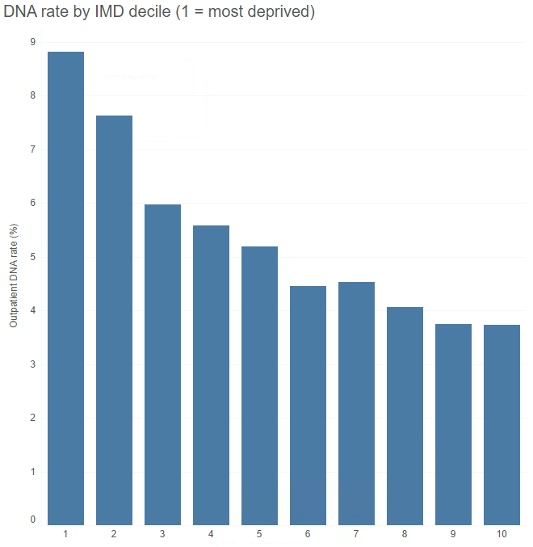
Case study: using quantitative analysis to inform qualitative investigations Quantitative analysis to find the “WHAT?” and Qualitative analysis for the “WHY?”
The ‘WHAT’ - Quantitative
Quantitative analysis undertaken at an Acute Hospital to understand inequalities in Outpatient missed appointments (DNAs)
Inequalities in DNA rates were found around:
Deprivation
Ethnicity
Age
Specialty
Time and day of appointment
Method of delivery (i.e., face to face vs virtual)
Distance from hospital
Qualitative work was carried out to understand WHY patients were missing their appointments
The ‘WHY’ - Qualitative
Stratified, open ended survey was carried out with 1000 patients who had missed an outpatient appointment, to understand their reasons
Participants were selected with focus particularly on cohorts with highest DNA rates from quantitative analysis
Typical answers included:
I forgot!
Didn’t receive an appointment letter (or couldn’t read it…)
Didn’t receive a text message
Too far to travel
Appointment was at an inconvenient time
I didn’t need the appointment anymore but forgot to cancel

Slide 31
Case study: using quantitative analysis to inform qualitative investigations Intervention implementation
Text all patients, allow for replies to cancel
Contact in additional languages
Call most at risk patients to confirm on day before
And then track DNA rates every month post intervention
Interventions
Social media campaigns
Offer more flexible appointment slots

Slide 32
Case study: using quantitative analysis to inform qualitative investigations Quantitative evaluation
Interventions
Carry out a qualitative analysis of patients who have received the interventions
Had telephone conversations with patients who have received text message reminders or phone calls
Asked patients if they were happy with the SMS/call service and if it helped to ensure they attended their appointment
Participant selection focused on groups with historically high DNA rates to ensure interventions are working for these target groups
Collated and analysed the responses using appropriate software/techniques
Use the findings to help further refine the interventions

Slide 33
Discussion: reflections
10 mins
Raise your hand on Teams or post in chat:
How useful might qualitative methods be for your evaluation?

Slide 34
Summary and next steps

Slide 35
Summary
Today we have:
Introduced qualitative data and analysis methods for evaluation
Explored the role of community engagement in evaluation
Understood how and when to apply these methods for intervention evaluation
Gained an understanding of how qualitative methods complement quantitative methods in a mixed approach
Marcus Green
Population Health Analytics Director
marcus.green@optum.com
You can access the Evaluation Toolkit for SWL using this form.
Notes:
Learning outcomes/objectives slide

Slide 36
Evaluation: How have we met the objectives of today’s session?
Log in to: Menti.com
Code: 9708 0449
Your views and feedback are important to us.
Please provide feedback via Menti regarding your experience in this session:
Scoring the session experience and outcomes (quantitative)
Feedback on what was good, and what would make this even better (qualitative)
Should you wish to discuss any part of your feedback, please contact:
laylabahramijovein@optum.com

Slide 37
Our Evaluation Journey: What’s next
Workshop 5: Quantitative Study Methods
9th January 2024
1400-1530
Virtual
Workshop 6: Evaluation Bias
16th January 2024
1400-1530
Virtual
Workshop 7: Value for Money
23rd January 2024
1400-1530
Virtual
Evaluation Framework
Communities of Practice
There will be a series of sessions for those involved in evaluating health inequalities programmes to come together for peer learning, best practice sharing, with evaluation champions sharing ideas and experiences.
Interested in being an Evaluation Champion?
It would be great to have people come forward to share their work so others can benefit. If you are interested in being an evaluation champion, please contact: Thomas.Herweijer@swlondon.nhs.uk
Communities of Practice
January 2024
March 2024

