Slide 1
Quantitative Study Methods
Evaluation Framework Workshop 5
9th January 2024

Slide 2
Agenda
Time | Item | Lead
(5 min) | Welcome and objectives | Marcus Green, Optum
(15 min) | Quantitative data to support analysis | Joe Green, Optum
(20 min) | Designing your quantitative evaluation | Marcus
(20 min) | Correlation vs causation | Joe
(20 min) | Measuring impact | Marcus
(10 min) | Wrap up Final thoughts Next steps | Marcus

Slide 3
Objectives for the session
We will:
Recap on the types of quantitative data and methods of collection
Explore different evaluation study designs
Focus on analytical approaches to disentangle causality from association
Consider methods to measure impact

Slide 4
Quantitative data to support analysis

Slide 5


Quantitative Evaluation: Strengths and Weaknesses
Strengths
Weaknesses
What is quantitative evaluation?
Can definitively answer the questions “How many” and “How much?”
Clear numerical / statistical results
Proven and verified statistical methodologies are available
Clear visualisations can be built to show findings including time-series graphs and variance charts
Able to use secondary data from various sources
Does not always answer the question “Why?”
Lacks softer intelligence
Non-analytical viewers may find the results harder to interpret than qualitative research
Using numerical methodologies, including data analysis and statistics, to assess whether or not an intervention has been effective in achieving its goals.

Slide 6


Quantitative Evaluation: Checklist and data types
Checklist:
Types of Data to Use
Research/evaluation question(s)
Agreed outcomes to test
Date(s) of intervention
Access to data for people who received the intervention OR a well-designed survey to record primary data
Historic data to benchmark future trends by
Costed data if you are aiming to evidence financial savings
Primary
Secondary
Collect yourself or by people you’re working with
Surveys, questionnaires, etc
Specific to what you need to answer your evaluation questions
However, can take longer to record and may not be feasible
Already recorded by other people / data recording systems
Can be large data which is ideal for in-depth, robust analyses
Faster to use
NHS has some of the largest and most robust datasets in the world
Information governance and ethical considerations

Slide 7

Secondary data sources
Access the Evaluation Toolkit here
Publicly available secondary data sources
Office for Health Improvement and Disparities: Fingertips: Public health profiles - OHID (phe.org.uk)
Office for National Statistics: Home - Office for National Statistics (ons.gov.uk)
NOMIS: Nomis - Official Census and Labour Market Statistics (nomisweb.co.uk)
NHS England: Statistics » Statistical work areas (england.nhs.uk)
NHS England: Statistical publications, open data and data products - NHS Digital
UK Data Service: UK Data Service
Locally available secondary data sources
Contact for access or support via SWL’s Health Insights Tool: isl.support@nhs.net
Measurement picklists
“Trusted measures: analytical resources for integrated care”, Nuffield Trust 2018 - https://www.nuffieldtrust.org.uk/resource/trusted-measures-analytical-resources-for-integrated-care
“Pic ‘n’ mix: an introduction to choosing and using indicators”, King’s Fund 2012 - How to commission for improving health outcomes: an introduction to choosing and using indicators (kingsfund.org.uk)

Slide 8
Quantitative measures
Focus on what and how many (numeric), include administrative sources such as Hospital Episode Statistics/Secondary Uses Service, GP practice data, surveys, questionnaires and structured interviews.
Type of measure | Example | Pros | Cons
Counts | The number of people attending a chair-based exercise class per month | Simple to understand | Makes comparison over time or between populations more difficult, especially if your denominator (e.g., population size or number of hospital beds) varies
Rates | The number of people A&E attendances per 1,000 population | Allow comparison over time and between population groups | Need to be calculated You need to know the total population size to convert back to a count
Ratios | Standardised mortality ratio: observed mortality: expected mortality | They are easy to interpret and to calculate and illustrate the relative quantity of one item in relation to another of the same units | The units must be the same on both sides of the ratio i.e., number of available hospital beds to the number of occupied hospital beds
Percentages | The percentage of people aged 25-34 who were admitted to hospital in the last 12 months | Allow comparison over time and between population groups | Need to be calculated and the numerator and denominator are not obvious
Averages | The number of GP appointments per patient per year | Allow comparison over time and between population groups | Need to be calculated
Process measures | These are also known as outputs and capture activities or things that are created through a service or intervention e.g., the number of care plans that were created | Help to identify that an intervention is live and to determine which patients are in receipt of the intervention. The type of measurement typically falls into one of the five above. | Do not represent outcomes in and of themselves
Outcome measures | The intended outcomes of the intervention should align to the goals and objectives of your programme e.g., reduction in A&E attendances for diabetic patients (the process measure, HBA1C levels, is distinct from the outcome measure for this intervention) | Indicates whether the intervention has delivered an intended outcome. The type of measurement typically falls into one of the five above. | The challenge is attributing an outcome measure as a true outcome of your intervention i.e., it was caused by your intervention and would not have occurred without the intervention

Slide 9

Using surveys to collect quantitative data – principles and consideration
Decide on how the survey will be administered e.g., online, by email, on mobile/device, on paper, interview led in person or over telephone
If digitally administered, think about the software you will use
Be clear on the purpose of the survey
Begin the survey with more straightforward questions that ease the respondent in
Ensure that every question relates to the overarching purpose
Design clear, concise and neutral questions
Make sure that all questions are direct and not convoluted
Try to avoid asking for two things in the same question
Try and use response scales where possible as these capture the intensity and direction of the response
Response scales should be balanced with equal number of response that are positive or negative e.g., excellent, very good, poor, very poor
Avoid yes/no and other binary type questions that limit the amount of data you collect
Keep the survey as short as possible
Consider pre-testing the survey before administering to your target population
Further reading
‘Writing an effective questionnaire’ – NHS England bitesize-guide-writing-an-effective-questionnaire.pdf (england.nhs.uk)
‘Guide to evaluation design, principles and practice’ – Midlands Decision Support Unit Guide to Questionnaires for Service Evaluation - Evaluation Works (nhsevaluationtoolkit.net)

Slide 10
Using surveys to collect quantitative data
Aligning process/output and outcome measures to questions
For example, through a logic model process, a long-term outcome of an intervention is identified — "Improvement in patients’ overall wellbeing scores”. If there is no existing data to measure, monitor and evaluate according to patient wellbeing, then there is the option of collecting data quantitatively via survey
There are many available wellbeing scales; one of the more simply and widely used is the ONS4: Personal Well-being ONS4 measures - Evaluating wellbeing (whatworkswellbeing.org) as seen below:
For each of these questions I’d like you to give an answer on a scale of 0 to 10, where 0 is “not at all” and 10 is “completely”
Overall, how satisfied are you with your life nowadays?
Overall, to what extent do you feel that the things you do in your life are worthwhile?
Overall, how happy did you feel yesterday?
On a scale where 0 is “not at all anxious” and 10 is “completely anxious”, overall, how anxious did you feel yesterday?
Other wellbeing measures:
What Works Centre for Wellbeing - Wellbeing Measures Bank - Evaluating wellbeing (whatworkswellbeing.org)

Slide 11
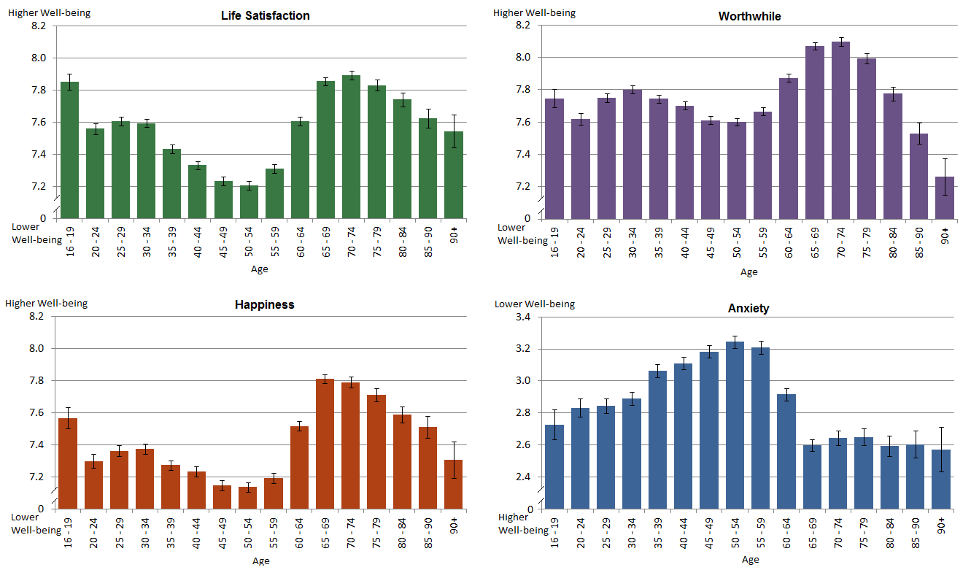
ONS4 Wellbeing Survey results for England 2016

Slide 12
Designing your quantitative evaluation

Slide 13
Study design approaches
Study Designs
Observational
Experimental
Populations
Descriptive
Analytic
“Ecological Correlation”
Individuals
Descriptive
Case Series
Analytic
Cross-Sectional Study
Cohort Study
Case-Control Study
RCT
Quasi-Experimental

Slide 14
Pre-experimental design
(before, during and after evaluation focusing only on an intervention group)
What is it?
A prospective evaluation where data is collected and analysed before the intervention is implemented (baseline). Further data is collected during the intervention and to track outcomes once the intervention has ended. There is no control group, and all measurement focuses on intervention participants.
How do you do it?
Agree your plan for data collection from intervention participants including baselining, tracking and follow up
Begin collecting data before the intervention starts
Track measures during and in follow up to the intervention
Analyse changes in the measures (using paired t-tests or repeated measures analyses of variance, like one-way repeated measure ANOVA)
Glossary
Guide
Advantages | Disadvantages
It is a relatively straightforward design You only need to track the outcomes of one group – the intervention group There are no ethical concerns with denying access to care for a control group | The lack of a comparison/control group means this design lacks internal validity and attributing outcomes to the intervention is difficult It is difficult to control for regression to the mean It assumes the experience of the intervention is the same for each participant and does not account for any changes to the intervention
A practical example
Tracking wellbeing scores three times for a wellbeing coach intervention; once before intervention, once at the intervention midpoint and once three months after the intervention has finished.
Paired Samples T-test in R - Easy Guides - Wiki – STHDA
11: Introduction to Repeated Measures - Statistics LibreTexts

Slide 15
Retrospective evaluation without a comparison group
What is it?
A backwards look at whether the intended outcomes of the intervention were achieved. This requires knowledge of the intended outcomes and the ability to identify the intervention group. It also requires the use of secondary data (data that has already been collected about the participants) to determine impacts.
How do you do it?
Identify all your intervention participants
Find the secondary data you can use for measures that align to the outcomes you’re interested in to show change over time
Your secondary data source needs to enable you to observe those measures for your participants pre and post intervention
Collect data in retrospect, asking intervention participants to recall information
Glossary
Advantages | Disadvantages
It is possible to evaluate your intervention even if it has already started It takes less time to complete and you do not have to wait for the results | It is not possible to prove your intervention caused the outcomes because you cannot tell whether participants would have experienced those outcomes without your intervention You cannot control for extraneous or confounding factors that may also impact the outcomes you are interested in Your participants may experience recall bias when you are collecting information about events, thoughts, feelings, emotions in the past You’re likely to be reliant on data collected for other purposes (secondary data) that may not align accurately to what you are trying to measure
A practical example
A falls prevention program has already begun and the metrics of interest are data points that can be found in existing secondary data sources such as GP records and hospital data.
Paired Samples T-test in R - Easy Guides - Wiki – STHDA
11: Introduction to Repeated Measures - Statistics LibreTexts

Slide 16
Quasi-Experimental Design
(intervention group compared with a matched control group)
What is it?
An evaluation that compares outcomes in your participants with a suitable control group that you choose (before, during or after your intervention).
How do you do it?
Identify your participants and collect baseline data (if applicable)
Track, monitor and feedback outcomes data during and after your intervention, in line with your plan and for both your intervention and matched control if you have one at the start
Match your control group according to age, sex, ethnicity, deprivation and comorbidities
Think through other variables or things you haven’t measured that might influence the effect you’re trying to evaluate (confounders) that you want to try and control for in multivariable regression analysis
Use the logic model or theory of change to inform the evaluation analysis
Undertake analysis to test for significance in outcomes between intervention and control group
Glossary
Advantages | Disadvantages
A control group can be easily selected by matching the characteristics of individuals and choosing a different geography There are no ethical concerns if a matched control group is selected retrospectively You can adjust for the effects of confounding variables using multivariable regression | May still be difficult to prove causality between intervention and outcome without random allocation to a control group The effect of confounders may be more likely in one of the groups because allocation is not random Evaluators may introduce bias in selecting the control group or might miss some of the potential confounding factors in selecting their control
A practical example
A health coaching intervention to encourage individuals to improve their diet and take physical exercise is offered to a cohort and outcomes for that cohort are tracked and compared to a similar control group chosen as the intervention is carried out.
Guidance on undertake multivariable regression can be found here - Introduction to Multivariate Regression Analysis (https://www.mygreatlearning.com/blog/introduction-to-multivariate-regression/)

Slide 17
Choosing control groups
The simplest and best control groups are often people with the same criteria from neighbouring geographies who have similar demographics and experience similar health challenges. When you look at the data, check to make sure there are no individuals included in both intervention and control groups.
People in the same segment, but different PCNs
or geographies
People in similar segments (or subsegments)
PCN 1
PCN 2
PCN 3
PCN 1
PCN 2
PCN 3
Segment 1
Participants
Participants
Segment 2
Control
Control
Control
Segment 3
Cohort
Control
Control
Cohort
Segment 4
Control
Potential challenges and opportunities:
Not viable with whole system intervention
Relies on having data for non-participating PCNs or geographies
Potential variance between control and intervention groups in terms of demographics and health risk
Important to compare the make-up of control and intervention groups closely to ensure they are comparable

Slide 18
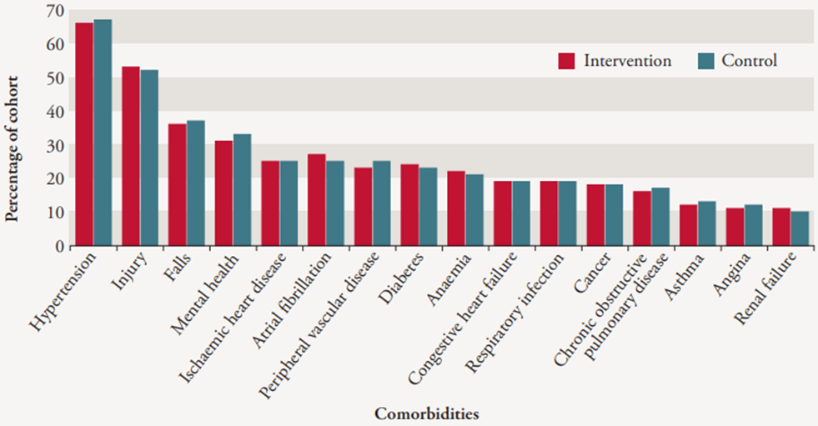
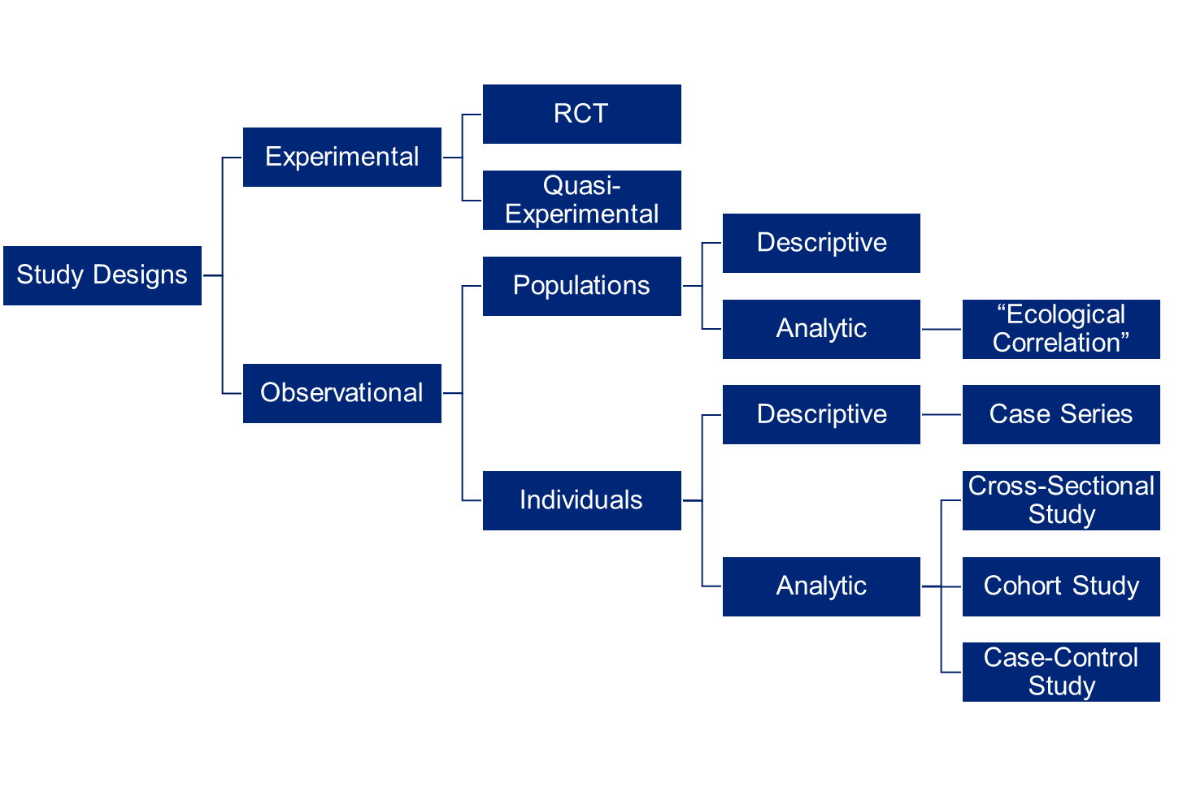
Generating matched cohorts
Potential challenges and opportunities:
Technically difficult – skillset required to run matched cohort models
Relies on having high quality whole-ICS data
Once it has been done, this technique is repeatable
Image source: https://www.nuffieldtrust.org.uk/research/evaluation-of-complex-health-and-care-interventions-using-retrospective-matched-control-methods

Slide 19
Experimental Design
(randomised in intervention group and control group selection)
What is it?
Known as a randomised controlled trial, experimental evaluation involves random allocation of individuals to the intervention or the control group.
How do you do it?
Find people to enrol in your study who meet your eligibility criteria
Randomise this group to intervention or control (no intervention), or to two different interventions if you want to compare two options and it is not possible to have a control group
Track and monitor outcomes between the two groups
Analyse and test if outcomes are statistically significantly different between the two groups
Glossary
Advantages | Disadvantages
Random assignment of individuals to the intervention vs control group makes it more likely confounding variables affect each group equally The effects of selection bias are reduced through random allocation You can compare two different interventions by having a well- matched group of people randomly assigned to each | There are significant ethical concerns with assigning individuals to a control group who do not receive an intervention that may benefit them – ethics approval will be needed to proceed Seeking ethical approval can be time consuming Evaluation requires more significant investment of resources compared to other designs Evaluation requires a larger number of participants in the groups being compared
A practical example
Random assignment of individuals either to StopAdvisor (interactive website for smoking cessation) or an information-only website about smoking cessation.
https://www.gov.uk/guidance/randomised-controlled-trial-comparative-studies

Slide 20

Discussion:
5 mins
Raise your hand on Teams or post in chat:
Do you have experience of using any of these types of evaluation study? Which do you think are most appropriate for your work?

Slide 21
Correlation vs causality

Slide 22


Slide 23
Correlation vs Causation - definitions
Correlation:
In statistics, correlation or dependence is any statistical relationship, whether causal or not, between two random variables or bivariate data.
Causation:
Causation indicates that one event is the result of the occurrence of the other event; i.e. there is a causal relationship between the two events. This is also referred to as cause and effect.

Slide 24
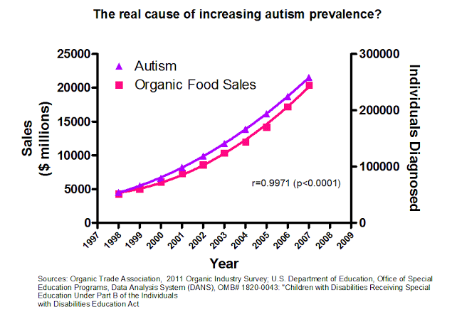
Correlation does not equal causation – spurious correlation
In statistics, a spurious correlation refers to a connection between two variables that appears to be causal but is not.
The logical interpretation of the graph on the left is that eating organic food causes autism.
However, this coincidental correlation is caused by the fact that autism has been better diagnosed, recorded, and reported since organic food became more popular in the 1990s.

Slide 25
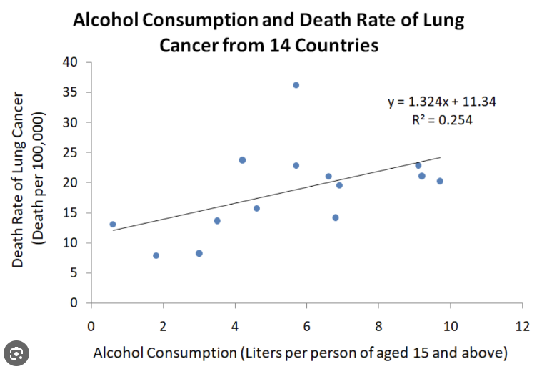
Correlation does not equal causation - Confounding
A confounder is a variable that influences both the dependent variable and independent variable, causing a spurious association.
The logical interpretation of the graph on the left is that alcohol consumptions causes lung cancer.
However, the true cause of 90% of lung cancers is smoking. But as people (and countries) who drink more alcohol are also likely to smoke more, smoking is the confounding variable.

Slide 26
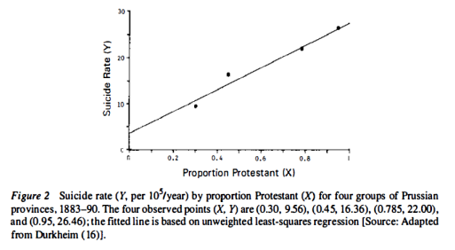
Correlation does not equal causation - Ecological fallacy
The ecological fallacy is the error of attributing the characteristics of a population to an individual.
The logical interpretation of the graph on the left is that protestants are committing suicide.
However, it is in fact Catholics committing suicide, who were often marginalized or even persecuted when living in pre-dominantly Catholic provinces.
Durkheim E. Suicide, (1897)

Slide 27

Questions of causality
Causal questions are difficult to answer in the real world. Consider three examples:
Industrial experiment: causal inference is straightforward because laptops are identical.
Clinical trials: causal inference is less straightforward because people aren’t identical. But randomised control trials ensures treatment/control groups are comparable on average.
Epidemiology: causal inference is challenging, because people are not identical and randomisation is typically not possible. How close can we get to having comparable treatment/control groups?
We have a causal question: does our treatment differentially affect subjects’ outcomes?
Industrial experiment: does water break laptop keyboards?
Clinical trials: does a drug decrease blood pressure?
Epidemiology: does smoking worsen lung health?

Slide 28
Evaluation: limitations, documentation and building confidence
Was it a good use of resources? / Did it work? / Should we do it again?
Building a defensible argument
Evaluation documentation
Knowledge, awareness and transparency over strengths and weaknesses
Data, assumptions, methods, results
The reader must be able to critically engage with information to draw own conclusions based on the limitations
What else would give confidence?
Iterative improvement
Building confidence
Data quality – improvements over time
Credibility / sample size / power
Numbers to treat
Using the Logic model assumptions
Causality - Bradford-Hill Criteria
Well, it depends?
Strength
Specificity
Plausibility
Coherence
Experiment
Analogy
Consistency
Dose Response
Temporal Sequence
On what?
…
“In what circumstances can [one] pass from [an] observed association to a verdict of causation?”
- Bradford A. Hill
Further reading: Applying the Bradford Hill criteria in the 21st century: how data integration has changed causal inference in molecular epidemiology - PMC (nih.gov)

Slide 29





Hypothesis testing
Hypothesis (H₁)
Null hypothesis (H₀)
A hypothesis, in a scientific context, is a testable statement about the relationship between two or more variables or a proposed explanation for some observed phenomenon
A null hypothesis is a type of statistical hypothesis that proposes that no statistical significance exists in a set of given observations. It is true until you disprove it.
Testing your hypothesis
Conclusion – accept or reject your hypotheses
Apply an appropriate statistical model to your analysis. Compare cohorts, or possibly time periods, and use significance to see if your outcome measures have changed
In your summary, state whether or not you accepted your hypothesis. This is a binary measure of the effectiveness of your intervention (or one aspect of it).

Slide 30

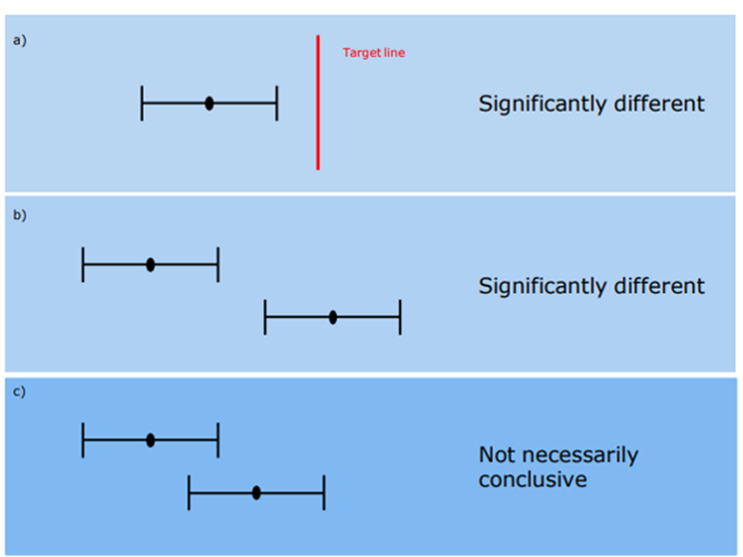
Confidence intervals
What are confidence intervals?
A measure of the statistical precision of an estimate and shows the range of uncertainty around the calculated estimate.
Lower and upper 95% confidence intervals are calculated.
At the 95% confidence level, over many repeats of a survey under the same conditions, one would expect that the confidence interval would contain the true population value 95 times out of 100.
Narrower confidence intervals (difference between lower and upper interval) indicate a more precise estimate.

Slide 31
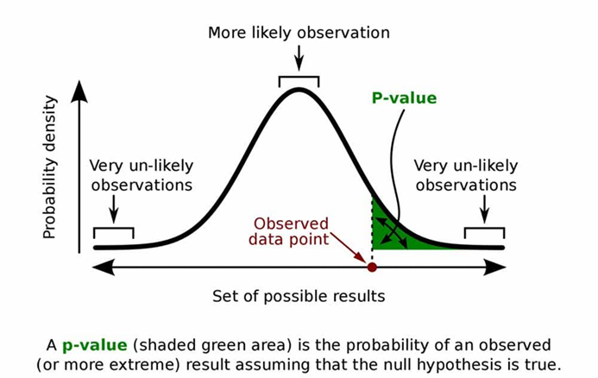

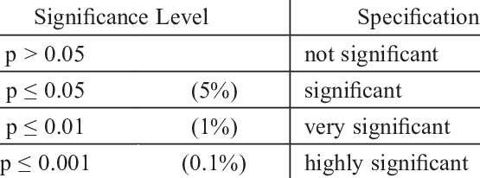
Significance and P values
What is statistical significance?
Statistical significance is usually denoted by a p-value, or probability value. Statistical significance is arbitrary – it depends on the threshold, or alpha value, chosen by the researcher. The most common threshold is p < 0.05, which means that the data is likely to occur less than 5% of the time under the null hypothesis
It is importance to put statistical significance in context alongside other types of significance, such as financial significance and clinical significance. Just because something has changed statistically, it doesn’t mean it will be life-changing to a patient’s health or the financial situation of an Integrated Care System

Slide 32
Population sizes and Power of studies
Key points:
Statistical power, or sensitivity, is the likelihood of a significance test detecting an effect when there actually is one.
A true effect is a real, non-zero relationship between variables in a population. An effect is usually indicated by a real difference between groups or a correlation between variables.
High power in a study indicates a large chance of a test detecting a true effect. Low power means that your test only has a small chance of detecting a true effect or that the results are likely to be distorted by random and systematic error.
Power is mainly influenced by sample size, effect size, and significance level. A power analysis can be used to determine the necessary sample size for a study.

Slide 33
Measuring impact

Slide 34

Baselining
The purpose of a baseline study is to establish a starting point for monitoring and evaluating the impact of an intervention or project. It provides a clear understanding of the current situation, identifies gaps, and provides valuable insights that guide the development of appropriate interventions and the establishment of indicators to track progress towards achieving desired outcomes. The baseline study serves as a reference point against which progress can be measured and evaluated throughout the project cycle. The following are some of the specific purposes of a baseline study:
1. Establishing a Baseline: The baseline study provides a starting point for monitoring and evaluating the impact of the intervention. It provides a reference point against which progress can be measured and evaluated throughout the project cycle.
3. Establishing Indicators: The baseline study helps to establish the types of indicators to track progress towards achieving desired outcomes. The indicators help to measure the effectiveness of the intervention.
5. Measuring Impact: The baseline study provides data that is used to measure the impact of the intervention. It helps to identify the changes that occur as a result of the intervention.
2. Identifying Gaps: The baseline study helps to identify gaps in the current situation. It provides valuable insights that guide the development of appropriate interventions.
4. Developing Appropriate Interventions: The baseline study helps to identify the needs of the target population and provides insights that guide the development of effective interventions.

Slide 35
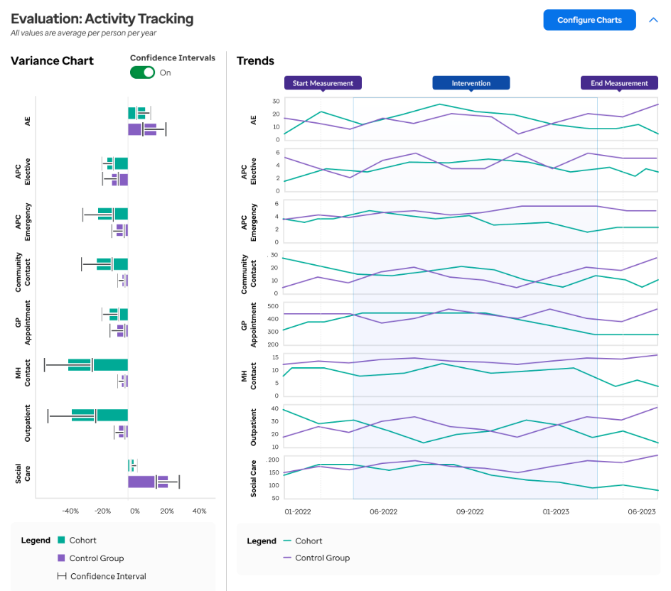

Tracking and follow up
If data refreshes regularly, it is wise to track changes every month to get an idea of trajectories.
However, it is worth being aware that it usually takes months or often years for real trends and results to become clear. It is important to make sure your stakeholders are aware of this from the outset (many commissioners aim for “in year savings” – this is normally not realistic).
It is wise to normally wait at least 12 months before attempting to write a full evaluation document, for example to control for seasonality.

Slide 36
Before and after differences
As described in the pre-experimental and retrospective design slides, there is a need to examine changes in measures over at least two points in time – usually before and after intervention. This can be done simply by comparing the average in a measure for the intervention group.
Example – the average wellbeing score on a 1 to 5 scale in the intervention group was 3.2 before intervention and 4.1 after intervention. So, we can say that the wellbeing score increased by 0.9 points on the scale.
However
This form of straightforward comparison does not tell you whether the difference is down to anything other than chance.
That can be tested using a paired t-test. The paired t-test is one of the more rigorous methods for comparing the difference in measures pre and post intervention.
A paired t-test assesses whether the difference is statistically different (i.e., not just due to chance)
It can be used to compare the average (mean) difference between pairs of measurements
Paired Samples T-test in R - Easy Guides - Wiki – STHDA
11: Introduction to Repeated Measures - Statistics LibreTexts

Slide 37
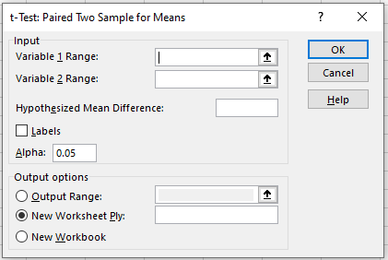
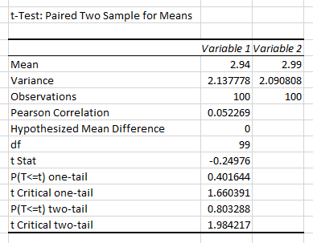
How to undertake a paired t-test in Excel
If you don’t have access to the Data Analysis under the Data tab in Excel, you will need to download the Analysis Toolpak which is free - https://www.statology.org/how-to-load-the-analysis-toolpak-in-excel/
Select Data Analysis and then the t-Test: Paired Two Sample for Means
Input your first set of measures under Variable 1 Range and second set under Variable 2 Range
Hypothesised mean difference is your null hypothesis which would typically be that there is no difference between the means and you are looking to disprove this – therefore the value would be ‘0’
Then choose where you would like to output the results under Output Range
In this example, we have 100 intervention participants with a wellbeing score between 1 and 5
The outputs will look like this
You can see the mean score in each sample (2.94 before intervention and 2.99 after intervention), the variance (a measure of spread) and number of observations
The important statistics here are the P two-tail and t Critical two-tail. The P two-tail shows whether the difference in means is significant – a value of less than 0.05 indicates that it is. In this example, the difference is not significant and therefore we can say that the change in the wellbeing score is as likely to be down to chance as it is the direct result of the intervention and therefore the positive change cannot be attributed to the intervention itself
The Pearson Correlation is a measure between -1 and +1 that indicates the strength and direction of the correlation between the means
There is more information here about how to undertake this test in Excel — How to Conduct a Paired Samples t-Test in Excel - Statology
There are other approaches for comparing differences between three or more observations as mentioned in the pre-experimental design slide. One such example is the ANOVA one-way repeated measure. There is more information on how to conduct such an analysis here - 11: Introduction to Repeated Measures - Statistics LibreTexts

Slide 38
Summarising your quantitative evaluation
Checklist:
Pick out the key points. If you can do a 3 or 4 bullet point summary to start with, the reader will quickly understand the key results. Add more depth afterwards.
Go back to your research question / hypothesis / outcomes. Did your intervention achieve them? Was it clear? Was it statistically significant?
Were there any issues in the analysis that made the results difficult to interpret? Discuss why, and what this might mean?
Crucially, does your evaluation suggest your intervention was a success? Would you recommend continuing it? Expanding it? Modifying it? Stopping it? This is what commissioners and key decision makers will want to know.
Add any recommendations for further evaluation and analysis, such as follow up studies further down the line, or additional metrics to test.

Slide 39
Quantifying effect size between your intervention and control group in quasi-experimental design
Effect size can be used to measure the standardised size of the difference between the intervention and control group for any given measure of interest
The P-value alone only indicates whether any change in measures between the two groups is statistically significant (i.e., is down to more than just chance) and does not indicate the magnitude of the effect
When your data is normally distributed – you can use Cohen’s D to test the magnitude of the difference in measures between the two groups. This is a good statistic to use alongside a paired t-test to demonstrate a statistically significant difference in outcomes you are trying to impact through intervention.
0.2 = Small effect size | 0.5 = Medium effect size | 0.8 = Large effect size
Considerations
The size of the sample (intervention group) — is the cohort big enough?
The precision of the measures (the construct validity) will also affect how well what you are measuring reflects the concepts

Slide 40
Quantifying effect size between your intervention and control group in quasi-experimental design – an example
A&E attendance rates in the intervention group compared with a control group:
Cohen’s d = (x₁ – x₂) / √(s₁² + s₂²) / 2
x₁ , x₂: mean of control group and intervention group, respectively
s₁, s₂: variance of control group and intervention group, respectively
A&E attendance rates per 1,000 individuals in the intervention group compared with a control group:
Cohen’s d = (3.4 – 0.9) / √(7.2² + 2.4²) / 2
= 0.465 indicating a medium effect size for the intervention
= Mean difference is significant with a reduction in 2.4 A&E attendances per 1,000 individuals

Slide 41
Summary and next steps

Slide 42

Summary
Today we have:
Recapped on the types of quantitative data and methods of collection
Explored different evaluation study designs
Focused on analytical approaches to disentangle causality from association
Considered methods to measure impact
Marcus Green
Population Health Analytics Director
marcus.green@optum.com
You can access the Evaluation Toolkit for SWL using this form.
Notes:
Learning outcomes/objectives slide

Slide 43
Evaluation: How have we met the objectives of today’s session?
Log in to: Menti.com
Code: 9873 7543
Your views and feedback are important to us.
Please provide feedback via Menti regarding your experience in this session:
Scoring the session experience and outcomes (quantitative)
Feedback on what was good, and what would make this even better (qualitative)
Should you wish to discuss any part of your feedback, please contact:
layla.bahramijovein@optum.com

Slide 44


Our Evaluation Journey: What’s next
Workshop 6: Evaluation Bias
16th January 2024
1400-1530
Virtual
Workshop 7: Value for Money
23rd January 2024
1400-1530
Virtual
Evaluation Framework
Communities of Practice
There will be a series of sessions for those involved in evaluating health inequalities programmes to come together for peer learning, best practice sharing, with evaluation champions sharing ideas and experiences.
Interested in being an Evaluation Champion?
It would be great to have people come forward to share their work so others can benefit. If you are interested in being an evaluation champion, please contact: Thomas.Herweijer@swlondon.nhs.uk
Communities of Practice
January 2024
March 2024

