Slide 1
Rapid Evaluation
Research Support Network session
26th February 2025

Slide 2
Creating a positive ‘thinking environment’
Start on a positive
Introduce yourself, state your role and share something that happened this week that was positive (professionally or personally).

Slide 3
Agenda
Time | Item | Lead
10am | Introduction and welcome | Marcus Green
10.15am | Why evaluate | Marcus Green
10.25am | Rapid evaluation steps Evaluation questions Data and measurement Analysing data | Marcus Green
10:30am | Rapid evaluation example | Marcus Green and Abi Carter
10:50am | Break
11am | Questions, troubleshooting and a group task Discussion in the round and a group task focused on the rapid evaluation of a community gardening project | Marcus Green and Evaluation Ambassadors
11:55am | Conclusions and close | Marcus Green
12pm | Lunch and networking | All

Slide 4
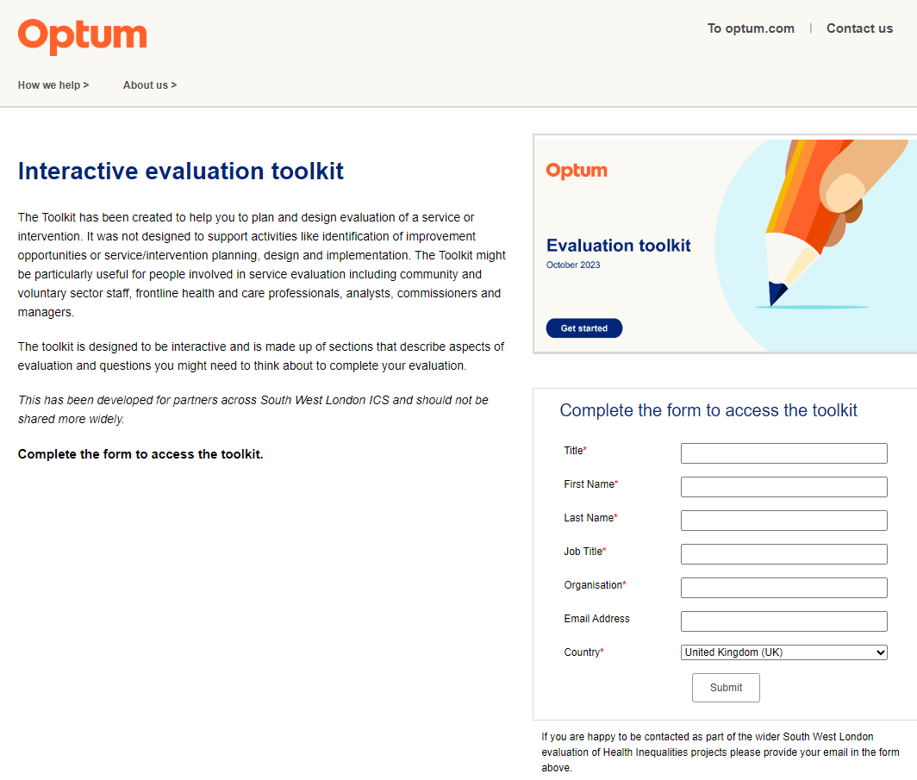
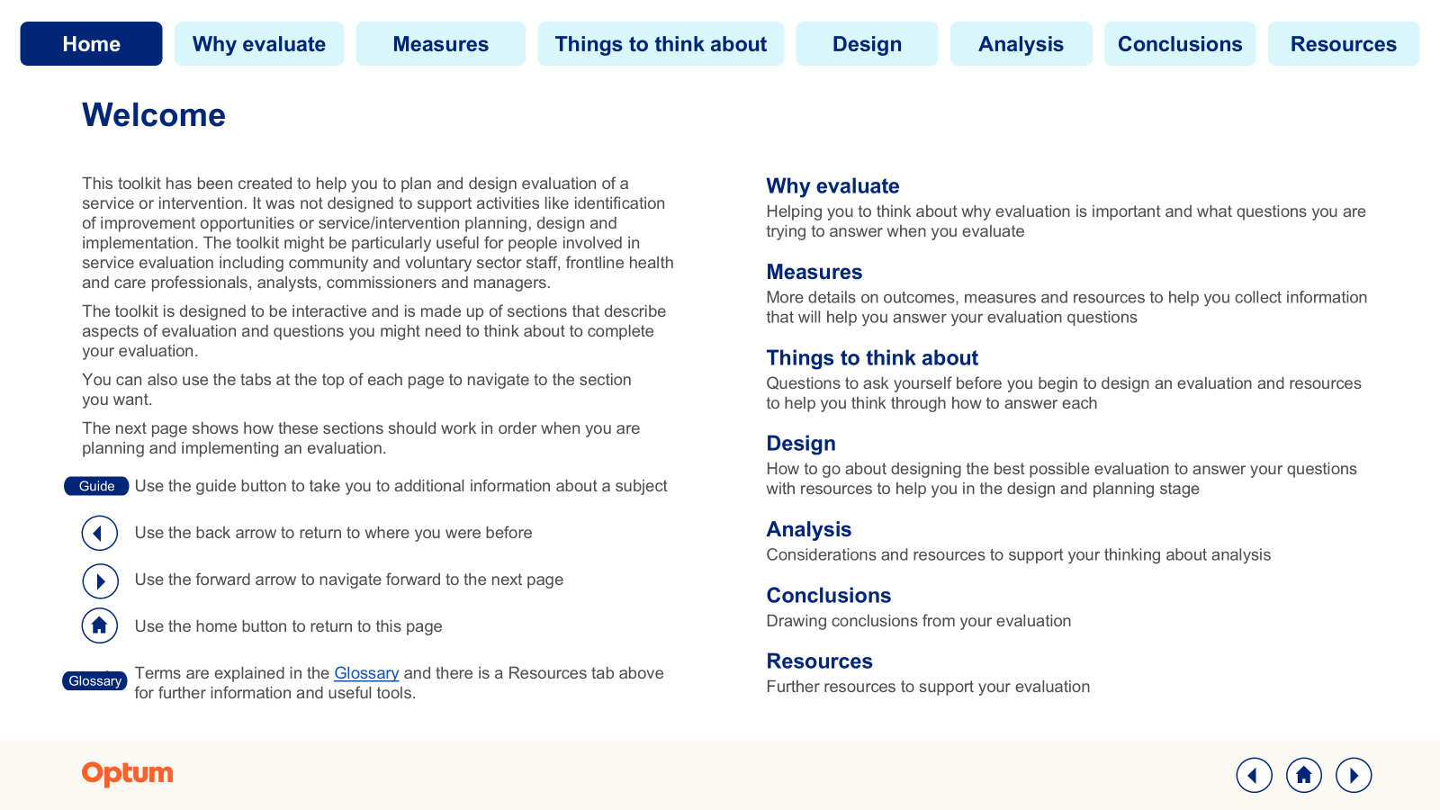
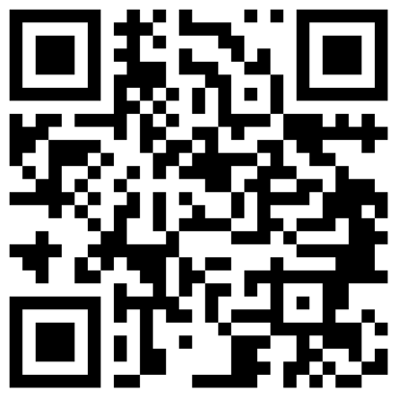
Evaluation toolkit
Simply visit - https://info.optum.co.uk/evaluation-toolkit
Scan QR code to access
OR
Visit: https://info.optum.co.uk/evaluation-toolkit

Slide 5
Why evaluate?

Slide 6
“Actions without intelligence is a form of insanity, but intelligence without action is the greatest form of stupidity in the world.”
Charles F. Kettering

Slide 7
Why is evaluation important for your programme?
Start with Why: Consider these three things to be clear about why evaluation is important to your programme
Why evaluate? What are the questions I’m trying to answer through evaluation?
What outcomes am I trying to achieve through my programme?
What are the priorities for my programme and are they agreed?
It is important to demonstrate that your service or intervention is having an impact. You may be looking to scale a pilot and need evidence that this would be worthwhile and to seek funding. Or perhaps you need to demonstrate to a commissioner that your service can continue to run.
Some of the evaluation questions you may be looking to answer could be:
What does my programme achieve compared to “do nothing” or standard care?
Who are the people that will most benefit from my programme or service?
How could evaluation of my service contribute to the existing evidence base in this area?
Have you created a logic model for your service which will support your evaluation?
What is the value of my programme or service?
What are the risks of my programme or service?
What does my programme look to achieve in terms of improving outcomes for people experiencing health inequalities?
Have you used your logic model to define outcomes and outputs and determined metrics for each?
Can you rank these according to importance to your stakeholders and measurability?
Do your stakeholders agree with your ranking/prioritisation?
Have you set expectations amongst stakeholders for when you will realise the intended outcomes?

Slide 8
Initial thoughts….
What does rapid evaluation mean to you?
What are the trade-offs you’d have to consider when evaluating with restricted resource and time?

Slide 9
Why Rapid Evaluation?
Traditional evaluations can take months or years—rapid evaluation delivers quicker insights
Ideal for VCSE organisations needing quick feedback for decision-making in constrained funding environments
Focuses on practical, real-time data collection with a clear impact
Notes:
Rapid evaluations are perfect for small-scale research where time and resources are limited. In this example, we’ll explore how a 1-month evaluation can provide meaningful insights into digital access barriers.

Slide 10
Key rapid evaluation steps

Slide 11
Evaluation journey
Evaluation questions
Set out the key questions you need answering that you can use to evaluate your intervention
Designing evaluation
Design your evaluation such that it answers your evaluation questions
Analysing collected data
Analyse your collected data to evaluate the impact of your intervention
Data and measurement
Decide your measures and what data to collect
Do this alongside designing your intervention
Resourcing evaluation and managing stakeholders
Engage, support and communicate expectations with all stakeholders needed for resourcing evaluation (i.e., in terms of data recording, data collection and data management)
Align on timeframe for realising outcomes
Sharing findings with audience
Share intervention findings from your data analytics in appropriate format for each group of stakeholders

Slide 12
Evaluation questions

Slide 13
What are the evaluation questions you are trying to answer?
Looking at an example:
‘Felix PCN are looking at 230 patients with obesity. This cohort of patients will be given lifestyle advice via a health coach, with the aim that they are empowered to improve their health by changing their lifestyle habits, e.g., increased physical activity levels, eating healthier foods’…
Questions we need to ask:
Programme effectiveness
Participants
Is the programme effective in supporting people to increase their levels of physical activity?
Is the programme effective in supporting people to eat more healthily?
How do we know the project/intervention made a difference? Can we use outcomes to help determine further intervention design and implementation?
What does the data tell us about the effectiveness of the programme?
What are the critical success elements of the programme?
Why do participants change their behaviour?
Why do some participants not change their behaviour or sustain positive behaviour change?
Are factors that are intrinsic to the individual relevant in whether the individual changes and sustains more positive health behaviour?
For rapid evaluation, stick to 2-3 questions max

Slide 14
Data and measurement

Slide 15
Data essentials checklist
If you want to evaluate an intervention, data is absolutely essential
It is important that all stakeholders understand this from the very outset of your intervention design
If data is not recorded or is unobtainable, a robust evaluation will be challenging
Meet with key data and analytics leads before projects begin to get foundations in place
Ensure clinical staff and others delivering the intervention have a mechanism for recording information about the intervention and coding individuals who receive the intervention

Slide 16
The “What” and the “Why” of the logic model
Where are you going? • How will you get there? • What will tell you that you have arrived?
The simplest form of a logic model:
INPUTS OUTPUTS OUTCOMES
Inputs: What is invested in the program (e.g., money, people, time, and space)
Outputs: What is done in the program (e.g., program activities) and the direct products that result from those activities
Outcomes: What results from the program (i.e., short- and long-term outcomes) measure what impacts, benefits, or changes result from the outputs and can be measured in changes in knowledge (e.g., pre- and post program surveys), attitude, skill, and behaviour (e.g., reduction in risk behaviours).
Can answer the following question: what difference did it make?

Slide 17
Make sure your metrics are SMART
S
Specific
What do I want to accomplish?
M
Measurable
How will I know when it is accomplished?
A
Achievable
How can the goal be accomplished?
R
Realistic
Does this seem worthwhile?
T
Timebound
When can I accomplish this goal?

Slide 18
Analysing data

Slide 19
Quantitative vs Qualitative Research
 | Quantitative | Qualitative
Definition | Involves collecting and analysing numerical data | Involves collecting and analysing non-numerical data
Purpose | To quantify variables and generalise results from a sample to the population | To understand concepts, thoughts, or experiences
Methods | Surveys, experiments, longitudinal studies | Interviews, focus groups, observations
Data | Numerical (e.g., statistics, percentages) | Textual or visual (e.g., transcripts, videos)
Analysis | Statistical analysis (e.g., mean, median, correlation, significance testing) | Framework analysis, thematic analysis, content analysis
Strengths | Objectivity, ability to generalise, precise measurement | Depth of understanding, context-rich data, flexibility
Examples | Measuring the impact of a new community programme on local employment rates, analysing survey results on volunteer satisfaction | Exploring the experiences of volunteers in a community project, understanding the challenges faced by a social enterprise through in-depth interviews

Slide 20
A qualitative analysis example - Framework Analysis
What is it?
A systematic method for analysing qualitative data using a structured framework
Used to identify key themes while maintaining a strong link to the original data
Why is it important?
Helps organise complex qualitative data into clear categories
Ensures transparency and consistency in data interpretation
Commonly used in policy and healthcare research
Key benefits
Provides a structured approach, making data easier to manage and compare
Facilitates systematic and transparent data analysis
Supports both deductive (theory-driven) and inductive (data-driven) approaches
How it works
Example
Familiarisation: Read and immerse yourself in the data.
Identifying a framework: Develop an initial coding framework based on research objectives or themes.
Indexing: Apply the framework systematically to label data.
Charting: Summarise data in a structured format using thematic matrices.
Mapping and interpretation: Identify patterns, relationships, and insights to draw conclusions.
Research question: What are the challenges faced by healthcare professionals in digital transformation?
Themes identified: Digital skills gap, resistance to change, workload concerns, patient engagement

Slide 21
Example
Rapid Evaluation

Slide 22
Example from Abi at Share Community

Slide 23
Rapid Evaluation Example: Bridging the Digital Divide
Bridging the Digital Divide: Research Project
Goal: Understand the challenges people face in accessing and using digital services.
Research question: What are the main barriers preventing people from accessing digital services, and what support do they need? Timeline: 1-month rapid evaluation. Methods: Participant questionnaires (before and after), Framework Analysis.
Notes:
This project is focused on digital inclusion, a key issue for social equity. Our research question is: What are the main barriers preventing people from accessing digital services, and what support do they need?

Slide 24
Pre-Research Questionnaire
Timeframe: Week 1 Objective: Capture baseline data on digital access and barriers.
Example survey questions:
Do you have access to a digital device? (Yes / No / Shared access)
Do you have internet access at home? (Broadband / Mobile data / No access)
What digital services do you struggle to use? (Banking, healthcare, government, social media, etc.)
Would you be interested in digital skills training? (Yes / No)
What is your level of confidence in using digital services? (1 ‘not very confident’ through to 5 ‘very confident’
Notes:
We start with a simple survey, capturing quantitative data. This helps us define the problem and tailor potential solutions. And understand who benefited post intervention.

Slide 25
Post-Research Questionnaire
Timeframe: Week 4 Objective: Measure changes in digital access, skills, and confidence.
Example Follow-Up Questions:
Have you learned new digital skills in the past month? (Yes / No)
Do you feel more confident using online services now? (More confident / No change)
What additional support would help you improve digital access? (Open-ended response)
What is your level of confidence in using digital services? (1 ‘not very confident’ through to 5 ‘very confident’
Notes:
The follow-up questionnaire helps us understand impact - did participants gain confidence? Do they still face barriers? This comparison is key in rapid evaluations.

Slide 26
Before and after differences
Examining changes in measures over at least two points in time – usually before and after intervention can be done simply by comparing the average in a measure for the intervention group.
Example – if the average digital confidence score on a 1 to 5 scale in the intervention group was 3.2 before intervention and 4.1 after intervention, we can say that the wellbeing score increased by 0.9 points on the scale.
However
This form of straightforward comparison cannot tell you whether the difference is completely attributable to the intervention
You could also ask this before and after question with a group of individuals who are on a waiting list
You could also undertake simple statistical testing on the before and after difference using a paired t-test. The paired t-test is a method for comparing the difference in measures pre and post intervention.
A paired t-test assesses whether the difference is statistically different (i.e., not just due to chance)
It can be used to compare the average (mean) difference between pairs of measurements
Paired Samples T-test in R - Easy Guides - Wiki – STHDA
11: Introduction to Repeated Measures - Statistics LibreTexts

Slide 27
Post-Research interview
Timeframe: Week 4 Objective: Understanding changes in digital access, skills, and confidence.
Example Questions:
What are some of the barriers that you have faced in feeling digitally confident?
Describe your experience of the digital skills classes
Have the digital skills classes had an impact on your confidence levels?
Notes:
The follow-up questionnaire helps us understand impact - did participants gain confidence? Do they still face barriers? This comparison is key in rapid evaluations.

Slide 28
Framework Analysis and findings
~70% struggle with digital access and cost
~40% feel they lack confidence using online services
60% would attend further free digital skills training if offered
Categorising qualitative data into themes
Theme | Example Quotes | Number of Mentions/ 25
Cost barriers | "I can’t afford broadband at home." | 12
Confidence issues | "I don’t know how to use online banking." | 9
Lack of access | "I share a phone with my family, so I don’t get much time online." | 5
Interest in further training | "I’d like free digital skills classes in my community." | 15
Notes:
This table showcases real-time findings from participant responses. Themes emerge from repeated concerns—helping us prioritise solutions. This data can inform funding applications, programme design, or advocacy.

Slide 29
Recommendations & Next Steps
Pilot a free digital skills workshop in partnership with local libraries
Advocate for subsidised broadband options with local internet providers
Develop an easy-to-read guide on essential digital services
Notes:
The rapid evaluation isn’t just about collecting data—it’s about driving action. In just 1 month, we have clear evidence-based recommendations.

Slide 30
A discussion in the round
Do you think the framework analysis technique is a useful method for understanding if your intervention has worked?
What are the other qualitative approaches you could use to evaluate when time pressured?

Slide 31
Group task

Slide 32
Group task: Rapid evaluation for a community project
Details
Scenario
You’re managing a rapid evaluation of a community gardening project with only one month to assess its impact.
In this project, local residents are invited to participate in gardening activities at a nearby park. The project aims to improve physical health, mental wellbeing, and community connections by encouraging people to spend time outdoors, learn about gardening, and work with others in their neighborhood.
Please work in groups to develop a rapid evaluation plan for this gardening project. Given the one-month timeframe, consider the following questions:
What should we measure? (E.g., quick indicators of physical health, mental wellbeing, community connections)
What data collection methods will work in a short timeframe? (E.g., pulse surveys, informal interviews, observational data)
How will we know if the project is successful within one month? (E.g., changes in engagement, self-reported wellbeing)
What are the limitations of a rapid evaluation? How might we compensate for them?
Available resources
Access to the project team (who designed the gardening project)
Support from the local council for data on park usage and community health
Quick feedback methods such as short surveys, focus groups, or informal interviews
Limited health data, but potential access to self-reported wellbeing measures
Stakeholders
The project team (running the gardening initiative)
Local residents (participating in the program)
Local council (who might continue funding the project)

Slide 33
Evaluation plan template
1
2
Evaluation questions
Data and measurement
Insert the questions your study is aiming to answer
Insert your outcomes and measures
3
4
Data analysis
Share findings with audience
Insert your type of data analysis techniques
Insert who and in what format you will share your findings with the audience

Slide 34
Accessing the Evaluation Toolkit

Slide 35
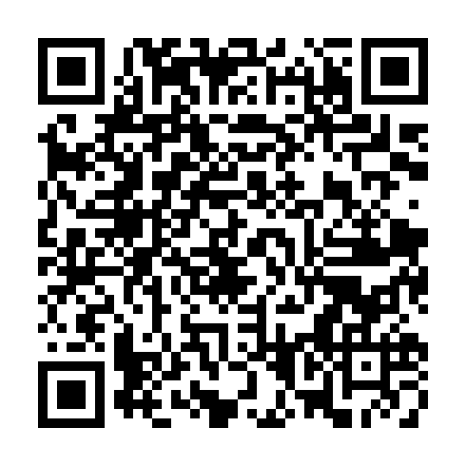
How to access the Evaluation Toolkit
Simply visit –https://nav.optum.co.uk/Evaluation-Toolkit.html
The landing page describes what the Toolkit is and its purpose
There is a form to fill in before you can access the Toolkit
The Evaluation Toolkit is for partners across South West London to access. Please do not share more widely as this has been purpose-built for South West London
Scan QR code to access

Slide 36
Please share you feedback with us!
Thank you for attending today’s workshop. Please follow the link below or scan the QR code to provide your feedback.
https://forms.office.com/e/F8Us7EfQQA

Slide 37
Appendix

Slide 38
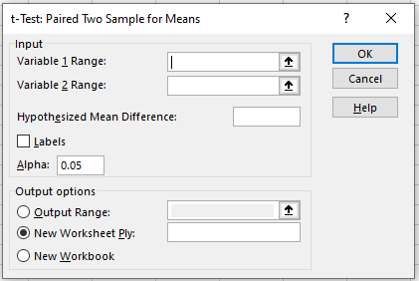
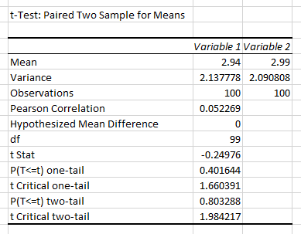
How to undertake a paired t-test in Excel
If you don’t have access to the Data Analysis under the Data tab in Excel, you will need to download the Analysis Toolpak which is free - https://www.statology.org/how-to-load-the-analysis-toolpak-in-excel/
Select Data Analysis and then the t-Test: Paired Two Sample for Means
Input your first set of measures under Variable 1 Range and second set under Variable 2 Range
Hypothesised mean difference is your null hypothesis which would typically be that there is no difference between the means and you are looking to disprove this – therefore the value would be ‘0’
Then choose where you would like to output the results under Output Range
In this example, we have 100 intervention participants with a wellbeing score between 1 and 5
The outputs will look like this
You can see the mean score in each sample (2.94 before intervention and 2.99 after intervention), the variance (a measure of spread) and number of observations
The important statistics here are the P two-tail and t Critical two-tail. The P two-tail shows whether the difference in means is significant – a value of less than 0.05 indicates that it is. In this example, the difference is not significant and therefore we can say that the change in the wellbeing score is as likely to be down to chance as it is the direct result of the intervention and therefore the positive change cannot be attributed to the intervention itself
The Pearson Correlation is a measure between -1 and +1 that indicates the strength and direction of the correlation between the means
There is more information here about how to undertake this test in Excel — How to Conduct a Paired Samples t-Test in Excel - Statology
There are other approaches for comparing differences between three or more observations as mentioned in the pre-experimental design slide. One such example is the ANOVA one-way repeated measure. There is more information on how to conduct such an analysis here - 11: Introduction to Repeated Measures - Statistics LibreTexts

