Slide 2
Outline of the Day
1pm Lunch & Networking
1:30pm Let’s find out more about the Research Support Network
1:40pm What are Evaluation Ambassadors
1:50pm Findings from our Research Cafes (basis for the network) with Dr Josephine Ocloo and Sapna Kurade
2:05pm What is the South London Clinical Research Network?
2:20pm What is the South London Applied Research Collaboration?
2:35pm What is the Health Innovation Network?
2:50pm HealthWatch & Research
3:00pm How can South London Partnership help?
3:15pm Abundance Project
3:30pm End of presentations

Slide 3
Welcome to the Network!
We want to build awareness of and expand opportunities to take part in research.
Meetings will be advertised on Eventbrite and on social media (Instagram, X and LinkedIn)
Follow @nhsswl on Instagram and @SWLNHS on X
Any thoughts for research methods to cover, please email SWL Health Improvement Team on HealthImprovementTeam@swlondon.nhs.uk
To register interest for future meetings, please use:
https://forms.office.com/e/D8dxcBFmuS

Slide 4
Evaluation Ambassadors

Slide 5
South West London’s Research Cafes

Slide 6
NIHR Clinical Research Network & Research Delivery Network
James Lyddiard, Network Director
RRDN South London
Notes:
These slides are for NIHR CRN staff to use when presenting at meetings and events. They are not intended to be used as a whole presentation (although they could be), but are for staff to pick from, so they can tailor their presentation to their audience. These general slides should be used alongside slides that have been produced specifically for meetings and events. There are empty slide templates at the bottom of the slide set.
These slides were updated in October 2021.
If you have any queries, please contact crncc.comms@nihr.ac.uk.

Slide 7
The UK Research Landscape
Invention
Evaluation
Adoption
Early-Phase Clinical Research
Late-Phase Clinical Research
Biomedical Research Centres
£0.5 billion
investment in relevant infrastructure to support clinical research at all points in the development pipeline
Clinical Research Facilities
Experimental Cancer Medicine Centre
HealthTech Research Centres
Clinical Research Networks
Patient Recruitment Centres
Applied Research Collaborations
Notes:
This slides shows where the Clinical Research Network fits within the NIHR structure.
The NIHR covers from bench to bedside research – including early phase clinical research to late phase clinical research and working with NHS trusts to adopt the research.
The Clinical Research Network (CRN) is part of the NIHR. NIHR CRN does the delivery – we get the studies set up (either in the NHS or social care), deliver the research and do all of the follow ups.
We provide researchers with the practical support they need to make clinical studies happen in the NHS (and public health and social care settings), so that more research takes place across England, and more patients can take part.
This practical support includes:
Reducing the “red-tape” around setting up a study (via the study support service).
Enhancing NHS resources by funding the people and facilities needed to carry out research “on the ground” – e.g. the CRN employs over 6,000 research nurses across the NHS.
Helping researchers to identify suitable NHS sites, and recruit patients to take part in research studies.
Advising researchers on how to make their study “work” in the NHS environment – this helps researchers deliver their study to time and target.
Other parts of the NIHR include Biomedical Research Centres, Clinical Research Facilities and Health Technology Cooperatives.

Slide 8
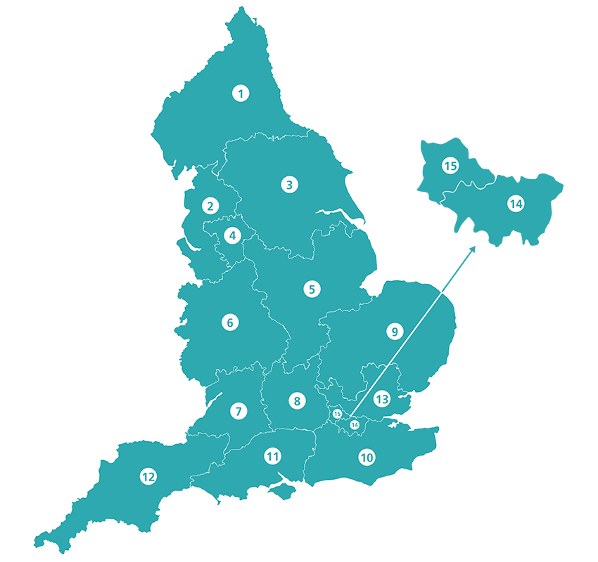
15 Local Clinical Research Networks
2014: a national network supporting clinical research
1 NIHR CRN Coordinating Centre
> 6,000 staff in NHS hospitals, health and social care settings
Relationships with public health and social care providers
Strategic funding allocations
Cross-NIHR work to address population health needs
Teams include
embedded and mobile research staff
learning and development
business intelligence
study support service
communications
public and patient engagement (PPIE)
1
National CRN Coordinating Centre
15
Local Clinical Research Networks
Notes:
This slide shows where the Local Clinical Research Networks are based in the UK.
There are 15 local Clinical Research Networks in the UK.
These LCRNs have been developed as a strategic response to local healthcare needs and are overseen by the National Coordinating Centre.
LCRNs have the ability to allocate funding and pilot cross-NIHR working for certain health needs.
They develop relationships with local populations, researchers, public health and social care providers (including all secondary care NHS organisations in England) and NHS providers and provide full coverage of secondary care NHS organisations in England.
Their teams operate across a range of specialties from embedded and mobile research staff, to learning and development teams, business intelligence, study support services, communications and PPIE.

Slide 9
30 Clinical Research Specialties
Stroke
Diabetes
Ageing Anaesthesia, perioperative medicine and pain management Cancer Cardiovascular disease Children Critical care Dementias and neurodegeneration Dermatology Diabetes Ear, nose and throat Gastroenterology Genetics Haematology Health services and delivery research Hepatology
Infectious diseases and microbiology Mental health Metabolic and endocrine disorders Musculoskeletal disorders Neurological disorders Ophthalmology Oral and dental health Primary care Public health Renal disorders Reproductive health and childbirth Respiratory disorders
Stroke Surgery
Trauma and emergency care
Cardiovascular disease
30
Clinical Research Specialties
Mental health
Notes:
This slide outlines the 30 specialties that the NIHR CRN covers.
The NIHR has widened its focus to include social care research that aims to improve the quality of life for users and carers through better social care provision and practice.
The 30 specialties are managed by are managed via six Specialty Cluster Leads and Assistant Specialty Cluster Leads.
The NIHR Clinical Research Network (CRN) has convened the NIHR Covid-19 Understanding and Elimination-Trials Implementation Panel (CUE-TIP) Group to provide cross-specialty oversight for the delivery of studies relating to COVID-19. The group provides strategic clinical oversight across the entire COVID-19 Portfolio..

Slide 10
Performing at Scale
Portfolio
Funding
People
£368m
6318
studies
> 6000
sites
c.6800 WTE (82% research delivery)
2022-2023 nearly 1 million participants recruited in England
Notes:
This slide provides some stats to show how theNIHR CRN is performing at scale. One stat per pillar has been pulled out. You can switch out the stats based on your audience and requirements.
Portfolio – in 2019/20 (England only):
4900 studies recruited, in 6051 individual sites
76% studies / 96% participants = non-commercial (vs commercial)
43% studies / 17% participants = interventional (vs observational / both)
Funding
LCRNs 2020/21 = £286m (core + ETC service) + £6.5m (additional) + £11m (VTF)
CRNCC 2020/21 contract value = £22m (exc. cross-NIHR services)
People
LCRNs = c.6800 WTE (82% research delivery)
CRNCC = 269 headcount (c.240 WTE)

Slide 11
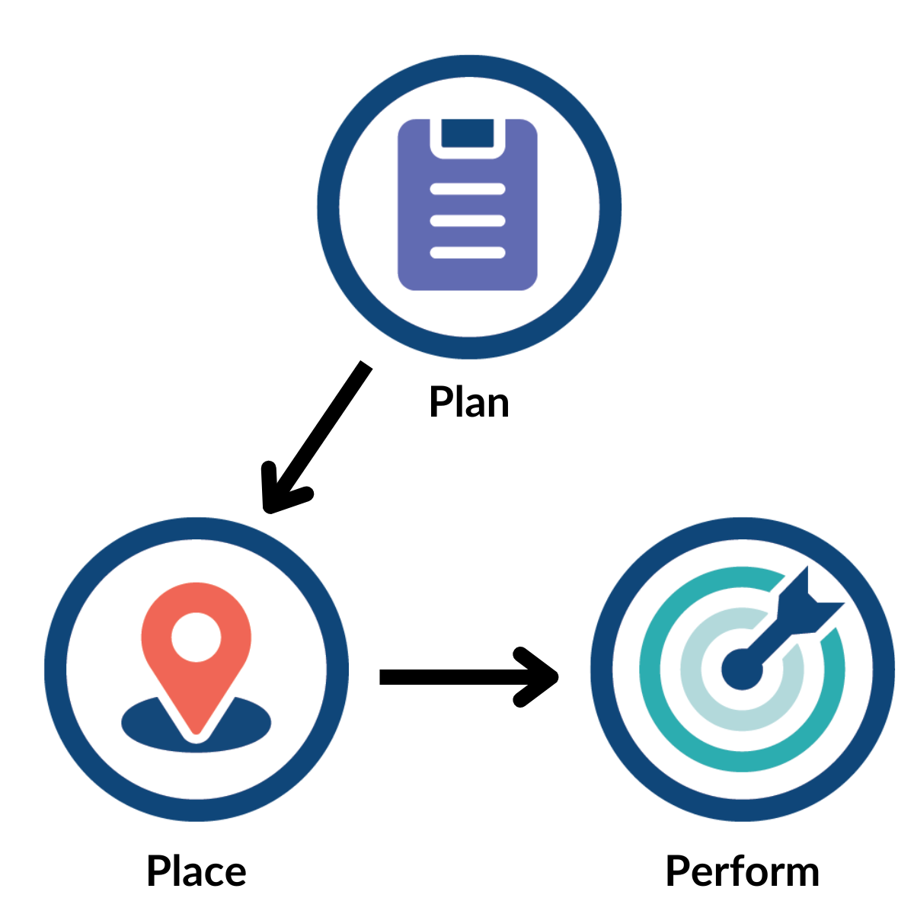
CRN Study Support Service
A wide range of support to help researchers plan, place and perform high quality research
Assistance with regulatory approvals, site identification and costings
Collaborations with researcher, R&D offices, funders, and other stakeholders to help deliver study to time and target
Notes:
This slide introduces the NIHR CRNs Study Support Service.
The Study Support Service is the NIHR CRNs main offering
The NIHR CRN supports researchers and the life-sciences industry in developing, setting up and delivering high quality research to time and target across the NHS and social care organisations (from 2018) in England
For any study that is eligible or applying for Network support, whether commercially or non-commercially sponsored, there are a range of services across the research pathway
Regardless of the location, study type, study size or therapy area of the research - consistent and high-quality support will be provided
Whether it is supporting with regulatory approvals, assistance with site identification, or guidance with the costings for a study, our dedicated advisors are here to help. This infrastructure provides unparalleled access to, and understanding of, the NHS research environment.

Slide 12
NIHR CRN Key Statistics 2022-2023
952,789
participants took part in health and social care research across England
This brings the total number of participants recruited over the last 5 years to
279,474 participants in primary care research
5,235,635
That’s the equivalent of
32,328 participants in commercial research
2,610
per day!
Notes:
This slide provides a dashboard of key statistics from 2022/23. The dashboard is editable, so the figures can be updated.
952,789 participants took part in health and social care research across England – that’s the equivalent of 2,610 per day!
This brings the total number of participants recruited over the last 5 years to 5,235,635.
279,474 participants took part in primary care studies.
32,328 participants took part in commercial studies sponsored by the life sciences industry.

Slide 13
NIHR CRN Key Statistics 2022-2023
X%
non-commercial studies
32,603 research participants completed the NIHR CRN’s Participant Research Experience Survey
6,318
Faster study setup and delivery
studies were supported by the NIHR CRN
X%
99.5%
93% said they felt valued by researchers
91% would consider taking part in research again
commercial studies
1,757
of NHS Trusts recruited to CRN studies
of these were commercial
44% of GP practices
Notes:
This slide provides a dashboard of key statistics from 2022/23. The dashboard is editable, so the figures can be updated.
In 2022/23, 6,318 studies were supported by the NIHR CRN in England, of which 1,757 were commercial studies sponsored by the life sciences industry.
A study is counted as 'supported by NIHR CRN' if it has been open to recruitment (and therefore in receipt of NIHR CRN support) at any point in that financial year, according to the study's Actual Opening and Closure Dates.
Patients from 99.5% of NHS trusts and 44% of GP practices across England took part in NIHR CRN supported research this year.
32,603 research participants completed the NIHR CRN’s Participant Research Experience Survey. 93% said they felt valued by researchers. 91% would consider taking part in research again.

Slide 14
CRN Impact: Delivering Breakthroughs
Better patient outcomes at research-active hospitals
UK’s flagship COVID-19 treatment trial - the RECOVERY trial
mortality for colorectal cancer 30% lower in first
30 days after surgery
Notes:
This slide shows two breakthrough case studies from the NIHR CRN. You can change the case studies based on your audience and requirements.
Case Study One: Better patient outcomes at research-active hospitals
Study tested whether hospitals with a high level of participation in bowel cancer trials have improved care outcomes.
Patients treated at hospitals with a high level of research had a mortality rate of 5%, compared to 6.5% in less research-active hospitals.
And 44.8% of patients were still alive five years after initial diagnosis, compared to only 41%.
Even patients who are not involved in trials benefit from care in research-active hospitals.
Published in BMJ GUT: http://gut.bmj.com/content/66/1/89
More information: http://www.nihr.ac.uk/news/patients-more-likely-to-survive-in-research-active-hospitals/4712
Link to the BMJ GUT journal paper - http://gutbeta.bmj.com/content/early/2016/10/14/gutjnl-2015-311308
Case study two: Randomised Evaluation of COVID-19 Therapy (RECOVERY)
The study is jointly funded between UK Research and Innovation (UKRI) and the NIHR - and is sponsored by University of Oxford.
RECOVERY was one of the first COVID-19 studies to be prioritised as urgent public health research by the Department of Health and Social Care. Consequently, delivery was expedited with the NIHR Clinical Research Network (CRN) playing a key role to set up the study in record time.
the first participant was recruited just 16 days after funding was awarded
within the first two weeks 1,000 participants were recruited
within three months 12,000 participants had been recruited from 176 different hospitals.
The RECOVERY trial is currently the world’s largest trial of potential COVID-19 treatments.
RECOVERY uses a multi-arm adaptive study design to assess new and existing/repurposed drugs as they are identified or become available. This includes:
Dexamethasone
A total of 2,104 patients were randomised to the dexamethasone arm of the study, receiving the drug in low dose, once per day for up to ten days. Data was compared with a further 4,321 patients randomised to usual care alone.
Data reported in the New England Journal of Medicine shows that dexamethasone reduces the risk of dying by one-third in ventilated patients, and by one fifth in patients receiving oxygen only. Overall, dexamethasone reduced the risk of 28-day mortality by 17%. There was no benefit among those patients who did not need respiratory intervention or oxygen.
More information: https://www.nihr.ac.uk/documents/case-studies/the-uks-flagship-covid-19-treatment-trial-the-recovery-trial/25358

Slide 15
CRN Impact: Delivering Results in Practice
STarT Back Study: a new stratified approach to managing back pain
Text2stop Study: smoking cessation programmes delivered
via text messaging
from GPs
Latanoprost UK Glaucoma Treatment Study:
RCT shows effective in visual field
preservation
Harmonie Study: monoclonal antibody
nirsevimab cuts hospitalisations
for RSV by 83%
Notes:
These three case studies show the results of research in practice. They show how research isn’t always about testing new treatments and drugs – it’s also about looking at how we can do things differently, to improve NHS quality and productivity.
STarT Back Study:
We supported the STarT Back study - a new stratified approach to managing back pain
Study showed improved patient outcomes and estimated cost savings of £34 per patient
New approach is now being applied across the country
NIHR CRN Primary Care used their local knowledge to hand pick all 10 general practices involved in the study
Information on the sTarTback tool is available from
http://patient.info/health/start-back-screening-tool-for-low-back-pain
https://www.keele.ac.uk/sbst/startbacktool/
Text2stop study
We supported text2stop study
Original recruitment strategy wasn’t attracting enough recruits
Most smoking cessation happens in primary care, so the Network enrolled general practices to contact suitable patients directly
The response was so overwhelming that the study closed four months ahead of schedule
Now, at www.nhs.uk/smokefree, people can register to receive free daily motivational text messages to help them quit
Pneumococcal disease vaccination study
Meningitis kills more children under five than any other infectious disease in the UK, with 50% of all cases occurring in this age group
Previously children in England were routinely vaccinated against seven of the most common types of streptococcus pneumoniae bacteria – the bacteria responsible for causing invasive diseases such as pneumonia, blood poisoning and meningitis
The challenge was to produce a vaccine that would include inactivated extracts from thirteen pneumococcal bacteria rather than just seven, giving children a much broader level of protection
Research into vaccinations by a global pharma company, assisted by the Clinical Research Network in 2011, developed Prevenar 13 – which was proven to be far more effective
The vaccination programme for all children in England has changed as a result.
Information available on NHS choices: www.nhs.uk/conditions/vaccinations/pages/pneumococcal-vaccination.aspx

Slide 16
https://bepartofresearch.nihr.ac.uk https://www.joindementiaresearch.nihr.ac.uk https://www.nihr.ac.uk/patients-carers-and-the-public/i-want-to-help-with-research/research-champions
Patient and Public Involvement and Engagement

Slide 17
Notes:
This is the launch year for the RDN, an opportunity to take forward the work of the CRN with improvements for the future.
We had feedback from stakeholders on how the work of the CRN could be improved. They said that its work could be confusing and a very different offer across the country, we need to be better at bringing in new commercial business, we need to avoid duplication and promote growth.

Slide 18
What is the NIHR Research Delivery Network here to do?
Support the successful delivery of high quality research, as an active partner in the research system
Increase capacity and capability of the research delivery infrastructure for the future
This means research can:
reach more people
address changing population needs
support the health and care system and the economy
become a routine part of care.

Slide 19
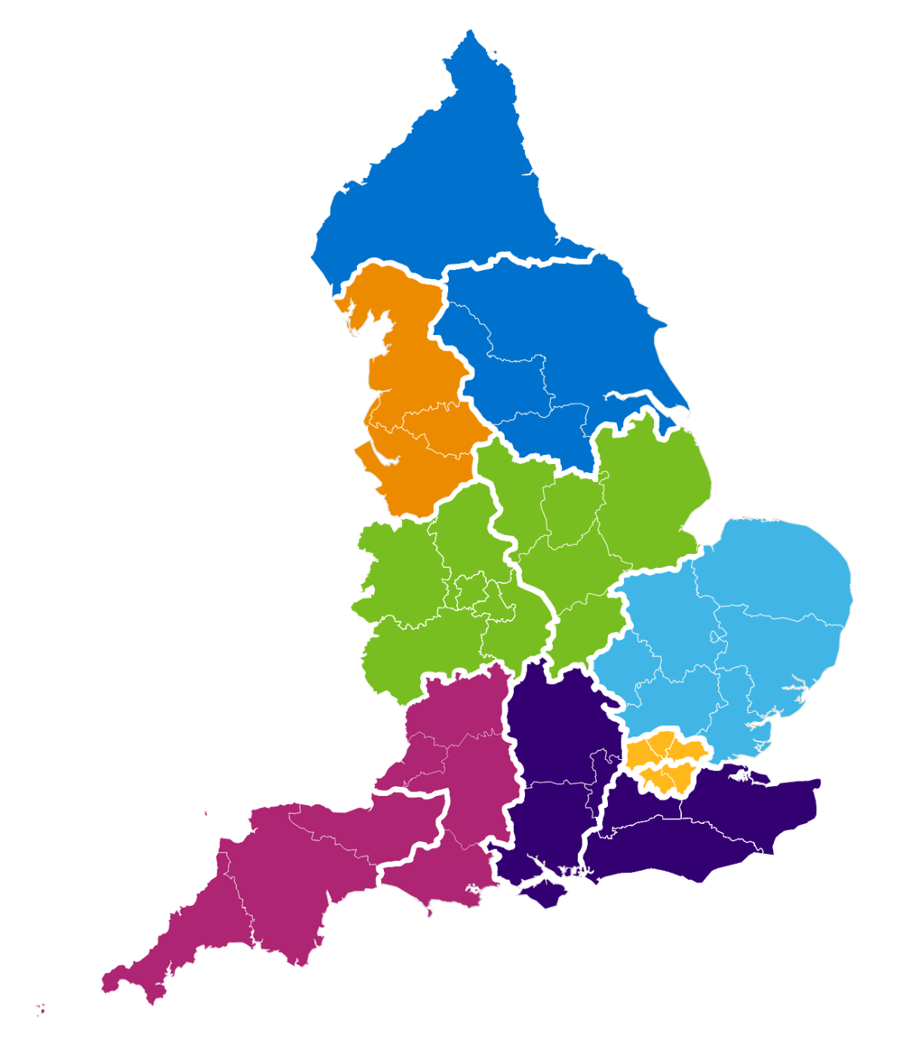
One single RDN
NHSE Region | New Regional Research Delivery Network
North East and Yorkshire | A | North East and North Cumbria
 | B | Yorkshire and Humber
North West | C | North West
Midlands | D | East Midlands
 | E | West Midlands
East of England | F | East of England
London | G | North London
 | H | South London
South East | I | South Central
 | J | South East
South West | K | South West Central
 | L | South West Peninsula
1
National CRN Coordinating Centre
A
B
C
12
Regional Research
Delivery Networks
D
E
F
G
K
I
H
J
L

Slide 20
Why are we transforming our services?
Customer & Internal Feedback
Success
NHS & Care
Partners
Research
Participants
Delivery Impact, Growth and Strategic development
NIHR
Response to
COVID-19
Portfolio RESET
post pandemic
Commercial
Partners
Continuous Improvement & Efficiency
Staff and
Investigators

Slide 21
How will we operate?
Policies
RDN vision
The Future of UK Clinical Research Delivery
2021
One organisation, providing consistent experience
Collective responsibility and joint leadership
Best Research for Best Health: The Next Chapter
2021
Life Sciences Vision
2021
Strategic development of research capacity and capability
Full response to the Lord O’Shaughnessy review into commercial clinical trials
2023
Collegiate and customer-focused partner
Continuous improvement, learning and value for money
Notes:
https://www.nihr.ac.uk/reports/best-research-for-best-health-the-next-chapter/34535#Bringing_clinical_and_applied_research_to_under-served_regions_and_communities_with_major_health_needs
https://www.gov.uk/government/publications/life-sciences-vision
https://www.gov.uk/government/publications/the-future-of-uk-clinical-research-delivery
https://www.gov.uk/government/publications/the-future-of-uk-clinical-research-delivery-2022-to-2025-implementation-plan/the-future-of-clinical-research-delivery-2022-to-2025-implementation-plan
https://www.gov.uk/government/publications/government-response-to-the-review-into-commercial-clinical-trials/full-government-response-to-the-lord-oshaughnessy-review-into-commercial-clinical-trials
Research delivery services need to align with NIHR RDN’s primary purposes:
(1) support the successful delivery of high quality research, as an active partner
(2) increase capacity and capability of the research infrastructure for the future

Slide 23
Thank you! Questions
Notes:
Questions at the end of the presentation.

Slide 26
SWL Research Support Network Launch
Alison White – Head of Innovation

Slide 27
Improving outcomes
Our mission
Speeding up the best in health and care, together
Driving down costs
Stimulating economic growth
Notes:
The 15 HINS operate as the “innovation arm of the NHS”.
We support our health and care partners to deliver improvements that:
Lead to better patient outcomes
Drive down the cost of care, and
Unusually for nhs organisations also
Stimulate economic growth
It is primarily due to this objective that HIN and UCLP set upi the DHLA programme, alongw ith other partner CWPLus and medcity

Slide 28
Working together for research and innovation in south London
How we relate
Academic Partners , the Applied Research Collaboration (ARC) South London and the Health Innovation Network (HIN) work collaboratively across the different stages of innovation from discovery to widespread adoption, using their unique skill sets.
Invent + Iterate
Evaluate
Adopt + Spread

Slide 29
KHP discovered new ways of integrating physical and mental health care in diabetes, as research evidence shows that diabetes is commonly associated with various types of psychological distress.
How does collaboration work in practice?
Innovation in diabetes
All three organisations are working together to improve outcomes for south Londoners in diabetes through innovation in education and a greater focus on mental health.
ARC South London’s research provided real world evidence on why south Londoners are missing out on vital diabetes education and revealed the potential for improvement if south Londoners could access education more flexibly, including offering more digital alternatives. Its applied research looked at local population needs in-depth and highlighted the need for education that is culturally relevant for people with African and Caribbean backgrounds.
Using this discovery and research, HIN has worked with south London health teams to develop and implement an innovative intervention called Diabetes Book & Learn, which also includes access to psychological support. This has radically improved access to patient education, increasing flexibility of education, increasing digital options and supporting the local ICSs to commission culturally relevant diabetes courses for people with African and Caribbean backgrounds.

Slide 30
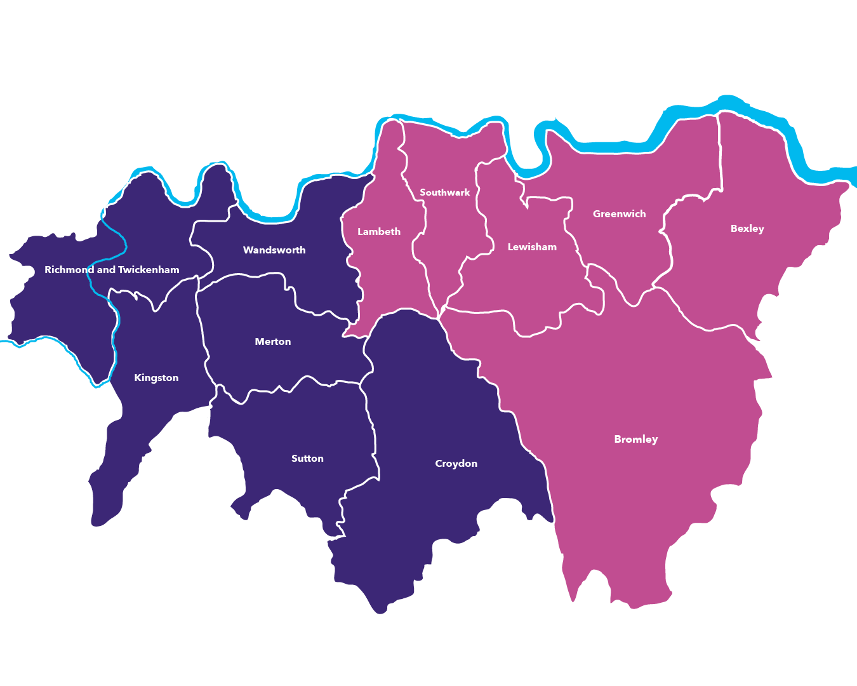
South London’s
Ecosystem
Community Trusts
NHS Trusts
Bromley Healthcare
NHS Hounslow and Richmond Community Healthcare
Royal Hospital for Neuro-disability
Your Healthcare
Croydon Health Services
Epsom and St Helier University Hospitals
Guy’s and St Thomas’
King’s College Hospital
Kingston Hospital
Lewisham and Greenwich
London Ambulance Service
Oxleas NHS Foundation Trust
St George’s University Hospitals
Mental Health Trusts
BioMedical Hub
South London and Maudsley
South West London and St George’s Mental Health
MedTech Hub
Mind and
Body Hub
Research and
education partners
Research partners
AI Centre for Value Based Healthcare
ICR: The Institute of Cancer Research
KITEC: King's Technology Evaluation Centre
LIHE: London Institute for Healthcare Engineering
MAISI: Manufacture of Active Implants and Surgical Instruments
NIHR Cardiovascular MedTech Co-operative
NIHR HealthTech Research Centre into dementia and brain health
NIHR King’s Clinical Research Facility
NIHR Maudsley Biomedical Research Centre
NIHR Policy Research Unity Mental health
NIHR St George’s Clinical Research Facility
REACT Institute
Goldsmiths University of London
King’s College London
Kingston University London
London South Bank University
Ravensbourne University London
Roehampton London
Royal College of Art
St George’s University of London
St Mary’s University Twickenham London
Warwick Business School
University of Greenwich
The London Cancer Hub

Slide 32
South London Partnership

Slide 33
VCSE & Abundance Project

Slide 34
One of our future sessions will be focused on where to find data for VCSEs and community researchers as a follow up of the event.
Superhighways also have some training sessions that might be relevant to community researchers coming up, see https://superhighways.org.uk/training-advice-and-technical/training/

