Slide 1
Welcome Address – Importance of Research to South West London
Katie Fisher, Chief Executive, NHS South West London Integrated Care Board

Slide 2
Welcome
Welcome to our 1st South West London Research Summit
The objectives of today are to:
  Showcase and celebrate the growth of health research that is happening in South West London across our academic institutions, our NHS organisations, local authorities, voluntary sector and communities
  Make connections
  Learn from each other
It has been 2 years since the set up of SWL Health Research Collaborative and 1 year since the start of the SWL Research Support Network
This talk covers the importance of research to South West London and the role the ICB plays

Slide 3

What is an Integrated Care Board?
Integrated Care Systems (ICSs) are partnerships of health and care organisations that come together to plan and deliver joined up services and to improve the health of people who live and work in their area.
42 ICSs were set up in July 2022 across England with a focus on prevention, better outcomes and reducing health inequalities
London has 5 ICSs – North West London, North Central London, North East London, South East London and South West London
Each ICS is made up of an ICB (Integrated Care Board) and an ICP (Integrated Care Partnership)
The ICS works on achieving four aims:
  Improve outcomes in population health and healthcare
  Tackle inequalities in outcomes, experience and access
  Enhance productivity and value for money
  Help the NHS support broader social and economic development.
The ICB role is changing to that of strategic commissioner this year

Slide 4

Importance of Research to ICSs
Research has an important role to play at an ICS level to improve population health outcomes for individuals and communities, particularly underserved communities.
    There is a mismatch between areas of high disease burden and where health research takes place.
    As an ICS, there is an opportunity to priority set and embed research into healthcare services so that local service challenges and opportunities are better understood.
The Department of Health and Social Care funds ~80% of clinical research through the National Institute of Health Research and this is focussed on patient and public benefit.
    Research activity has been shown to add value not just in producing evidence in the longer term but also to the provider organisations and their immediate users.
    It does not take up care resources as research activity is funded as is the support needed to undertake them in care environments.
There is also a strong economic case for health research. Nationally, for each £1 invested in research, there was a return of £19 in general economic benefit.
Under the Health & Care Act (2022), all integrated care boards (ICBs) have a legal duty for research.

Slide 5
Why is research & innovation important in South West London (SWL)?
  Benefits our Population: Being able to produce local research that is applicable and appropriate for our local SWL population not only improves our understanding of the population but it means we are better placed to address their needs.
  Improve community empowerment: Having people-centred research also makes it easier for patients, service users and members of the public to be involved in research, thereby helping us to better understand their needs and respond appropriately.
  Contribute to ICP priorities: Research can contribute financially to ICP priorities and attract investment and external research.
  Benefit Workforce: Staff satisfaction, recruitment and retention is higher among staff who are involved in research
  Improve Patient Outcomes: Active clinical academic research - and the changes to practice arising from it - is associated with improved patient and carer experiences and use of research evidence in commissioning decisions improves experience and outcomes.
  Improve value for money and efficiencies: Embedding evidence-based approaches from research transforms health and care. Improves the cost-effectiveness and cost benefits of services and interventions in SWL thereby providing savings across the system
  Improve Quality of Services: Quality improvement of health and care and population health through the applications of the evidence generated by research
  Reduce Health Inequalities: Research & innovation improve public participation and enables better working relationships with communities helping us to better understand communities and reduce health inequalities
  Enable Innovation & Gold Standard Care: Research is an essential part of healthcare generating evidence about effective diagnosis, treatment and prevention and investing in healthcare research infrastructure enables innovation (e.g. digital tools).

Slide 6
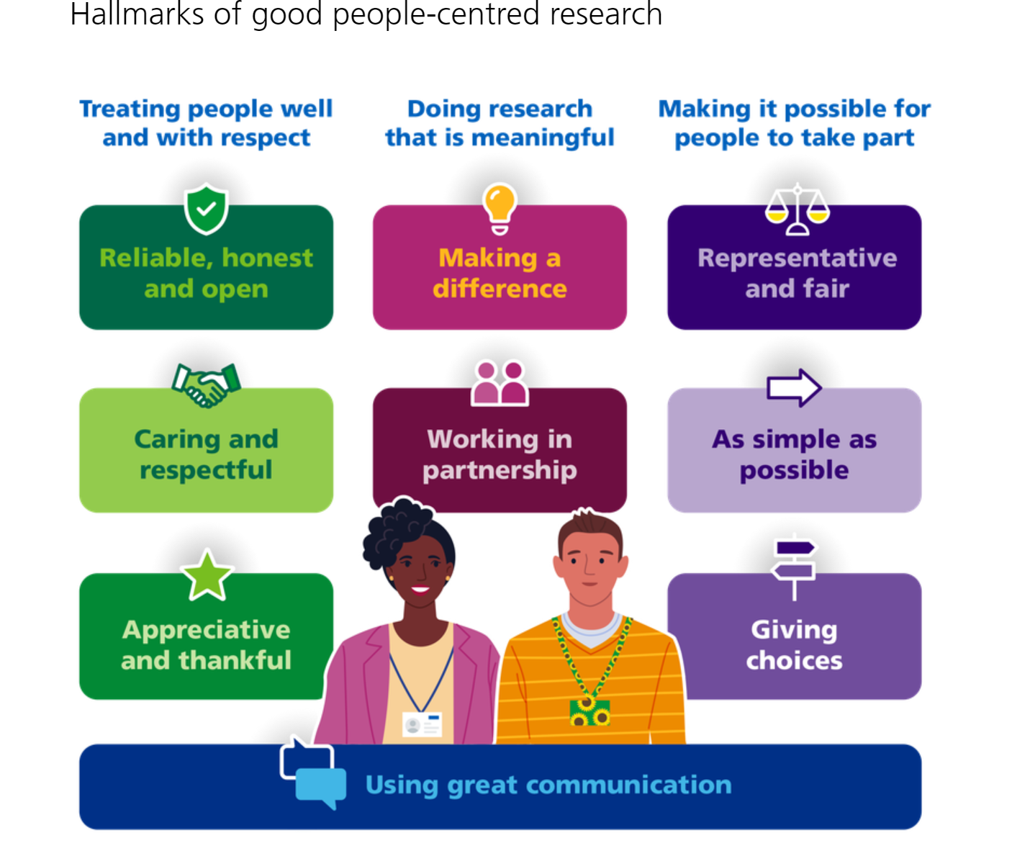
Why is research & innovation important in South West London?
The SWL ICB facilitates and promotes research across the 6 boroughs of South West London.
Here in South West London (SWL) ICS, we are putting our people central to our SWL People Centred Health Research Work Plan 2024-26 as we believe that clinical and other health research is for and about people.
Our plan focuses on:
  Growing our research capability & workforce in the ICS
  Better identification of our research needs and priorities
  Growing public participation & involvement
  Embedding an evaluation culture
  Implementation of research findings.
  Improving access to knowledge & data
Source: People-Centred Clinical Research - Health Research Authority (hra.nhs.uk)

Slide 7

Thank you!

