Slide 1
RESEARCH CAFÉ Enabling Local Public Health Research in South West London
12:00 – 13:00
Facilitator: Sam Green
Speakers: Sally Hargreaves and Rachel Flowers

Slide 2
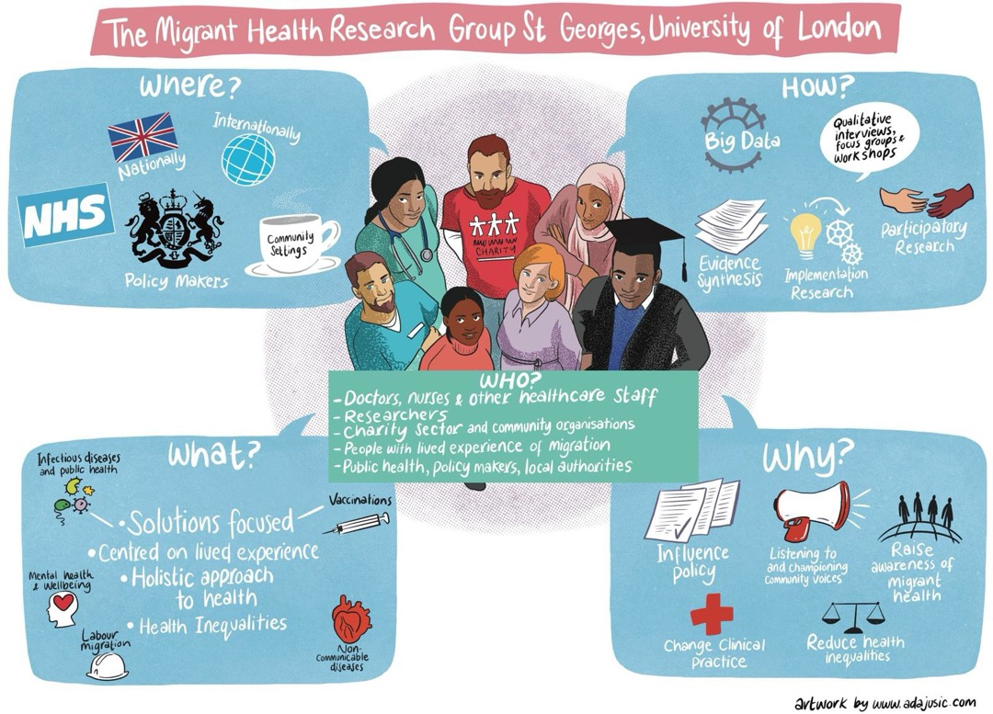
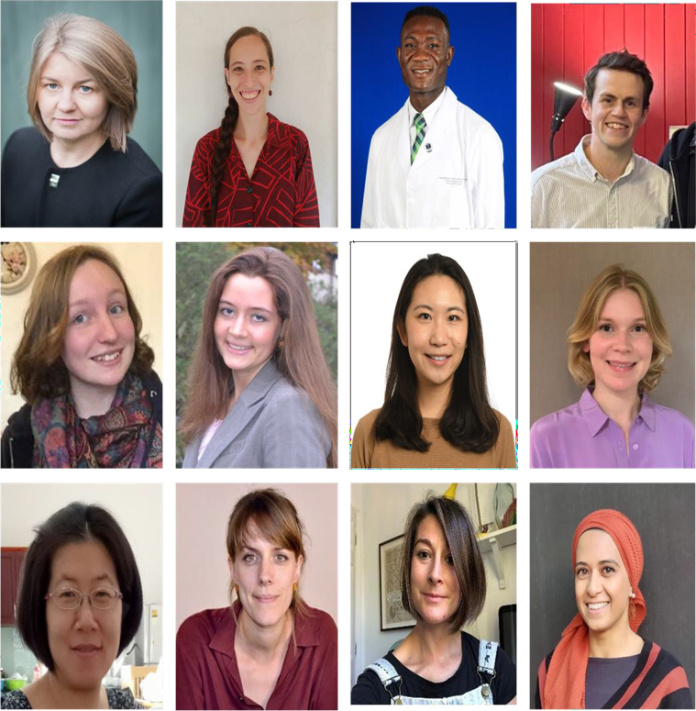

Slide 3
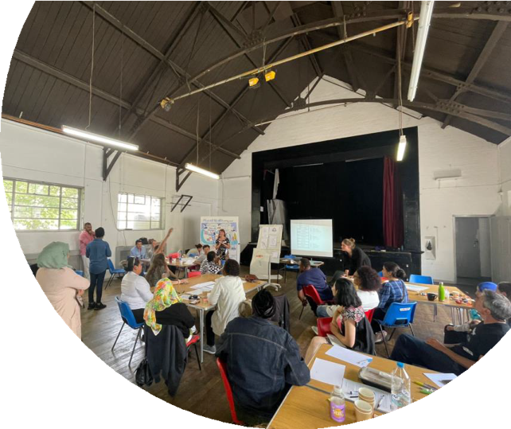
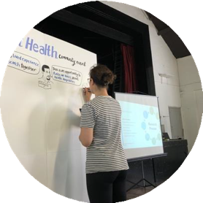
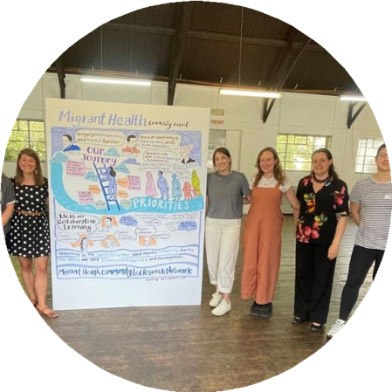
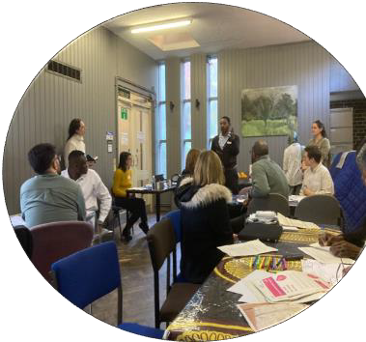
Migrant Health Community Research Network
Created by the Migrant Health Research Group at St. George’s Hospital
https://mhcrn.softr.app/

Slide 4
Community Engagement and Involvement in research

Slide 5
The processes and practices by which individuals and groups within a community actively contribute to, and influence, the research process.
NIHR 2024

Slide 6
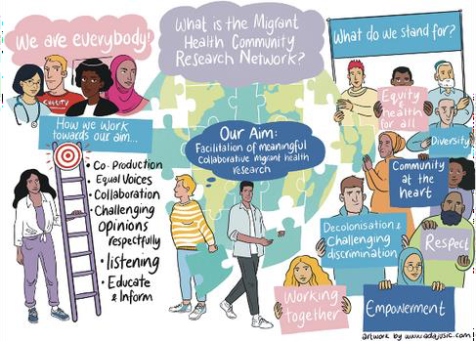
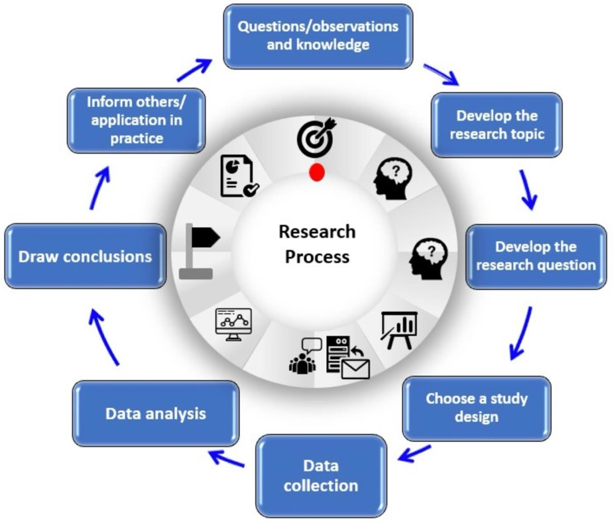
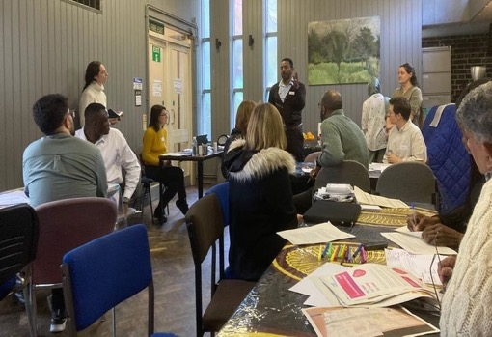
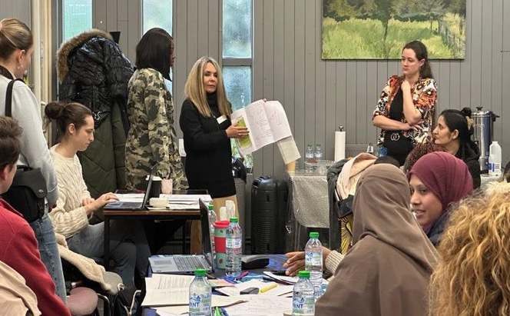
The Research Process

Slide 7
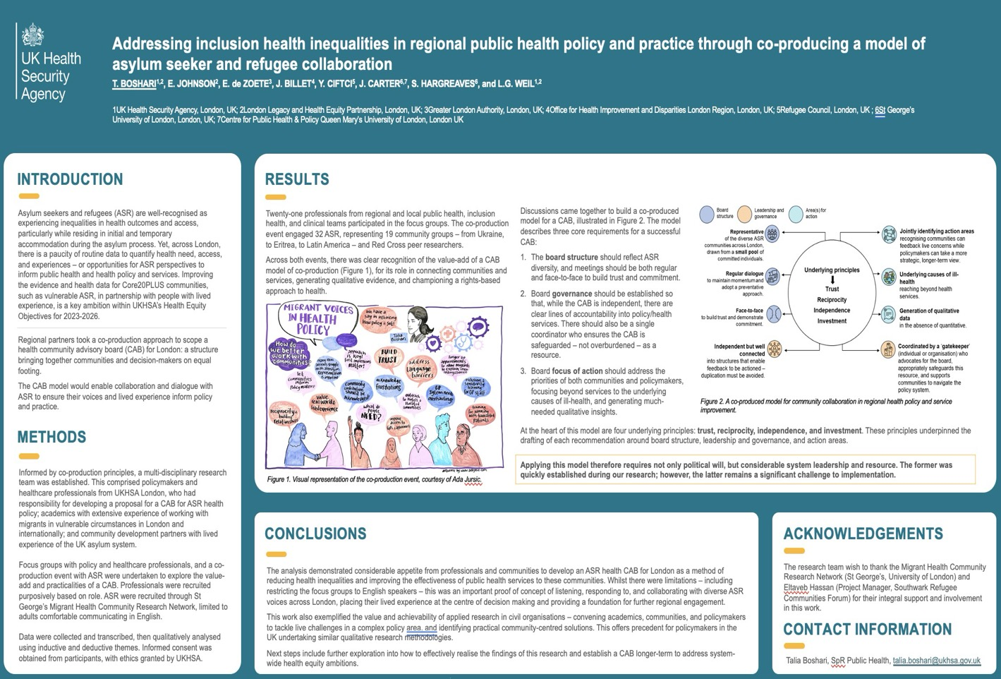

Slide 8
Importance of Community Engagement
“Community engagement is not just a part of health research; it's its heart and soul. It ensures that our efforts are not only scientifically sound but also socially relevant and culturally sensitive."
Dr. Tedros Adhanom Ghebreyesus, Director-General of WHO, 2023
Building trust
Building relationships
Being accountable
Improved interventions & increased
participation
Diversity in enrollment
Scientific rigor

Slide 9
Vacc on Track Study

Slide 10
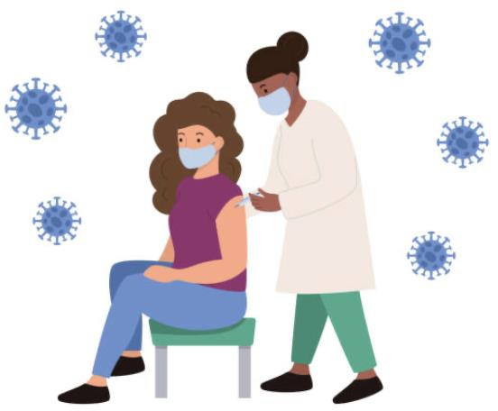
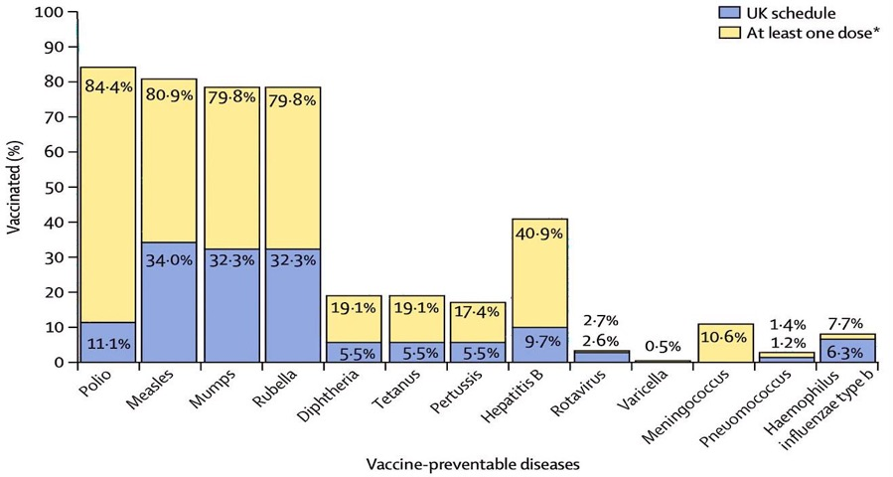
Low vaccination coverage in migrants
Global evidence
IOM study of 12,526 refugees (36 nationalities) assessed in the WHO Eastern Mediterranean region (Lebanon, Jordan, Egypt) on route to the UK
Few refugees were fully aligned with the UK vaccine
schedule:
Only 34% vaccinated for measles
Polio: 11%
Diphtheria and tetanus: 5%
Adults were significantly less likely than children to be in line with the UK immunisation schedule for polio and measles

Slide 11
UK guidelines on vaccination for migrants
All migrants in the UK have access to primary care and therefore vaccination regardless of immigration status in theory
Key catch-up vaccines for adults and adolecscents:
3 doses Td/IPV
2 doses MMR
1 dose MenACWY
HPV (if between 15-25
years old)
MSc Migration and Health 2023
ESCMIDPostgraduateEducation Course Montisola, 26-30September 2022 –Hybrid Edition

Slide 12
Many arrive to the UK under-immunised or with
unknown immunisation status
Most were unsure which vaccinations they had received, some suggested that “the children are not immunised enough” in their home country
Some participants suggested they had low confidence in the healthcare or vaccination system in their home country
Around half of participants suggested that some form of childhood vaccination records were given
Participant demographics
71 adult interview participants
62% asylum seekers/refugees, 38% other immigration status
Mean age: 43.6 years
69% female
62% lived in the UK less than 10
years

Slide 13
Fragmented Delivery in UK primary care
Almost universal good catch-up programmes for Under 5
vaccination
Adult migrants were often reported as being excluded. One GP stated that over 5’s and adults are sometimes assumed to be “up to date from the country they come from” (GP10)
Models of delivery were diverse and fragmented, comprising a range of clinics and providers, different staff members (primarily nurses), and a combination of opportunistic and proactive programmes. We identified multiple barriers and facilitators to increasing catch-up vaccination in migrant communities.
12

Slide 14
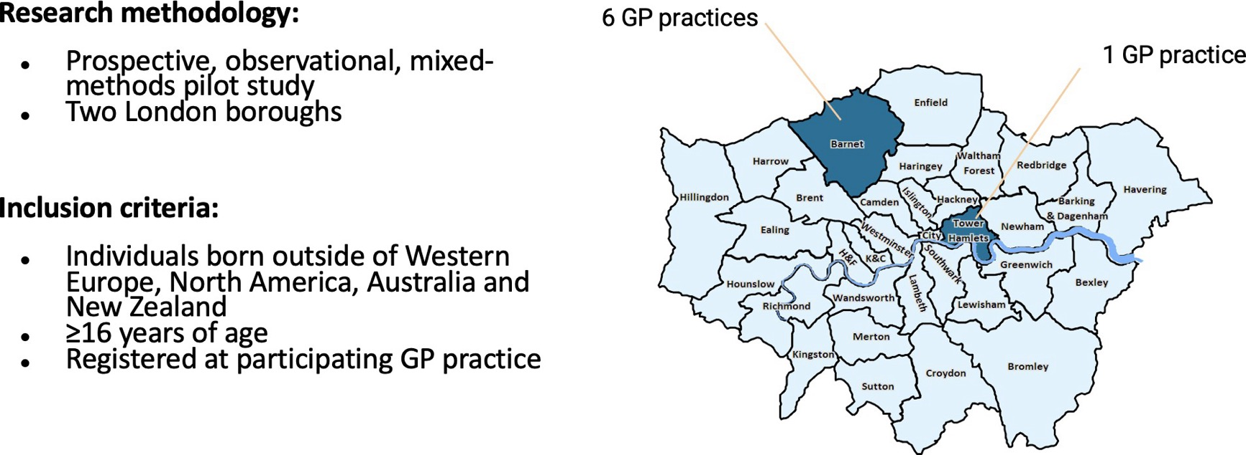
Prospective observational study: Vacc on Track
13

Slide 15
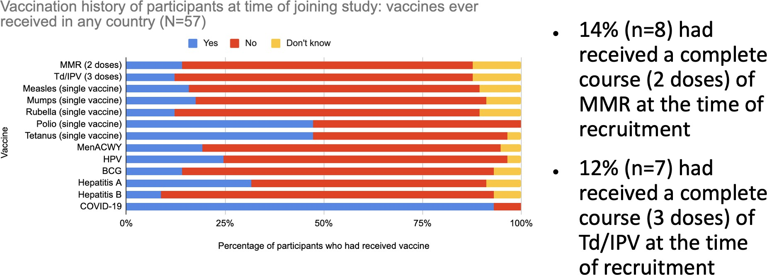
>86% of migrants were under-vaccinated for MMR and Td/IPV vaccines

Slide 16
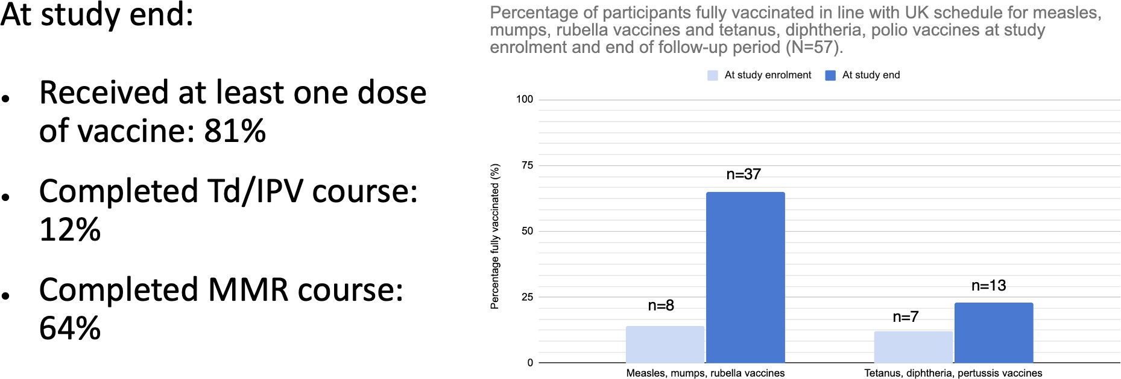
81% of migrants received at least one dose of vaccine through our referral, but completion rates were poor

Slide 17
Co-design study:
lisolo malamu
(‘good talk’)

Slide 18
STUDY OVERVIEW
✗ Design: Community-based participatory research study
✗ Aim: To co-design a tailored intervention to increase COVID-19 vaccine uptake with Congolese migrants living in London, UK
✗ Who: Designed and led by a coalition of 5 academic and community partners (including 3 Congolese), with 32 Congolese migrant participants
✗ What: Peer-led semi-structured interviews, poster
walls, community days, co-design workshops,
celebration event
✗ Intervention: community-led workshops, plays and
posters/flyers to promote behaviour change
17

Slide 19
What factors support better research with these communities?
✗ Partnered with a trusted community sector
‘umbrella’ organisation in the local area
✗ Timeline & budget supported trust building
✗ Initial broad engagement ➔ local presence
✗ Financial compensation
18

Slide 20
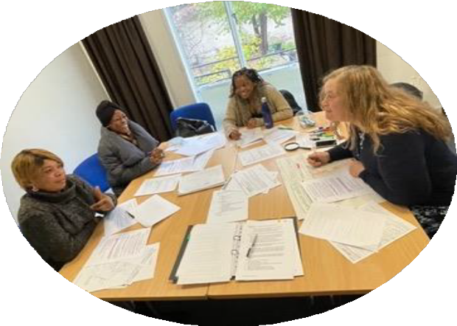
Build relationships and trust
✗ Planned through an equity lens and invested in building relationships:
✗ Shared relative experiences
✗ Listened and learned
✗ Openly discussed agenda and expectations
19

Slide 21
Address power dynamics
✗ Reflexivity
✗ Used approaches to empower community partners to participate with full voice
✗ Ensured partners understood their rights
✗ Supported partner’s and community’s ownership of the research and worked to help them leverage skills (reciprocity)
20

Slide 22
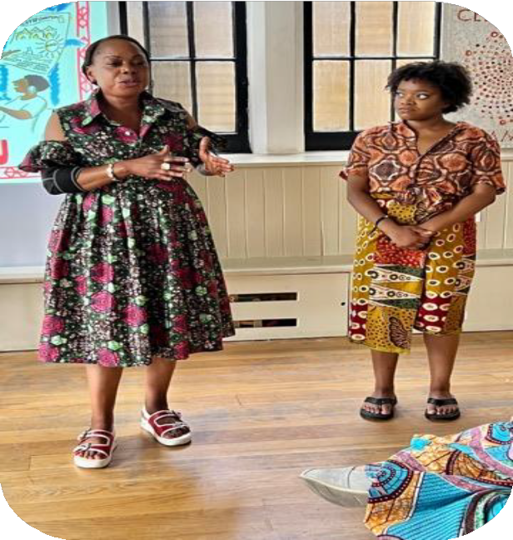
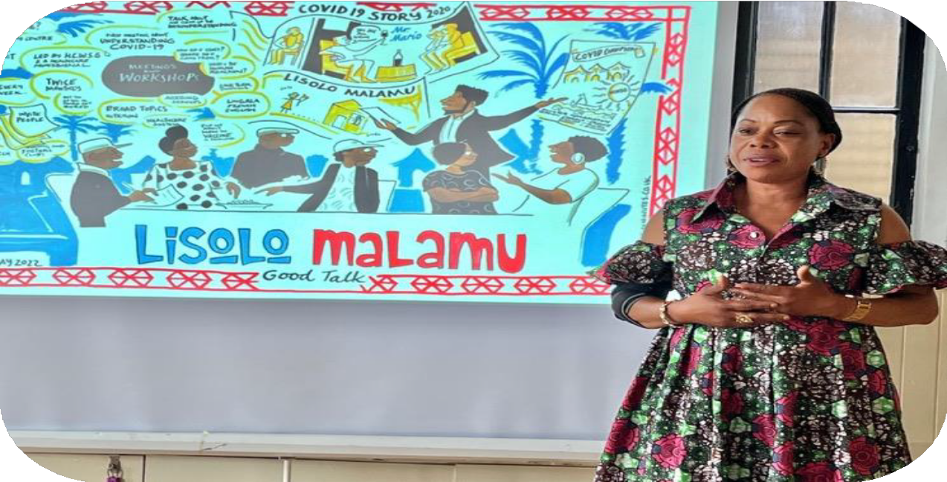
Mimi and Sarah presenting the study findings and impact at the celebration
21

Slide 23
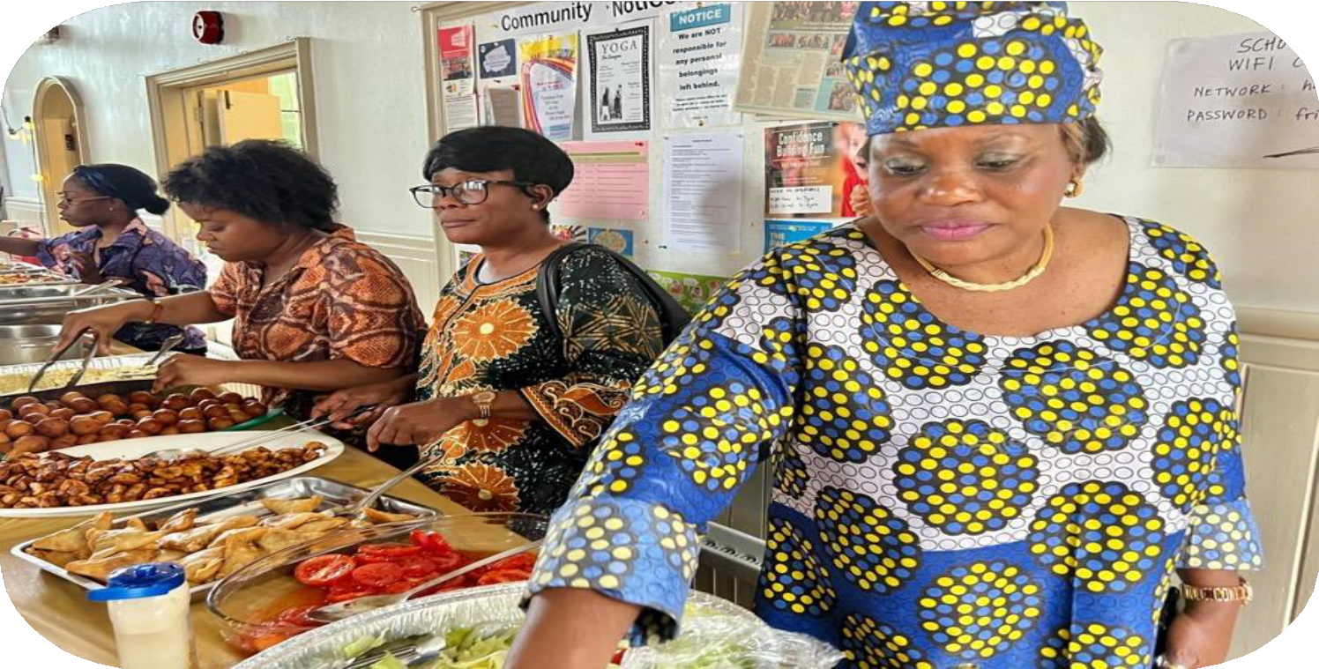
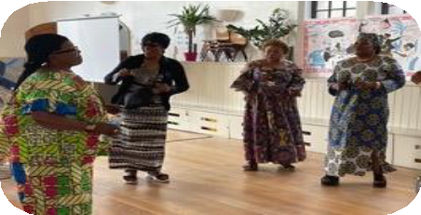
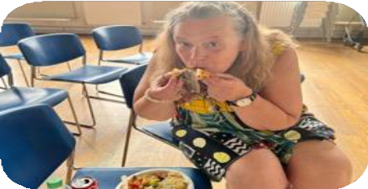
22

Slide 24
Developing a Framework for Healthcare Provision for People Seeking Asylum

Slide 25
Why is this important?
PSAs are entitled to free healthcare in England but face significant access barriers.
Local examples of good practices exist, but there’s a
need for a more consistent and scalable approach.
This research provides a path toward accessible, consistent, and high-quality healthcare services for people seeking asylum.

Slide 26
Methods
Focus groups with
stakeholders

Slide 27
Findings – Lived Experience Insights
Key themes:
We come as blind people and we want you to open our eyes to the things that we don’t yet know.
Workshop participant, London
Communication gaps in healthcare settings.
Lack of knowledge about NHS and entitlements.

Slide 28
Findings – Policymaker and HCP Insights
Key themes:
Lack of System-level collaboration and
data sharing
Strong leadership is vital
Quite literally everything hinges on that relationship [between ICBs and the Home Office] … it’s very difficult to negotiate and maintain good practice in that space. ICB representative

Slide 29
Framework Overview: Five pi lars of good practice
Valuing lived
experience
Working
in partnership
Strengthening
Upskilling the workforce
Maximising
data for action ^{pathways to}
care
Three Recommendation Levels:
Commissioning and Regional Stakeholders
Provision
The Home Office

Slide 30
The Health & Wellbeing of Asylum Seekers and Refugees in
Southwark
Southwark’s Joint Strategic Needs Assessment
St. George’s – University of London Southwark Council & South East London ICB
March 2023

Slide 31
AIMS & OBJECTIVES
Aim
The aim of this JSNA is to provide an overview of the health and wellbeing needs of migrant, asylum
seeking and refugee (ASR) groups in Southwark, and of current service provision for this population.
Objectives
Identify the different migrant, asylum seeking and refugee populations living in Southwark. Explore the key health and wellbeing issues that these groups may be at increased risk of.
Understand the diversity of these populations and the services available to them.
Identify gaps in data collection on these populations.
Scope | Includes
Populations | Asylum seekers living in initial accommodation centres Unaccompanied asylum seeking children Refugees living in the community Those with no recourse to public funds (NRPF) receiving statutory support Migrants with irregular immigration status living in the community
Age group | All ages
Settings | Initial accommodation centres, dispersal accommodation, communities.
Slide 10

Slide 32
Get in touch! s.hargreaves@sgul.ac.uk

