Slide 1
RESEARCH CAFÉ Fostering South West London’s Clinical Research
12:00 – 13:00
Facilitator: Ashley Brown
Speakers: Heather Jarman and Kathryn Brown

Slide 2
Fostering Clinical Research
Professor Heather Jarman
Group Director for Health and Care Professionals Research
St George’s , Epsom and St Helier Univeristy Hospitals and Health Group
South West London Health Research Summit | May 2025
Notes:
RESOURCES
Print out some EN journal article types

Slide 4
Session aims
Provide an overview of the importance of getting involved in research
Identify strategies at individual and organisation level that foster clinical research

Slide 5
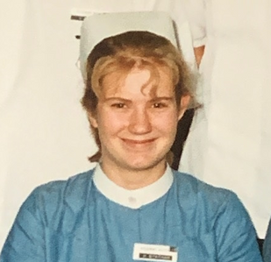
My work story
SCHOOL
TRAINING
WORKING
CLINICAL
RESEARCH
So long ago I’ve forgotten it
Sometime ago
Mainly emergency care and major trauma
Consultant Nurse, Clinical Director for Major Trauma
Research Director, Professor of Emergency Care, Clinical Academic

Slide 6
Why should we be fostering clinical research?
Good for patients
Research-active trusts delivering clinical research trials and studies have better patient outcomes.
Patients value the opportunity to participate in research studies and trials as part of their care.
Good for staff
Healthcare professionals say they find the experience of being involved in research studies positive and rewarding
Good for the Organisations
Support the recruitment and retention of high calibre individuals in the organisation
CQC well-led inspections include research in lines of questioning

Slide 7
Barriers to getting involved in research
Individual barriers
Personal barriers
Organisational barriers
Professional barriers
Lack of skills, not part of role, lack of time, clinical development more important
"I'm not academic enough"
No research culture, lack of management support, conflict with service demands, perception of research as 'nice to do'
Low drive for use of evidence, lack of visible research priorities

Slide 8
A multi-layered approach to research engagement
Research leadership
Research active
Research aware or research ‘curious’
Organisational culture
Debbie Carrick-Sen et al (2016)

Slide 9
Organisational culture

Slide 10
Senior Leadership Team presence
Group Research Strategy
Trust induction
Job descriptions
Agenda item at HCP Board
Trust awards and recognition
Ward acreditation
Embedding research in the organisation

Slide 11
HCP Research Engagement Schemes
Using data to improve practice programme
Research Mentorship
Writing for publication workshops
Research toolkit for Matrons and Health and Care Leaders
Research Champion scheme
Research Internships
Chief Nurse Research Fellowship
HCP pre-doctoral researcher forum
Senior Research Fellowship
HCP doctoral and post-doctoral researcher forum
Research advice drop-in sessions
RESEARCH AWARE ‘CURIOUS’
Schemes for All
RESEARCH ACTIVE
Developing a research career
RESEARCH LEADERSHIP
Clinical academic careers and leadership

Slide 12
The research ‘curious’

Slide 13
Using data to improve practice

Slide 14
Research Champions
The research champion link role is open to all health and care professionals interested in research and who want to help promote research awareness, engagement, and delivery of research within their teams and clinical area.
“The research curious”

Slide 15
Research Champions
Structure
Up to 30 places
3 study days per year (training and updates)
Led by Research Matrons and Chief Nurse Research Fellows
How the role is undertaken varies by clinical area and the experience of the Research Champion themselves. It might include:
promotion of research in clinical area (teaching sessions, noticeboards, communication)
working with research delivery teams to identify patients suitable for research studies
supporting clinical staff with project development, career advice

Slide 16
Research
active

Slide 17
Writing for publication workshop
This workshop offers a basic introductory session on why and how to write for publication, covering publishing models, authorship, ethics and the importance of avoiding plagiarism.
Face-to-face / online session
Follow-up action learning sets to support writing
Mentorship

Slide 18
Chief Nurse Research Fellowship
Chief Nurse Research Fellowship purpose
Running since 2020 with the aim of increasing the capacity and capability (the ability to carry out research) in health and care professionals
The Fellowships offer:
A structured clinical academic development programme that includes a Post-Graduate Certificate in Research Skills and Methods
One day per week for 1 year (backfilled) to provide time to undertake the programme
Monthly clinical and academic support meetings to review personal and research project plans
Chief Nurse Research Fellows 2020
Chief Nurse Research Fellows 2022
Chief Nurse Research Fellows 2024

Slide 19
Research leadership

Slide 20
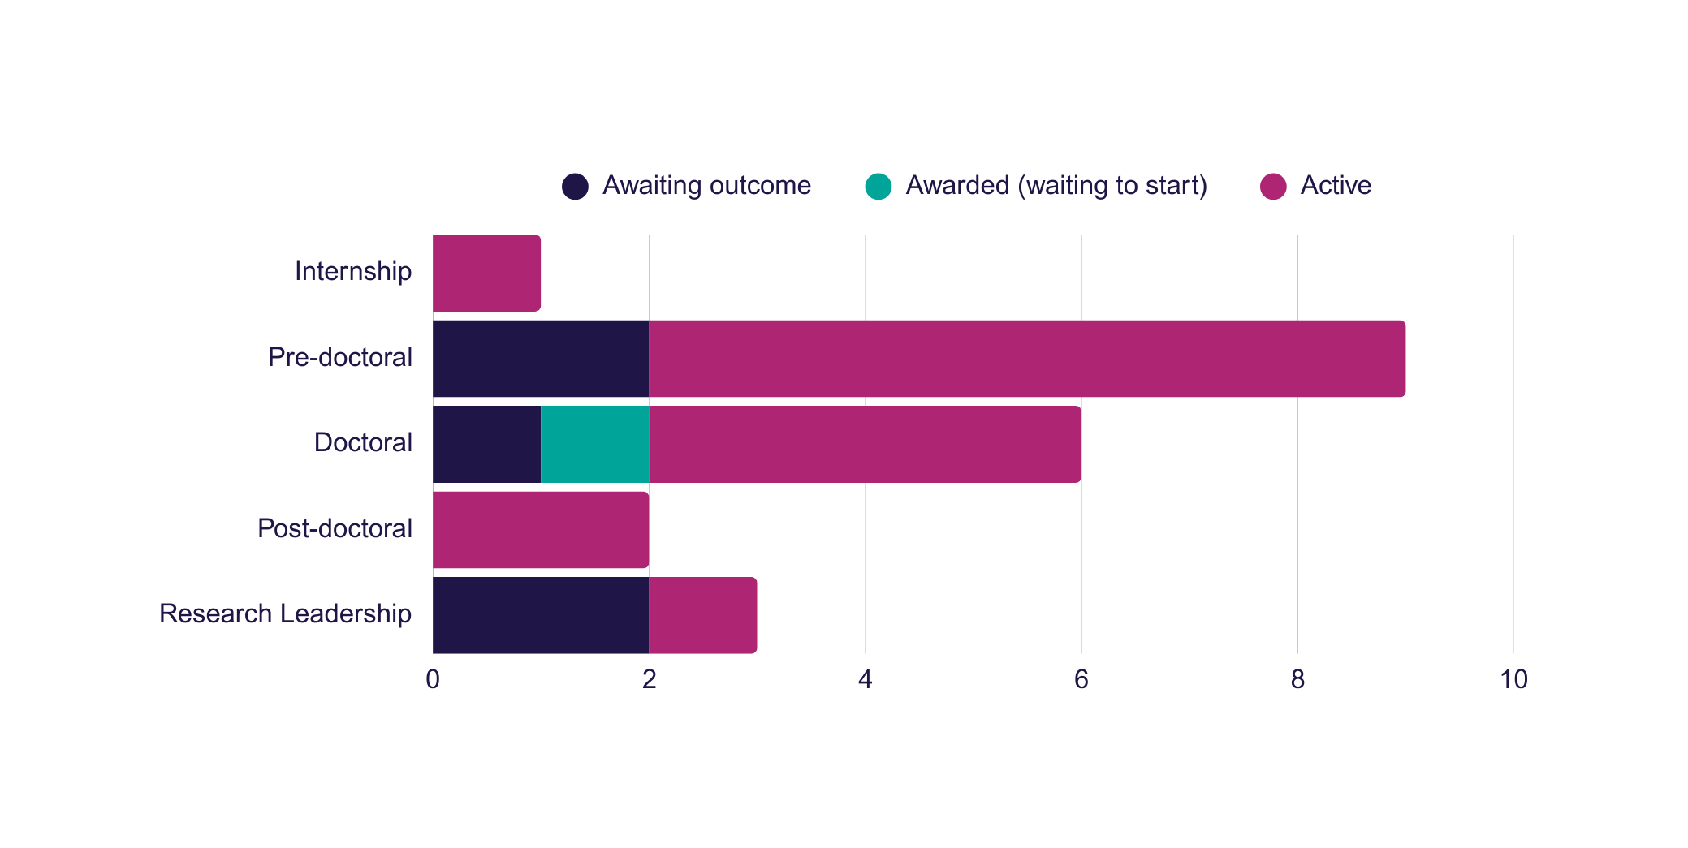
NIHR funding success rates

Slide 21
NIHR Doctoral Fellows
Gino Hipolito
Emilee Gosnell
Rebecca McLoughlin
Helena Jackson
Speech and Language Therapist
Community
Research topic: support for children with selective mutism
Clinical Scientist (audiology)
Community
Research topic: increasing hearing aid use in infants
Physiotherapist
Haematology
Research topic: self-management interventions for adults with sickle cell disease
Dietician
Renal
Research topic: nutritional screening in renal patients
Notes:
Others doing PhDs

Slide 22
Top tips
There is a lot of enthusiasm to get involved in research
Using multi-layered approaches give the widest possible reach
For individuals you just need to start small

Slide 23
Fostering Clinical Research
Professor Heather Jarman
Group Director for Health and Care Professionals Research
St George’s , Epsom and St Helier Univeristy Hospitals and Health Group
hcp.research@stgeorges.nhs.uk
Notes:
RESOURCES
Print out some EN journal article types

Slide 24
SWL ICB Research Summit May 2025 Growing Our Research Workforce Kat Brown Associate Director of Research K&RFT South London Community Settings Lead RRDN SWL ICB Research Collaborative

Slide 25
Aims - Overview of national context, updates and drivers - Benefits - Sharing our approaches, thoughts and feedback

Slide 26
National changes and aims
DH/NHS England
NHS constitution duty on promotion, conduct and use of research
Lord O Shawnessy’s report: strengthening industry partnership and increasing commercial activity
Healthcare professional guidance and frameworks; Multi-professional Practice-based Research Capabilities Framework, Chief Nursing Office FOR England’s (2021) Strategic Plan for Research, Health Education England’s (2022) Allied Health Professions’ Research and Innovation Strategy for England, The Chief Midwifery Officer for England’s (2023) Strategic Plan for Research.
NIHR HLO’s
Increase diversity of research uptake in underserved communities
Demonstrating to research participants that their research is valued
Increasing participation on portfolio studies
Reducing study set up time
Increasing proportion of portfolio studies that deliver to time and target
INTERPRETATION
Clear mandate and frameworks to ensure research is consistently embedded into everyday NHS health and care.

Slide 27
Benefits
Patients: access to new treatments or technologies
Staff: increased satisfaction and retention
NHS: evidence of effectiveness
Overall: improved communication and increased quality of care
Research helps to improve the care provided by the NHS.
It's the driving force behind new advances in medicine, helping find new cures and better treatments for all.
But it's the people who take part in health research who make these vital discoveries possible.
Research active hospitals have lower mortality rates and patients’ perception, and experience of care is higher in research active organisations.
Staff have increased job satisfaction and NHS employers can improve recruitment and retention when staff are enabled to be involved in research.
https://bmchealthservres.biomedcentral.com/articles/10.1186/s12913-021-06354-y
https://academic.oup.com/pmj/article/95/1124/323/6983980

Slide 28
Making it meaningful
Consistently embed research into everyday NHS health and care
Making it easier for all (awareness, use and conduct of research)
Actively champion inclusive and representative research
Foster a culture of innovation, evidence – based improvement collaboration
Academic and industry partnerships
Increase diversity of research uptake in underserved communities
Targeted research that addresses unmet health needs
Invest in workforce gaining research knowledge
Research, right place, right time
Crossing boundaries
(service, organisational, system/geographical)
3 Key areas

Slide 29
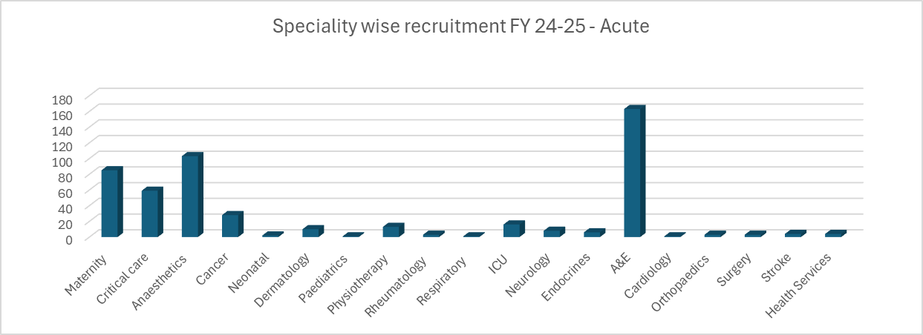
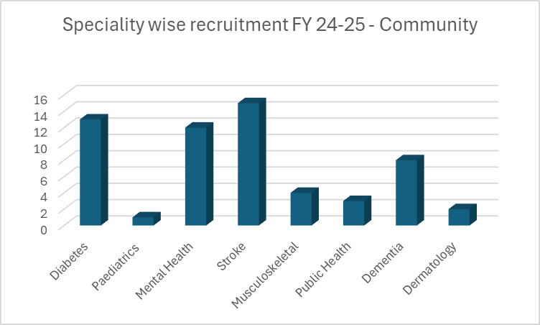
Where are we now
Small core infrastructure
Acute
Cross pathway
Community
165 studies being managed
Expertise embedded in clinical areas;
Over 250 clinicians trained in Good Clinical Practice in Research (GCP)
Over 70 Principal Investigators (PI’s)
Expertise in research grant writing and funding calls
736 patients recruited
A diverse range of our clinicians leading research across our organisation ​

Slide 30
Steps to move forward
STRATEGIC RESEARCH AMBITION
STRATEGIC RESEARCH OBJECTIVES | Create a research culture | Capability and Capacity Workforce and environment |  | Partners and Place: Actively engaging stakeholders |  | Promote digitally enabled research
DELIVERY PHASES
IMPORTANT ENABLERS | Clinical, Workforce, Digital strategies Developing robust performance reporting Evidence benefits/impacts Funding/generating income |  | What could we help achieve? |  | For patients For staff For our organisation For the wider system
Deliver high quality research opportunities for our staff and our patients that are meaningful to them
Patients at the heart of our plans
so that research drives the greatest benefits and positive impacts for health outcomes and experience
Attract and retain high calibre workforce to build research capacity and capability
AGREE
Fit for purpose; work towards the ambition
IMPLEMENT
Planning relates to all staff groups and areas
SUSTAIN
Measure impact, maintain flexibility
RESET AND TRANSFORM
A new approach to research Everyone clear about the part they can play

Slide 31
Focus on workforce
Challenges
No time for discussion, planning or participation
Limited awareness of what's available
Lack of equity to uptake of supported pathways for the multiprofessionals research
Alignment with higher education institutions, high profile organisations (initiatives, support, sharing, developing new models).
Integrating with existing
Ensure research is included and emphasised
existing frameworks and programmes;
Embedding the Trust’s health care professional’s capability framework
Four pillars of practice (evidence, research and development)
Multi-professional Practice-based Research Capabilities Framework (support health and care professionals to engage in, and with, research)
HR initiatives and processes; Talent pools and recruitment materials)
Inductions other forums
Approach
“must include all voices and perspectives”

Slide 32
Opportunities to think about research
BOARD OVERSIGHT
Governance, reporting and monitoring
CULTURE
Research everybody's day to day in healthcare
WORKFORCE
Capacity and Capabilities
Collaborations and partnerships
Academic, Industry, Charities
Individual practitioners:
when planning their professional and career development,
to support discussions during supervision;
when reviewing their individual capability and competency profile;
Service and departmental managers when:
job planning,
developing job descriptions,
informing job evaluations,
identifying and reviewing objectives during professional development reviews;
Health and care organisations aiming to:
embed a culture that values engagement in, and with, research,
recognise, delineate and support research potential and research activity as part of everyday practice for health and care professionals;
Education and training providers:
when planning or revising the learning outcomes and content of academic award-bearing study,
when designing other continuing professional development opportunities.
.

Slide 33
Multi pronged approach
SUSTAINABLE, SUPPORITG AND INCLUSINVE ENVIRONMENT
DEVELOPING EXISITNG STAFF
ATTRACTING STAFF
FOSTER OPEN FORWARD-THINKING CULTURE
PROMOTE DIVERSE CAREER PATHS
EXPAND EDUCATIONAL OPPORTUNITES
ENCOURAGE AND FACILITATE COLLABORATIONS AND PARTNERSHIPS
FUNDING OPPORTUNITIES
SUPPORT RESEARCH INFRASTRUCTURE
Discover Listen and act
Build
Initiate and integrate
Sustain
Evolve and advance

