Slide 1

RESEARCH CAFÉ
Innovating Community Research in South West London
13:30 – 14:30
Facilitator: Kwan Ku and Rashmi Kumar
Speakers: Iyinoluwa Oshinowo and Professor Nicola Thomas

Slide 2
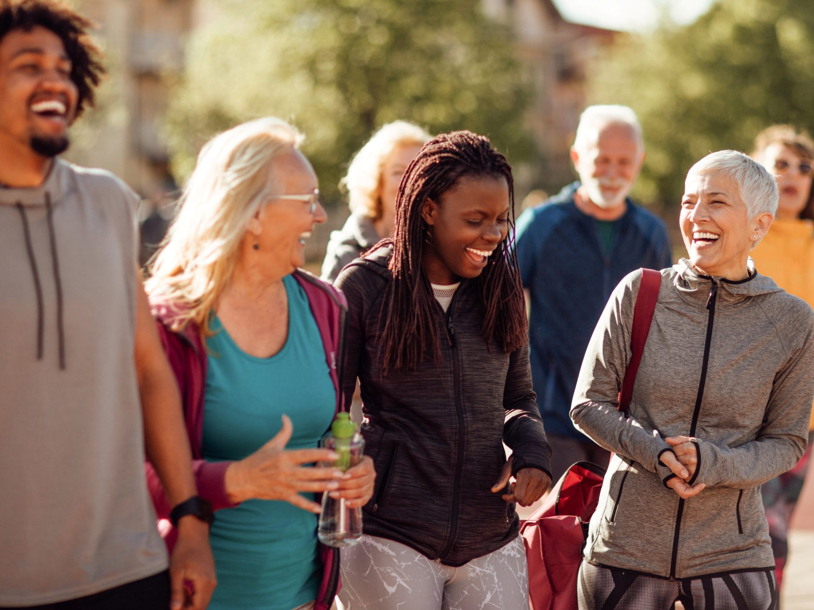


From Conversations to Change: Community Research in Practice
Iyinoluwa Oshinowo | Research and Engagement
Healthwatch SWL Collaborative

Slide 3



From Conversations to Change: Community Research in Practice
How I Got Into Research
  Journey into Research: NHS UCL (CORE) & NCCMH Healthwatch
  As an AP: I wanted to move from making small, daily changes to influencing system-wide improvements based on staff and patient experiences.
  As an RA: Research focused on mental health outcomes, including evaluating safety programmes and mental health interventions, and co-designing research with patient advisory groups.
  Community research where I engage with patients and staff to provide insights that can improve health and care services.
Notes:
How can I continue working somewhere I can partner with patients to shape the services they use?

Slide 4

From Conversations to Change: Community Research in Practice
Healthwatch, what we do: Community Research
  Healthwatch explores people’s experiences of health and care services. These insights are used to make sure decision makers in the NHS improve the standard of care.
  What I do:
  Healthwatch South West London Collaborative: Croydon, Kingston, Merton, Richmond, Sutton, Wandsworth
  Research and engagement
  Community-led research
  Feedback insights to health and care staff, and key decision makers

Slide 5

From Conversations to Change: Community Research in Practice
Healthwatch, what we do: Community Research
  A big part of Healthwatch’s process is collaboration and co-production with patient groups and organisations that work within local communities (from conversations to change)

Slide 6
From Conversations to Change: Community Research in Practice
Project process example of engagement
  The Delivery of the Accessible Information Standard in South West London GP Practices
  Situation:
  To evaluate how GP Practices implement the Accessible Information Standard (AIS) in South West London (SWL).
  Approach:
  Working primarily with voluntary sector organisations to access patients and carers who work with the local communities that fall under the AIS.
  Consulting staff within these organisations to inform our development of survey and focus group questions.

Slide 7
From Conversations to Change: Community Research in Practice
Project process example of engagement
  The Delivery of the AIS in SWL GP Practices
  Outcome:
  Greater access to groups that may not be aware of ongoing community research, or who may not be able to easily participate.
  Produce research strategies and tools that are accessible, appropriate, and will increase the likelihood of reaching the target population.
  Increase response rate to surveys, richer responses to focus groups, and therefore insights that can be captured more accurately and influence change.
Notes:
Health South West London Collaboration: Croydon, Kingston, Merton, Richmond, Sutton, Wandsworth
Research and engagement – thinking about how questions can be phrased to capture insights in the best way, and report insights in the best way to mak
Being dynamic in conversations rather than dynamic
Having a level of awareness, reassuraning people who are research fatigued, but also managing expectation of what can be done
Leads to fruitful conversations
Prioritising inisights and findingins and finding common ground.
Initiatives that encourage further conversations, empower communities, which lead to change

Slide 8
From Conversations to Change: Community Research in Practice
Communities we sought to engage
  We needed to reach people:
  With sensory loss (d/Deaf or hard-of-hearing, Blind or vision loss)
  With learning disabilities
  From neurodiverse groups
  With neurological conditions
  We had a steering group of staff representing organisations that work in these communities. They provided guidance on how to make our survey, focus group questions, focus group sessions, and even our project report accessible.

Slide 9
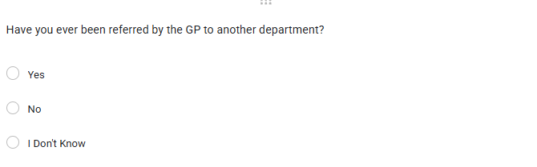
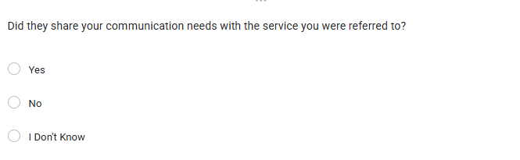
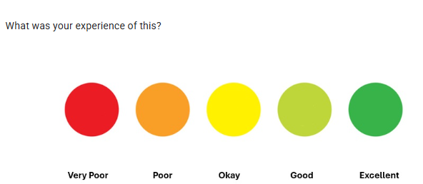

From Conversations to Change: Community Research in Practice
Practical example
From ‘What was your experience of your GP service sharing your communication needs and the support you needed, where you may have been referred to another service? [free text]’
To:
1) Simple closed question
2) Simple language
3) Picture examples to further explain each rating on the scale

Slide 10
From Conversations to Change: Community Research in Practice
From conversations to decision makers
  We shared our findings with:
  The GP practices we engaged with and discussed how the recommendations, based on our findings, could be implemented.
  South West London Integrated Care Board
  The Clinical Lead for Primary Care for the SWL ICS
  We set up a Community of Practice:
  Including patients, carers, GP practice staff, ICB representatives, and voluntary organisations.
  We shared our key findings and discussed practical ways to deliver recommendations.
  We shared our report and resources at a GP clinical training day.

Slide 11
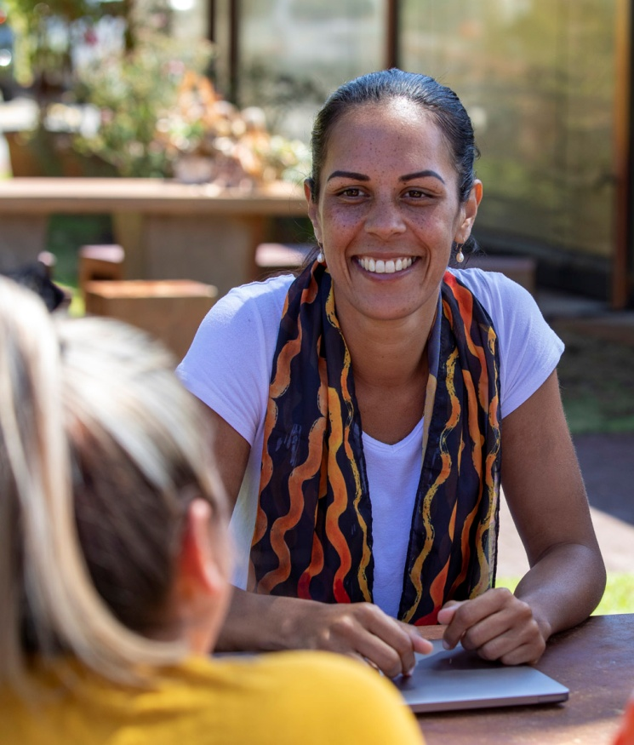
Key Takeaways
  Turning conversation into change means conducting research with communities, not on them.
  This ensures their voices are integrated throughout the research process, and ultimately in the changes that shape services.

Slide 12
Connecting with Healthwatch
  Collaborate with local Healthwatch to conduct research
  And
  establish connections with local voluntary sector organisations
  Empower local organisations to participate in research alongside Healthwatch organisations and academic organisations

Slide 13
Iyinoluwa@swlhealthwatch.org.uk

Slide 14

Innovating Community Research
Can you change the world with a haircut?
Professor Nicola Thomas
London South Bank University nicola.thomas@lsbu.ac.uk

Slide 15

Outline
What inspired me to get into research
Key highlights from our work
Ideas and opportunities for involvement

Slide 16

What inspired us to do this project?
A bit about me….
Men of Black, south Asian and mixed heritage more at risk of high blood pressure, strokes and kidney disease (Kidney Research UK 2019)
Variety of reasons for this
Our project idea based on Los Angeles study (Victor et al 2018)
BP fell by 27.0 mmHg in the barber plus pharmacist group and by 9.3 mmHg in the barber-only group.
BP <130/80 mmHg was achieved 63.6% in barber + pharmacist group 11.7% in the barber-only group (P<0.001).

Slide 17
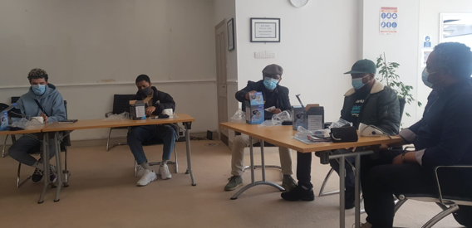
Part 1: what did we do?
Part 1: 2022 Feasibility study: can it be done in Croydon?
Collaboration with charitable organisations
Barber network already established
Training of barbers online and face-to-face
“You can change the world with a haircut”

Slide 18
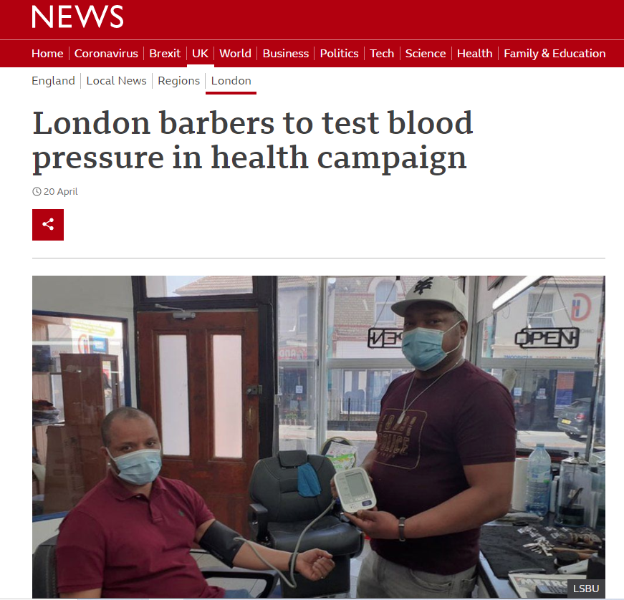
Part 1: what did we find? end of project March 2022
3 barbers kept up momentum
3 barbers became de-motivated over time
2 barbers did not take any measurements
BP data capture often difficult
236 measurements recorded (+ some not recorded).
15% > 140/90 mmHg
5 readings > 180 mmHg

Slide 19
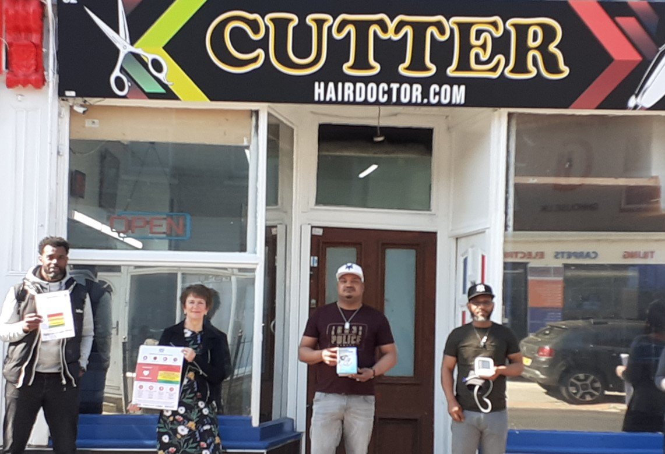
Part 1: what were the challenges?
Launching post-lockdown
Keeping the momentum going
Collection of data
Funding and incentivisation
We did not know what happened to clients

Slide 20
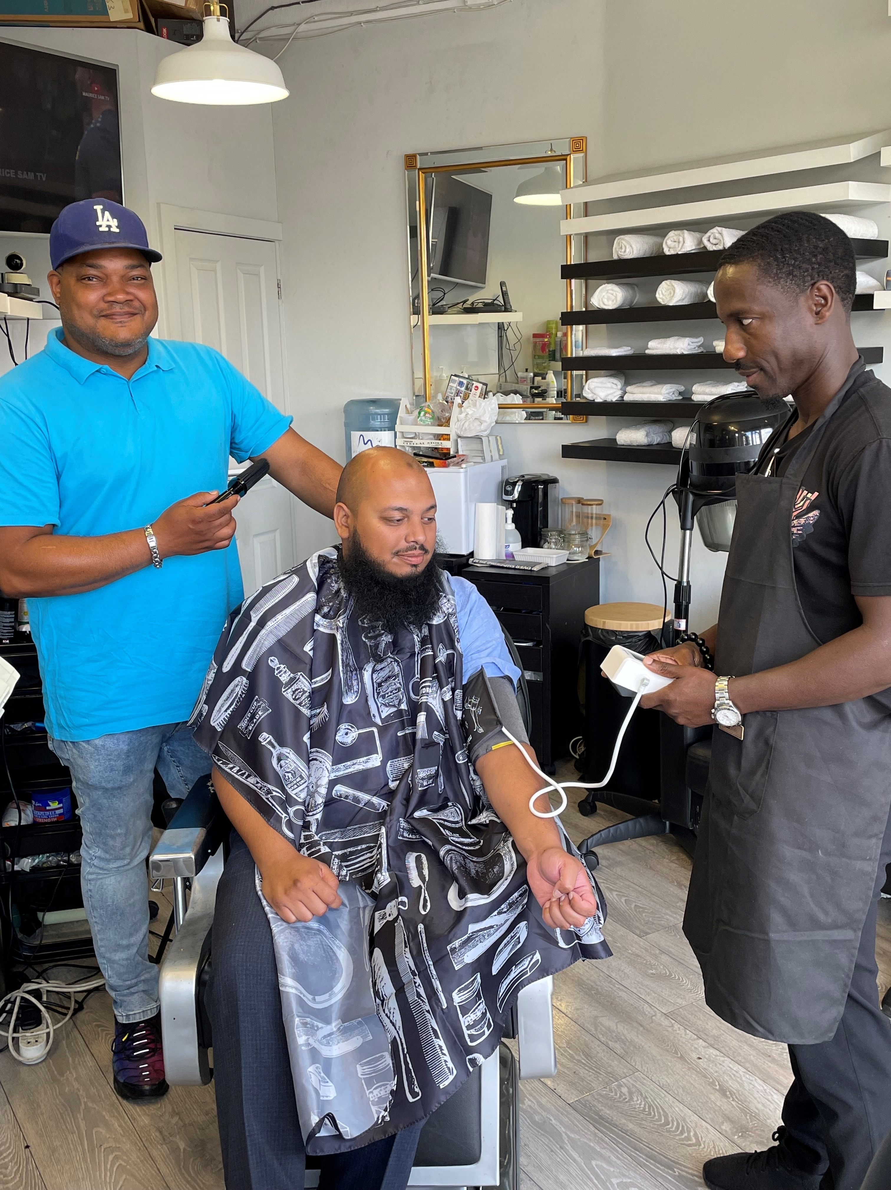
Part 2: what did we do?
In 2024, 2 barbers incentivised to take BP readings
£5 per haircut and £5 reduction in price for clients
Clients with BP ≥14/90 encouraged to have follow-up at Wellness Centre or GP
Interviews with barbers (2) and barbershop clients (2)

Slide 21
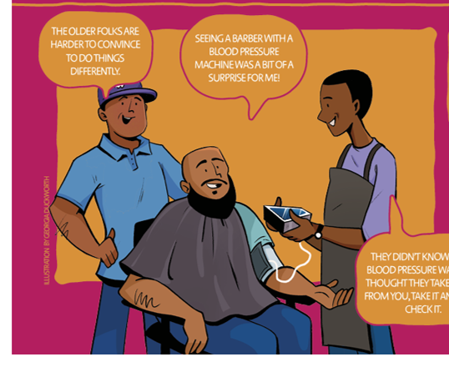
What did we find?
167 BP readings
24% ≥140/90 mmHg
Clients accepting of barbers taking BP, although “it was a bit of a surprise to me”
Further education needed “they didn’t know what blood pressure was”
A struggle to encourage people to have follow-up “The older folks are harder to convince….”

Slide 22
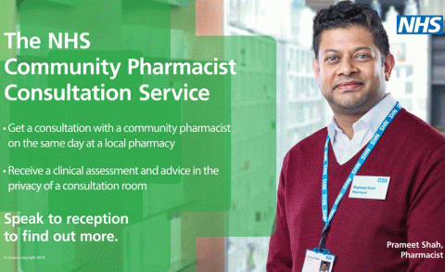
What happens next?
Funding for another 3 months May-July 2025
Aim for 150 BPs with 2 existing barbers and recruit 2 additional barbers in Croydon
Health adviser to see clients with high BP in barbershop
Recruit community pharmacists
Spread to SW London

Slide 23

Opportunities for involvement
We aim to spread to SW London
- we can share our expertise
- we can offer barber training
We need:
- an identified contact name/responsible person
to work together to identify 2-3 barbers per borough
to work together to collate our data
to seek further funding
to consider role of technology
nicola.thomas@lsbu.ac.uk

Slide 24

Thank you to our team and funders
Winner Outstanding Contribution to the Local Community Times Higher Education Award 2024

Slide 25
