Slide 1

RESEARCH CAFÉ
Fostering Interdisciplinary Research on Integrated Care Systems
13:30 – 14:30
Facilitator: Alison White
Speakers: Professor Adam Le Gresley and Dr Sam van Elk

Slide 2
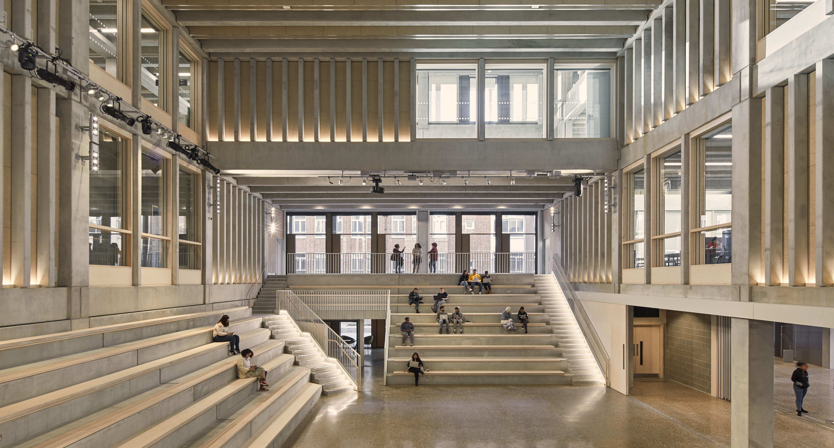

Driving interdisciplinary health research
SWL Health Summit
Wednesday 14 May 2025
Professor Adam Le Gresley
Health, Education and Society KERI Director

Slide 3

LGX – a rapid, simplified test for the rapid detection of Staphylococcus aureus (SA)

Slide 4
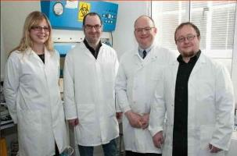
LGX is cleaved by enzyme secreted by Staphylococcus aureus
Staphylocoagulase is an enzyme expressed externally that is characteristic and diagnostic for Staphylococcus aureus.

Slide 6

LGX prototype validated
in community studies
200 participants – nasal swabs
Sensitivity - 91% (95% CI, 85-95%)
Specificity - 82% (95% CI, 74-88%)
+ve Predictive Value - 88% (95% CI, 77-91%)
-ve Predictive Value - 94% (95% CI, 88-98%)
67 participants – nasal swabs
Sensitivity - 91% (95% CI, 78-97%)
Specificity - 85% (95% CI, 70-93%)
+ve Predictive Value - 84% (95% CI, 70-93%)
-ve Predictive Value - 92% (95% CI, 78-97%)

Slide 7
Gatekeeper approach – pathway to efficiency gains
Patient admitted
Screening decision
Culture
LGX
point-of-care
Up to
65hrs
DNA PCR
Positive
30 mins
Positive
Approx 70% of patients
Positive
Negative
Positive
Up to
22hrs
Negative
Negative
Patient SA Positive - clinical decision
Patient treated as non-carrier of SA

Slide 8
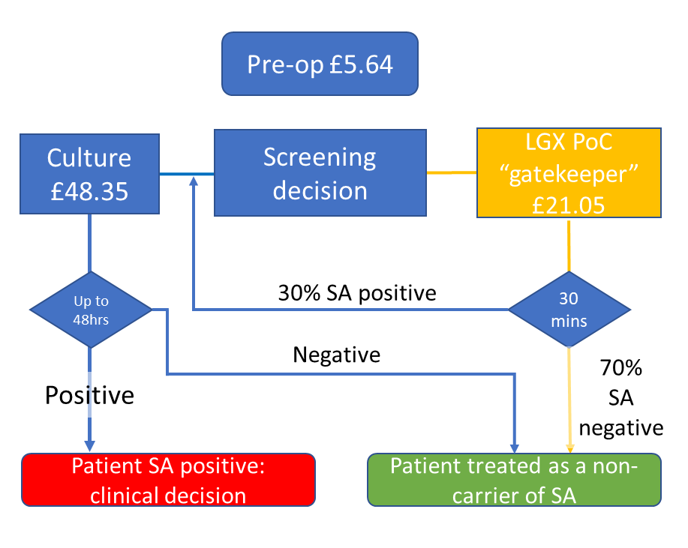
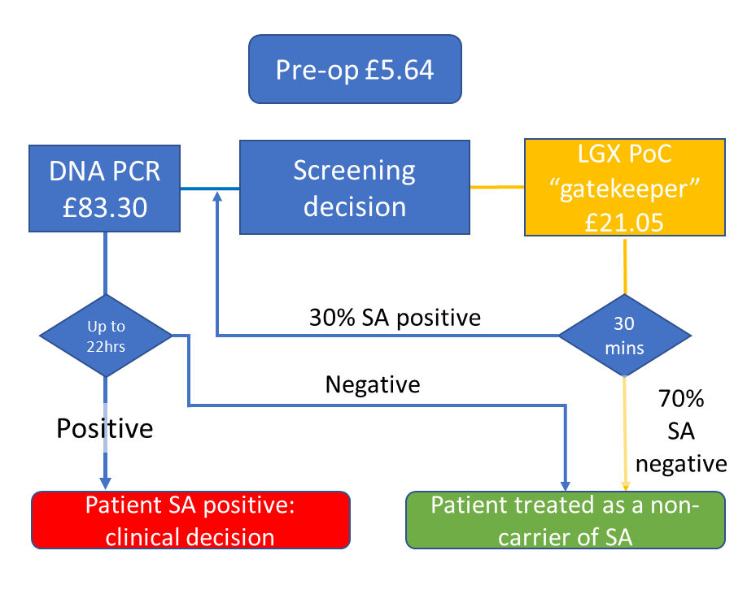
Health economics case: preliminary cost-benefit based on patient journey
LGX vs culture
LGX vs PCR
Culture pathway cost - £53.99
LGX screen + culture pathway cost - £41.20
Cost saving per 100 patients - £1,279
Time saving - 24 to 48 hours
PCR pathway cost - £88.94
LGX screen + PCR confirm of +ves - £51.68
Cost saving per 100 patients - £3,726
Time saving - 1-2 hours

Slide 9




Project team – LGX
Project leads:
Prof Adam Le Gresley
Dr Alex Sinclair
Prof Mark Fielder
Chemical Synthesis:
Dr Lyndsey Geldeard (PDRA)
Luke Bywaters (PhD)
Samerah Malik (PhD)
Microbiology:
Dr Lauren Mulcahy (PDRA)
Dr Fredericka Mitchell (PDRA)
Engineering:
Liam Griggs (PhD)
Prof Jian Wang
Collaborations:
Dr Simon Goldenberg
Dr Unell Riley
Dr David West, CTO
Hugh Ballantine Dykes, CEO
Funding:
SEC Faculty
Kingston Enterprise
PARK
Innovate UK
Development of an in situ Culture-Free Screening Test for the Rapid Detection of Staphylococcus aureus within Healthcare Environments. A. Sinclair, L. Mulcahy, L. Geldeard, S. Malik, M. Fielder and A. Le Gresley: Organic and Biomolecular Chemistry, 2013, 11, 3307.
Bywaters, Luke, Mulcahy-Ryan, Lauren, Fielder, Mark, Sinclair, Alex and Le Gresley, Adam (2017) Synthetic scale-up of a novel fluorescent probe and its biological evaluation for surface detection of 'Staphylococcus aureus'. Molecular and Cellular Probes, 36, pp. 1-9.
Rapid Culture Free Detection of Staphylococcus aureus. A. Sinclair, M. Fielder and A. Le Gresley: UK Patent GB1212853.4 (filed 27th July 2012), UK Patent GB1305634.6 (filed 27th March 2013), EU patent PCT/GB2013/051947 (filed 24th July 2013) and US patent 14/415457 (filed 26th April 2015), Granted September 2019.

Slide 10
Ideas and opportunities for involvement

Slide 11

Knowledge Exchange and Research Institutes
Cross-institutional Knowledge Exchange and Research Institutes (KERIs) to build greater focus around our areas of excellence…
…where we can be credible and authoritative and encourage excellence and collaboration across disciplines, to address the global challenges central to the University’s Town House Strategy.
Our KERIs:
Behaviour, Business and Policy
Cyber, Engineering and Digital Technologies
Design, Arts and Creative Practice
Health, Education and Society

Slide 12
Health, Education and Society overview
Allied Health
Learning disabilities
End-of-life care planning
Inclusive health and wellbeing
Mental health
Health and social care workforce planning
Dementia
Health
AI cancer diagnosis
Anti-cancer antibodies
Anti-microbial resistance
Ocular drug delivery
Infant blindness
Human Papilloma Virus

Slide 13
KERI-specific schemes
Promoting external engagement and collaboration
Co-funded PhD Studentships
Policy Support Fund
Participatory research
Enhancing research culture
Cross-KERI collaboration fund to assist teams of KERI members to prepare external bids

Slide 14




















Funding bodies/partners

Slide 15
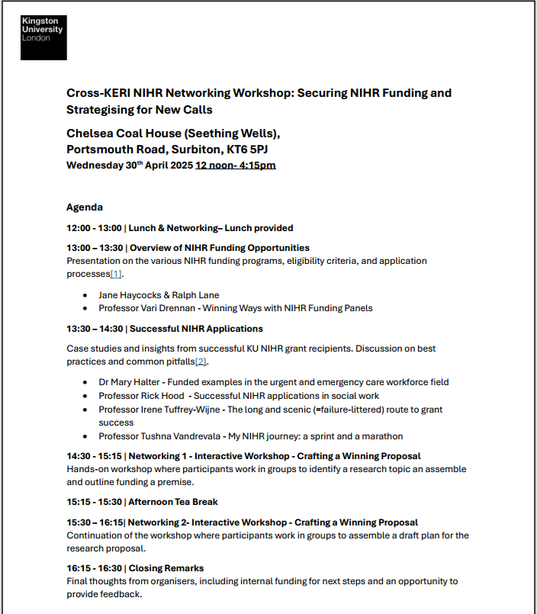
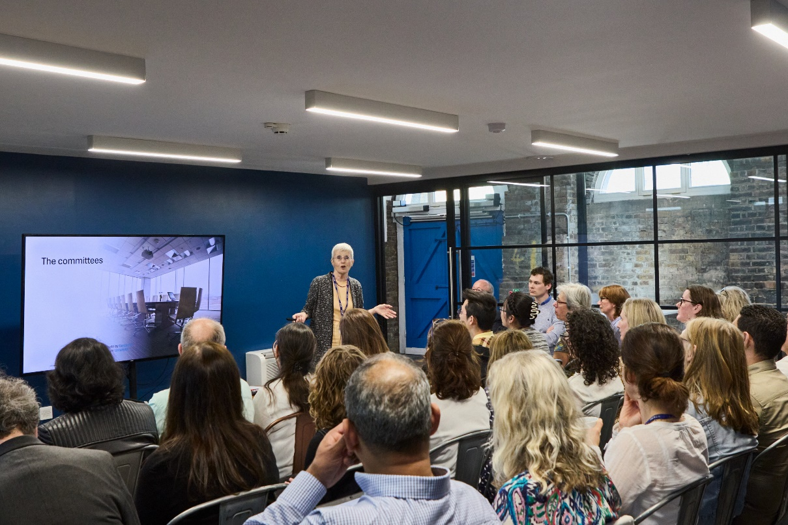



Cross-KERI NIHR networking event

Slide 16
Thank you for listening
Q & A

Slide 17
ORGANISING FOR COLLABORATION IN ICSs
SUPPORTING WORK IN SWL
Public Service Management and Organisations

Slide 18
Introductions
Sam van Elk & Kaori Hara
Work centred on health and social care organisations
Recently begun work around ICSs
Lecturer & doctoral student in KCL’s department for public organisations
Not just ICBs & ICPs
Collaboration across whole footprints
Interests in how we coordinate, collaborate well
And do that under huge pressure
Want to support the system

Slide 19
Purposes
Make contact
Share early work
Invitation

Slide 20

The ICS Research-Practice Network
Wanted to help system
Early event to figure out what needed
Unexpected appetite for conversation
https://www.kcl.ac.uk/business/research/integrated-care-systems

Slide 21
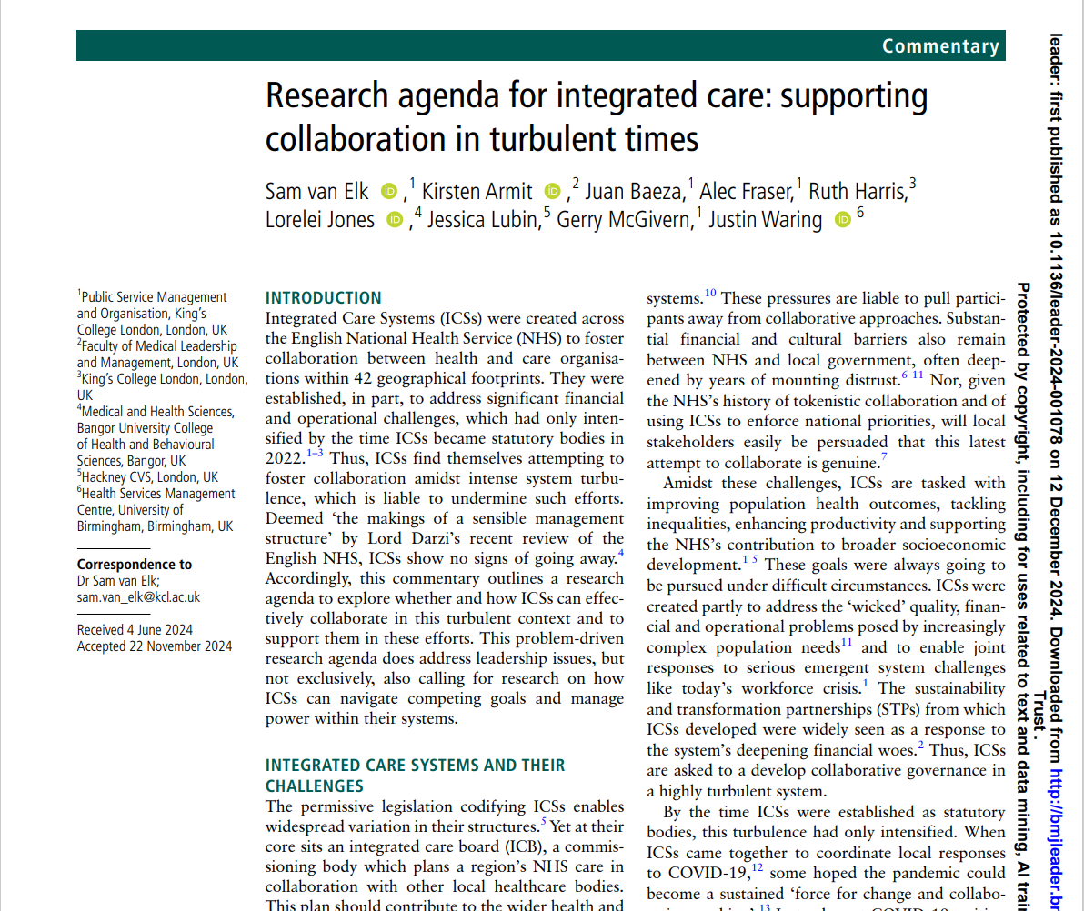
Developing an ICS research agenda for today’s turbulent context
Collaboration & competing goals
Power imbalances
System leadership
Ideal of shared goals (Bell et al., 2022; Moore et al, 2023)
But may need to work with divergence by ‘cycling back and forth’ (Bolden et al., 2023; Waring et al., 2023)
Significant in ICSs (Mitchell et al., 2023)
How can this best be navigated?
Vital to buffer against national pressures (Curry et al., 2022)
Spanning boundaries, diplomacy, strategic views (Jones et al., 2023; Sims et al., 2021)
How achieve agreement or navigate disputes?
Can we use power to enfranchise (Harris et al., 2022)?
But how do all this right now?
https://kclpure.kcl.ac.uk/portal/en/publications/a-research-agenda-for-integrated-care-supporting-collaboration-in

Slide 22
Working in South West London
Through the network
When you think we might help
Through Kaori’s project

Slide 23


My background: From clinical physiotherapist to doctoral researcher
10 years of practice as Physiotherapist in Japan and in the NHS
Specialist sevices experiences in hospitals
Community services experiences
Multidisciplinary collaboration essential for patient-centred care. ICSs designed to support.
However, often hindered by systemic barriers, requiring significant frontline efforts!

Slide 24



My project
How do frontline practitioners, managers, and strategic planners undertake and experience collaboration?
How do these collaborative experiences evolve across organisational boundaries and over time?
Interested in being part of this?
Please get in touch!
In depth qualitative case studies in SWL
Notes:
Step 1: Realisation in Clinical Practice
Recognised limitations in directly applying medical knowledge to diverse patient contexts.
Valued conversations and collaborative relationships with patients, families, and multidisciplinary practitioners.
Understood patient care complexity requires integrated and adaptable approaches.
Step 2: Encountering Systemic Barriers
Observed significant systemic barriers obstructing effective interdisciplinary collaboration.
Experienced frustration and a sense of powerlessness as a frontline practitioner unable to initiate systemic change.
Identified gaps and fragmented care impacting patient outcomes and experiences.
Step 3: Pursuing Research for Systemic Change
Developed a strong motivation to understand organisational structures and system-level perspectives.
Committed to amplifying frontline practitioner voices through research.
Aimed to bridge frontline realities with policy-level strategies, driving meaningful improvements in integrated care.

Slide 25
So please – get in touch if we might be useful!
sam.van_elk@kcl.ac.uk
kaori.hara@kcl.ac.uk

Slide 26
References
Bell, L. et al. (2022) Role of an Integrated Care System during COVID-19 and beyond: a qualitative study with recommendations to inform future development. Integrated Healthcare Journal. [Online] 4 (1), e000112.
Bolden, R. et al. (2023) Paradoxes of Multi-Level Leadership: Insights from an Integrated Care System. Journal of Change Management. [Online] 23337–357.
Curry, L. et al. (2022) The role of leadership in times of systems disruption: a qualitative study of health and social care integration. BMJ Open. [Online] 12 (5), e054847.
Harris, R. et al. (2022) Developing programme theories of leadership for integrated health and social care teams and systems: a realist synthesis. Health and Social Care Delivery Research. [Online] 10 (7), 1–118.
Jones, L. et al. (2023) Role of medical leaders in integrated care systems: what can be learnt from previous research? BMJ Leader. [Online] 7 (2), 133–136.
Mitchell, C. et al. (2023) Primary care services in the English NHS: are they a thorn in the side of integrated care systems? A qualitative analysis. BMC Primary Care. [Online] 24 (1), 168.
Moore, J. et al. (2023) Collaborative Leadership in Integrated Care Systems; Creating Leadership for the Common Good. Journal of Change Management. [Online] 23 (4), 358–373.
Sims, S. et al. (2021) What does Success Look Like for Leaders of Integrated Health and Social Care Systems? a Realist Review. International Journal of Integrated Care. [Online] 21 (4), 26.
Van Elk, S. et al. (2024) Research agenda for integrated care: supporting collaboration in turbulent times. BMJ Leader. [Online] leader-2024-001078.
Waring, J. et al. (2023) Navigating the micro-politics of major system change: The implementation of Sustainability Transformation Partnerships in the English health and care system. Journal of Health Services Research & Policy. [Online] 28 (4), 233–243.

Slide 27
To find our more:
    sam.van_elk@kcl.ac.uk
    kcl.ac.uk/business
    @kclkbs
    ©2023 King’s Business School

Slide 28


