Slide 1
SOUTH WEST LONDON RESEARCH SUPPORT NETWORK One Year On
15:45 – 16:00
Sapna Kurade, SWL Research Support Network Manager, King’s College London

Slide 2
South West London Research Support Network: One Year On 14 May 2025
Sapna Kurade Project Manager South West London Research Support Network & Research Engagement Network Project

Slide 3
Why We Are Here, Together?

Slide 4
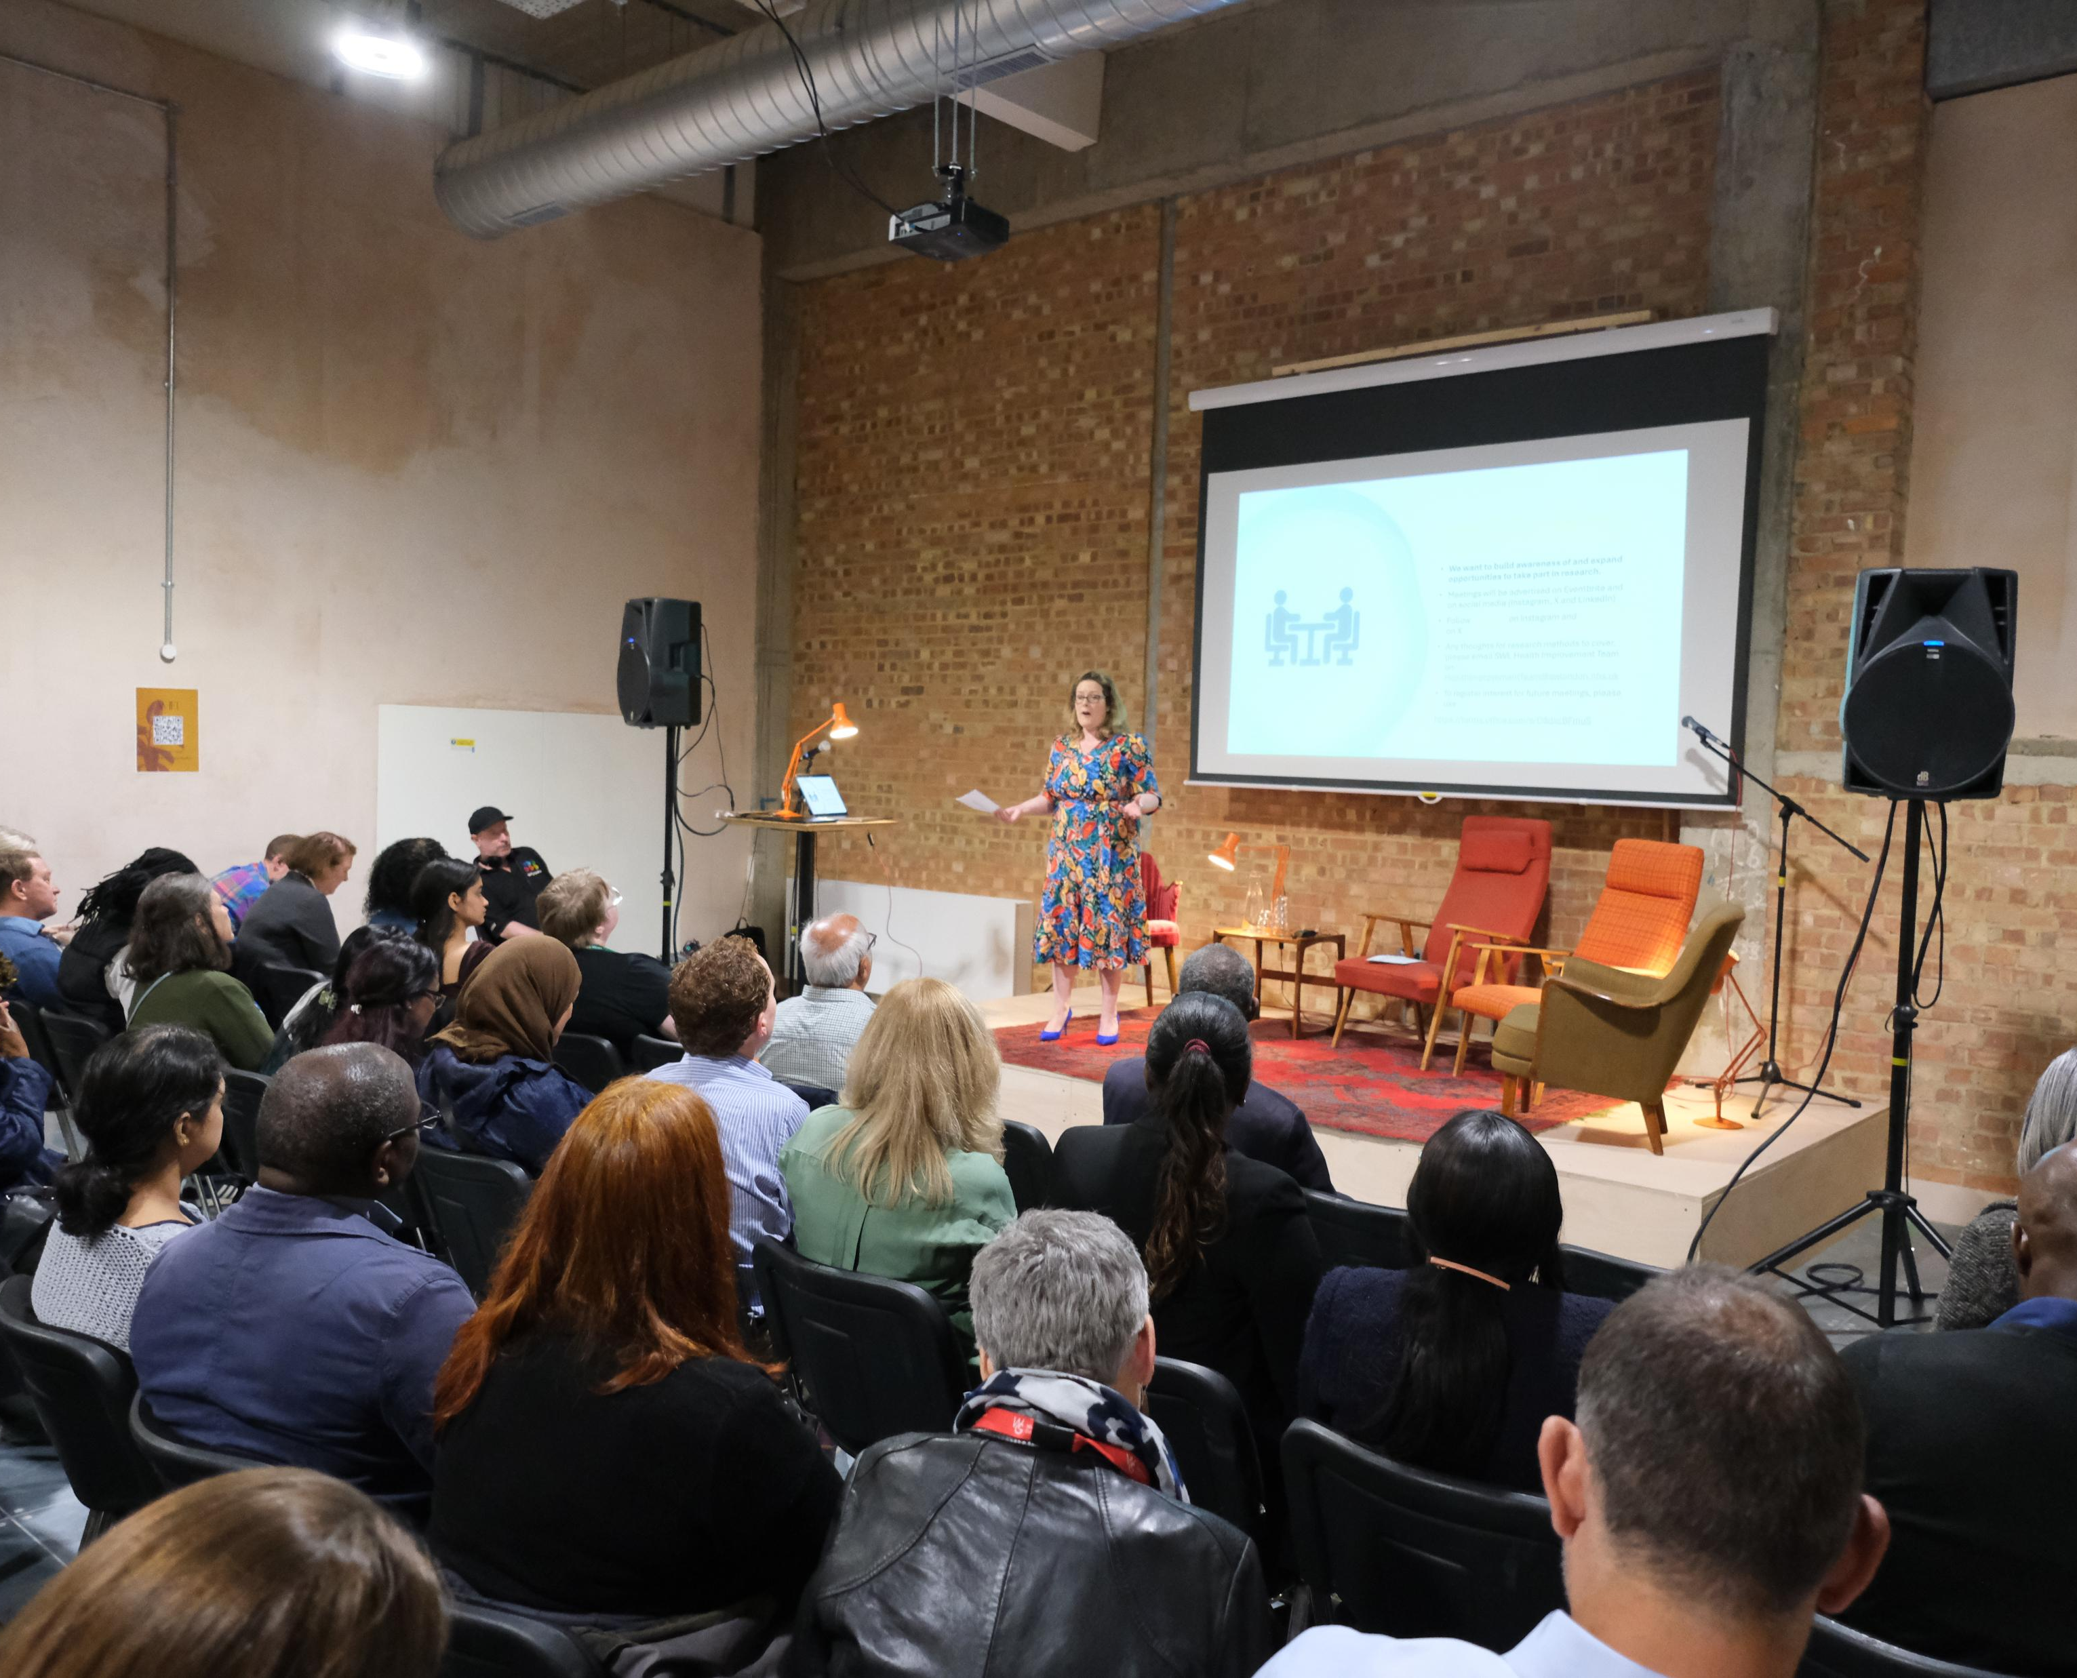
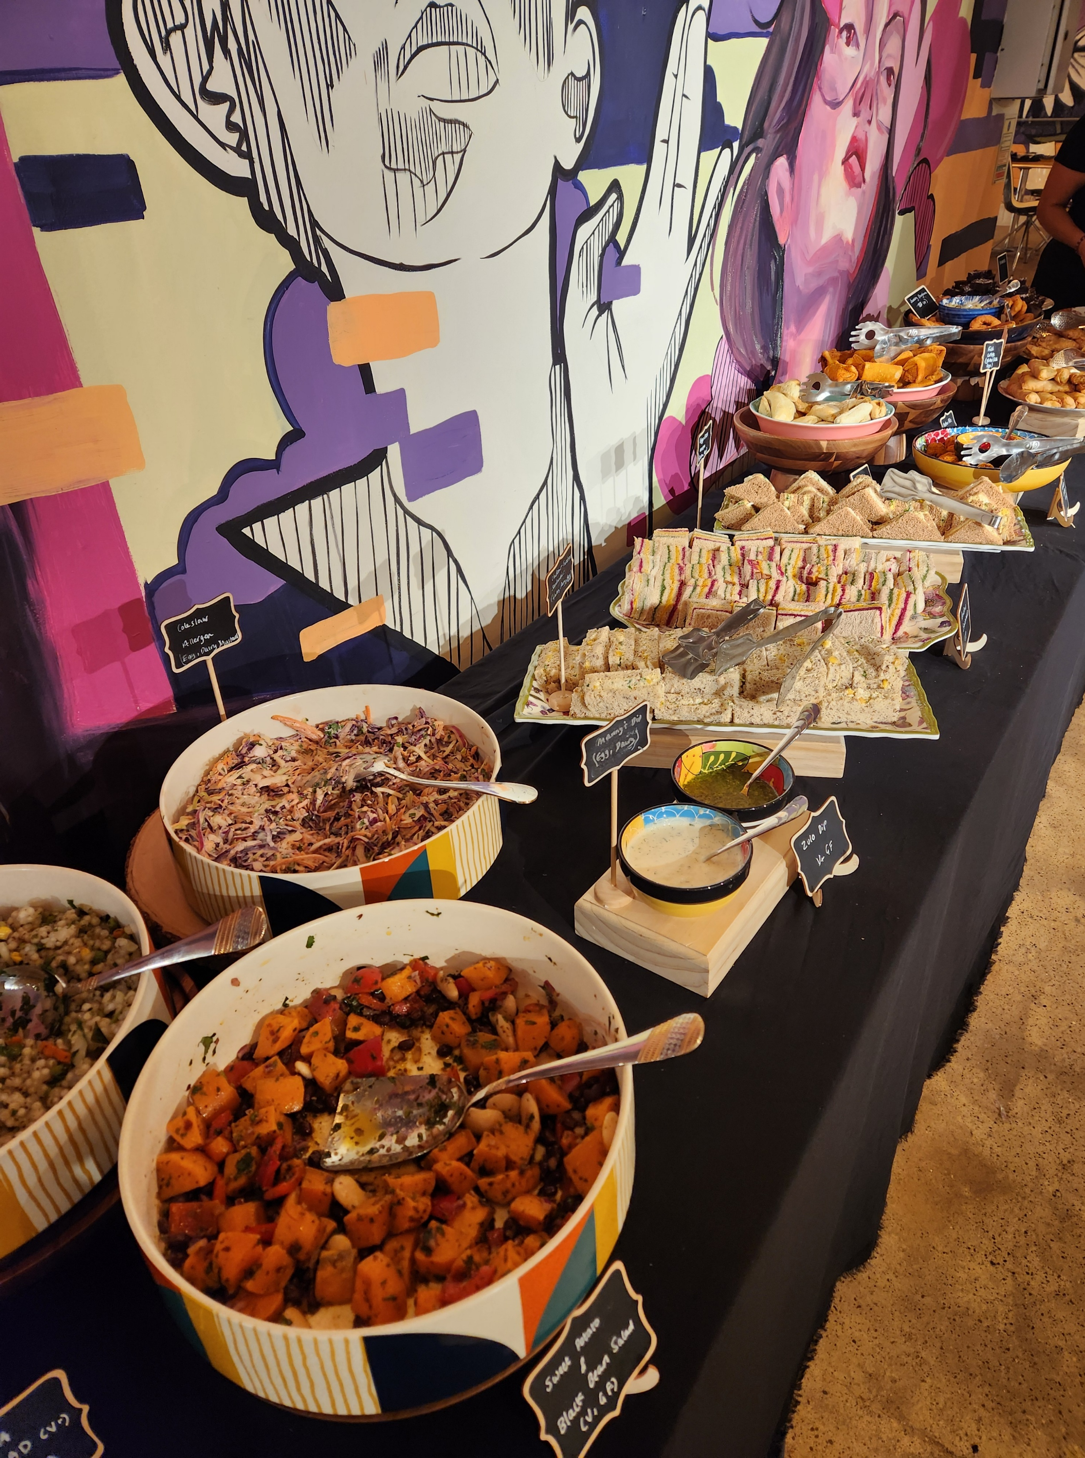

Slide 5
What Would It Take To Feel Supported In Your Research Journey?
Collaboration
People work together as equals — researchers, communities, NHS staff, and the public all have a voice.
“I want to feel like I’m shaping something, not just being asked questions.”
Accessibility
Information is clear, events are easy to join, and support is there if you need it.
“I want to feel like I don’t need a PhD to take part.”
Inclusivity
Everyone feels welcome and respected, no matter their background, experience, or identity.
“I want to feel like research includes people like me — not just experts.”
Community-led
Ideas come from real local needs, not top-down. People with lived experience help set the agenda.
“I want to feel like research starts with what matters in my community.”

Slide 6
What Is the SWL Research Support Network?

Slide 7
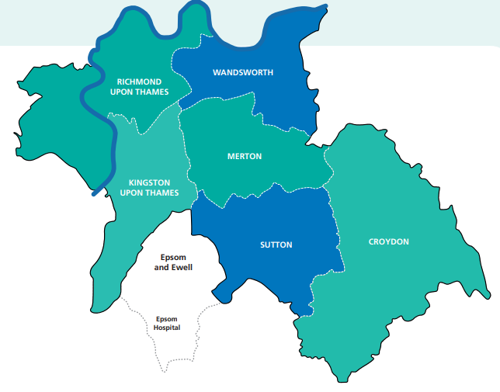
A Local Research Network That Belongs to Everyone
Launched in May 2024 by NHS South West London Integrated Care System
Created to strengthen research capacity in local communities and voluntary organisations
Builds inclusive spaces for collaboration across VCSEs, NHS staff, and researchers
Offers practical training, networking, and peer learning opportunities
Helps embed evaluation skills across sectors and support more equitable participation in research
In partnership with BIG South London, with representation from NHS, voluntary sector, universities, local authorities, and the public across all six SWL boroughs

Slide 8
Network Cafés vs Research Cafés

Slide 9
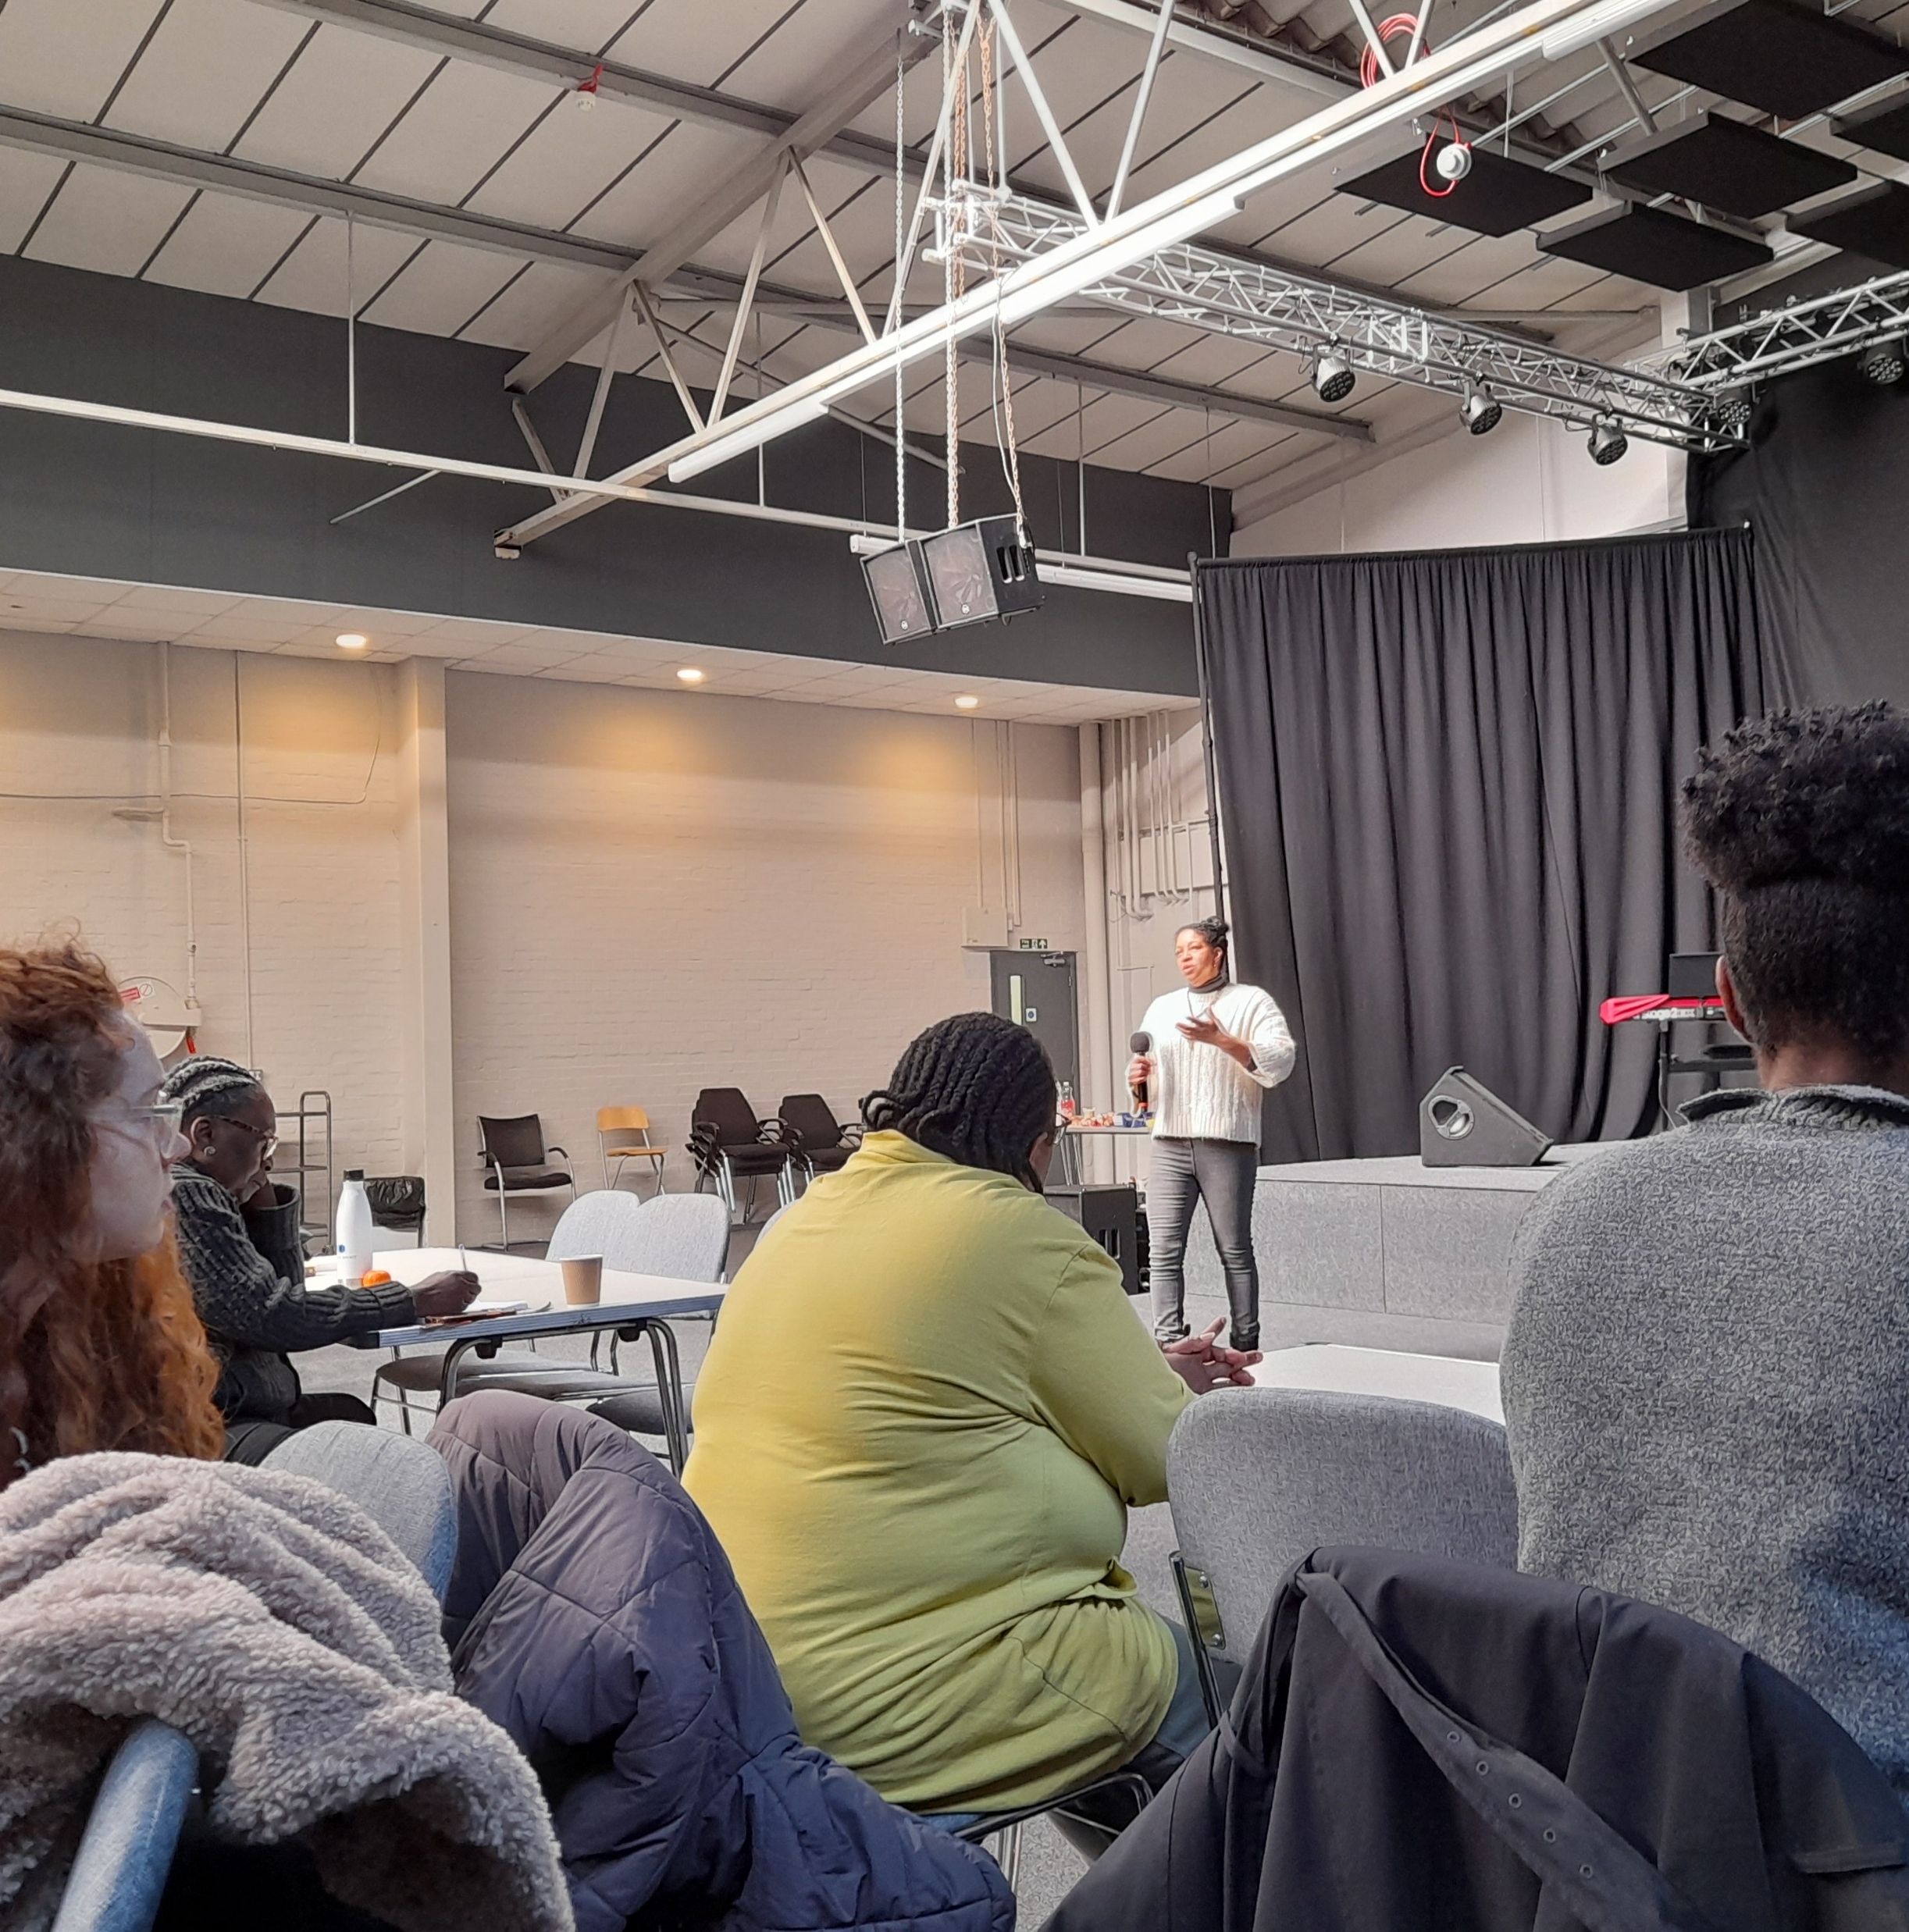
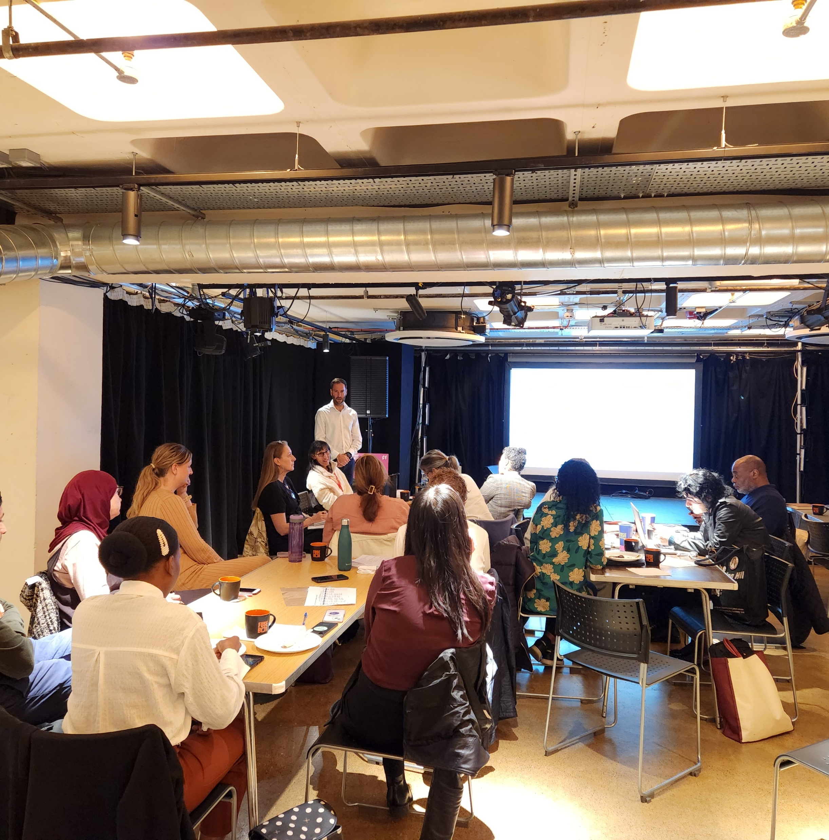

Slide 10
Different Tools, Shared Purpose
Network Cafés | Research Cafés
Part of the Research Support Network | Part of Research Engagement Network project
For skills, confidence & connections | For engagement, literacy & participation
Topics: evaluation, bid writing, surveys, leadership | Topics: mental health, service user experiences, brain health – dementia/stroke
Co-learning spaces | Peer-led inclusive methodology
300+ attendees from various sectors | 160+ participants from underrepresented backgrounds

Slide 11
One Year On – What We Have Done?

Slide 12
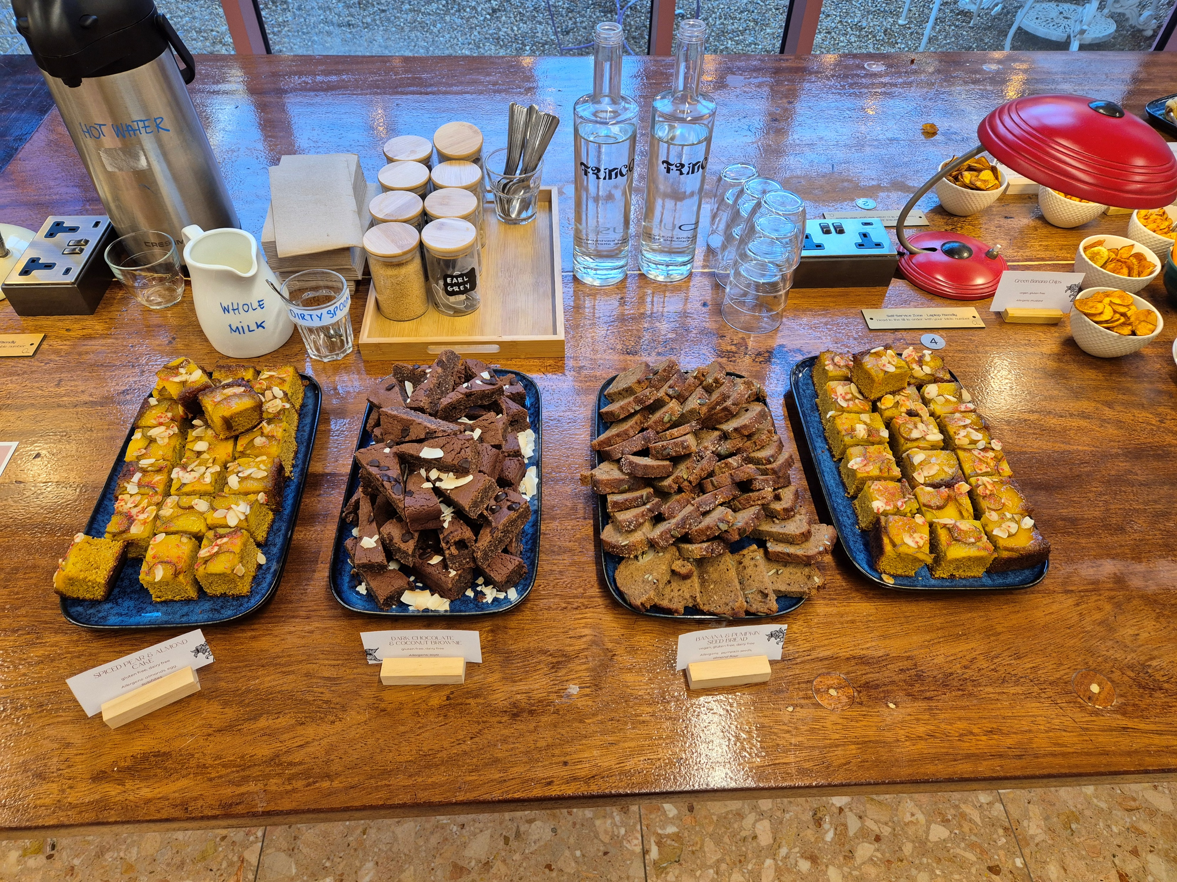

Slide 13
10+ Events 12 Evaluation Ambassadors 500+ Lives Touched
May 2024
Launch of the South West London Research Support Network
August 2024
How to Avoid Losing Friends and Alienating People with Surveys
Dr. Catherine Heffernan (SWL ICB)
September 2024
The Importance of Evaluation Marcus Green (Optum)
October 2024
Measuring Outcomes and Proving Impact Marcus Green (Optum)
February 2025
Rapid Evaluation
Marcus Green (Optum)
January 2025
Where to Find Data for Community and Voluntary Organisations
Kate White and Karen McLean (Superhighways)
December 2024
Smart Literature Searches and Critical Appraisal for NHS Professionals
Liz Lourandos (Epsom & St Helier)
November 2024
Bid Writing - Turning Vision into Funded Projects
Alison White (HIN SL) and Kate Scott (KU)
March 2025
Evidencing Impact: How to Align Your Evaluation with Funder Priorities
Marcus Green (Optum)
April 2025
Leadership and Community Engagement for System-Wide Change in Health
Durka Dougall and Samira Ben Omar (CfPH)
May 2025
South West London Health Research Summit
July 2025 (Upcoming)
More Than A Tick Box: Designing WITH Not For Our Stakeholders
Fiona Jones (City St George’s)

Slide 14
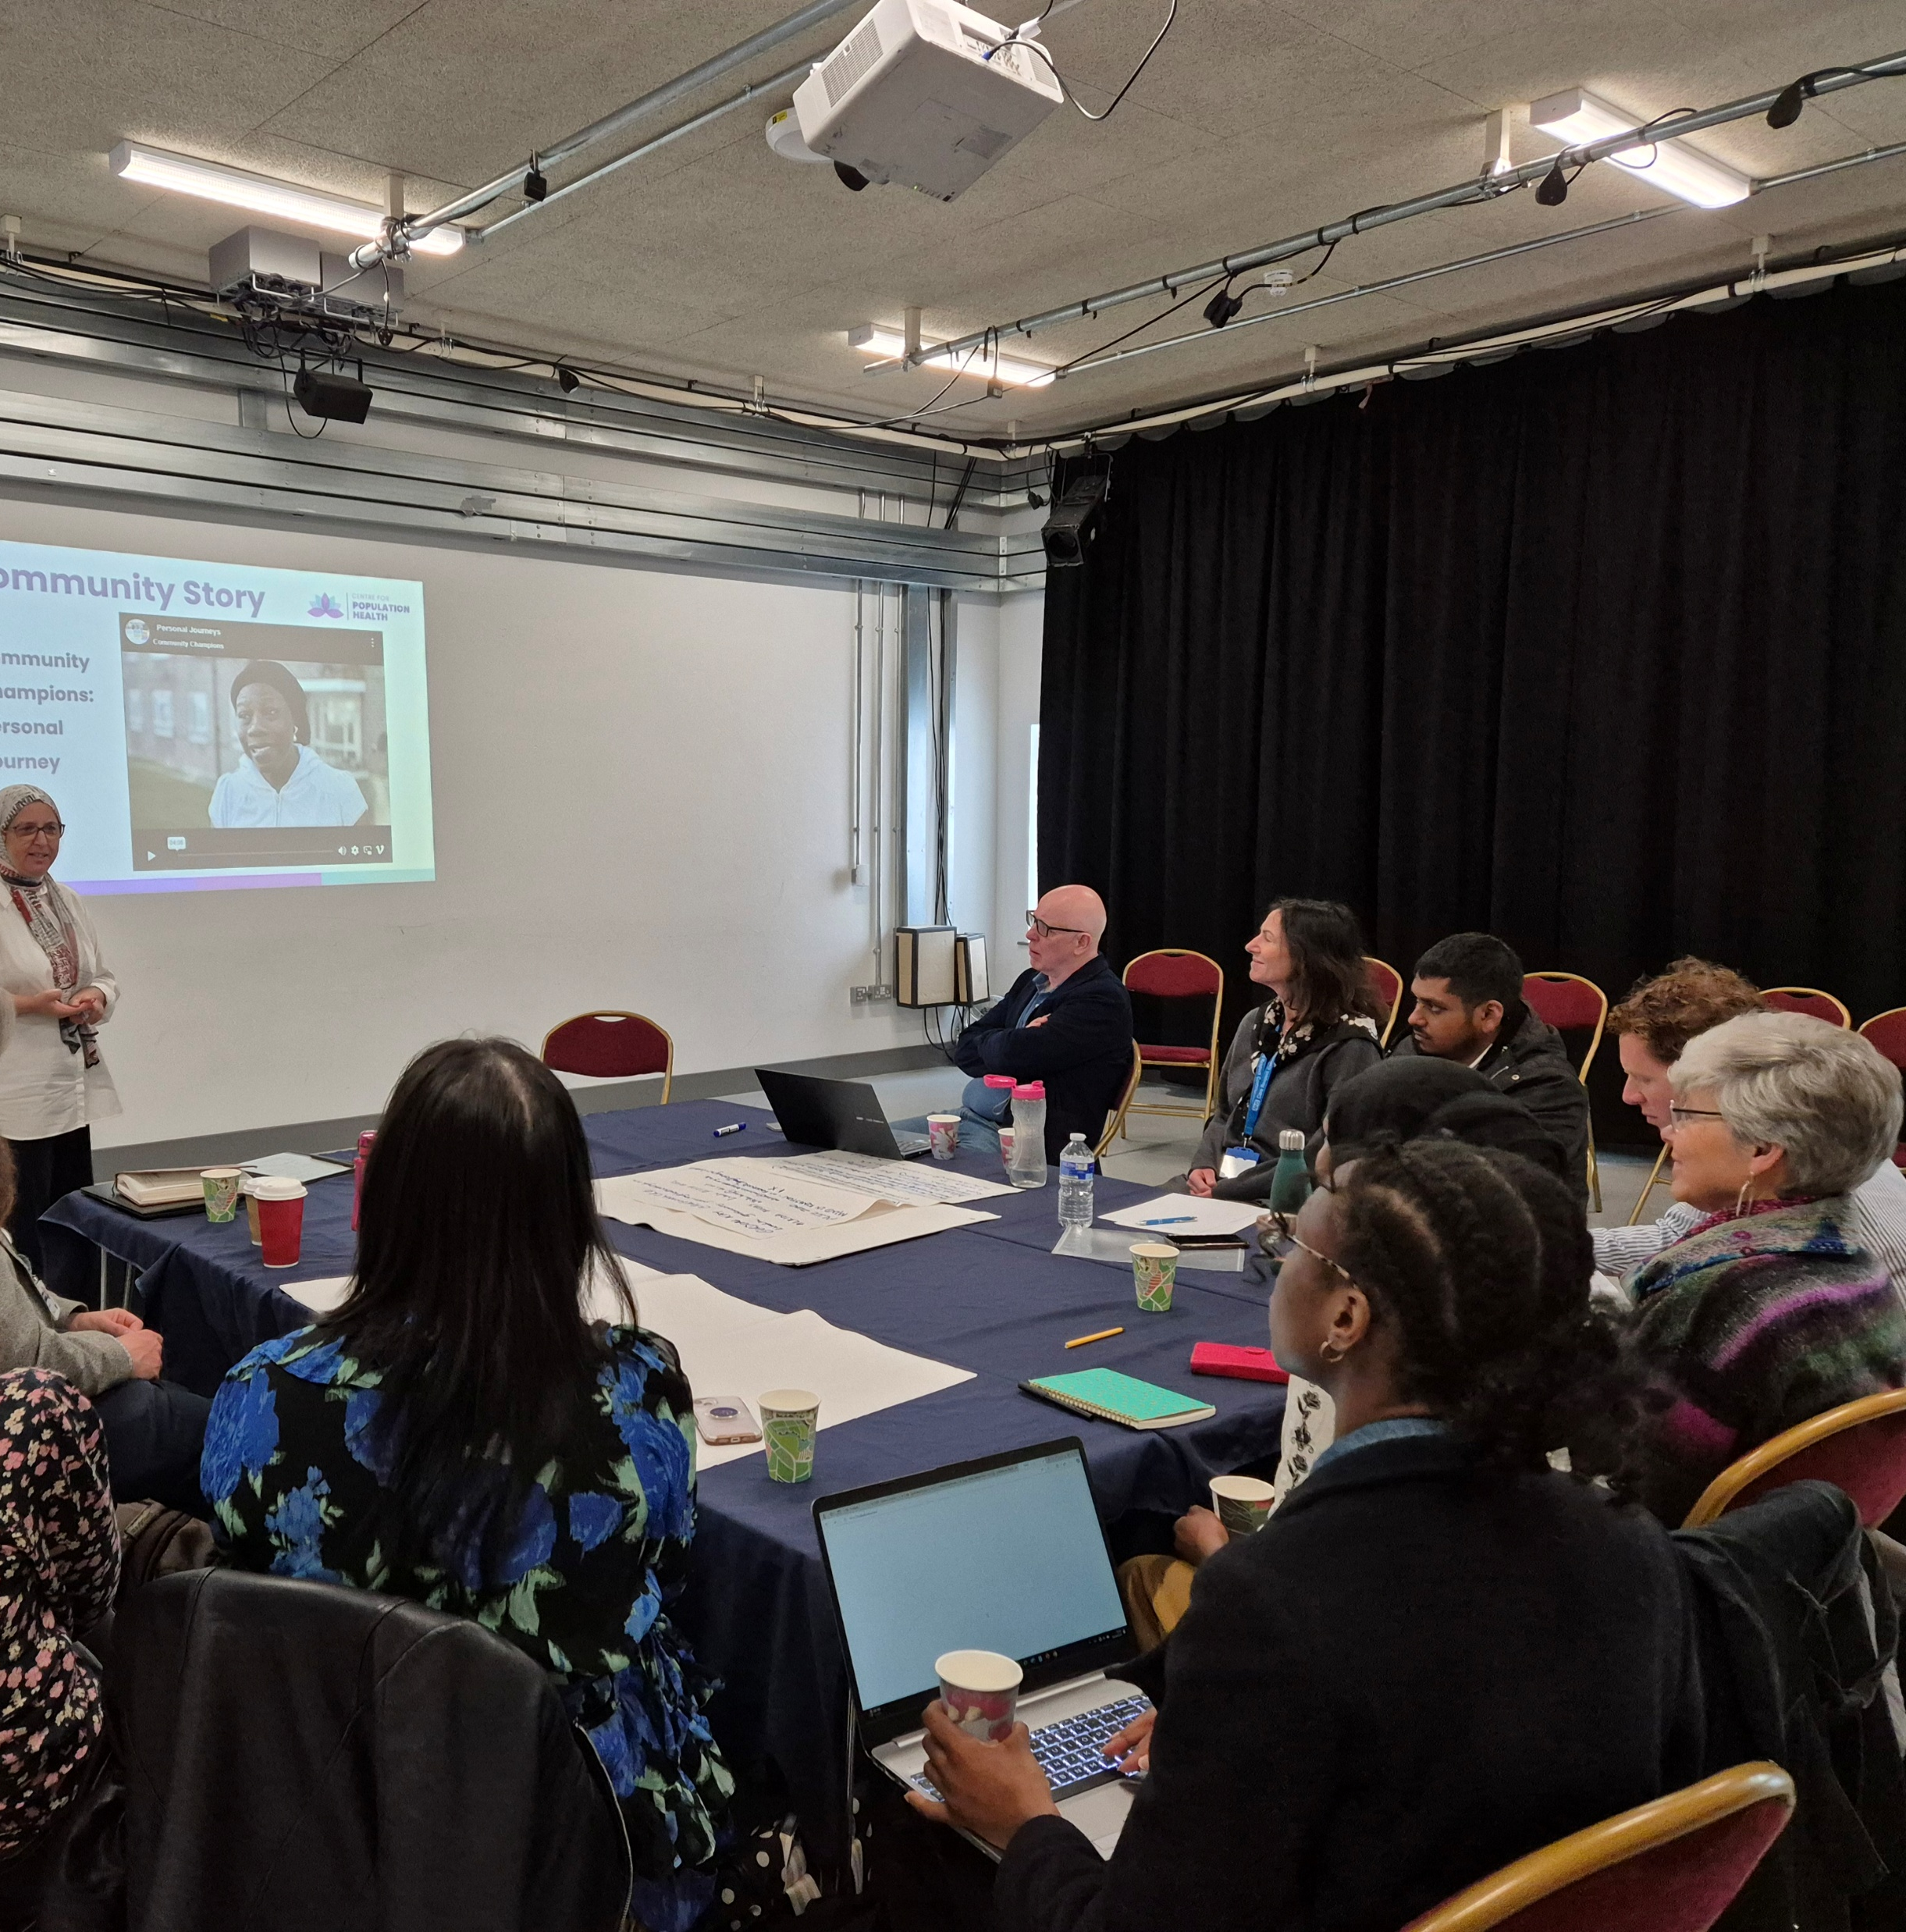
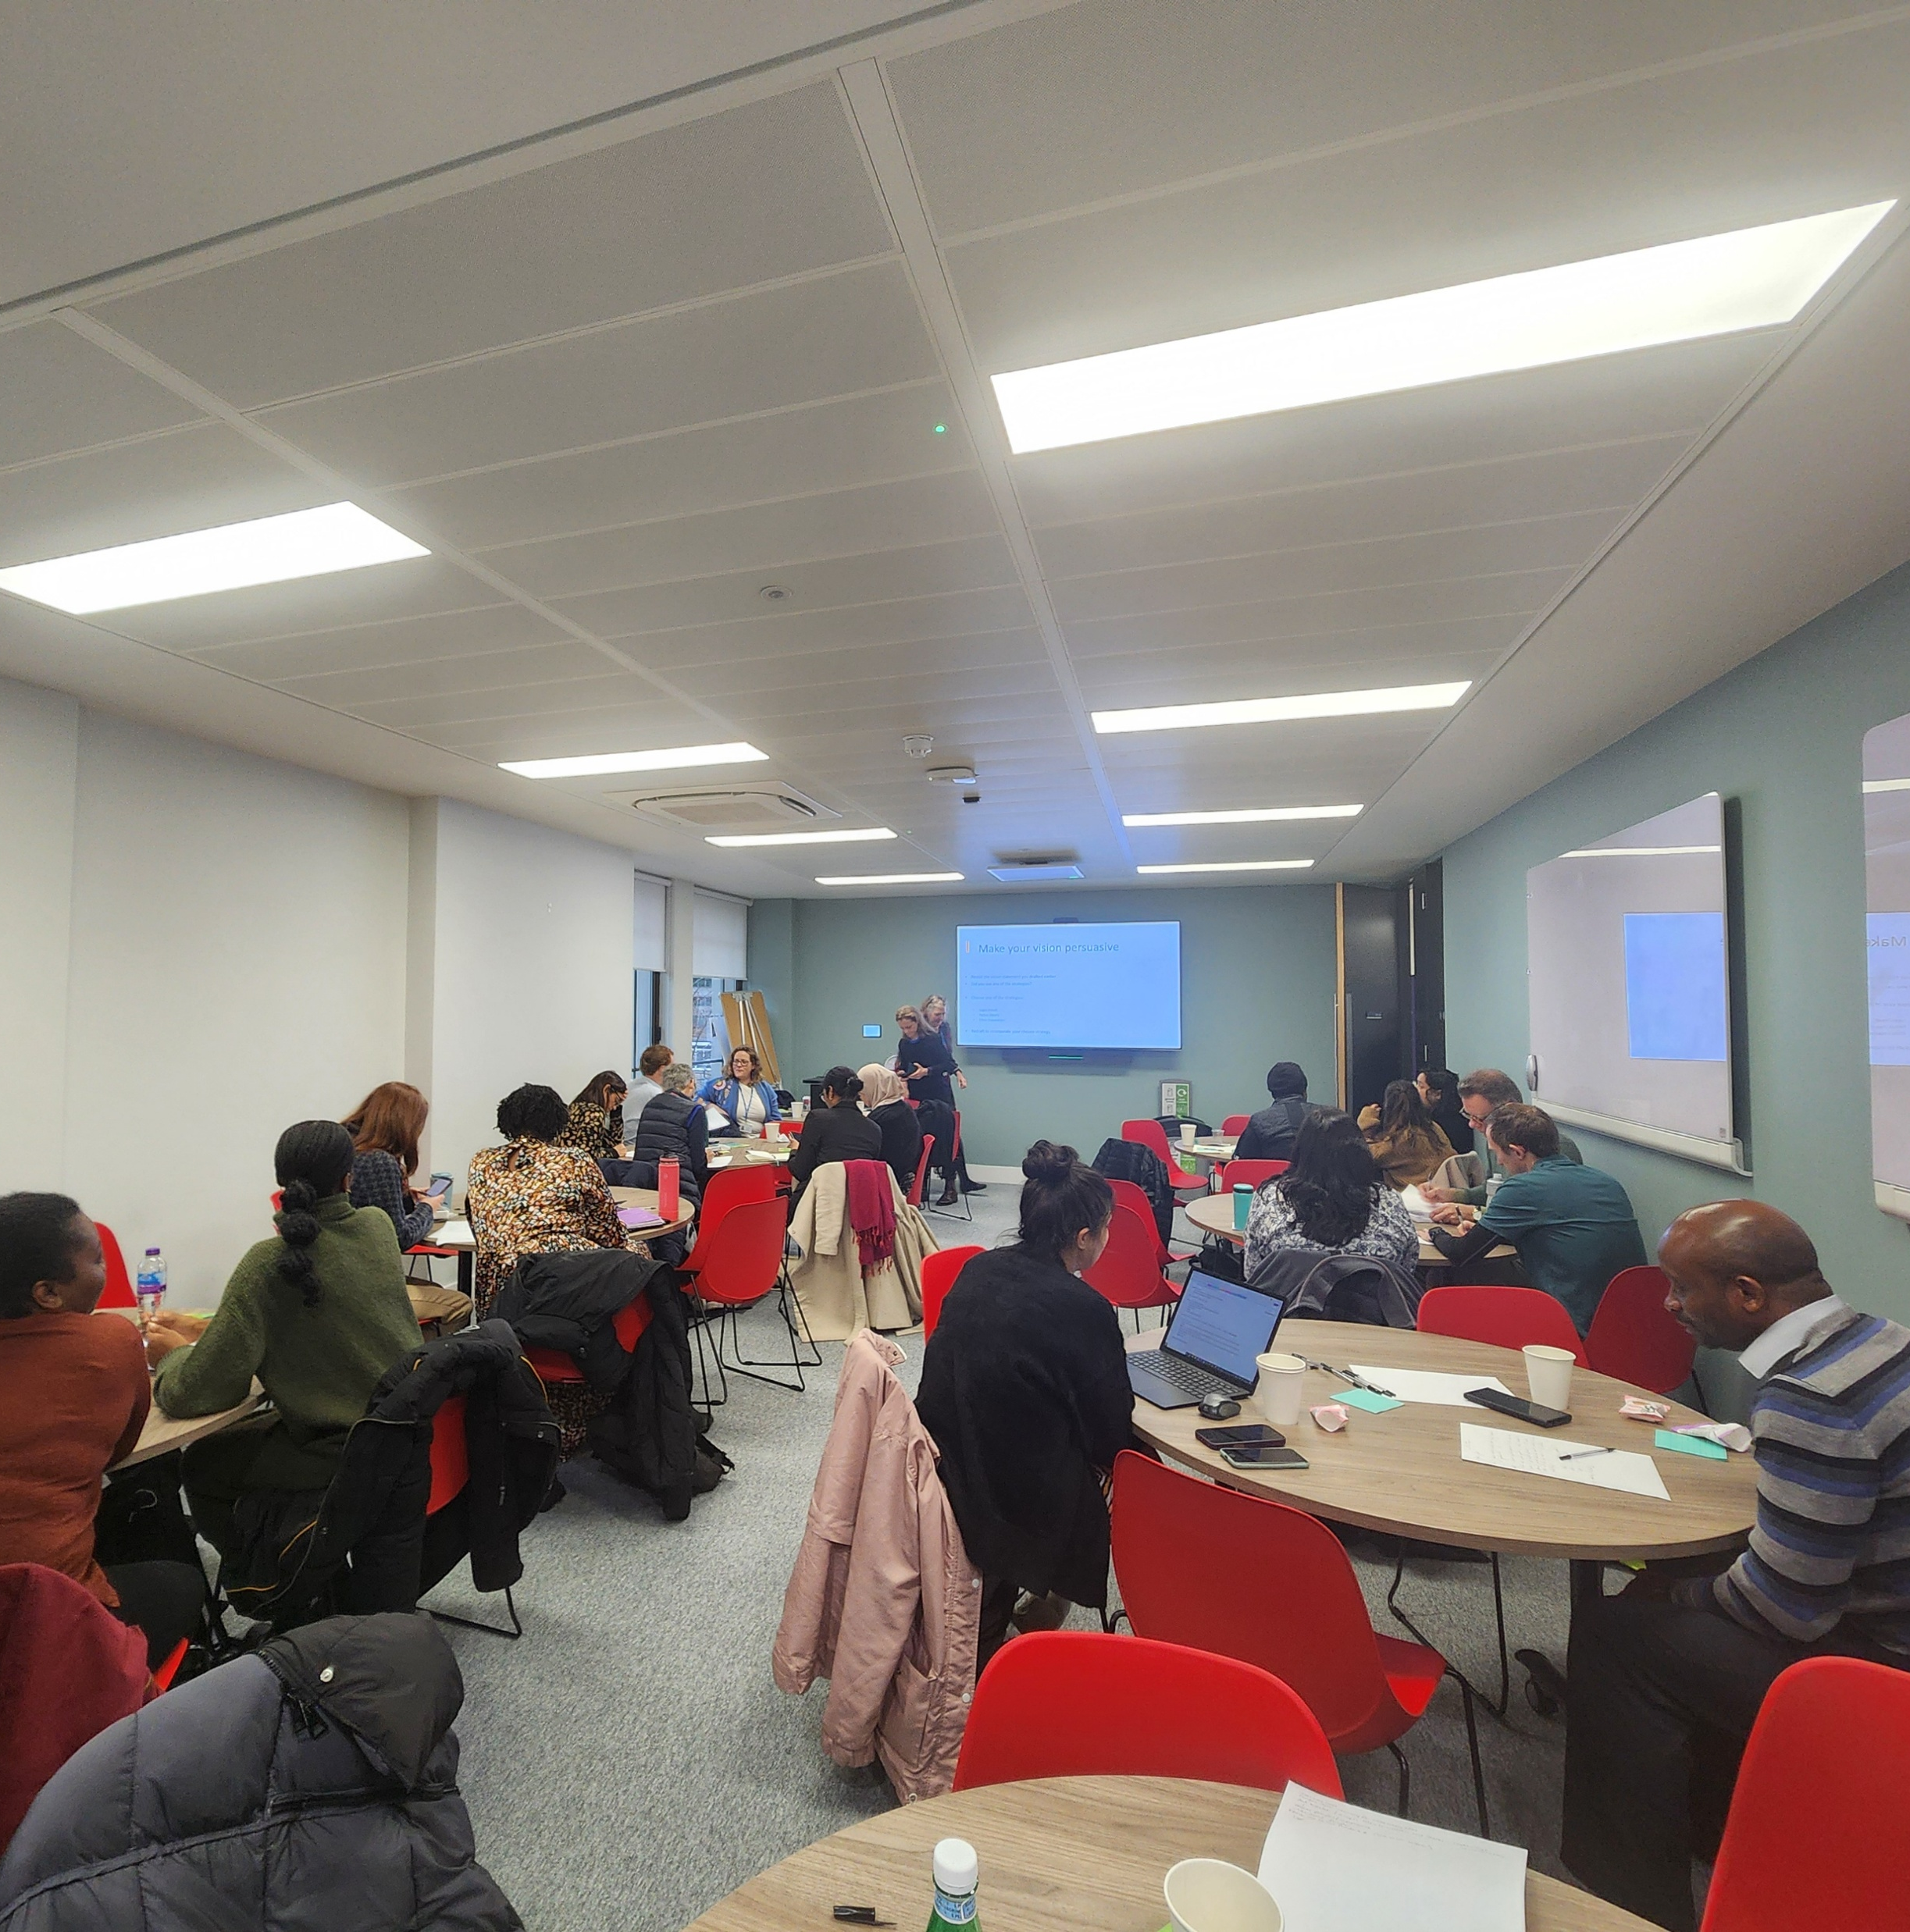

Slide 15
Voices From the Network

Slide 16
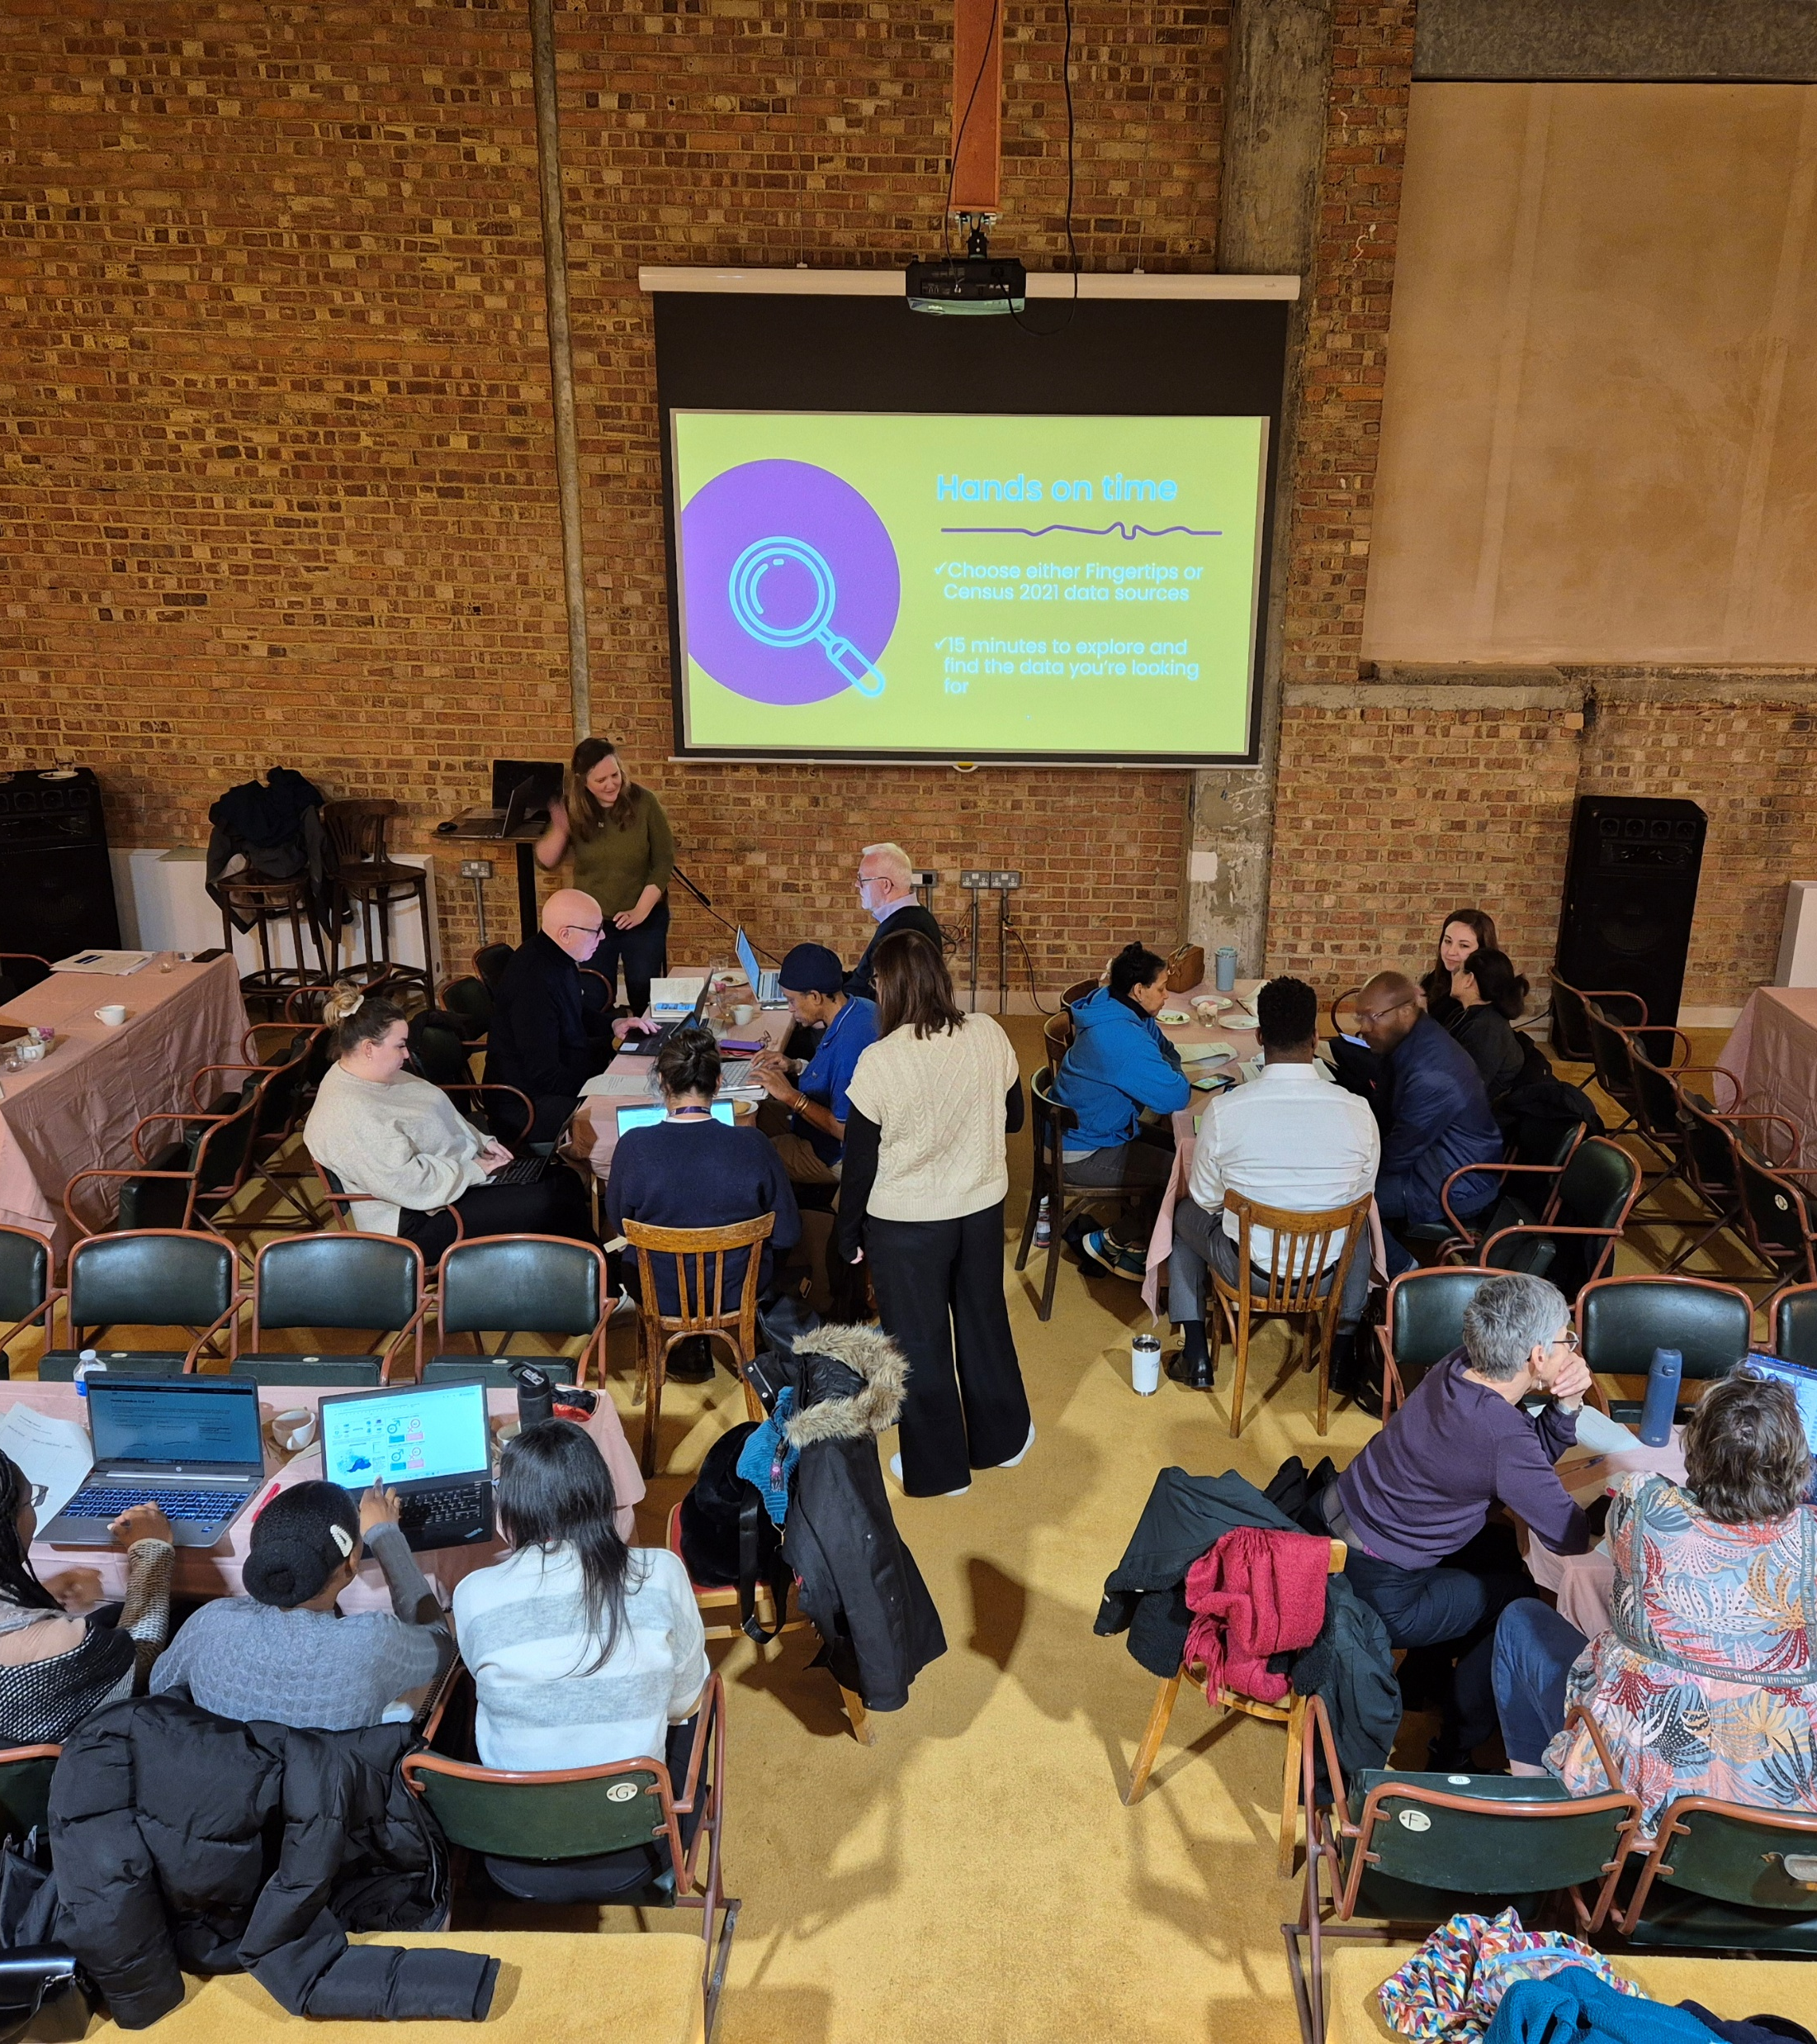
What People Are Telling Us…
What People Valued
“Food, networking, topic!”
“The speaker kept on the right side of being helpful for non-academics. I found it very helpful!”
“I felt at ease… learning and having access to information for future reference.”
“I really liked the open dialogue, sharing of ideas, and interactions.”
“The smaller number of people enabled everyone to ask questions and feel heard.”
“Great workshop — lots of helpful discussion and resources!”
“Loved the pace of learning — not overwhelming. 45-minute slots worked well.”
“Demos were more concise and relevant than YouTube — so helpful.”
“The environment and ease to communicate and share.”
“For a beginner like me, all the info was super valuable.”
“Thoughtful speakers, great venue, good lunch — would attend again!”

Slide 17
What People Are Telling Us…
Areas We Are Improving
Clearer takeaways and handouts requested at some sessions
More time for discussion or peer input in some groups
Balancing content for beginners vs. those with more experience
How We Are Listening
We were planning a deep-dive session on qualitative and quantitative evaluation techniques. But based on feedback, there was a strong ask to focus on how to align your evaluation with funder priorities — so we pivoted. And it worked!
We are also trialling demo-led sessions and tweaking timings and pacing — because when people say it’s too much or not enough time to reflect, we take that seriously.

Slide 18
What’s Next And How You Can Join

Slide 19
Let’s Grow the Network, Together
Browse our Knowledge Bank
Practical tools and resources from past Network Cafés on evaluation, data, funding, and research methods.
Lead a Network Café
Got a cross-sector topic to share? We would love to hear your idea.
Stay Connected
Join our mailing list or the SWL Health Research Collaborative to get updates on events, opportunities and resources.
Shape the Network
Have ideas for future topics or formats? Tell us what would help you and your sector.
Need Research or Evaluation Support?
We can link you with our trained Evaluation Ambassadors and topic experts.
Want to Become an Evaluation Ambassador?
If you are experienced in evaluation and based in South West London — get in touch.
Email: SWLICB-HIT@swlondon.nhs.uk Learn more about our Research Support Network

Slide 20
We Want To Hear From You!

Slide 21
What Did You Think of Today?
Please scan the QR code to share your feedback on today’s Summit.

