Slide 1

St Mary’s School of Medicine
Transforming your education for our world
Professor Sonia Kumar
Executive Dean of Medicine
Professor of Medical Education
Visiting Professor Imperial College London, University of Leeds, SBV University India

Slide 2
Agenda
Background
Why a School of Medicine and why now?
CARE Doctors
Examples of principles and projects
Centenary building
QA

Slide 3
Background
Notre Dame, Cobham
MBBS Kings College London
Kings, London Deanery, Imperial, Leeds
Front line GP 20 years
Research Centre MEdIC at Imperial
Community based health and education

Slide 4
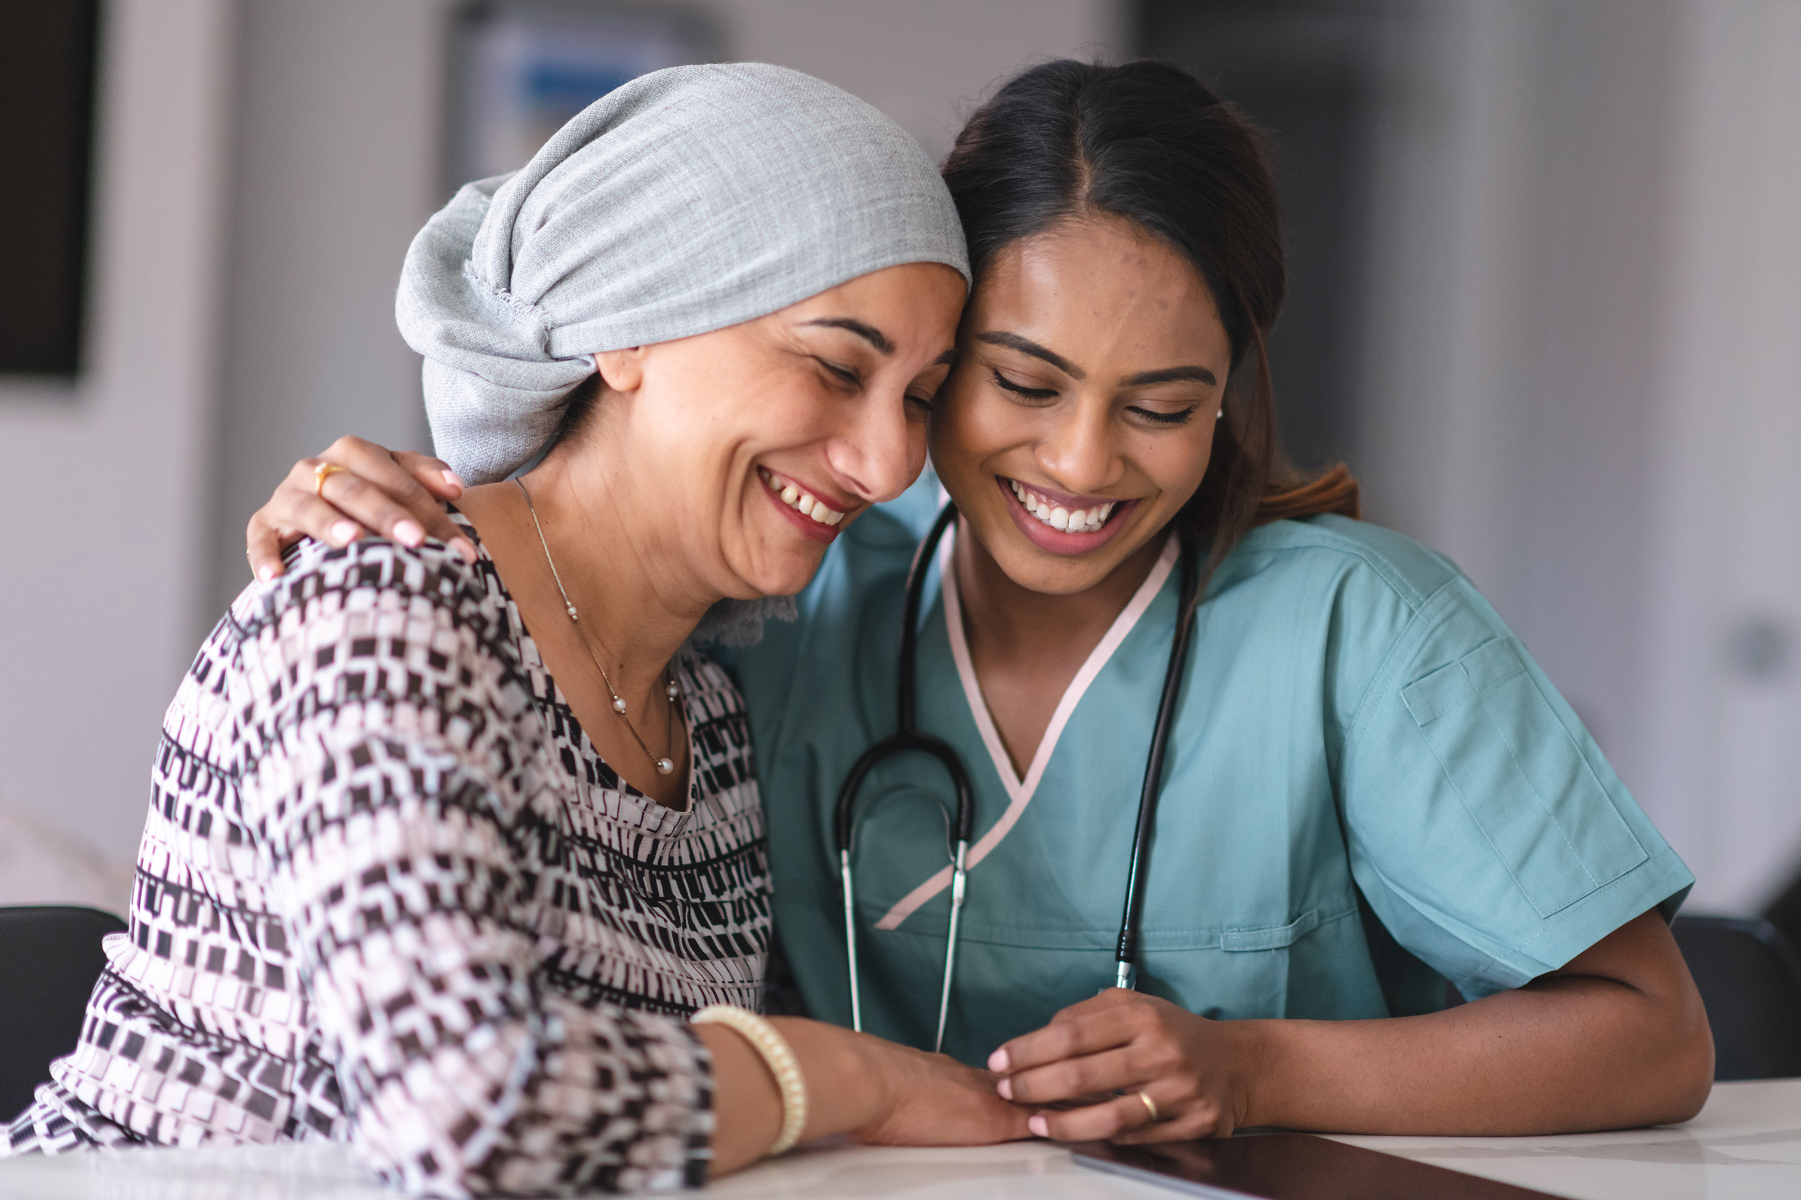
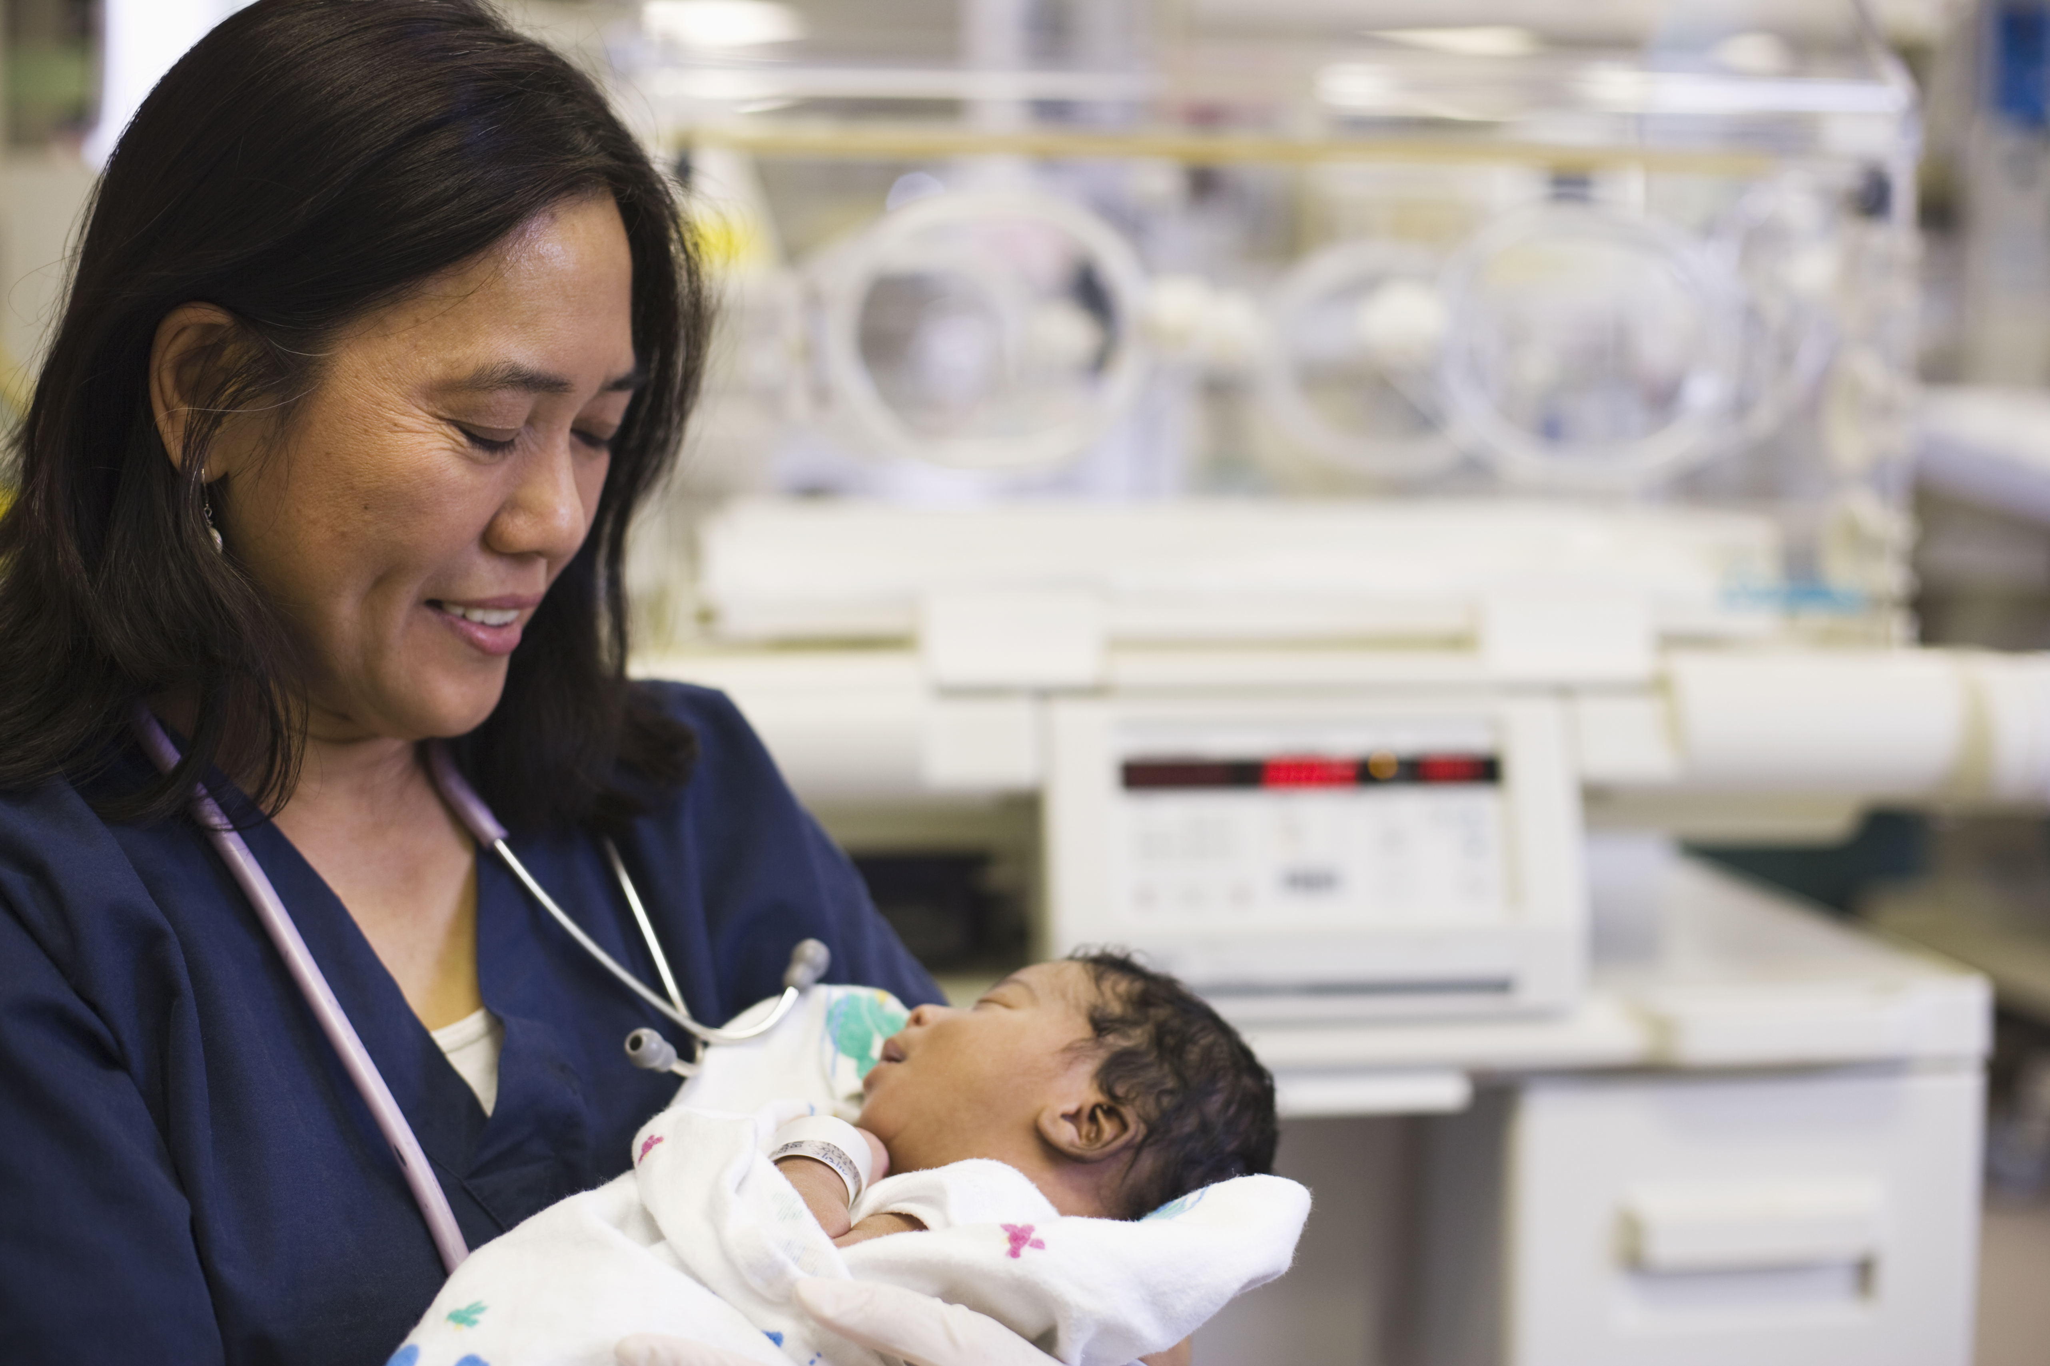
Why a School of Medicine and why now?
Society seeing increasing health inequalities and a decreasing retention of doctors in the NHS
We need a holistic change in how we understand health and train our future doctors
At St Mary’s our goal is simple: we are striving to advance medical education: integrating scientific and digital excellence with core human values and social purpose.
St Mary’s graduates will have a commitment to health inequalities and the attributes to thrive as a doctors
Opens September 2026 (Subject to final GMC approval)

Slide 5
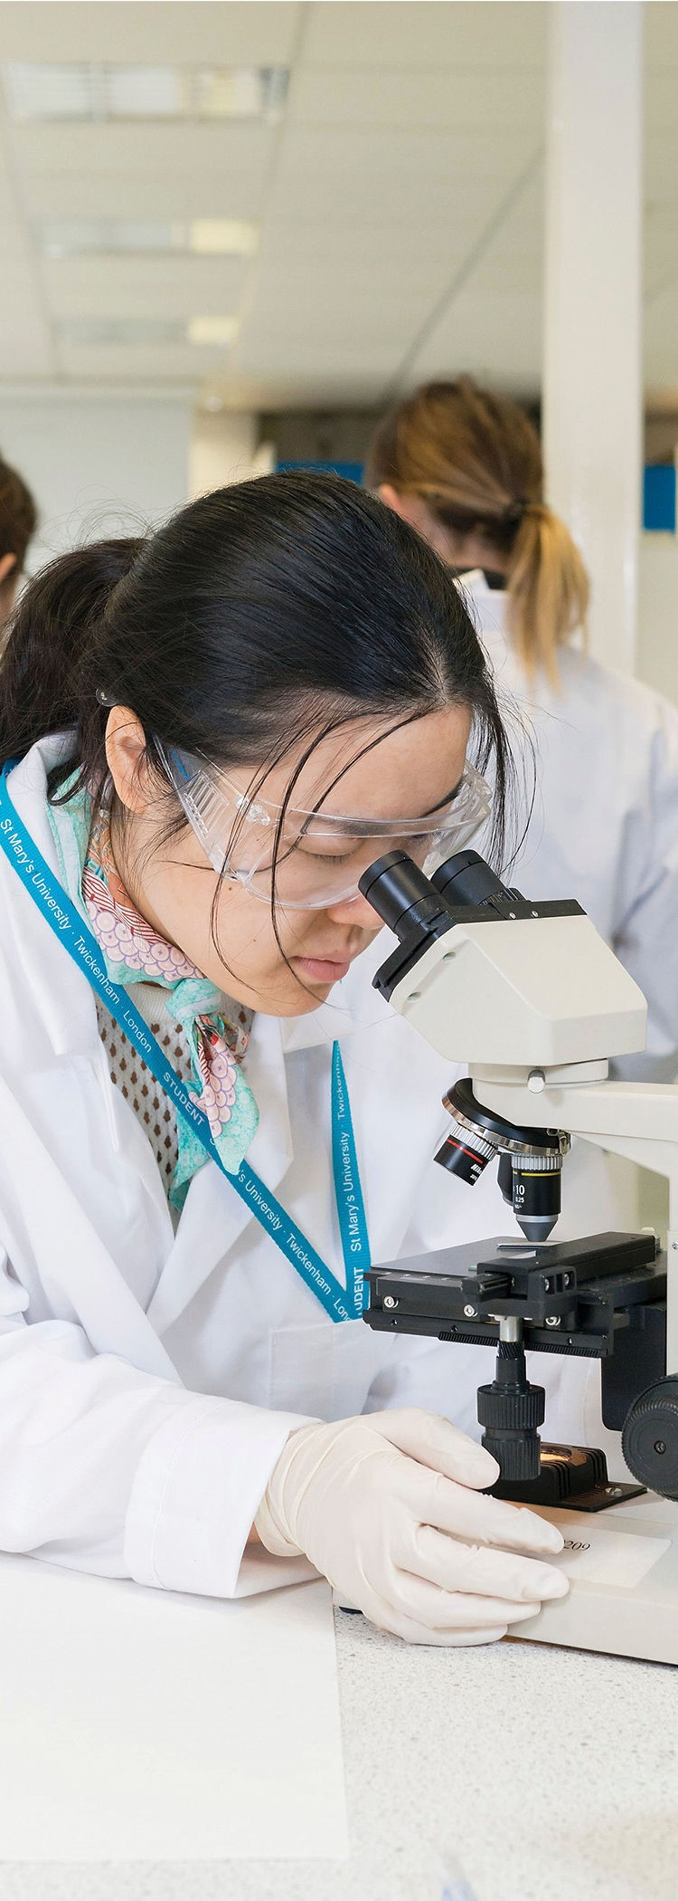

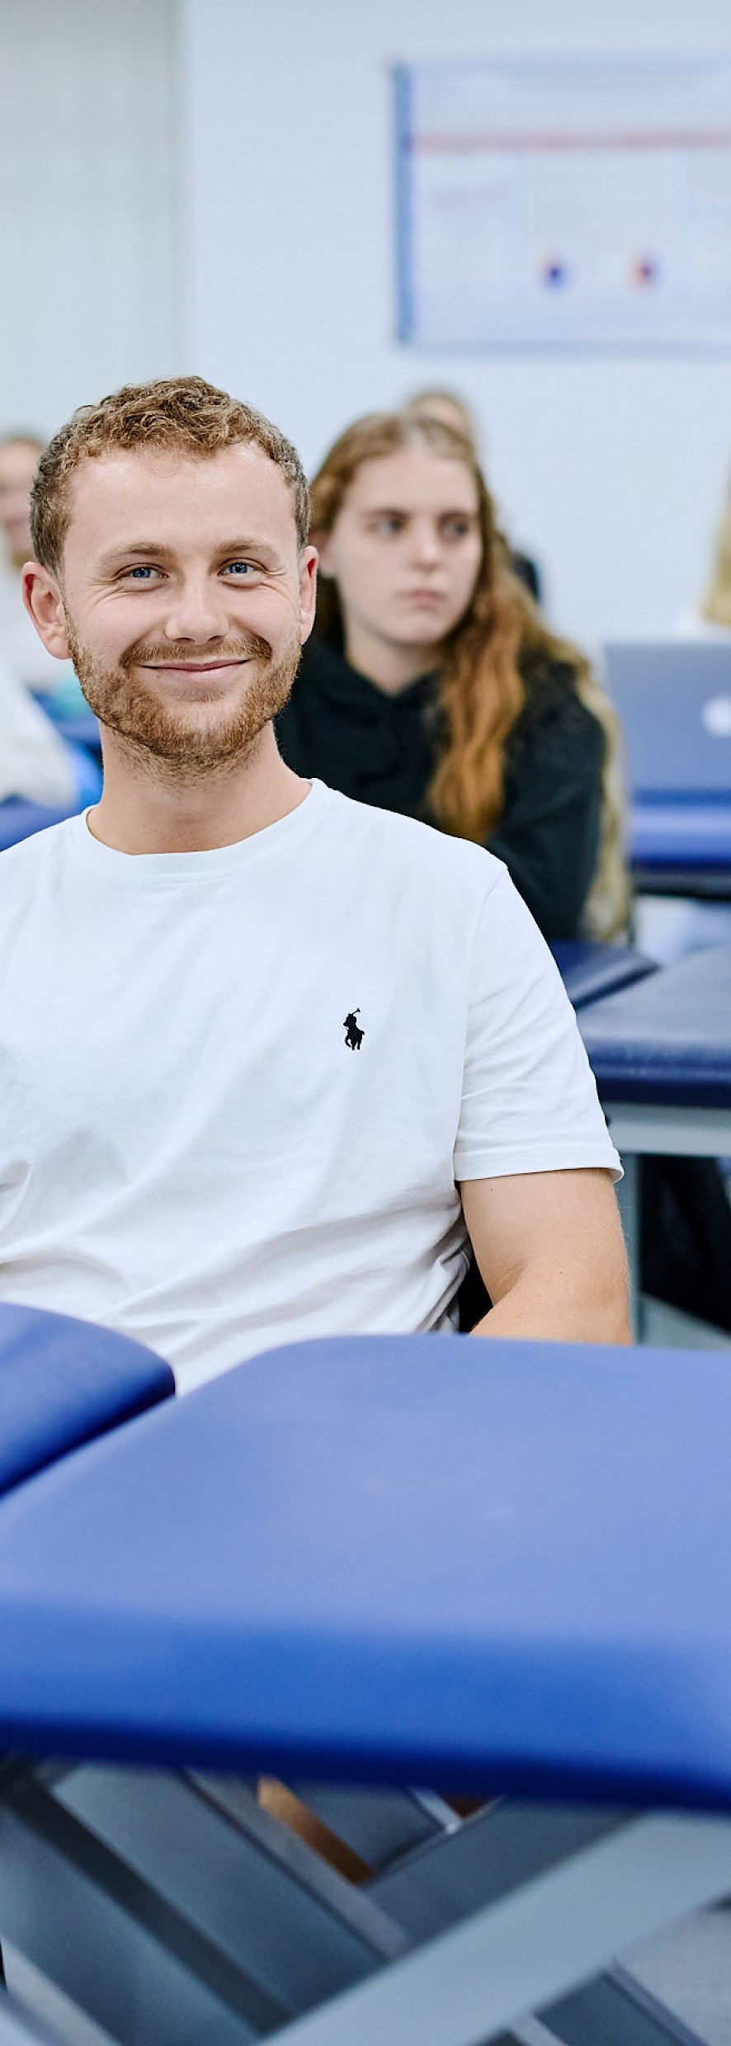
St Mary’s graduates that ‘CARE’
· Compassion. For patients, each other and themselves.
· Ambition. World leading science meets core human values and social purpose
· Readiness. Prepare to practice as a future NHS Doctor through active patient care from year 1
· Excellence. Join a TEF Gold/Top 5* University in our brand new digitally advanced at our London green campus.

Slide 6
A community-driven and community-led medical school
Placement mapping: placements mapped to national deprivation indices, placing students in diverse communities
Values-based recruitment: using a values-based recruitment model, recruiting well rounded holistic students, strong focus on local WP students when places are available
A Local medical school for local people: curriculum mapped to local inequality data ensuring local people and their priorities are at the heart of everything we do, students are given PAMs before placements
Locally Embedded, Globally Focussed: map learning outcomes to UN SDGs understand global challenges eg climate change and health and explore collaborative online co-learning international learning (COIL).
Community engagement: local community will play a key part ensuring patient and community voices are at the core of what we do - Patient and Public Committee, expert patients, lay representation

Slide 7

PAMs
Architects' impression

Slide 8
Examples of student projects
Year 1 Music Therapy: intergenerational music making with patients with dementia, learning difficulties and mental health.
Year 2 Social Action Project: collaborate with charities/community groups on issues such as homelessness, food poverty, and mental health
Year 3 Student Health Coaches: students trained to address preventable diseases and social isolation
Year 4 Longitudinal Patient Advocates: care co-ordinators between primary/secondary care, social care, and charities, helping vulnerable patients receive integrated care.
Student select modules: students will be able to choose novel placements eg Health Watch, medics into schools, charities eg Brite Box, private providers, research centres, pharma

Slide 9
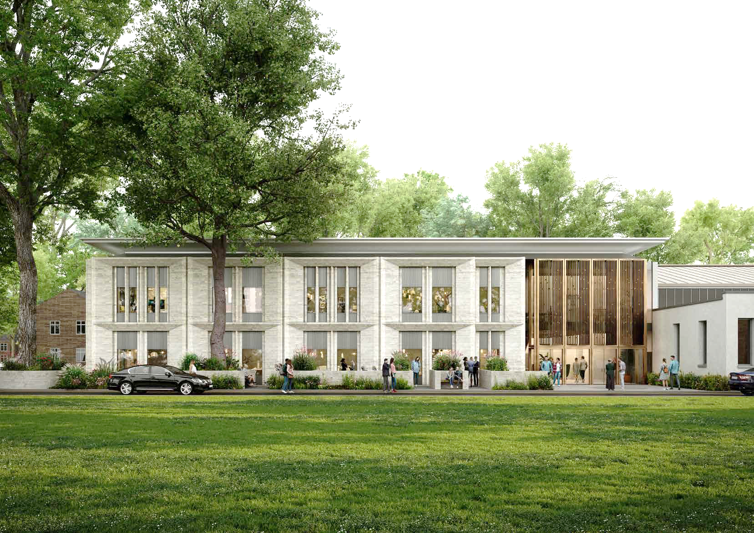
The Centenary building
Architects' impression

Slide 10
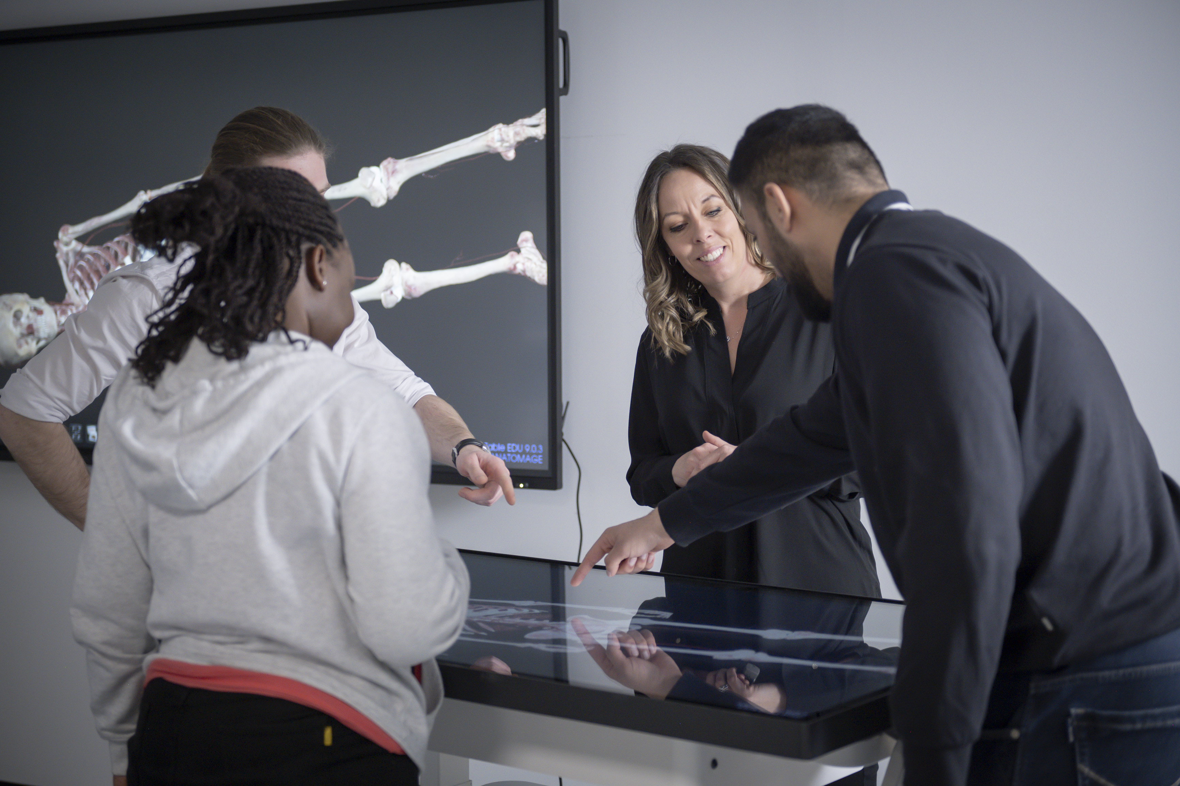
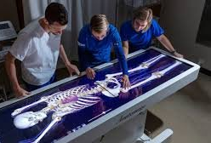

Cutting-edge Digital Facilities
Notes:
Anatomage virtual dissection tables to help train students

Slide 11
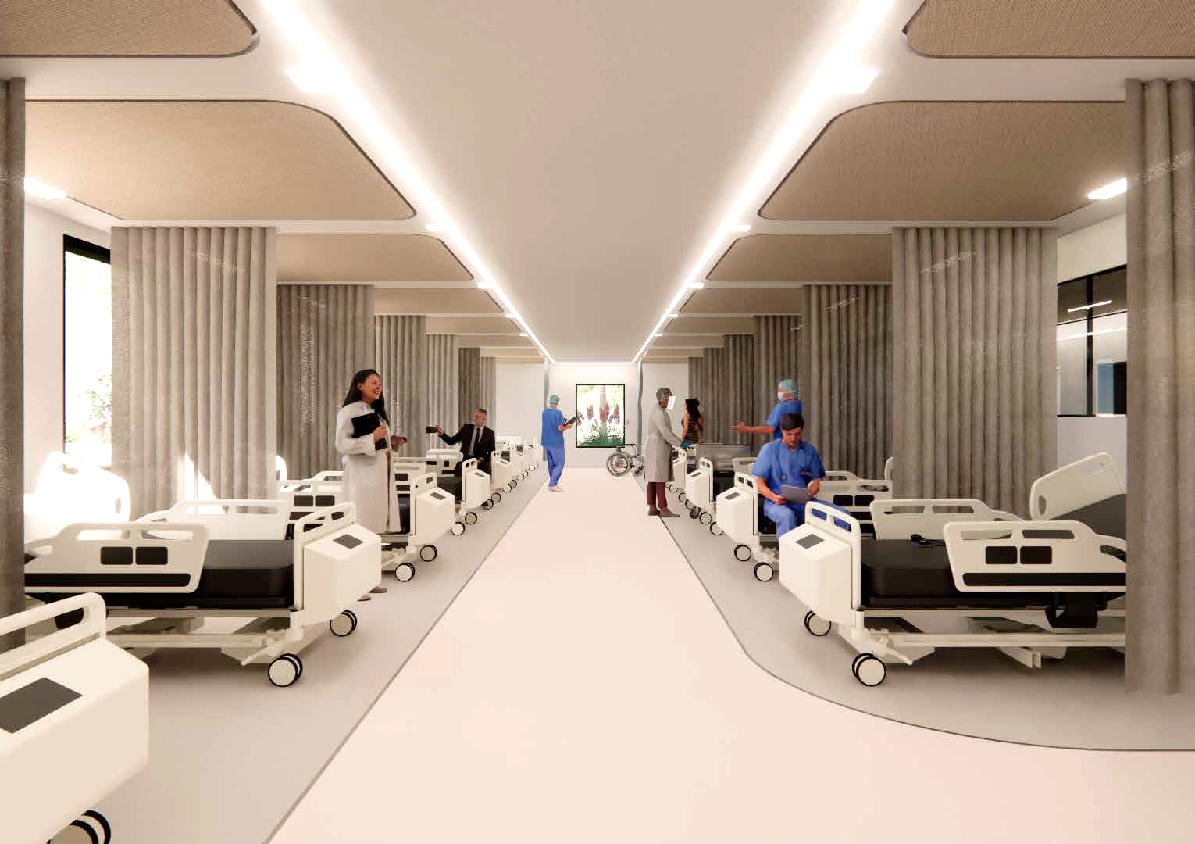
Integrated Skills and Simulation Centre

Slide 12
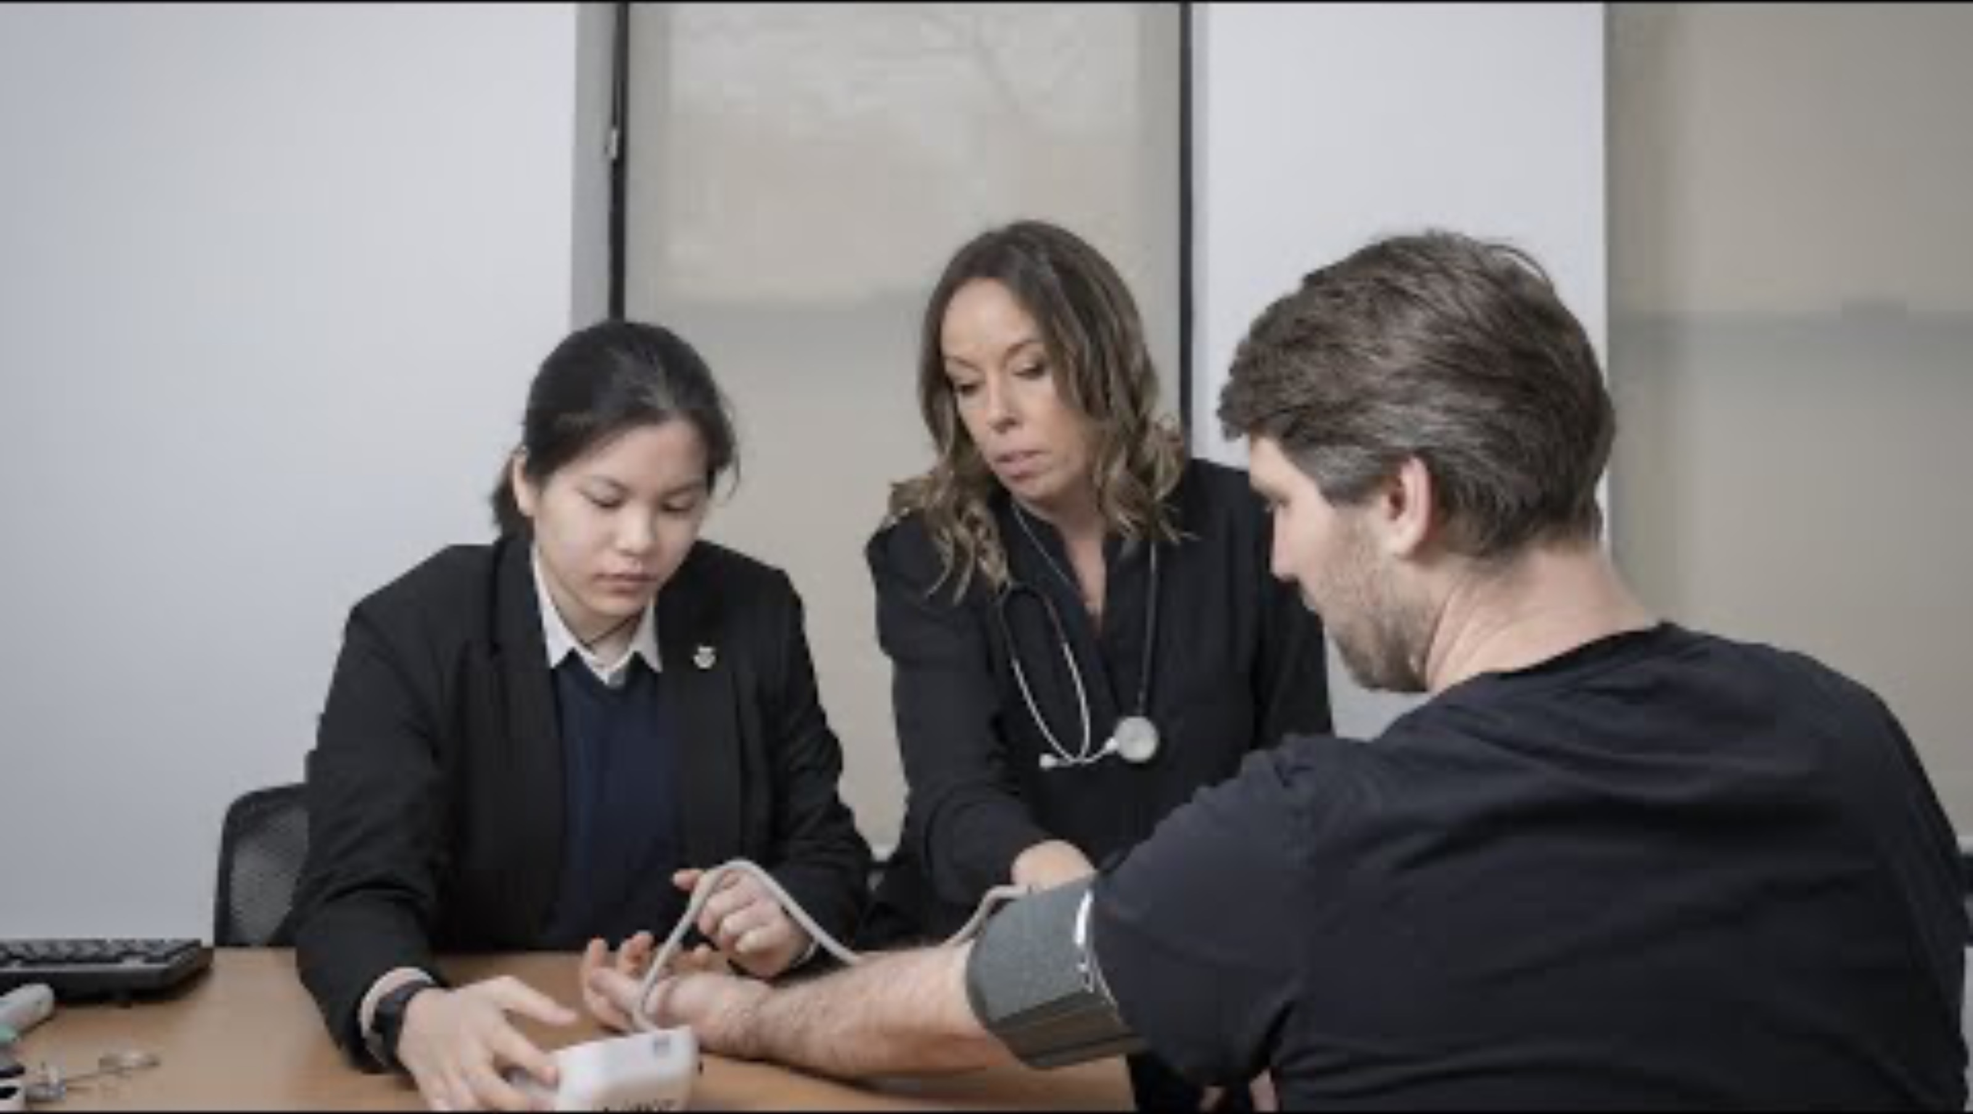
Notes:
https://youtu.be/ajeBT651UVg?si=4qmP2n477x_fTCe2

Slide 13
Thank you and please do get in touch sonia.kumar@stmarys.ac.uk
Notes:
.

