Slide 1
South West London’s Health Research Summit
14 May 2025
Dr Alison Austin
Deputy Director of Embedding Research
NHS England
Notes:
Standard title slide

Slide 2
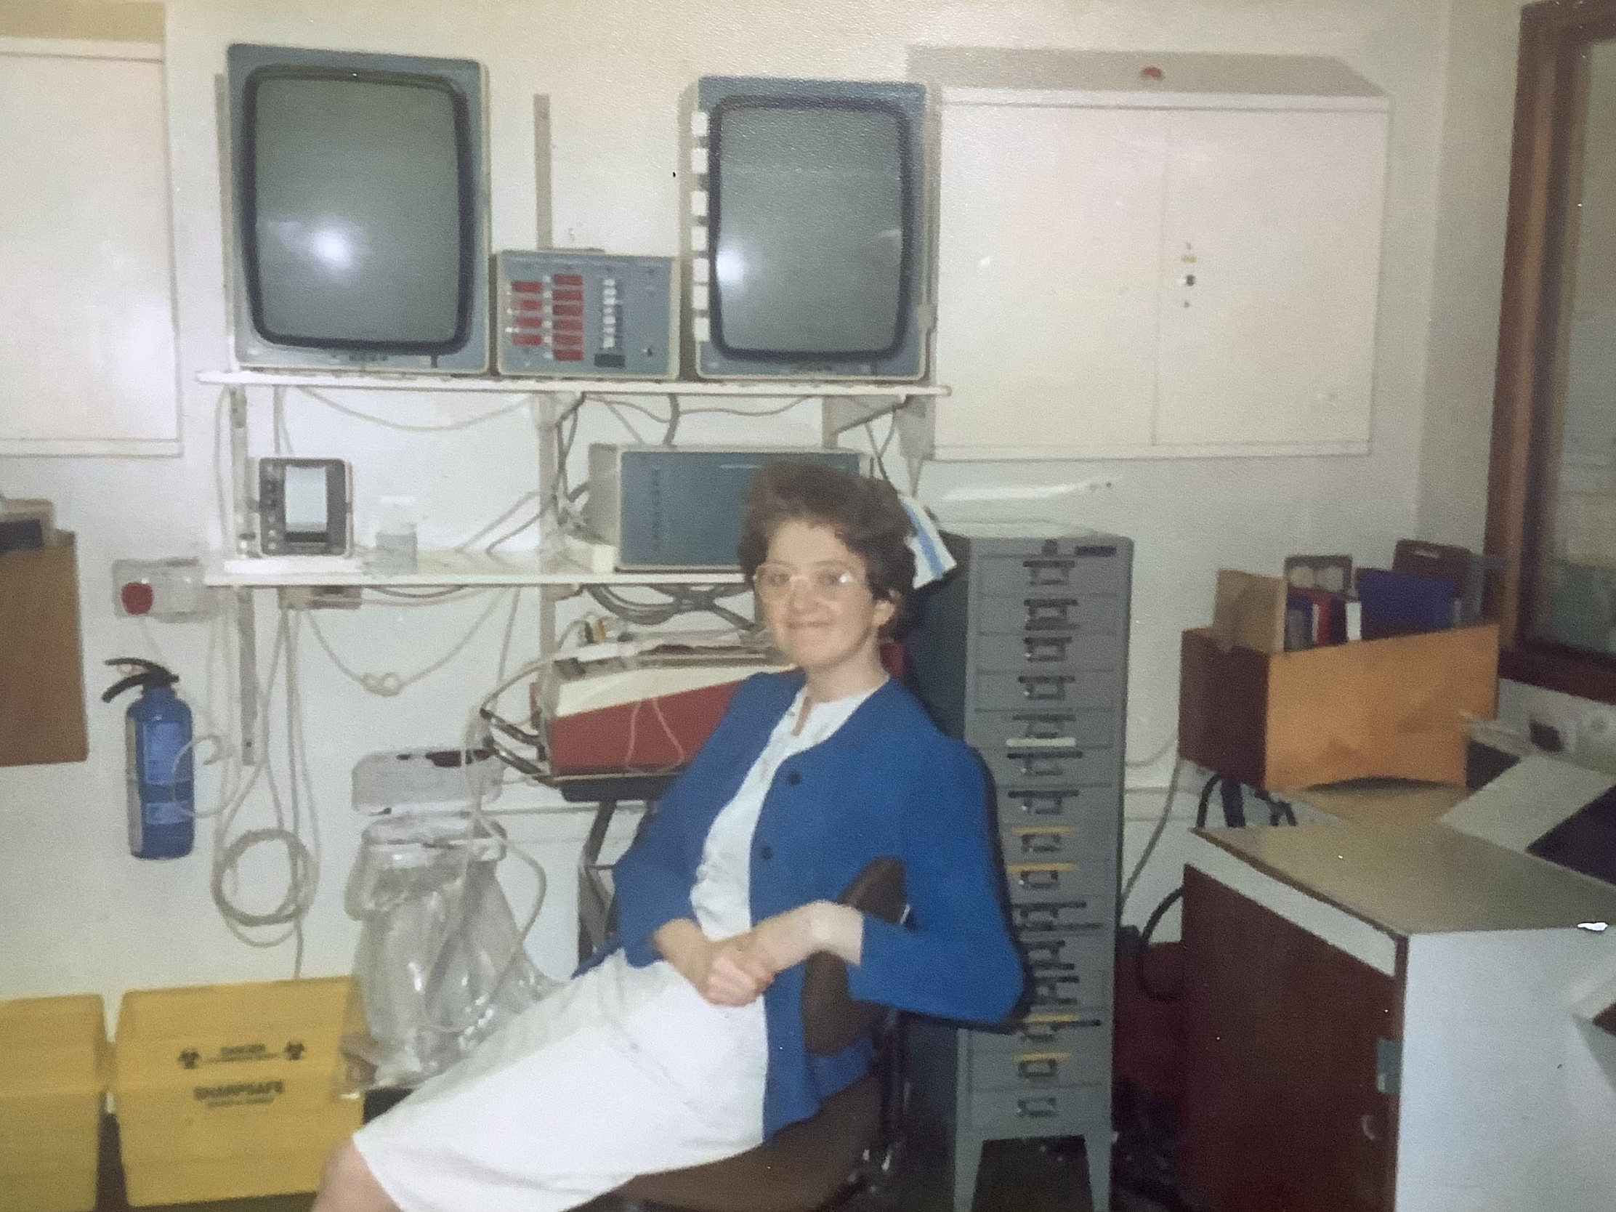
Not all who wander are lost
From NHS to NHS via Research

Slide 3
The pandemic has brought the importance of clinical research and the benefits to patients, the NHS and wider society into a sharper focus than ever before.
Transferable New Knowledge
Clinical trials
Public health research
Observational studies applied research
Policy research
Research into NHS services and care pathways
Not Audit or evaluation

Slide 4
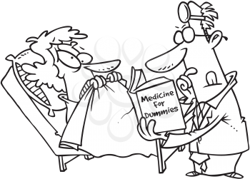
The reason we do research is to generate the evidence patients and the health system needs to provide high quality care and improve outcomes.
Improved outcomes
Patient experience
Financial Benefits
Staff satisfaction
Research in the NHS
Staff recruitment
Reduced Mortality
Improved
care

Slide 5
NHS England: Embedding Research in the NHS
System guidance & assurance
Increasing
Diversity
Increasing scale
Increasing
pace
working with ICS and local engagement networks to increase opportunities to take part in research – ICS REN development programme
Toolkits to support engagement with underserved communities, addressing health inequalities
In geographies and settings - expecting all NHS organisations to be involved in research
Data driven research – Data for R&D programme
Linking Research Volunteer Registries
Linking Be Part of Research to other platforms including the NHS App
Increasing engagement with Be Part of Research through exploring touchpoints
Aim for 1m people registered their interest in taking part in research
Making it faster to set up and undertake research
Roll out of National Contract Value Review
UK Standard Contracting Process
Excess Treatment Costs
Guidance for ICSs in maximising the benefits of research and development of research strategies
Develop and support network of ICS research leaders
Co-development of research finance guidance
Developing research measures and metrics to monitor impactful research activity and delivery
Integration of research within policies, strategies, plans and frameworks – including workforce and primary care

Slide 6
Where does research take place?
Clinical research should mirror the diverse populations in the UK.
Race / Ethnicity
Age
Gender
Disease state
Disabilities
Rates of recruitment to health research varies substantially across England.
Lack of alignment between recruitment and disease prevalence.
(Bower et al, 2020)
High prevalence
High recruitment
Low
recruitment
Low
prevalence

Slide 7
ICS Research Engagement Network (REN) development programme
Increasing
Diversity
Collaborations between ICB, NIHR infrastructure & Voluntary, Community, Faith, and Social Enterprise (VCFSE) organisations
People and systems in 23/24
Research impact in 23/24
47 teams including 4 mental health network teams were working nationally across 41 ICS regions in 2024/25 to increase diversity in research participation. Teams aim to:
support sustainable research engagement for communities across the ICS geography who are typically underserved by research,
increase inclusivity and opportunities for diverse communities to take part in research, and
embed approaches to diverse engagement around research in the way the ICB and researchers across the ICS operate.
873 people leading or delivering activity nationally
595 community champions trained
25 REN teams involved in developing research strategy so far
16,000+ people attended 435
public facing events
10,000+ people invited to join studies
22,000+ people signposted to registries
64 research funding bids submitted

Slide 8
REN in South West London
Increasing
Diversity
South West London ICB REN Team led by Dr Catherine Heffernan
Research Café Project
Pharmacy & Digital Exclusion
Working in partnerships with
Local Authority,
clinical research networks,
NIHR South London ARC, & other academic organisations
VCSE partners including:
Croydon Voluntary Action
SWL Healthwatch,
Healthwatch Wandsworth,
Healthwatch Croydon,
Healthwatch Richmond,
Community Action Sutton,
Reaching 500 people, increasing people:
sign up for studies,
contributing into research proposal,
conducting research as public members
expressing interest in being peer researchers.
72 accredited pharmacy sites reached over 5,400 people:
47% over 75yrs old
27% White British
97.4% did not use the NHS App
38.3% new how to order medication online
86.2 did not want to sign up to BPoR

Slide 9
Any Questions?

