Slide 1
Writing for publication: making your work visible
Dr Vageesh Jain MBBS MPH FFPH
Consultant in Public Health Medicine
NHS South West London ICB

Slide 2
Why publish?
Pros | Cons
Professional reputation and credentials | Time consuming and opportunity cost
Learning | Frustrating and laborious
Generating evidence: useful for everyone | Can be difficult to navigate processes
Organizational/team visibility | Limited local/real world impact
Validating your work (peer-review) | Support on skills/networks often missing
Individual impact

Slide 3
Types of publication
Editorial
Analysis/commentary
Research
Short (e.g. <800 words)
Often invited but can pitch to editors
High impact/well-read although concise and opinionated
Arguing a clear single point
Medium length (e.g. 1-2000 words)
Often relevant to policy/practice
Don’t need to show new data
Can be more creative e.g. frameworks, challenging thinking
Reviews, case reports, case control, cohort, prevalence, quasi-experimental, trials
Usually <3-3500 words
Qualitative or quantitative but presenting something new

Slide 4
Editorials and Analyses: Medical/PH Journals
Journal | Focus Area | Notes
NEJM | Medicine | Accepts Perspective and Editorial pieces, often commissioned
JAMA | Medicine | Accepts Viewpoints and Opinion pieces on policy, ethics, and clinical issues (incl JAMA Health Forum)
Nature Medicine | Medicine | Accepts Perspectives, News & Views & Comment, often by invitation
Annals of Internal Medicine | Medicine | Accepts Commentaries, On Being a Doctor, and Health Policy essays
Lancet | Medicine/Public Health | Publishes Comment, Viewpoint, and Correspondence articles, including unsolicited
BMJ | Medicine/Public Health | Publishes Analysis, BMJ Opinion, and Personal View articles, unsolicited
PLOS Medicine | Medicine/Public Health | Accepts Commentary, Debate, and Analysis
AJPH | Public Health | Publishes Commentaries, Editorials, and Policy Analysis
EJPH | Public Health | Accepts Editorials and Commentaries
Health Policy | Public Health Policy | Accepts Editorials and Commentaries
Journal of Health Economics | Health Economics & Policy | Accepts Research and Review only
Milbank Quarterly | Health Economics & Policy | Accepts Policy Analysis, Synthesis, and Commentary articles
Health Affairs | Health Economics & Policy | Accepts Commentary, Analysis on Health Policy, Narrative and Briefs
BMC Public Health | Public Health | Accepts Matters Arising, Case Studies, Debates, and Commentary
Journal of Public Health | Public Health | Accepts Editorials and Commentary pieces( incl Cherkov Corner – Arts)
Journal of Urban Health | Urban Health | Accepts Editorials, Case Studies and Commentary
Journal of Epidemiology & Community Health | Epidemiology | Accepts Theory and Methods, Editorials, Gallery, Commentary
International Journal of Public Health | Public Health | Accepts Editorials and Commentary
IJERPH | Environment/Public Health | Accepts Editorials, Commentary, Case Reports, Concept Papers

Slide 5
Path to publication
01
02
03
04
Question
Writing
Publish
Disseminate
Definition
Establish group if needed
Review previous literature
What is the main point?
What are the subheadings?
Research/analysis
Make sure methods fit chosen article type
Tailor writing style (e.g. opinionated vs. factual)
Journal submission
Peer-review and editing
Acceptance
Expert networks
Non-expert networks
Within organization
Outside organization

Slide 6
General tips for publication
Be selective, aim high
Appraise existing evidence early
A few key messages, no jargon
Collaborate with experts

Slide 7
Analysis/commentary: tips
Writing needs to be persuasive and engaging
Less factual although needs to be a little balanced
Focus on the headline
Start with concise 1st para explaining headline
Develop argument through subheadings and examples/refs

Slide 8
Analysis/commentary: examples

Slide 9
Reviews: types
Type | Method | Search | Appraisal | When?
Critical | Narrative/conceptual | Identifies most significant papers | No formal quality assessment | To explore/critique or build on existing research theory or concepts underpinning practice
Rapid | Narrative & tabular | Completeness of searching depends on time/scope constraints | Time-limited/light touch quality assessment | To evaluate policies, grey literature, and direction of effect in literature
Scoping | Narrative & tabular | Completeness of searching depends on time/scope constraints | No formal quality assessment, summarizes field of research | To understand quantity and quality of literature, and specify needs for future reviews
Systematic (+/- meta-analysis) | Narrative & tabular/graphical | Comprehensive searching, multiple databases | Quality assessment, according to guidelines (e.g. STROBE, CONSORT) | To aggregate multiple studies and small samples to provide recommendations
Umbrella | Tabular/graphical | Search for other reviews | Quality assessment of reviews or studies within reviews | To summarize multiple other reviews e.g. if many or conflicting

Slide 10
Reviews: tips
Understand evidence-base prior to deciding best type of review
Focus on rapid review if time is tight and/or aiming to summarize policy documents
Focus on systematic review for (typically) high quality evidence, if more time/capacity:
Focused question with well thought out ‘key terms’ for search
Decide on inclusion/exclusion criteria
At least 3-4 existing similar studies to appraise
For meta-analysis, need papers that can be legitimately pooled

Slide 11
Original research
Decide on evidence gap being addressed, after reviewing existing literature and speaking to experts
Specify research question with clear intervention (or e.g. condition of study) and outcome [PICO]
Identify sources of data or data collection methods
Conduct analysis (multiple stages depending on method)
Write up should be framed against key findings
Keep writing concise, scientific, don’t speculate

Slide 12
Converting practice into evidence: Examples

Slide 13
Example 1: Editorial
Notes:
Arguing a single novel point:
Locally (rather than globally) determined COVID control targets make it hard to fairly assess needs for vaccines across countries, leading to a fragmented and inequitable global vaccine allocation through COVAX

Slide 14
Example 2: Analysis
Notes:
Arguing a single novel point with detailed analysis and exploration:
New drugs have increased the potential benefits of CKD screening but the evidence base on cost-effectiveness must be developed, outlining specific research and policy questions which need answering to develop the evidence for national CKD screening programme

Slide 15
Example 3: Mapping Review
Notes:
Searched open-access databases of 35 HTA agencies from 18 countries for reports from 2008 to 2018. Classified interventions according to WHO Classification to understand whether HTA looked at PHIs, where, when, and how

Slide 16
Example 4: Rapid Review
Notes:
Collated COVID vaccination policies (open access) from all US States and compared how different groups were being prioritized for vaccines. Compared priority positioning with that of CDC guidance through a simple ranking approach to reveal population groups most frequently prioritized higher, lower, or not mentioned in national guidance

Slide 17
Example 5: Original Research
Notes:
Developed question while working on COVID response and based on media controversy around stopping vaccine rollouts. Obtained open-access national level data on COVID vaccine uptake and vaccine supply, compared trends over time in different countries to understand impact of policy change

Slide 18
Thank you
Email: vageesh.jain@swlondon.nhs.uk

Slide 19
Getting Published: an example
Dr Catherine Heffernan, SWL ICB, LaPHRN, June 2025

Slide 20
Writing up your work
Start with the board paper or report
Think of the audience who would be interested in this
You can submit your work first to a conference
writing up the abstract is good practice
if you’re successful as a presenter, you’ll get feedback that will improve your work
doing a poster will help make your work concise

Slide 21
Writing up your work
Journal articles are roughly 3000 words
Take the ‘blue pen’ to your report (i.e. edit)
Re-organise the report into headings of:
Introduction
Background (set the context, what’s already known but the gap…)
Aim of article (why it is important!)
Methods
Results
Discussion
Main observations
What does this study add to the body of knowledge
Limitations and strengths
Conclusion

Slide 22
Writing up your work
Find a published peer-review article that is similar to yours and see how they have reported their methods, results and discussion
Find a second one… a third one….This will give you an idea of what is looked for in the article.
Think: What is the purpose of each section? What makes each section effective?
Once you have a draft, make your decision on the journal you’re writing for
Download their author submissions guidelines and follow them exactly!
Note if you must follow any known guidelines – e.g. CONSORT for RCTs, Squire for quality improvement – see Reporting guidelines | EQUATOR Network
There are AI tools that can help with the preparation – e.g. PaperPal – and journals like BMJ use Penelope.ai

Slide 23
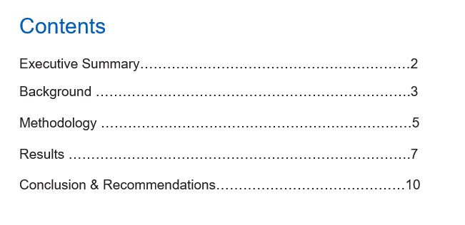
Example

Slide 24
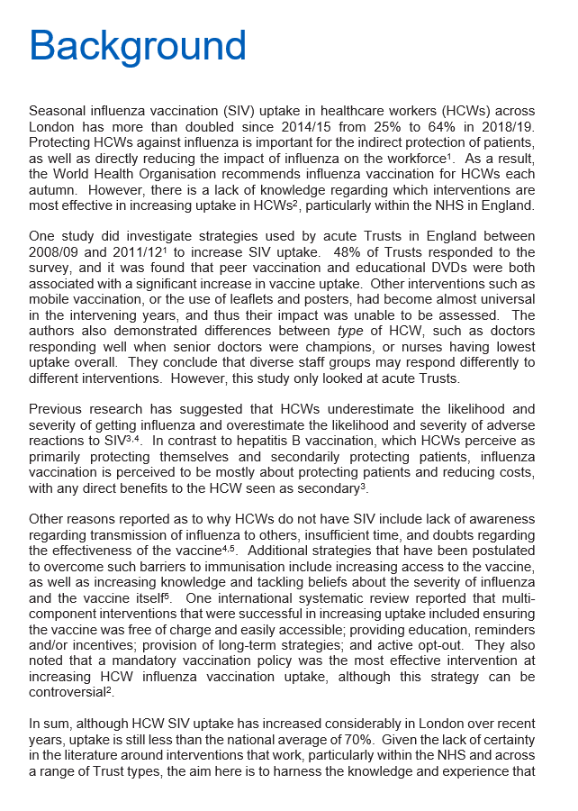

Slide 25
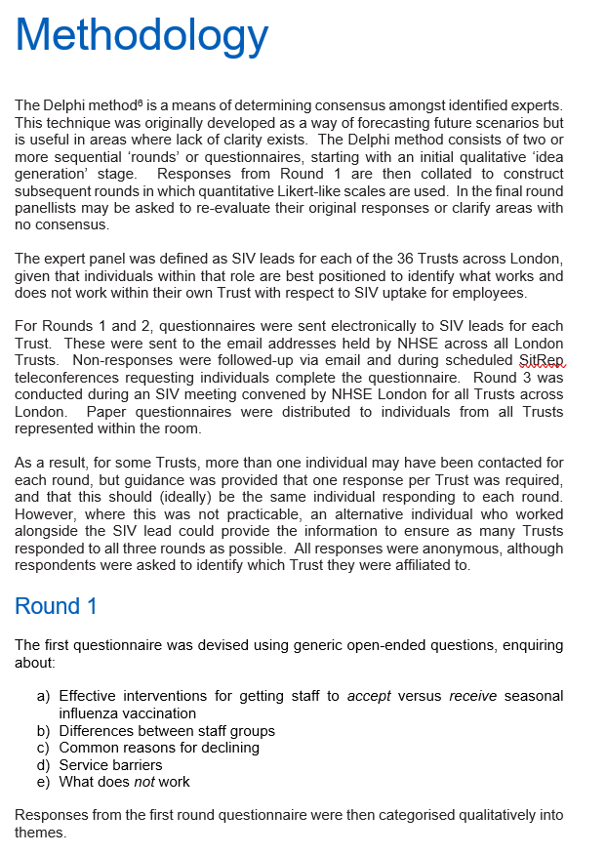
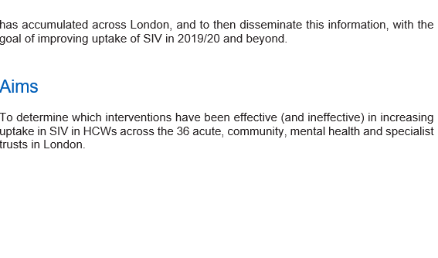

Slide 26
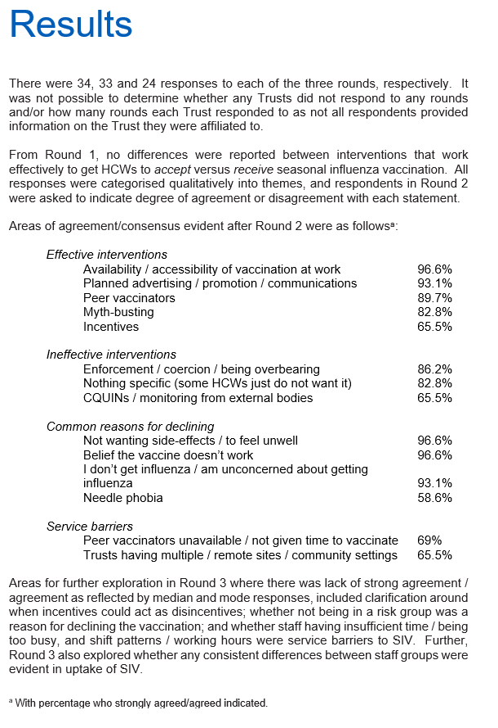

Slide 27
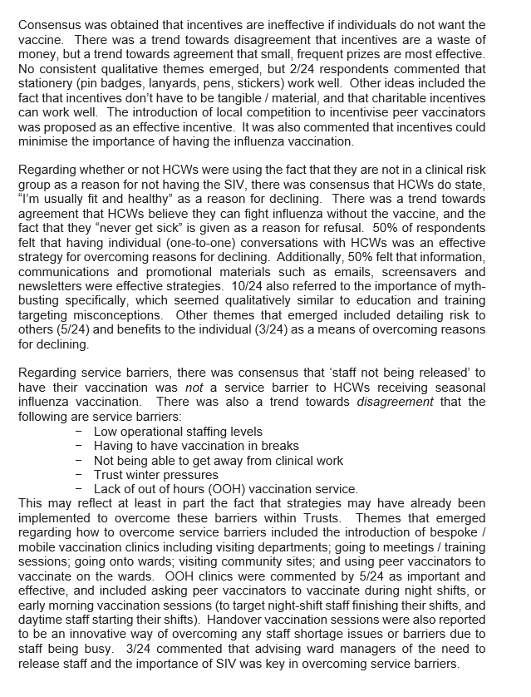
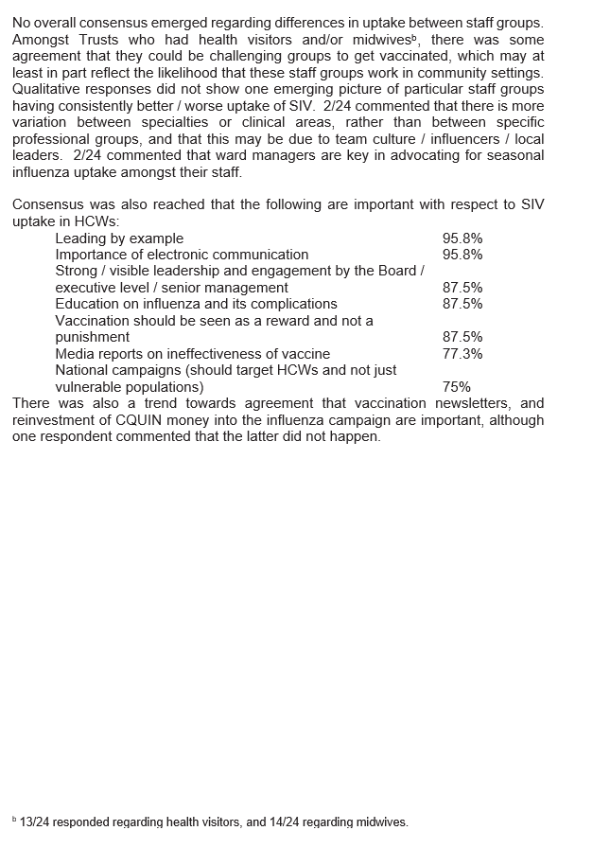

Slide 28
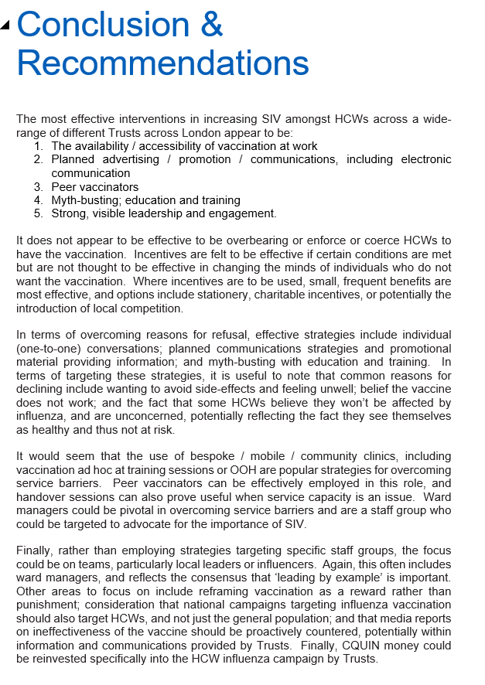
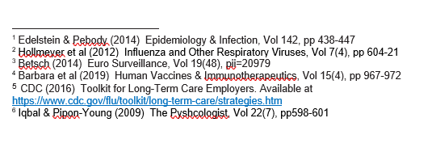

Slide 29
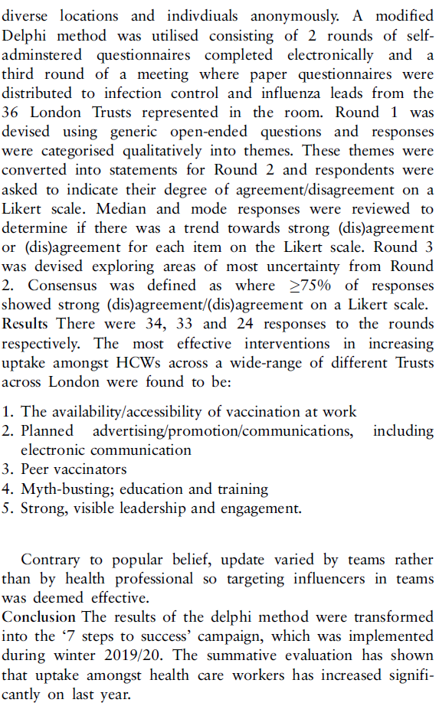
Example

Slide 31
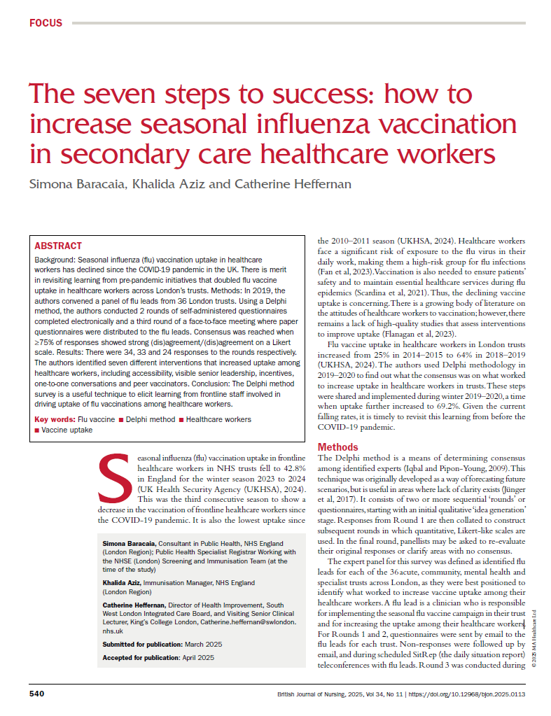
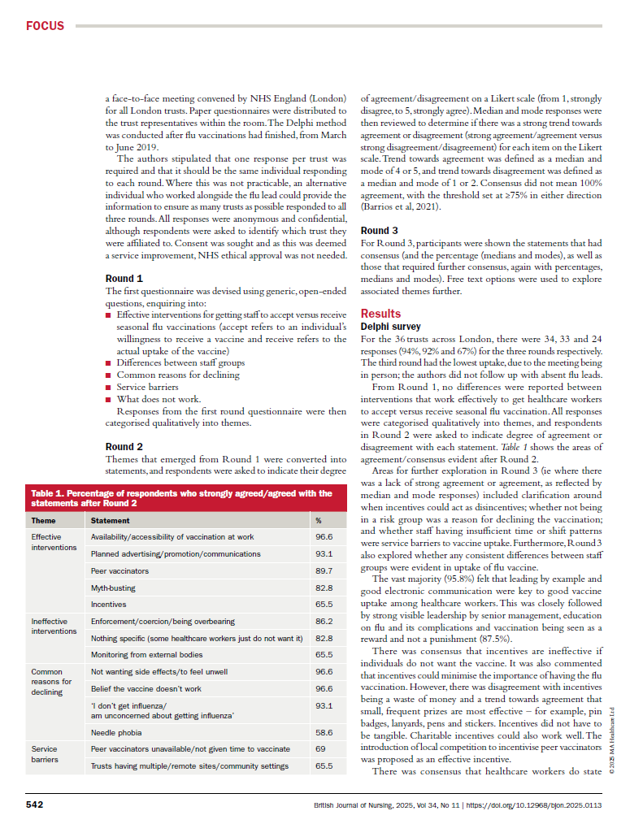

Slide 32
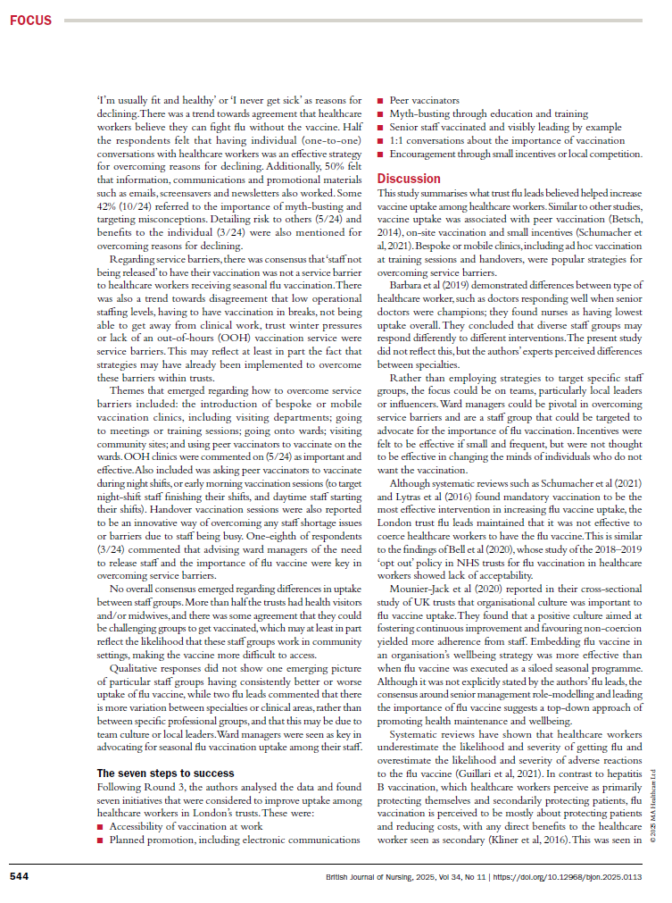
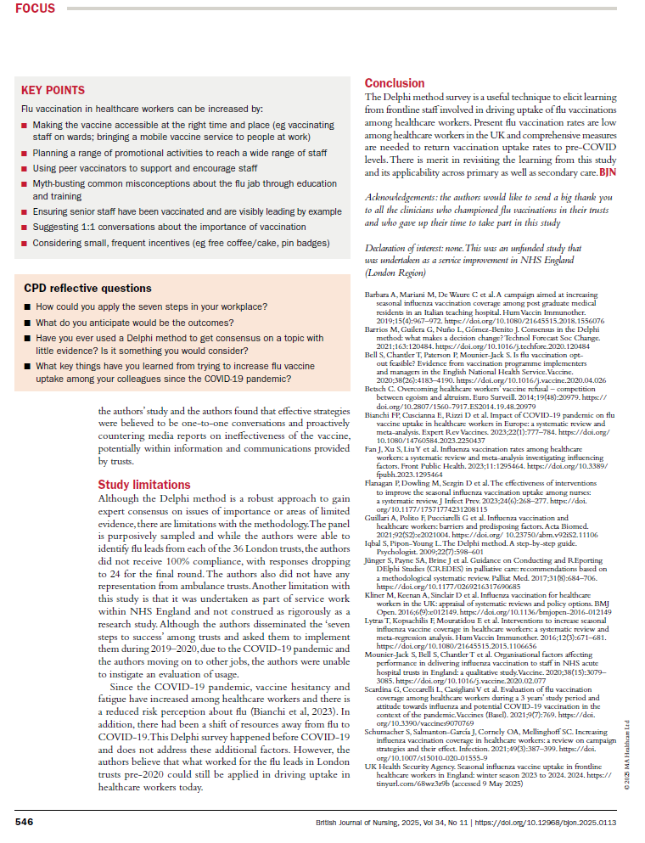

Slide 33
Over to you…

Slide 34
Build your Article Framework
Choose a topic and outline your article using the IMRAD structure:
Introduction: What is the problem? Why does it matter?
Methods: What did you do?
Results: What did you find?
Discussion: What does it mean?
Exchange outlines with a peer and provide feedback using the checklist below:
Is the research question clear?
Are the methods appropriate?
Are the results logically presented?
Does the discussion reflect on implications and limitations?

Slide 35
Thank you!

