Slide 1




Building Research Careers in Health and Social Care
Prof Cilla Harries
Head of Graduate Research School and Researcher Development, Kingston University

Slide 2
What we will cover
Introductions
Why does Research matter?
Clinical and Practitioner Academic career pathways
Top tips:
Develop an area of interest/specialism/research
Be visible/influential/impactful
Seek out collaborative communities and grasp leadership opportunities
Give and receive coaching and mentorship
How do we make research careers more inclusive and accessible

Slide 3
Why does research matter?
Discuss and share back

Slide 4


Career opportunities: the importance of innovation in our work
Research
Practice
Policy
We all want to make the world a better place.
Notes:
Its important to remind ourselves why we do research.
Research benefits society – it helps us to be innovative and to know how to do things better, so we can improve people’s lives, and drive prosperity. Here is the McKinsey 2020 report calculating the cost benefits of improving health.
To improve the effectiveness of our workforce and our services we need research evidence.
So we need to become more research intensive, improve the quality of our research, increase the quantity of that quality and increase our research capability. We are looking to continually improve what we do – so we can keep improving our benefits to society. We need approaches and processes that help us to drive forward this ambition forward.
‘We found that occupational therapy is the only spending category where additional spending has a statistically significant association with lower readmission rates for all three medical conditions:heart failure, pneumonia, and acute myocardial infarction.
One possible explanation is that occupational therapy places a unique and immediate focus on patients' functional and social needs, which can be important drivers of readmission if left unaddressed.’

Slide 5
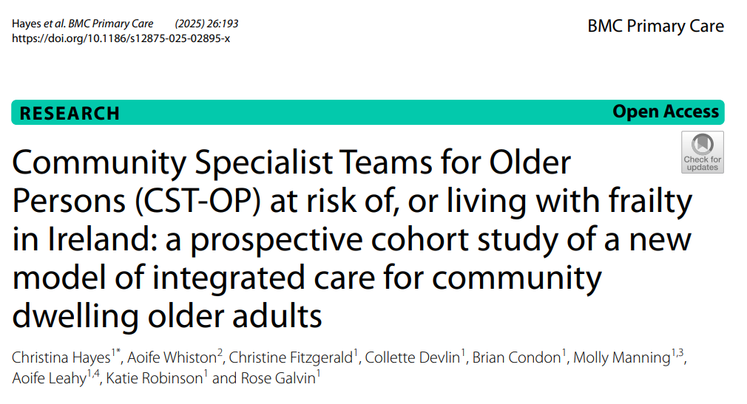
Career opportunities: the importance of innovation in our work
Research
Practice
Policy
We all want to make the world a better place.
Significant improvements in health outcomes for older adults at risk of or living with frailty who received an interdisciplinary Comprehensive Geriatric Assessment in the community. The majority maintained functional independence up to 6-months visit.
Notes:
Community Specialist teams research from the The Ageing Research Centre (ARC) at University of Limerick, ARC later (in slide21) and also Katie Robinson (slide 18) – Katie is Co-Lead of the ARC
Its important to remind ourselves why we do research.
Research benefits society – it helps us to be innovative and to know how to do things better, so we can improve people’s lives, and drive prosperity. Here is the McKinsey 2020 report calculating the cost benefits of improving health.
To improve the effectiveness of our workforce and our services we need research evidence.
So we need to become more research intensive, improve the quality of our research, increase the quantity of that quality and increase our research capability. We are looking to continually improve what we do – so we can keep improving our benefits to society. We need approaches and processes that help us to drive forward this ambition forward.
‘We found that occupational therapy is the only spending category where additional spending has a statistically significant association with lower readmission rates for all three medical conditions:heart failure, pneumonia, and acute myocardial infarction.
One possible explanation is that occupational therapy places a unique and immediate focus on patients' functional and social needs, which can be important drivers of readmission if left unaddressed.’

Slide 6
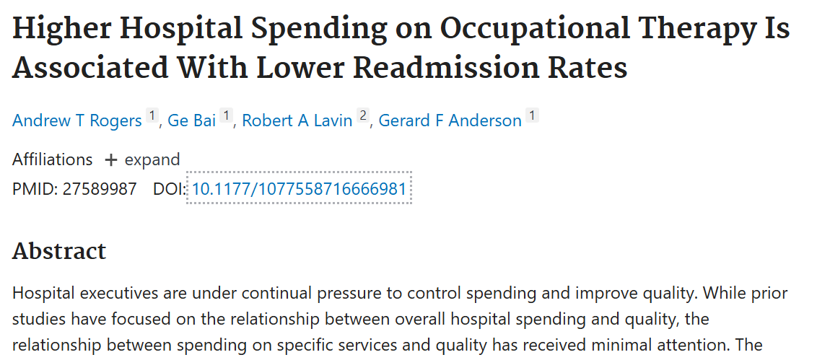
Career opportunities: the importance of innovation in our work
Research
Practice
Policy
We all want to make the world a better place.
Rogers AT, Bai G, Lavin RA, Anderson GF. Higher Hospital Spending on Occupational Therapy Is Associated With Lower Readmission Rates. Med Care Res Rev. 2017 Dec;74(6):668-686. doi: 10.1177/1077558716666981. Epub 2016 Sep 2.
Notes:
Its important to remind ourselves why we do research.
Research benefits society – it helps us to be innovative and to know how to do things better, so we can improve people’s lives, and drive prosperity. Here is the McKinsey 2020 report calculating the cost benefits of improving health.
To improve the effectiveness of our workforce and our services we need research evidence.
So we need to become more research intensive, improve the quality of our research, increase the quantity of that quality and increase our research capability. We are looking to continually improve what we do – so we can keep improving our benefits to society. We need approaches and processes that help us to drive forward this ambition forward.
‘We found that occupational therapy is the only spending category where additional spending has a statistically significant association with lower readmission rates for all three medical conditions:heart failure, pneumonia, and acute myocardial infarction.
One possible explanation is that occupational therapy places a unique and immediate focus on patients' functional and social needs, which can be important drivers of readmission if left unaddressed.’

Slide 7

We try to know more and do better.
But developing research skills and expertise is hard!
We need to see how others do it, learn, practice, be encouraged ….find our talents
Notes:
Its important to remind ourselves why we do research.
Research benefits society – it helps us to be innovative and to know how to do things better, so we can improve people’s lives, and drive prosperity. Here is the McKinsey 2020 report calculating the cost benefits of improving health.
To improve the effectiveness of our workforce and our services we need research evidence.
So we need to become more research intensive, improve the quality of our research, increase the quantity of that quality and increase our research capability. We are looking to continually improve what we do – so we can keep improving our benefits to society. We need approaches and processes that help us to drive forward this ambition forward.

Slide 8
Clinical and Practitioner Academic career pathways
What pathways or research skills building ways do you know about or have explored?

Slide 9
Capacity building initiatives across NIHR

Slide 10
Infrastructure and Capacity Building Structures
The Infrastructure and Capacity Building Structures team at the NIHR Academy builds on and adds value to the investment in training and academic career development that is happening throughout the NIHR.
The parts of the NIHR that have a remit to build research capacity are the:
BRCs – Biomedical Research Centres (20 centres)
PSRCs – Patient Safety Research Collaborations (6 centres)
ARCs – Applied Research Collaborations (15 centres)
HRCs – HealthTech Research Centres (14 centres)
IO – Innovation Observatory (1 Horizon Scanning centre)
HPRUs – Health Protection Research Units (13 units)
HPRFAs – Health Protection Research Focus Awards (2 awards)
SPCR – School for Primary Care Research (1 centre, 9 partner sites)
SPHR – School for Public Health Research (1 centre, 9 partner sites)
SSCR – School for Social Care Research (1 centre, 7 partner sites)
Programme Grants (including; Programme Grants for Applied Research, Research Programme for Social Care, Cross-programme Decarbonising the health and social care system, and NIHR International Programmes)
MHRGs – Mental Health Research Groups (2 sites)
MHRLs – Mental Health Research Leaders

Slide 11
Academic Career Development (ACD) Leads
Each of these centres/units has a named ‘Academic Career Development Lead’ (formerly known as Training Lead) and invests NIHR funds in research training for individuals within their locality.
What do we do with and for Academic Career Development Leads?
We list them on the NIHR website
We provide an induction and facilitate meetings
We contact them with updates about available funding calls and opportunities
We ask for a local academic career development strategy
We ask that they complete narrative and data sections of annual report on research capacity development
We bring all the leads together annually at the NIHR Academic Career Development Forum (previously Training Forum). The purpose of this meeting is to share best practice and promote excellence in research capacity development.
The individuals funded to undertake their research training at each site are NIHR Academy members.

Slide 12
NIHR Schools
NIHR Schools offer a number of career development opportunities that may be of interest to individuals in primary care, public health and social care:
NIHR School for Primary Care Research - https://www.spcr.nihr.ac.uk/trainees
NIHR School for Public Health Research - https://sphr.nihr.ac.uk/training/
NIHR School for Social Care Research - https://www.sscr.nihr.ac.uk/capacity/

Slide 13
Capacity Building Structures – NIHR Incubators
NIHR Incubators are intended to help where there is a recognised issue with research capacity that needs a community driven approach to make a difference.
Offer the recognition that an area is of strategic importance and that increased research capacity is needed
They are bespoke to address the needs of specific areas and communities
To be successful incubators need to be field-led
They offer the opportunity to explore the challenges experienced by those working in the field. Why is there a capacity issue?
They aim to encourage early career interest in target disciplines and build identifiable communities and critical mass
As part of the 2026 NIHR Incubator Competition, we will have 5 new Incubators.

Slide 14
Capacity Building Structures – NIHR Incubators
We currently have 15 live Incubators in the following areas:
Acquired Brain Injury Social Care Network
AI and Digital
Applied Health and Care Research Methodology
Clinical Education
Community Rehabilitation
Diagnostic and Therapeutic Radiographers
Emergency Care
General Paediatrics
Knowledge Mobilisation for Research Inclusion
Mental Health Social Care
Paediatric Critical Care
Palliative and End of Life Care
Pharmacy Professionals
Regulatory Science in AI and Digital Healthcare
Race Equity and Diversity in Careers

Slide 15
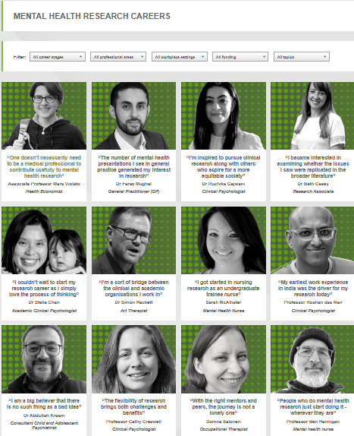
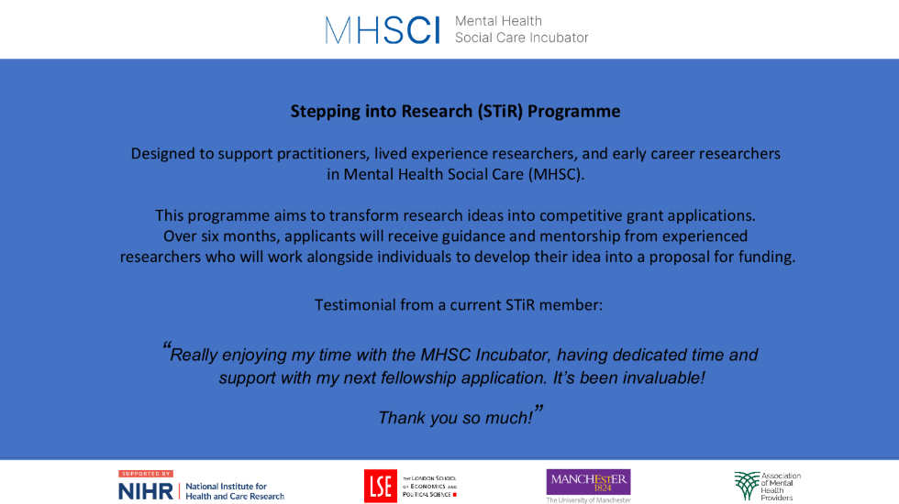
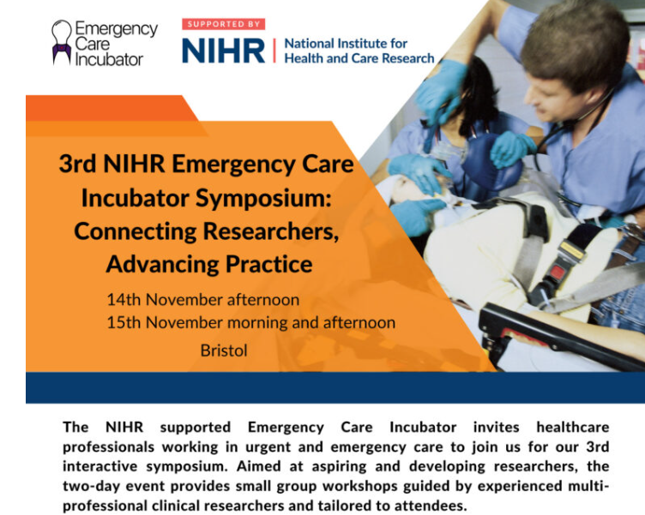

Examples of activities of the NIHR Incubators
Webinars/launch events: to understand community needs
Mental Health Social Care: Stepping into Research (STiR) Programme
Applied Health and Care Research Methodology: NIHR hosted webinars: ‘Discover funding opportunities for qualitative researchers’ and ‘Discover how qualitative research creates impact’
Emergency Care Incubator: 3rd Emergency Care Incubator Symposium: Connecting Researchers, Advancing Practice.
Mental Health (previously supported by NIHR): career case studies and ‘research map’, GROW Researcher Development Programme
Nursing and Midwifery (previously supported by NIHR): ‘masterclasses’ for those submitting applications and supervisors; RDS nursing careers advisory pilot
Wessex REACH (previously supported by NIHR): newsletter, small grants

Slide 16
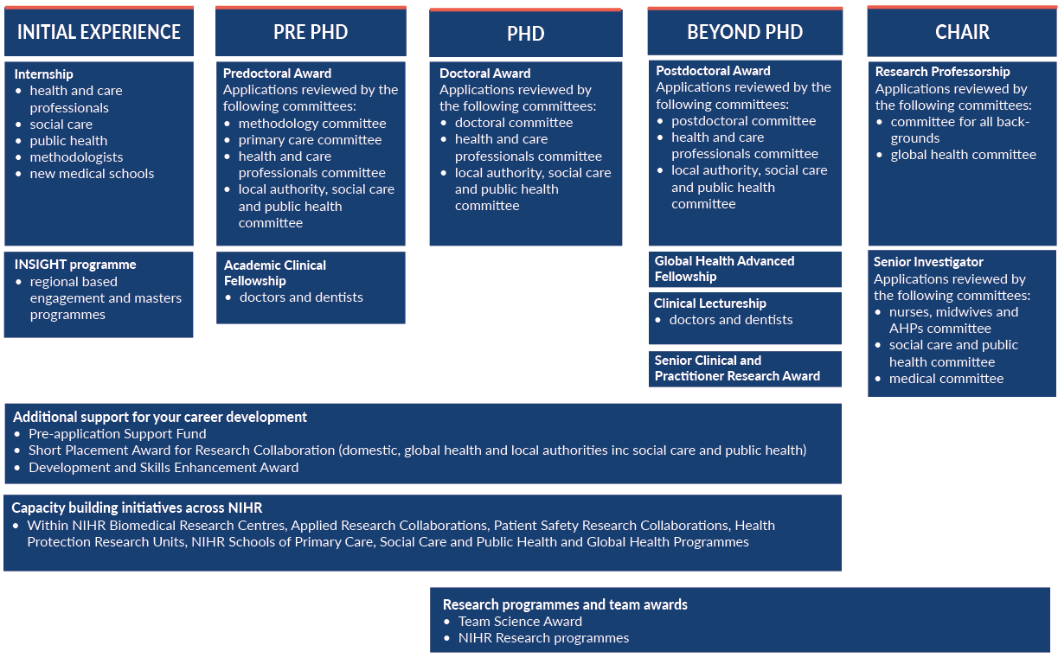
Current awards and programmes

Slide 17
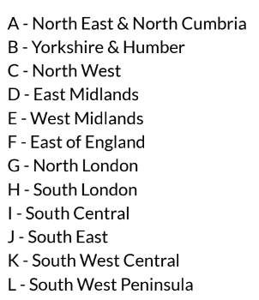
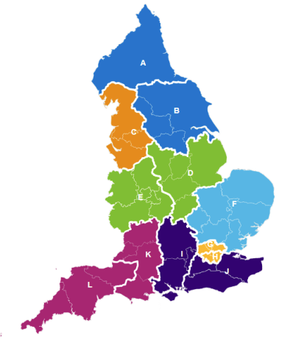
Health & Care Professional Internship Programme
The Programme funds research internships open to Health and Care Professionals (excluding doctors and dentists) registered with an approved regulatory body.
These are managed by organisations across 12 regions in England, with 23 internships available per a year within each region.
Research internships give health and care professionals the opportunity to develop research knowledge and skills that can enhance practice, build research delivery expertise or begin a practitioner academic career.
The programme plays an important role in increasing the awareness of research amongst health and care professionals, and where appropriate, provides individuals with a strong foundation on which to build a research related career.

Slide 18
Health & Care Professional Internship Programme
 | Region | Programme Lead | Lead Institution
A | North East and North Cumbria | Simon Hackett | Cumbria, Northumberland, Tyne and Wear NHS Foundation Trust
B | Yorkshire and Humber | Carole Burnett | Leeds Teaching Hospitals NHS Trust
C | North West | Jo-Anne Simpson | NHS R&D North West
D | East Midlands | Louise Bramley | Nottingham University Hospitals NHS Trust
E | West Midlands | Andrew Finney | Midlands Partnership NHS Foundation Trust
F | East of England | Claire Whitehouse | James Paget University Hospitals NHS Foundation Trust
G | North London | Hortensia Gimeno | Barts Health NHS Trust
H | South London | Joanne Cull | Guy's and St Thomas' NHS Foundation Trust
I | South Central | Sarah Williams | Hampshire and Isle of Wight Healthcare NHS Foundation Trust
J | South East | Julie MacInnes | Sussex Partnership NHS Foundation Trust
K | South West Central | Nicola Manning | University Hospitals Bristol and Weston NHS Foundation Trust
L | South West Peninsula | Catherine Pittman | University Hospitals Plymouth NHS Trust
Get in touch with your regional programme to find out more about the internships available and round timings. See our webpage here
Notes:
RE

Slide 19
INSIGHT: Inspiring Students into Research
The INSIGHT Programme aims to attract students and recent graduates into the full range of research careers from research delivery to academic.This includes careers combining research and practice.
It is open to students and early career professionals from:
Registered Health and Care Professions (not including doctors or dentists)
Public Health Professions
Social Work Professions
It funds Higher Education Institutions (HEIs) across 12 regional INSIGHT Programmes in England to deliver:
Innovative engagement programmes to showcase and attract students and recent graduates into the full range of research careers, including careers that combine research and practice.
Funded Research Masters Studentships to provide valuable training for students and recent graduates who may have had limited exposure to real world research during their training to date. This includes course fees and a stipend to cover up to 30 Masters places per year available within each region (300+ opportunities per year across England).
Opportunities will be available in 2024, 2025 and 2026. Find out more on the NIHR Webpage

Slide 20
INSIGHT: Inspiring Students into Research
Bold = Lead Institution
Opportunities are advertised by the 12 regional INSIGHT Programmes. Contact your regional INSIGHT Programme here
Institutions offering research Masters places within each region are:
A - North East & North Cumbria: Northumbria University Newcastle, Newcastle University, Teesside University & University of Cumbria
B - Yorkshire & Humber: University of Leeds, University of York, University of Sheffield, University of Bradford & University of Hull
C - North West: University of Lancashire, University of Manchester, University of Liverpool & Lancaster University
D - East Midlands: University of Nottingham & De Montfort University
E - West Midlands: University of Birmingham, Aston University, Birmingham City University, Coventry University, Staffordshire University, University of Keele & University of Warwick
F - East of England: University of Essex & University of Hertfordshire
G - North London: City St George’s, University of London & Queen Mary University of London
H - South London: King's College London, London South Bank University, Kingston University & City St. George's, University of London
I - South Central: University of Southampton, Oxford Brookes University, University of Winchester, University of Portsmouth & Solent University
J - South East: University of Brighton, University of Chichester & University of Kent
K - South West Central - University of the West of England & Bournemouth University
L - South West Peninsula - University of Plymouth & University of Exeter

Slide 21
NIHR Local Authority Short Placement Award for Research Collaboration
SCHEME | Award Funding | What is the scope of the award? | When to apply?
NIHR Local Authority Short Placement Award for Research Collaboration (NIHR LA SPARC) | up to £15,000 | Opportunity for both individuals working in Local Authority settings and NIHR Academy members to enhance their career and undertake a short placement allowing them to move between NIHR and Local Authority settings in either direction Further your skills, knowledge and expertise to work at the interface between practice and academia. Develop bespoke co-produced placements and the abilities and skills to co-produce research that delivers real benefits to people and communities. Shape mutually beneficial research collaborations/networks & joint ways of working between NIHR and Local Authorities. Funding now includes salary support and conference fees. | Annual Competition Launches in September

Slide 22
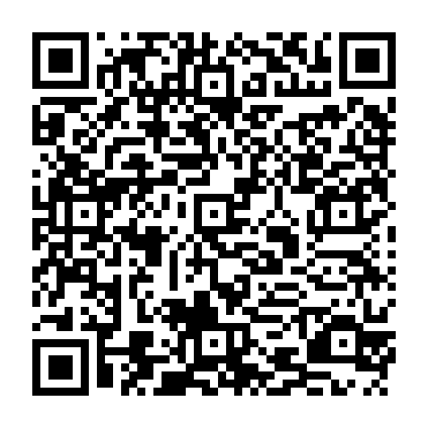

Clinical and Practitioner Academic career pathways Sign up to the NIHR newsletter

Slide 23
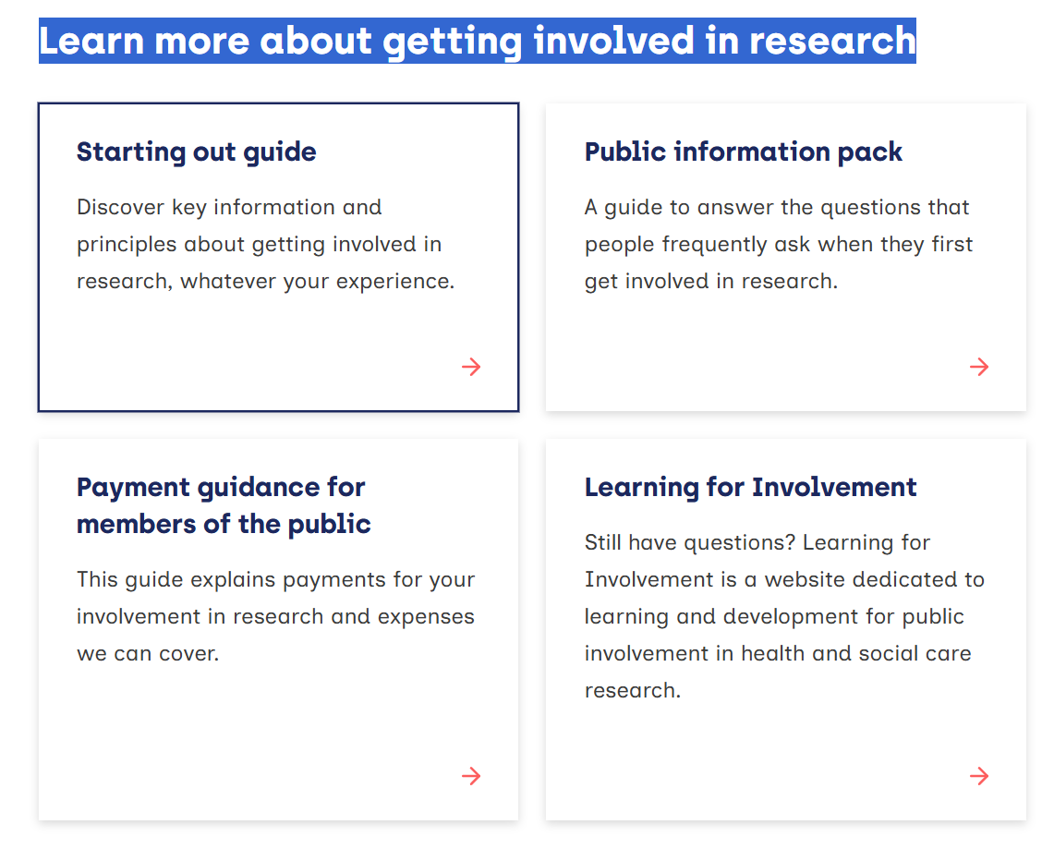
Public and Patient Engament and Involvement (PPIE) Public involvement in research | NIHR

Slide 24

Follow social media for NIHR
● LinkedIn: NIHR (National Institute for Health and Care Research)
● YouTube: NIHRtv
● X: @NIHRresearch
Events | NIHR
Doctoral Programmes for Healthcare Professionals | Grant funding | Wellcome
Professional body, charitable or interest group funding

Slide 25
To create research career development opportunities You need….
A research interest -
Networks and collaborators
Visability
Mentorship
Support inclusion and accessibility

Slide 26
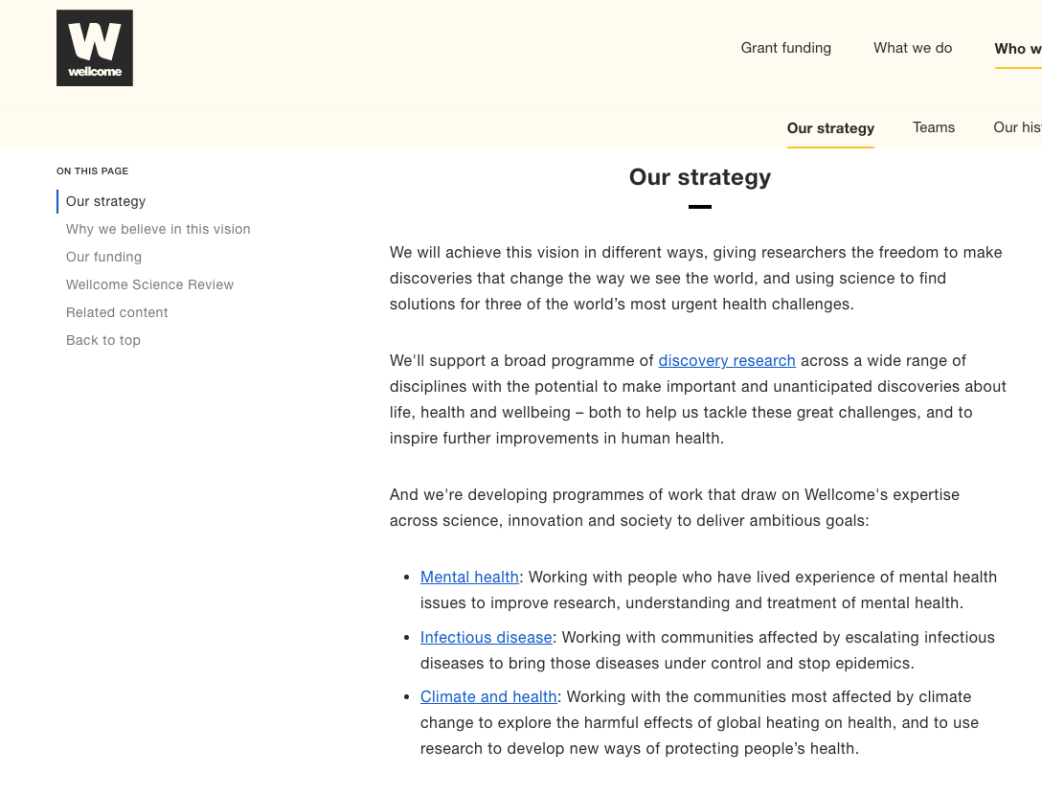
You need to develop a research interest/specialim to connect with others
Is your interest fundable?
Research investment is all around funders’ priorities
Be known for something!

Slide 27
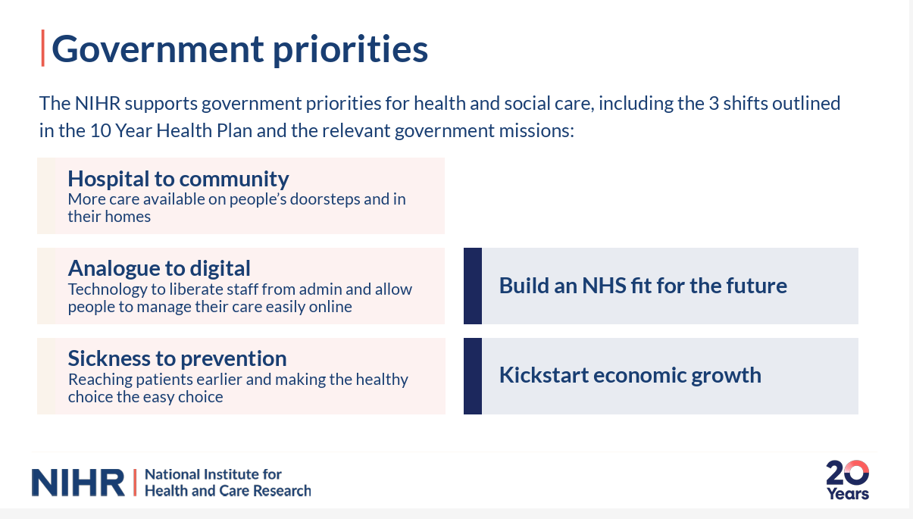
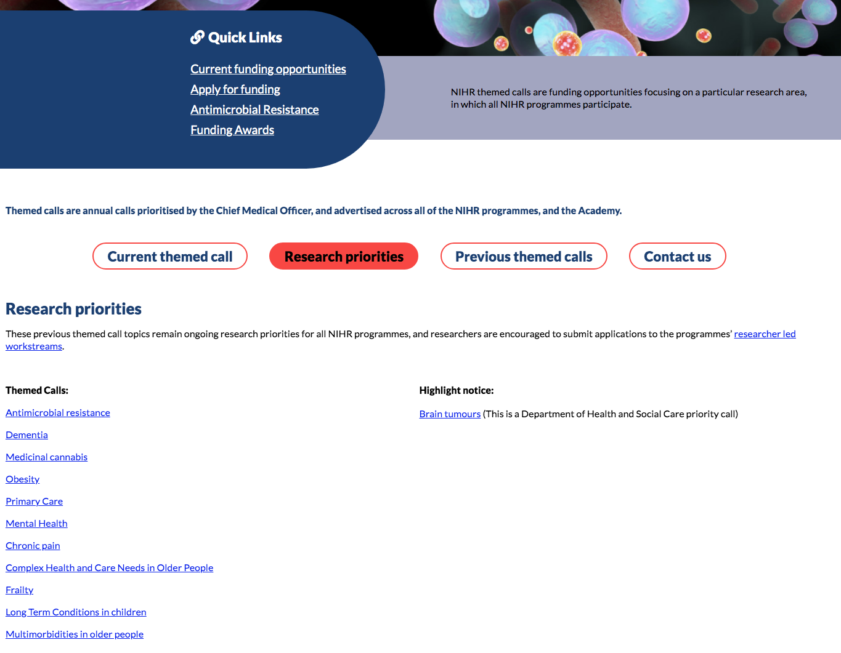
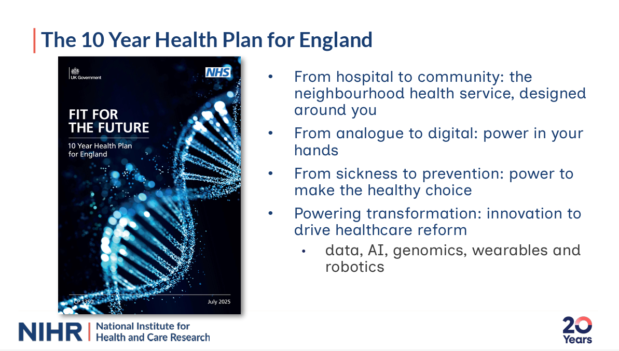
Who funds your type of research?

Slide 28
What is your area of interest and who funds your type of research?

Slide 29
To create career development opportunities You need….
A research interest
Visability
Networks and collaborators
Mentorship
Diversity

Slide 30
Visability - How can people find you?
Be visible/influential/impactful
You need to be visable to collaborate, find common interests, connect, influence...
How can people find you?

Slide 31
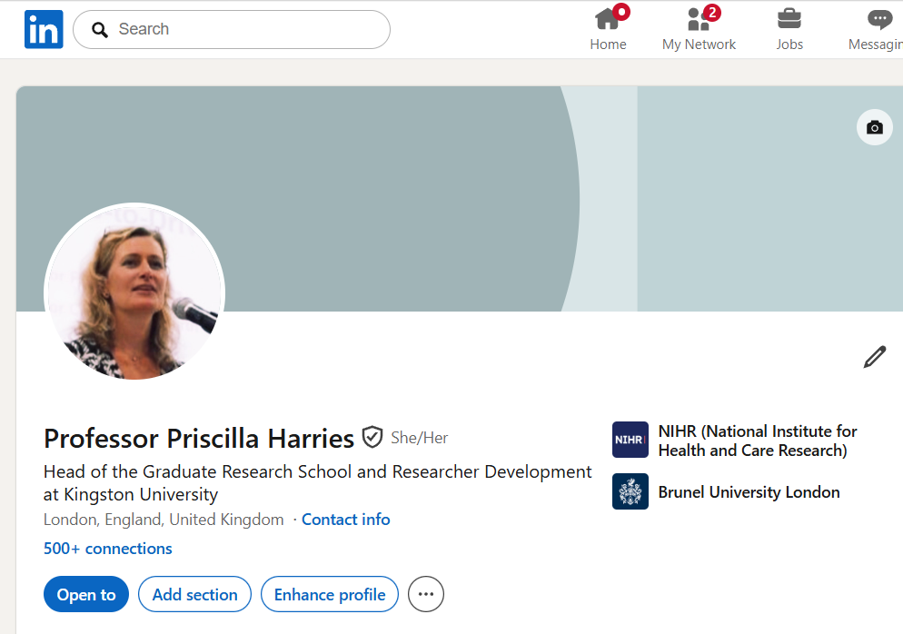
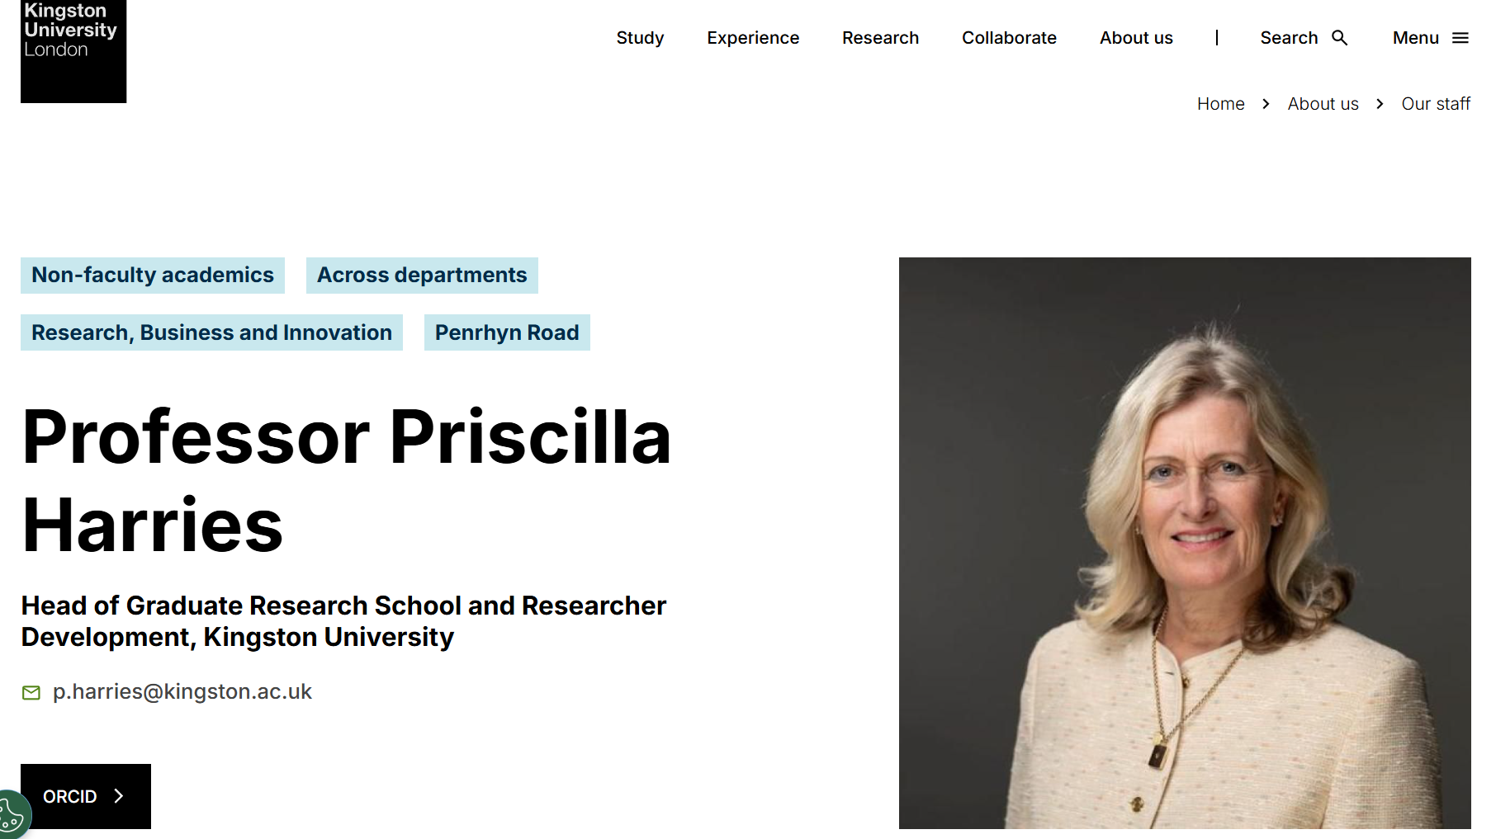
How can someone find you?
Linkedin for CV and to join relevant groups, direct message etc
Uni employer site for grants/publications so they have your email
Notes:
https://www.researchgate.net/signup.SignUp.html

Slide 32
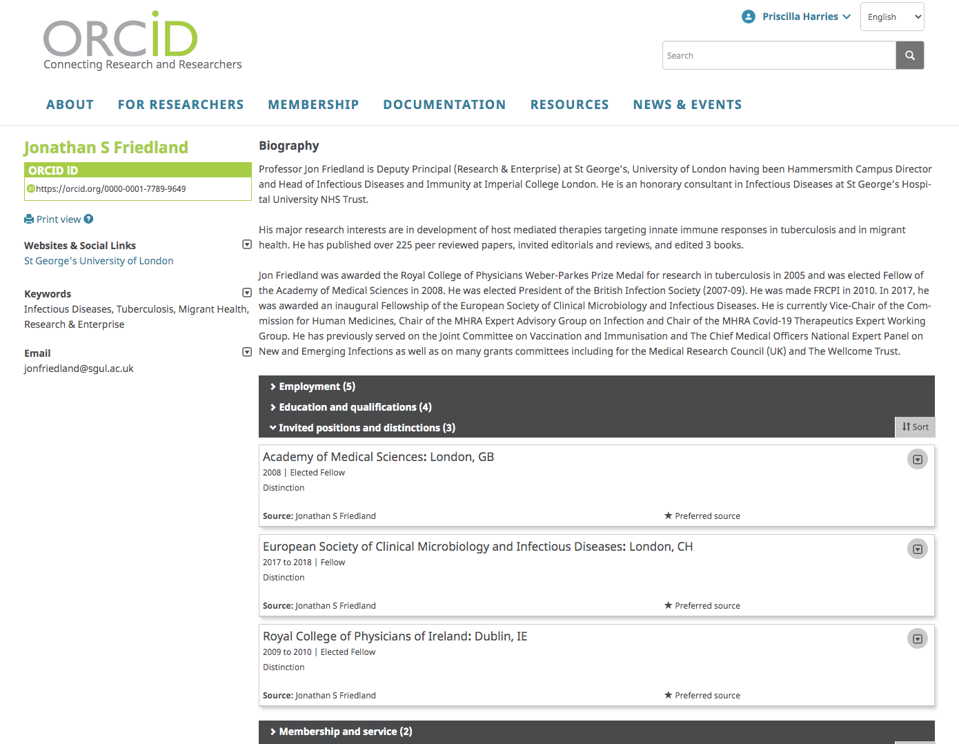

How can someone find you?
Media tend to check on social media
Research leaders may look up your Orcid site – new uni website profiles

Slide 33
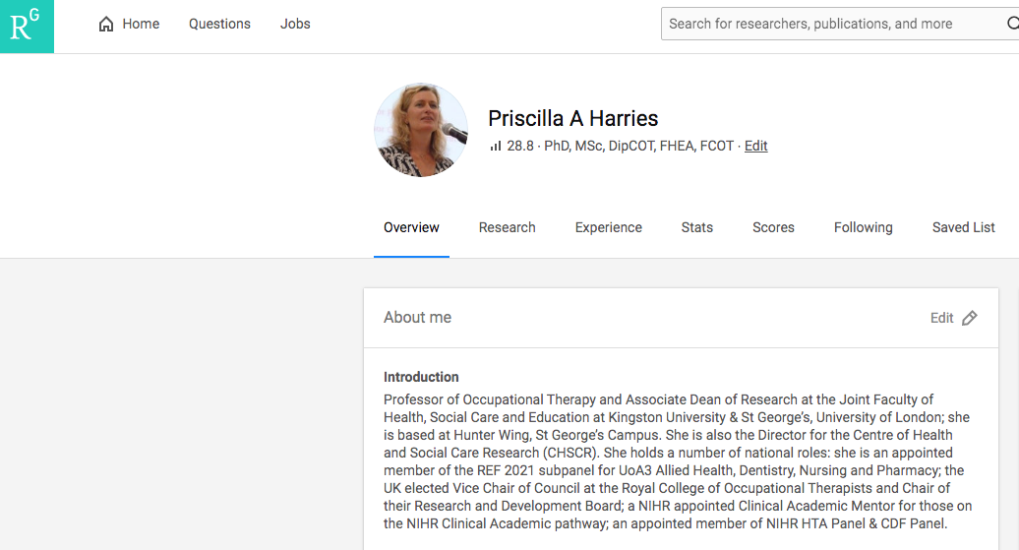

How can someone find you?
Researchgate – follow key colleagues
Easy way to show and share publications with networks
Notes:
https://www.researchgate.net/signup.SignUp.html

Slide 34
To create career development opportunities You need….
A research interest
Visability
Networks and collaborators
Mentorship
Support inclusion and accessibility

Slide 35
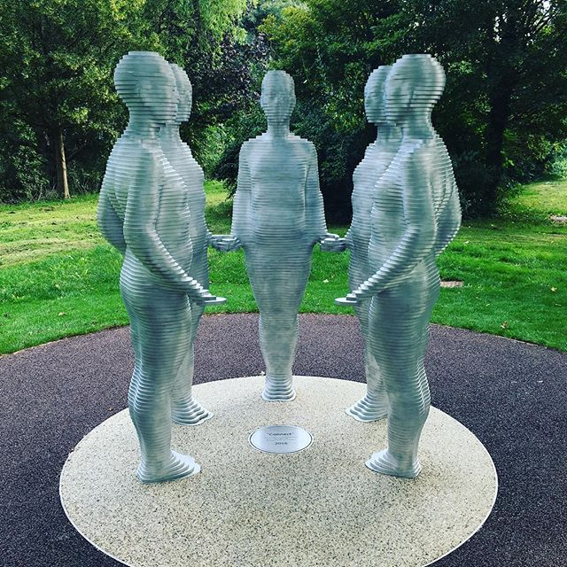
Networks and collaboration are key
Connect so you can …
Get jobs, learn, gain experience,
Contribute to books, publications
Apply for grants
Support others
Be invited to committees, funding panels, consult, advise, review etc

Slide 36
Who does research in your area of interest?
We need communities of practice and research groups to build research capability and capacity
Seek out collaborative communities and grasp leadership opportunities
Who are your communities or groups?

Slide 37
To create career development opportunities You need….
A research interest
Networks and collaborators
Visability
Mentorship
Support inclusion and accessibility

Slide 38


Give and receive coaching and mentorship
Narrative CVs
Who are your mentors - who could you ask?

Slide 39

Don’t fall out with people!
Act with research integrity at all times
(e.g. act collegially and share/author data appropriately,
ethically – don't collect data without informed consent,
be honest – no falsification of results, etc)
In the future contacts:
may reviewing your paper!
may be reviewing your grant application!
may interview you for a job!
Be friendly and positive about their work- you want them to invite you to work with them and retain sector reputation/credibility!

Slide 40
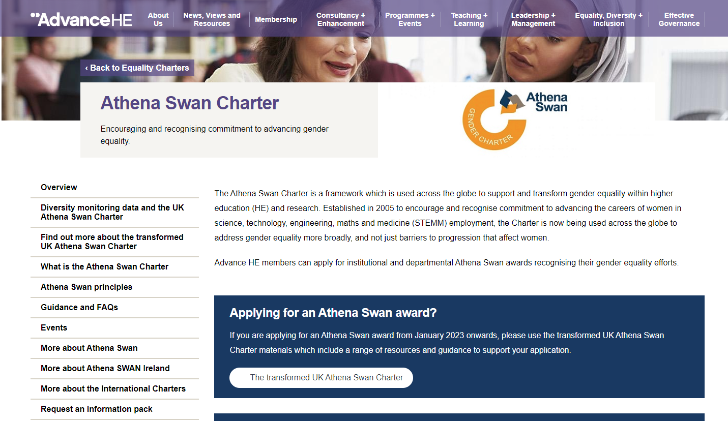
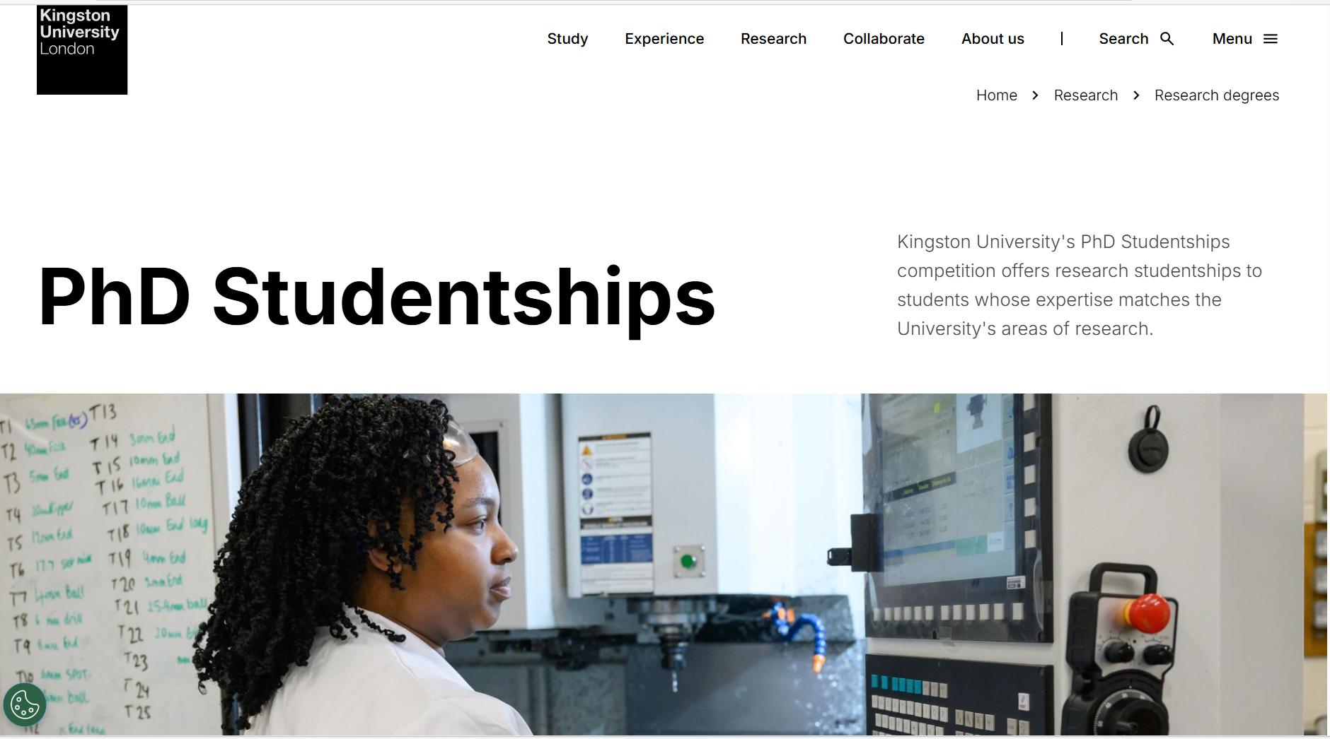
How do we make research careers more inclusive and accessible
For example Athena Swan - awarded by Advance HE
Race Equality studentships

Slide 41

QR code for your evaluation and feedback!

Slide 42
Initial experience

Slide 43
INSIGHT: Inspiring Students into Research
The INSIGHT Programme aims to attract students and recent graduates into the full range of research careers from research delivery to academic.This includes careers combining research and practice.
It is open to students and early career professionals from:
Registered Health and Care Professions (not including doctors or dentists)
Public Health Professions
Social Work Professions
It funds Higher Education Institutions (HEIs) across 12 regional INSIGHT Programmes in England to deliver:
Innovative engagement programmes to showcase and attract students and recent graduates into the full range of research careers, including careers that combine research and practice.
Funded Research Masters Studentships to provide valuable training for students and recent graduates who may have had limited exposure to real world research during their training to date. This includes course fees and a stipend to cover up to 30 Masters places per year available within each region (300+ opportunities per year across England).
Opportunities will be available in 2024, 2025 and 2026. Find out more on the NIHR Webpage

Slide 44
INSIGHT: Inspiring Students into Research
Bold = Lead Institution
Opportunities are advertised by the 12 regional INSIGHT Programmes. Contact your regional INSIGHT Programme here
Institutions offering research Masters places within each region are:
A - North East & North Cumbria: Northumbria University Newcastle, Newcastle University, Teesside University & University of Cumbria
B - Yorkshire & Humber: University of Leeds, University of York, University of Sheffield, University of Bradford & University of Hull
C - North West: University of Lancashire, University of Manchester, University of Liverpool & Lancaster University
D - East Midlands: University of Nottingham & De Montfort University
E - West Midlands: University of Birmingham, Aston University, Birmingham City University, Coventry University, Staffordshire University, University of Keele & University of Warwick
F - East of England: University of Essex & University of Hertfordshire
G - North London: City St George’s, University of London & Queen Mary University of London
H - South London: King's College London, London South Bank University, Kingston University & City St. George's, University of London
I - South Central: University of Southampton, Oxford Brookes University, University of Winchester, University of Portsmouth & Solent University
J - South East: University of Brighton, University of Chichester & University of Kent
K - South West Central - University of the West of England & Bournemouth University
L - South West Peninsula - University of Plymouth & University of Exeter

Slide 45
NIHR Undergraduate Internship Programme
The NIHR Undergraduate Internship Programme (UIP) is designed to engage and attract students from underrepresented professions in the early stages of their academic studies to consider a career in health and social care research.
Early career researchers (the applicant) will have the opportunity to apply to host up to 3 interns who will gain hands-on experience through a fully funded and flexible placement in the area or discipline they are interested in pursuing.
NIHR is looking to prioritising funding internships in the following disciplines/professions of strategic importance:
Nursing, Midwifery, Allied Health Professionals (AHP’s), Social Care, Research Methodology, Public Health, Data Science, Pharmacy, Healthcare Science
If successful, early career researchers will recruit interns via the host organisations normal recruitment processes.

Slide 46
New Medical Schools Intercalated Degrees and Internships
Forms part of the Integrated Academic Training (IAT) programme.
Open to New Medical Schools opening from 2015 onwards
Anglia Ruskin, Edge Hill, UCLan, Sunderland, Aston, Lincoln, KMMS
Focus on widening participation
Three years of funding to support:
internships for medical students
intercalation programmes for medical students
infrastructure support e.g:
set up of a Clinical Academic Training Office
creation of a research / academic society

Slide 47
Health & Care Professional Internship Programme
The Programme funds research internships open to Health and Care Professionals (excluding doctors and dentists) registered with an approved regulatory body.
These are managed by organisations across 12 regions in England, with 23 internships available per a year within each region.
Research internships give health and care professionals the opportunity to develop research knowledge and skills that can enhance practice, build research delivery expertise or begin a practitioner academic career.
The programme plays an important role in increasing the awareness of research amongst health and care professionals, and where appropriate, provides individuals with a strong foundation on which to build a research related career.

Slide 48
Health & Care Professional Internship Programme
 | Region | Programme Lead | Lead Institution
A | North East and North Cumbria | Simon Hackett | Cumbria, Northumberland, Tyne and Wear NHS Foundation Trust
B | Yorkshire and Humber | Carole Burnett | Leeds Teaching Hospitals NHS Trust
C | North West | Jo-Anne Simpson | NHS R&D North West
D | East Midlands | Louise Bramley | Nottingham University Hospitals NHS Trust
E | West Midlands | Andrew Finney | Midlands Partnership NHS Foundation Trust
F | East of England | Claire Whitehouse | James Paget University Hospitals NHS Foundation Trust
G | North London | Hortensia Gimeno | Barts Health NHS Trust
H | South London | Joanne Cull | Guy's and St Thomas' NHS Foundation Trust
I | South Central | Sarah Williams | Hampshire and Isle of Wight Healthcare NHS Foundation Trust
J | South East | Julie MacInnes | Sussex Partnership NHS Foundation Trust
K | South West Central | Nicola Manning | University Hospitals Bristol and Weston NHS Foundation Trust
L | South West Peninsula | Catherine Pittman | University Hospitals Plymouth NHS Trust
Get in touch with your regional programme to find out more about the internships available and round timings. See our webpage here
Notes:
RE

Slide 49
Pre PhD

Slide 50
Predoctoral Award (Simplified)
Designed to advance your health and social care research career at Masters level
This award is available to:
anyone working in a Local Authority, or an associated setting
registered HCPs, working in NHS settings
fully qualified General Practitioners, General Dental Practitioners, Community Dentists and HCPs working in Primary Care settings
applicants proposing to undertake training to develop as a methodologist in one of the applicable methodological areas
Funding
Local Authority, HCPs and Primary Care
Up to 1 year Full Time Equivalent (FTE)
Methodologists
Up to 2 years FTE
Flexible FTE uptake options between 30-100%; however, the maximum award duration is 4 years
Full Masters fees at the UK rate or £5000 bespoke Masters-level training per Full Time year
£1000 conference fees
£1000 PPI and Research Inclusion
£1000 Supervisory fees
Applicants that already hold a relevant Masters qualification are able to apply, with the expectation that they would have an award of a shorter duration e.g. 6 months
Launches annually in January

Slide 51
Health and Social Care Professionals - Approved Regulatory Bodies
Academy for Healthcare Science
General Chiropractic Council
General Dental Council
General Medical Council
General Optical Council
General Osteopathic Council
General Pharmaceutical Council
Health and Care Professions Council
Nursing and Midwifery Council
Social Work England
UK Public Health Register

Slide 52
Academic Clinical Fellowship (ACF)
Provides 25% protected academic training for resident doctors and dentists undertaking specialty or core training or working in general practice
Arrangements regarding clinical and academic time for ACF posts are agreed at a local level with academic and clinical leads
Support in preparing an application for a research training fellowship (to undertake a higher research degree)
Funding and support
Standard duration of 3 years (4 years for GPs) with less than full time options available
Funds 100% salary (for both clinical and academic time), bursary for conference and travel
Access to the formal Masters-level NIHR Research Training Programme
Eligibility
Medically or dentally qualified
At the early stages of speciality training
Able to demonstrate outstanding potential for a career as a clinical academic
Able to meet the clinical specification for the advertised post
Launches annually in October

Slide 53
PhD

Slide 54
Doctoral Award (Simplified)
Salaried time to undertake a funded PhD by research in health and care research.
Open to all aspiring research leaders in health and social care.
Research proposals must fall within NIHR’s Remit for Personal Awards.
Clinicians/Practitioners and those based in LA settings have the option to include 20% funded clinical/practice time within the award.
Applicants must:
Register for a PhD at a recognised HEI in England, if you are not already enrolled.
If already registered for a PhD (or MPhil, with transfer to PhD), not have been registered for more than 12 months at 100% WTE by the time the award starts.
Funding and support:
3 years WTE (and can be taken up between 0.5 and 1.0% WTE).
Funding for salary, research, working with people and communities costs and training and development costs, including £3000 conference-related costs and full PhD fees.
Can apply for co-funding with charity partnerships.
Launches twice annually in April and October.
Applications will be assessed by one of the three committees, each with a particular focus:
Local Authorities, Social Care and Public Health
Health and Care Professionals
Other Doctoral research / researchers

Slide 55
Beyond PhD

Slide 56
Postdoctoral Award (Simplified)
Salaried time to undertake funded post-doctoral research and a bespoke training and development programme
Applicants may:
have recently completed, or will soon be awarded, a PhD or approved* professional doctorate
have started to establish themselves as an independent researcher, or be established as an independent researcher, but not yet recognised as a leader in their field
be seeking to re-establish their research career following a career break or period dedicated to professional practice
* The eligibility of professional doctorate holders is assessed on a case-by-case basis
Funding and support
Funding for salary, research activities, research assistance, conference attendance and for training and development
Awards have a duration of between 2 and 5 years (and can be taken at between 50 and 100% WTE)
Recipients are permitted to apply for a second Post-Doctoral Award in due course, but the total duration of support is limited to 8 years WTE
Practice Time: Registered practitioners are permitted to dedicate up to 40% of award time to the development of their practice or policy role, which will be funded by the award
Application windows open twice annually, in the spring and autumn
Applications are welcome from all, and will be assessed by one of three committees, each with a particular focus:
Local Authorities, Social Care and Public Health research
Health and Care Professionals
Other post-doctoral research / researchers

Slide 57
Clinical Future Leaders Fellowship
7 year award for registered health and care professional as defined by NIHR, a doctor or dentist to transition from postdoctoral researchers to research leadership roles
Applications by nomination only (3 nominations max per HEI for each round)
Applicants may:
have started to establish themselves as an independent researcher, or be established as an independent researcher, but not yet recognised as a leader in their field
be seeking to re-establish their research career following a career break or period dedicated to professional practice
Funding and support
Funding for salary, research activities, research assistance, conference attendance and for training and development. Funding for salary is shared by the NIHR and the contracting organisation.
Awards have a duration of 7 years with part time options available.
It is permitted to dedicate up to 20% (or 40% in exceptional circumstances) of award time to the development of a practice role, which will be funded by the award
Application windows annually, in the autumn

Slide 58
Global Advanced Fellowship (GAF)
Applicants may be:
starting to establish themselves as an independent researcher, or are already established as an independent researcher but not yet recognised as an international leader in their field
seeking to transition into applied health and social care research or re-establish their research career following a significant career break
Applicants must:
hold a relevant PhD or postgraduate medical research degree but not hold a Professorship or Chair position
be based at a contracting host organisation that meets one of the following criteria:
a Higher Education Institution (HEI) or Research Institute located in a Low and Middle Income Country (LMIC)
a UK HEI, with the requirement that an LMIC HEI or Research Institute is a partner organisation.
be conducting research that directly and primarily benefit patients and the public in countries on the OECD DAC list.
Funding and support:
Up to £750,000
2-5 years WTE (between 50 and 100% WTE)
Funding for salary, research costs and training and development costs, including £2000 per year conference related costs
From April 2026 funding will be limited to sub-Saharan Africa and South Asia, addressing acute infectious disease threats and chronic health security challenges, including AMR and infectious diseases of poverty, with a focus on the poorest and most vulnerable population
Launches annually in April

Slide 59
Clinical Lectureship
Provides 50% protected academic training time for doctors and dentists in possession of a PhD/MD that are undertaking specialty training or working in general practice
Arrangements regarding clinical and academic time for CL posts are agreed at a local level with academic and clinical leads, as well as the NHSE local office
Funding and support
Standard duration of 4 years with less than full time options available
Funding salary (both clinical and academic), bursary for conference and travel
Access to AMS Starter Grants
Eligibility
Be in higher speciality training (medicine)
Have completed a research doctorate (PhD) or equivalent
Show outstanding potential for continuing a career in academic medicine or dentistry
Launches annually in March (medicine) and October (dentistry)

Slide 60
NIHR Senior Clinical and Practitioner Research Award
Award designed to support senior clinicians and practitioners at the post-doctoral level and offers protected time from within current roles to engage in research activities.
Funding and support
Between 20% and 50% of the award holder’s salary
Training and development (up to £5,000 PA)
Contribution to research activity costs ~£20,000 PA (up to £100,000 over 5 FTE years).
Assessment criteria
Underrepresented specialisms and groups
Clinical or practitioner role
Commitment of the applicant to a continued career involving research
Quality and appropriateness of the research activity & training proposed
Support from mentorship team and host organisation.
Launches annually in the autumn

Slide 61

NIHR Academy Members based in infrastructure criteria
Those undertaking a formal training/career development award, which should meet all of the following criteria:
Be competitive, include a training plan and have a defined
end point (such as an application for further funding)
Receive at least 25% funding from the NIHR* for
salary/stipend over the lifetime of the individual’s
award*
Be hosted in a setting with a remit for research capacity development**
* For ARCs and HPRUs/ HPRFAs funding can be from NIHR or from an official co-funding partner
** This includes: NIHR BRCs, PSRCs, ARCs, HRCs, IO, HPRUs, HPRFAs, SPCR, SPHR, SSCR, PGfAR, RPSC, Decarbonising the health and social care system, MHRGs, MHRLs

