Slide 1


NIHR St George’s Clinical Research Facility
Dementia and Arthritis Research Café with Positive Network in Balham
Presented by: Valentina Raspa, Senior Clinical Research Nurse; Jeremy Opoku, Clinical Research Coordinator; Pauline Dawkins, Healthcare Chaplain at St George's Hospital and Peer Researcher and Grace Salmon, Positive Network Manager and Peer Researcher

Slide 2
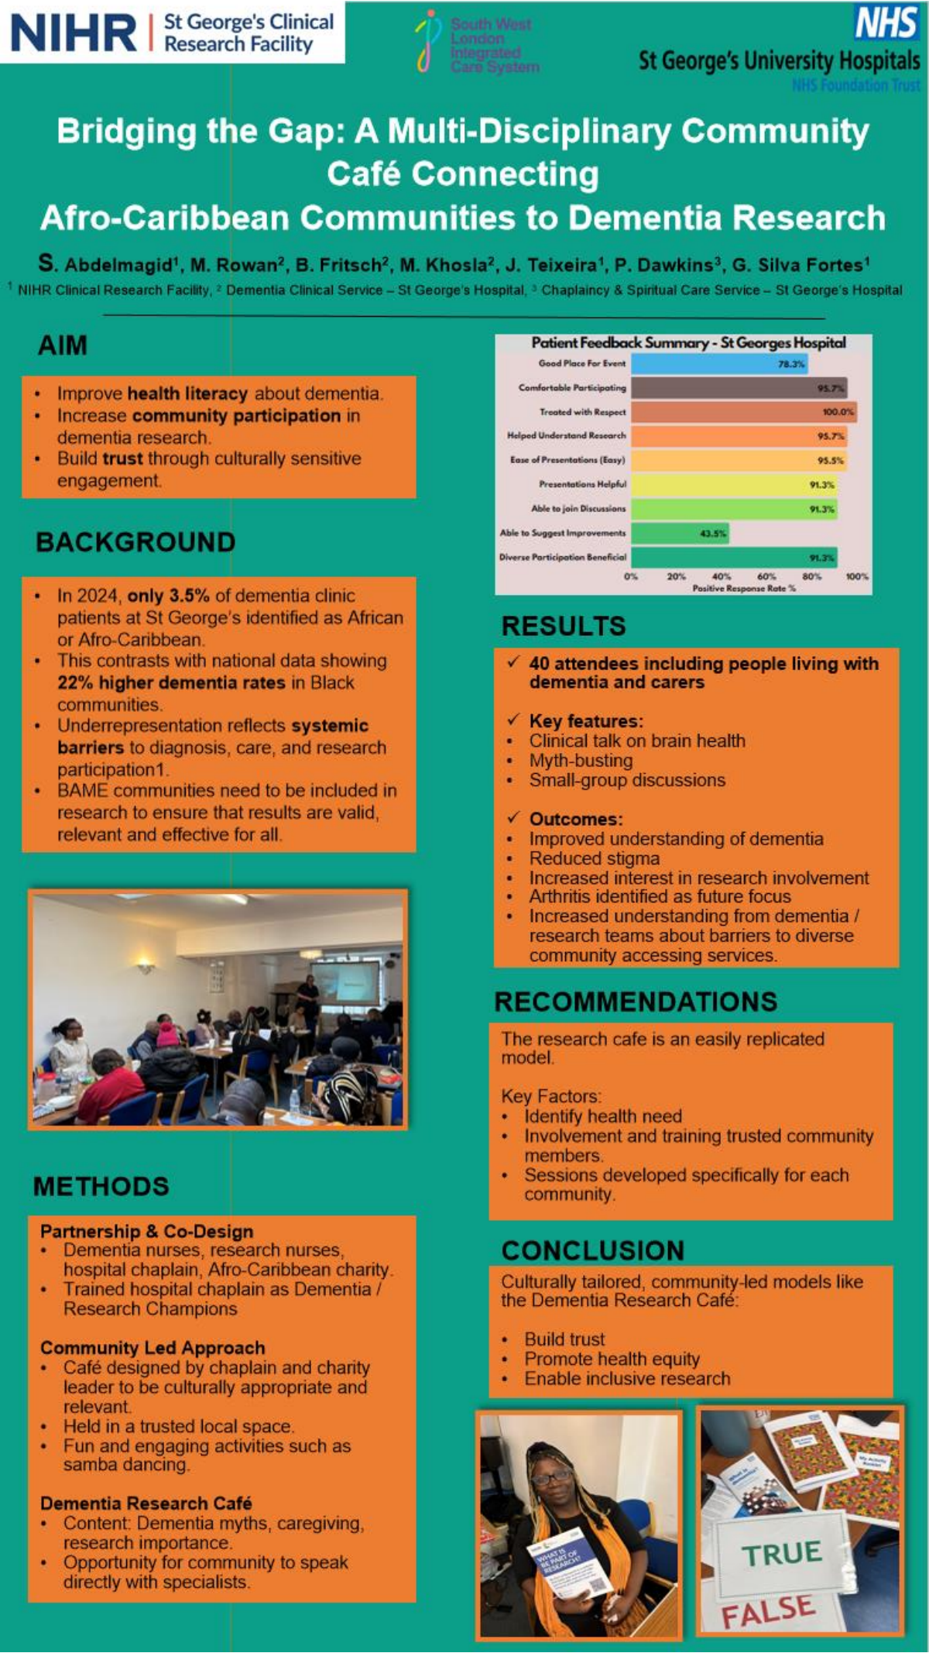
Building trust and continuity through our Dementia and Arthritis Research Cafe
A community-led approach to engagement, listening and return visits
Presenting as a team
Trust in practice meant continuity by design:
Valentina/ Sophie/Jeremy- Strategy & Planning
People asked for another dementia cafe - and we went back
Identified the need for accessible materials to be secured for the café, and the need for a multidisciplinary approach.
We added arthritis because the community said it mattered
We used trusted partners and familiar faces
Grace/Pauline - Peer researcher & community connector
Brought back trusted community relationships through Positive Network, co-shaped the session and helped lead the room in a way that felt welcoming and credible.
We showed that what people said before changed what happened next
Interactive thread: throughout the presentation we will ask you to notice where trust came from - and how continuity was made visible.
Sophie/Jeremy - Research Delivery & Coordination
Coordinated and secured meetings with key clinical contacts in the Rheumatology and Musculoskeletal Physiotherapy departments at St George’s.

Slide 3
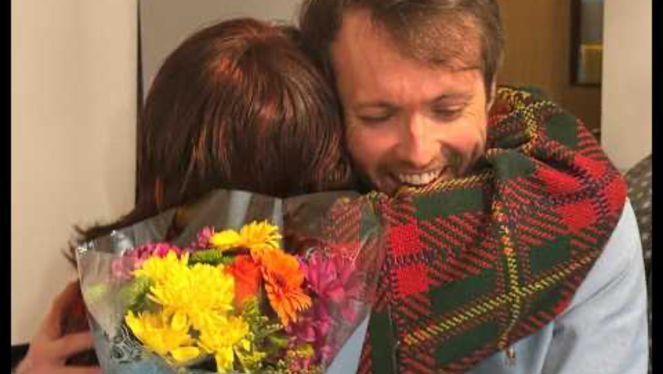
Notes:
Our Clinical Research Facility's Dementia and Arthritis take centre stage at community-led Research Café in Balham

Slide 4
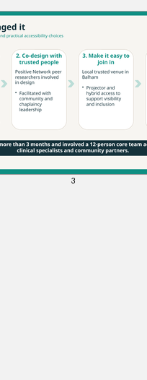
What usually builds trust first?
Why a research cafe approach?
“When you work with communities, what helps trust form first?”
Traditional engagement can feel formal and one-way. A cafe format made space for ordinary conversation, myth-busting, practical questions and shared learning.
A. Familiar faces
B. Clear follow-through
Most importantly, it allowed us to return to people with something recognisably shaped by what they had told us before.
C. Shared decision-making
Community feedback after the first dementia cafe led directly to a new session with arthritis included next time.
D. Time for questions
We found it was not one thing on its own - it was continuity across all of them.
Notes:
Interactive opening: 30-second show of hands before we tell our story
Ask the room:

Slide 5
How we made it happen together
Internal Strategy & Planning
Research Delivery & Coordination
Community Trust and Co-facilitation
Three roles, one joined-up model for trust, delivery and follow-through
The point is not that one person-built trust alone. Trust came from the hand-off between internal strategy, community credibility and visible follow-through.
Notes:
Community trust and co-facilitation- Brought the perspective of a peer researcher and trusted connector from Positive Network, Helped shape the content so the room felt relevant and respectful, Made participation feel safe, familiar and community-led
Research Delivery & Coordination- ensured ongoing feedback from multiple perspectives throughout the cycle to support joined-up planning from early engagement through to delivery on the day

Slide 6
How we managed the cafe
Co-design, trusted partners and practical accessibility choices
1. Listen first
2. Co-design
3. Remove barriers
4. Blend voices
5. Return afterwards
Built on learning from the earlier dementia cafe and pre-cafe meetings.
Peer researchers and Positive Network helped shape content and format.
Local trusted venue, projector support and hybrid access helped inclusion.
Clinical specialists, peer insight and open Q&A sat side-by-side.
We used feedback, follow-up and reflection to keep the relationship going.
Planning took more than three months and involved a 12-person core team across CRF staff, clinical specialists and community partners.
Notes:
[Sources]
- NIHR St George's CRF article says planning took more than three months and involved a 12-strong core team including CRF staff, clinical specialists and peer researchers.
- The article also notes that Positive Network peer researchers co-designed the cafe and practical changes such as a projector were provided to support participation.
[/Sources]

Slide 7
What impact and success looked like
Numbers mattered - but so did confidence, clarity and willingness to stay involved
41
100%
95.7%
95.5%
91.3%
people attended in person, with additional online participation
of respondents felt the event was relevant or very relevant in the published summary
felt comfortable participating
said presentations were easy to follow
said discussion and participation were relevant
What changed?
“Both presentations were so clear and easy to follow - and if I'm invited, I'd be happy to take part in research.”
Improved understanding of dementia and arthritis
Reduced stigma and stronger confidence to ask questions
Greater interest in research involvement
A clearer signal that arthritis should stay part of the continuing model
That is trust moving from information to invitation.
One attendee said the presentations were “so clear and easy to follow” and that, if invited, they would be happy to take part in research.

Slide 8
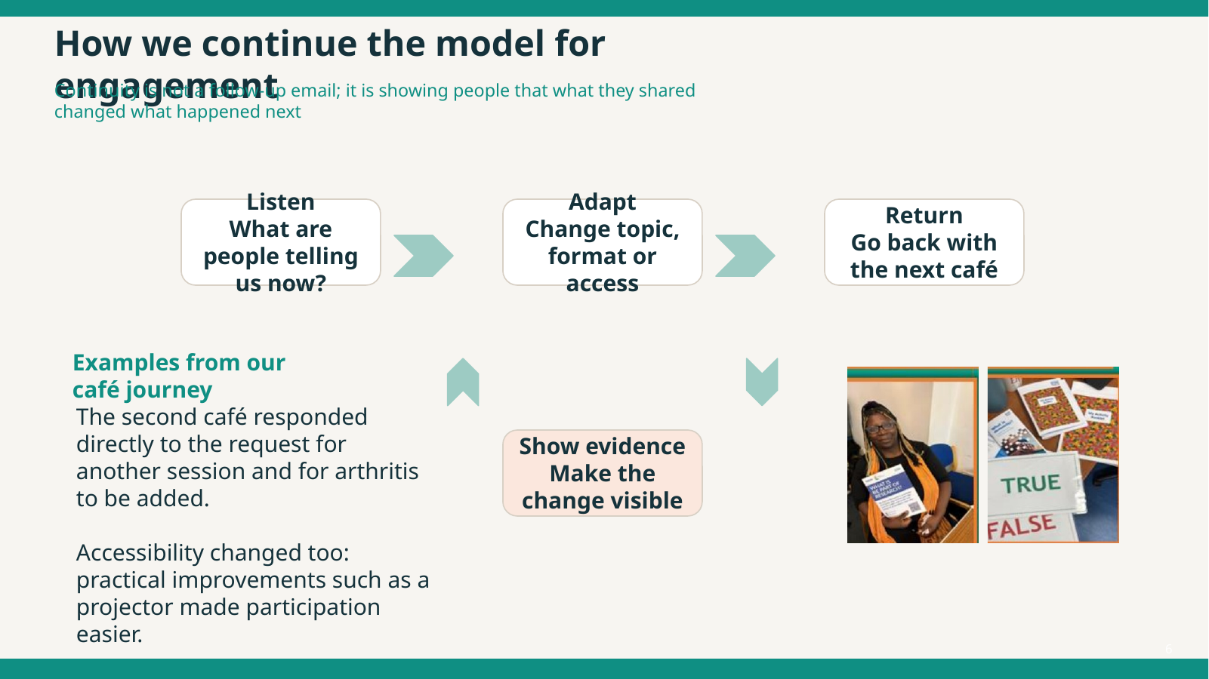
Where did continuity show up?
Why this matters
Turn to the person next to you and pick one moment from our story that felt like continuity in action.
Trust grew because people did not just receive information once. They could recognise their influence across time.
Going back after the first cafe
Adding arthritis because people asked for it
That is the difference between a one-off event and an engagement model.
Keeping trusted community partners involved
Showing that what people said changed the next step
Notes:
Interactive reflection: Prompt for the audience, 2-minute pair discussion, then one or two share-backs
Suggested facilitation: let Grace lead the room discussion here, then Tinashe or you bring back the organisational learning.

Slide 9
How we continue to use the model for engagement
Continuity means showing people that what they shared changed what happened next
Listen
Adapt
Return
Show it
What are people telling us now?
Change topic, format or access
Go back with the next cafe
Make the change visible
Example from our cafe journey
Our practice now
The request for another session and for arthritis to be added was heard, then acted on. Accessibility changed too: projector support made participation easier.
We keep continuity visible by naming what changed, who influenced it and what the next step will be.
That turns engagement from a single event into a relationship.

Slide 10
What will you take back to your own setting?
Three prompts
Trust grows when engagement is
1. Where could you replace a one-way engagement activity with a cafe-style conversation?
Co-designed with the community
Accessible
Respectful
Sustained over time
2. What is one visible way you could show communities that their feedback changed your next step?
3. Who are the trusted people or places you should co-design with rather than simply invite in?
Thank you
Notes:
Interactive close. Three prompts
Final audience prompt and handover into Q&A
Invite one or two reflections, then move to questions.

Slide 11
Thank you
For any further information regarding our Research Café please email Adama Roberts, St Georges Clinical Research Facility Patient Public Involvement and Engagement Manager - adama.roberts@stgeorges.nhs.uk
Notes:
Interactive close. Three prompts
Final audience prompt and handover into Q&A
Invite one or two reflections, then move to questions.

