Slide 1
Delivering inclusive public health research in and with local authorities: how do we work together?
Jessica Sheringham
Principal Research Fellow, NIHR Population Health Career Scientist, UCL
London-wide REN celebration
9 July 2026

Slide 2




About me
Researcher at UCL, consultant in public health
10+ years evaluating public health programmes
Interest in housing/health nexus, child/young people health & wellbeing, breathing problems
Expertise in mixed methods, implementation and process evaluation
Values: capacity building in public health research, doing research that matters to communities and services

Slide 3


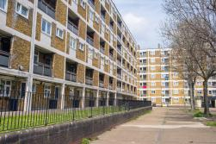

Local authority health responsibilities: public health +…
Public health mandated responsibilities
NHS Health Checks
Health visiting
School nursing
Sexual health
Drug and alcohol treatment and recovery
Smoking cessation
Oral health programmes
Local health protection (with UKHSA)
+ support for NHS commissioning
Notes:
Housing
Education
Employment
Environment
Safety
Social Care
public health mandated responsibilities +++
NHS Health Checks — councils must offer a health check to all eligible adults aged 40 to 74 every five yearsNational child measurement programme — annual weighing and measuring of children in reception and Year 6
Health visiting services — the healthy child programme for children aged 0 to 5, including five mandated universal health reviews
School nursing services — the healthy child programme for children aged 5 to 19
Sexual health services — including open-access sexually transmitted infection (STI) testing and treatment, and contraception provision
Drug and alcohol treatment and recovery services — an accessible system providing a full range of NICE-compliant interventions
Smoking cessation services — stop smoking support and treatment
Oral health improvement programmes — including supervised toothbrushing in high-deprivation areas where appropriate
Local health protection — councils have a duty to ensure arrangements are in place to respond to health protection incidents and emergencies in their area, working with UKHSA.

Slide 4
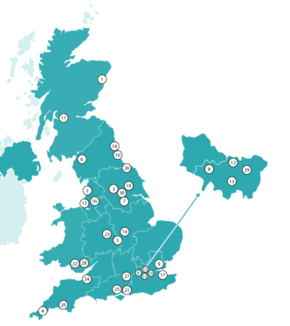

HDRCs: centres of NIHR funded research capacity
Growing local authority research capacity nationally
Ealing
Islington
Lambeth
Tower Hamlets
+ …

Slide 5




Research by local authorities or on local authority services
Research with local authorities as partners

Slide 6
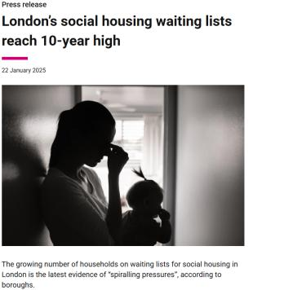
Household overcrowding, place and poverty
Varies by place: Highest in urban areas, particularly London (7%, vs 3% nationally)
Unevenly distributed:
common in households with dependent children
more than 2x as high in families headed by people from ethnic minority backgrounds
higher in lone parent families (13.5%)
A consequence of poverty, driving people to live in homes too small for families: e.g. in London over 25% are in poverty after paying for housing costs
Also driven by shrinking social housing sector and fewer larger (3 bed+) properties available overall.
Notes:
Jess
3% overall,
https://www.ethnicity-facts-figures.service.gov.uk/housing/housing-conditions/overcrowded-households/latest/#by-ethnicity-and-area
Drivers – shrinking SH sector, higher rents, smaller properties
City-wide, households can expect to wait 844 days (2 years and 3 months) for a one-bed property, while the wait for a family-sized home of four or more bedrooms stands at 2,304 days (6 years and 3 months). https://centreforlondon.org/publication/londons-social-housing-waiting-times/

Slide 7
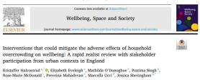
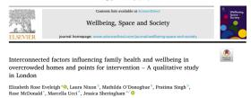








Overcrowding: from data science to community action
Consult
Consultation with VCS and 2 councils
How do you identify overcrowding & what can you do?
Research
Research with Evidence Islington & HealthWatch Islington: qualitative research + data science & “what works” review
Engage
Space Hacks: Workshop with VCS, HealthWatch Islington, Islington Council, Community Researchers
Local & national policy engagement
Notes:
Mayor Civic Award

Slide 8
Discussion questions for all tables
1. What’s your experience, understanding of local authority health research, as relevant your setting?
  focus in your table discussions on some common elements across your group that are most relevant to you
2. What does inclusion in research mean to you?
  Focus on different elements by table from the EDI ‘pillars’ (see next slide)
3. How can we work together to achieve inclusive research?
  What barriers have you experienced to inclusive research?
  How might working with partners help address those barriers?

Slide 9
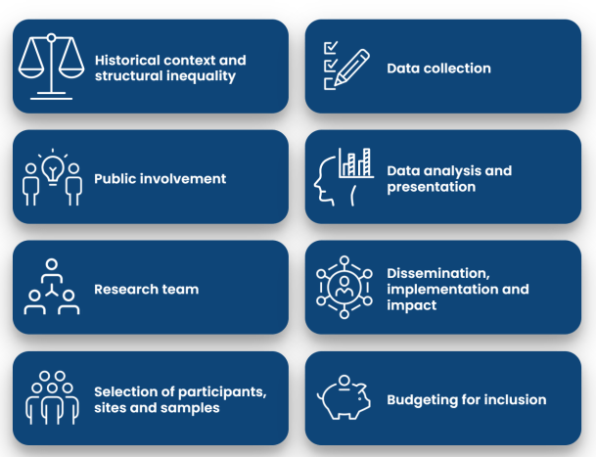
What to consider in research inclusion: NIHR RSS EDI toolkit
Notes:
https://www.rssleicesterresources.org.uk/edi-toolkit

Slide 10
Discussion questions – by table, focused on pillars
What does inclusion in research mean to you?
“Data”
Where/who will you seek to include in your desired participants?
How can you best reach them?
2. DISSEMINATION/IMPACT:
How can diversity be included in the ways you disseminate
How can you ensure diversity in who disseminates?
3. BUDGETS AND TEAM BUILDING:
What additional costs need to be factored in when designing inclusive research?
How might embedding equality, diversity and inclusion extend the timelines of your research?
How to build and sustain inclusive teams with equity of experience and opportunity?

Slide 11
Historical and structural inequalities
Evidence from overcrowding example
As evidenced in the literature, overcrowding is more commonly experienced in urban areas, such as London, and amongst Black and South Asian communities than white British communities.
Some of the research into the health effects of overcrowding in the UK, however, has been conducted on primarily White populations.³⁴
Our stakeholders for this project in London councils were also particularly concerned about the distinct and severe effects of children growing up in overcrowding and their parents.
Guidance
Identify whether previous research has excluded certain populations.
Consider historical and structural issues that influence how under‑represented groups perceive research participation.
Plan how to navigate these issues to avoid perpetuating inequalities
Links: data collection, public involvement
Notes:
We haven’t done this

Slide 12
Public Involvement
Idea came from consultation with 5 community sector organisations, which included residents with experience of living in overcrowding.
Involvement throughout the lifecycle of the project: Eg resident joined the project team, attended monthly project team meetings. She contributed at all stages of the project from design to delivery, including dissemination.
Community sector organisations were involved throughout the project and made a significant difference to how the project was designed and delivered (e.g. discussing our findings with members of Disability Action Islington led directly to us conducting a focus group amongst people with disabilities).
Engagement, support and reward for those involved: All of people involved in providing advice and contributing to the project were reimbursed for their input, in line with NIHR guidance.
Ensure public involvement practices are sensitive to EDI issues.
Develop strategies to recruit and retain diverse contributors.
Provide support to empower contributors from diverse backgrounds.
NB Evidence I would now seek to collect:
Data on protected chars of contributors – recruitment & retention
Mechanisms for involvement
Adaptations during project in response to contributors
Notes:
Sabrina – do you have a doc for: strategies to recruit and retain diverse contributors
See annual report from 24/25 on recruitment approach
Training for CRs; how do we
SDB: 2 rather than 1, pre meet, post meet,
Adaptation in response: Structure to do in FG rather than all as less threatening
Summary publicly available

Slide 13
Selection of participants, sites and samples
In our selection of participants, our choice of site was congruent with evidence of need – it was in a densely populated area of London, with a diverse population. Since we submitted our application, ONS Statistics on overcrowding indicated that although pockets of overcrowding were high in Islington, other areas of London such as Tower Hamlets experienced greater overall overcrowding prevalence. We expanded our study to Tower Hamlets.
How generalisable is your sample?
Has geographical need informed your choice of site(s)?
Are you excluding anyone, if so is this justified?
How is data on equality, diversity and inclusion collected?
Links: data collection; budgeting; analysis
Notes:
VAI – how do we target VCS for projects?
Data from the evaluation - noting we can change this– who did we reach? In what ways is diversity sought? Seniority, directorate, demographics, VCS – level of contact but how might we do this?
Fran – can we audit VAWG for EDI?
Jack – can we audit focus groups for adult learning – going to under served groups? Would this have happened at all in another form without you/EI?
Claire – audit baseline

Slide 14
Inclusive Data Collection
We instigated multiple strategies to reduce barriers to participation, e.g. data collection was conducted by researchers of diverse ethnicities, some of which were embedded in the community. We employed interpreters for discussions, funding for carers, and provided play facilities to encourage parents to bring children to focus groups.
We adapted recruitment and data collection strategies to the setting. For example, in response to sharing interim findings with VCS partners to inform analysis, we set up a specific group with members of Disability Action Islington whose represented noted they had some specific experiences they wanted to share.
- Assess how equitable your data collection strategy is across groups.
Ensure recruitment and data‑collection approaches methods address participants’ protected characteristics, needs, and circumstances.
Identify additional steps needed to include seldom‑heard or marginalised groups.
Notes:
As slide 6

Slide 15
Data Analysis & Reporting
Analyse and present participants’ EDI characteristics transparently.
Incorporate diverse perspectives during interpretation.
Clearly describe how EDI characteristics are represented in reporting.
Links: data collection; sampling
Although we sought to collect data on demographic characteristics, we did not have high completion of demographic forms. Our sample of participants was diverse in terms of ethnicity and disability and many were single parents, who may experience particular barriers to research participation. It was also entirely female, which also reflected our study team, which was entirely female.¹⁶ We were aware that women had an important contribution but it means there was a perspective missing from the research.
Notes:
Projects?
Baseline evaluation?

Slide 16
Research Team & Culture
Consider diversity within the research team.
Assess and strengthen the team’s cultural competence.
Document how diverse perspectives influenced the study design.
Sources of evidence - consider
Profile of researchers
Training sessions (planned, budgeted)
Mentoring
Strategies for fair career progression/opportunities, safe spaces, respectful team dynamics
The research team’s cultural and EDI competence came from recruitment of community researchers alongside university-based researchers, specific training and advice from VCS partners throughout.
The ActEarly researchers seconded to the project had close links with the local community and had been trained in coproduction. In team meetings, they shared the ActEarly coproduction principles and advised the wider team on adhering to them in the conduct of the research.
We held joint training sessions between university researchers and VCS partners.
We were also advised and supported throughout by HWI and Bromley by Bow Centre on recruitment, the interpretation of findings and dissemination of results.
Notes:
EI team: built into strong HR policies – where we advertise, mitigations at interview, guaranteed interview scheme
Cultural competence: neurodiversity session run by the team, workplace passports – your document that you can share with your mgr to agree adaptations with your mgr and it follow you throughout the org, e.g. shorter days, big screen
How diverse perspectives influence HDRC
– EI implementation sessions in person – run by range of staff, evidence of staff at all levels shaping delivery,
- SDB – see also earlier

Slide 17
Budgeting for inclusion
Evidence from overcrowding example
Our VCS partner advised on what barriers to participation may arise and how to address them.
This ensured the study was sufficiently costed from the start to enable translation of materials, and interpreters for groups, funding for people with disabilities and caring commitments to take part in research.
All of people involved in providing advice and contributing to the project were reimbursed for their input, in line with NIHR guidance.
What additional costs need to be factored in when designing inclusive research?
How might embedding equality, diversity and inclusion extend the timelines of your research?
Are there steps that researchers can take to reduce costs?
To note: NIHR are committed to funding costs associated with inclusive research
Factor into budgeting at all stages incl dissemination
Notes:
Inclusive research TEAM
Inclusion community researchers
Inclusivity of projects in EI
Factored in costs of resident engagement, LWW, paying for carers: lessons learned: LBI policies state should produce evidence for need for carers
Budgeted for translation of materials
Developing booklet – an output from community researchers – directly for residents to use
Makes easier for all pptto get ijvolved in research

Slide 18
Dissemination, implementation and impact
Dissemination needs to be tailored to the different and diverse audiences which your findings need to reach.
Implementation to diverse communities needs to be considered at the design process, and not through adaptations further down the line.
Adopting inclusive approaches to dissemination and implementation from the outset is more likely to lead to impact which includes reducing health and care inequalities.
We list the range of activities and partners that happened from the programme. We had planned dissemination events with VCS partners.
We were more successful at sharing findings opportunistically, by attending existing events with readable summary leaflets of our findings, such as coffee mornings.
Notes:
Ref the booklet
Website – different format of meeting notes for residents (1 page summaries
Going to communities (eg VAI conference) rather than expecting them to do it for us

