Slide 1
WNL Research Engagement Network
Aims:
Strengthen collaboration across our research community, including local communities & VCSE, academic & health & care.
Strengthen our Pop Health Improvement approach through effective research that informs population health
Drive inclusivity in research and ensure our research is meaningful in the context of our diverse and our most underserved communities.
Approach
A research partnership tying health research & community health & wellbeing together to tackle inequalities & develop inclusive research;
Raising awareness of & building relationships with research, studies & research organisations
Built on strong local community initiatives and partnerships
Focused on sustainability, working in areas of high deprivation & committed to working with communities over the long-term, building trusted relationships
We have developed a Research Engagement Network to oversee this work which meets on a regular & ongoing basis
A partnership that includes 12 VCSE partners
Worked with over 4000 local people to date with 12 community research champions & now building Youth Research Champions
Developed community research champions to further build relationships with diverse communities driving forward inclusive research
Strengthened relationships with our academic partners
Undertaken over 80 community engagement events, ranging from health roadshows to outreach to online events
500+ blood sugar checks (20% advised to book GP appointment)
Connected with local communities on a range of health and wellbeing advice, support & research studies including (but not limited to) mental health information, healthy lifestyle behaviours and specialist healthcare professionals & academic partners.
1000+ blood pressure checks (15% referred to GP for further checks)
We have been building researcher relationships and have partnered with two genomics studies and are co-partners on two grant applications (one now successful):
  Over 200 participants in studies

Slide 2





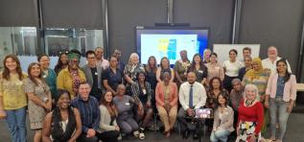

Our NWL REN Journey
Cohort 1 22/23
Community Research Champions
Health Roadshows
Partnership Forum
Cohort 1 24/25
Community led priority on Prostate Cancer
ARC Health Equity Summit
ICB NWL Health Equity Award
The Marmot Report on Structural Racism
NIHR ARC NWL
ARC NWL programme ended in March 2026
Merging of NWL and NCL ICBs
ICS REN WEST AND NORTH LONDON PROGRAMME 26/27
Cohort 1 & 2 23/24
Community led priority on Hypertension
Built up our Community Research Champions
Cohort 2 focus on Youth Mental Health
Cohort 1 25/26
Youth Community Research Champions
OUR PARTNERS
Your Health in Your Hands: Communities, Champions, Connections

Slide 3
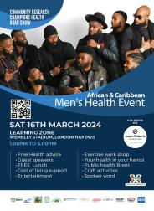
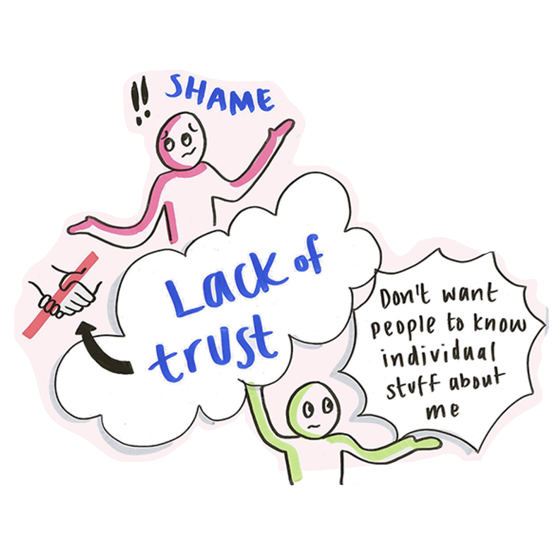
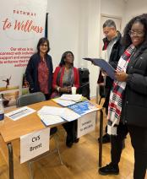
Our Achievements
Reach
64 Community Research Champion
Research participation
279 people registered in health research studies
Co-developed prostate cancer research bid
Health outreach
1200 health checks delivered
Screening, referrals through NHS partnerships
Community feedback
95% value health research
92% understand health research
75% willing to participate in research
CRCs reported increased confidence, communication and research skills
Youth CRCs improved accessibility of research participant materials
53 community engagement events
Across 5 boroughs
3700 people engaged (across 4 years)

Slide 4
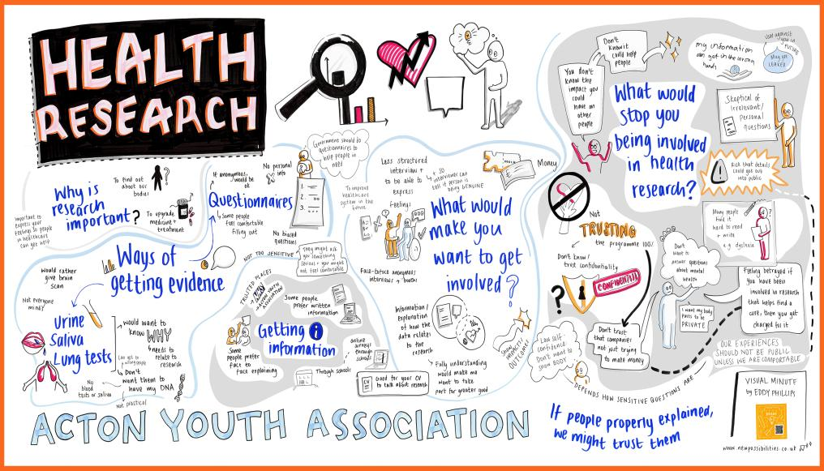

Slide 6





SEL Research Engagement Network (REN):
Taking the learning from previous RENs in south-east London (SEL) into 26/27
London-wide REN Learning Event, LSBU, 9th July 2026
Dr Rachna Chowla, GP & Joint Director of Clinical Strategy, King’s Health Partners

Slide 7

Notes:
Early RENs unearth the conditions needed to nurture trust and partnership working between communities and researchers
Learning all round
Main themes as touched on my Adam
Trust
Partnership working
Upskilling – new for both
Coproduction rather than extraction
Issues with sustainability, mismatch of research cycle and REN programme timelines

Slide 8
2026-2027 REN programme in SEL
Partnership:
SEL VCSE Alliance/HighTrees
+ SEL ICS + RRDN + KHP
Transform how marginalised and minoritised communities shape + take part in health research in South East London >> research-ready communities + community-ready researchers >> a shared SEL model for research engagement (collaborative, not extractive)
Who
Aim
Mabadiliko – community lead >> Understood barriers/opportunities for community participation
2022-2023
New partnership – aligning aims, asks and offers, ways of working
Co-developed model for equitable
involvement including training
Build on REN learning with view to integrating
into existing
SEL networks
VCSE alliance leads in boroughs + engagement plan +
research charter
2023-2024
Training
1
Lambeth HDRC, importance of Community Knowledge Network
Researchers
2024-2025
2
Facilitated borough engagement events to broker connections
Collective leadership + scale + reach + learning + building towards sustainability
Community groups + researchers >> matched on interest >> trained up + attend facilitated sessions to support co-working
2025-2026
Governance +
Sustainability Planning
3
Notes:
Training for borough Alliance leads on what good community-led research looks like in practice
Lead 2-3 Co-design sessions to explore the development and application of a community research charter across the Alliance
Exploring how a community ethics review process could work at SEL level
Support Alliance leads to develop borough engagement and deliver events

Slide 9
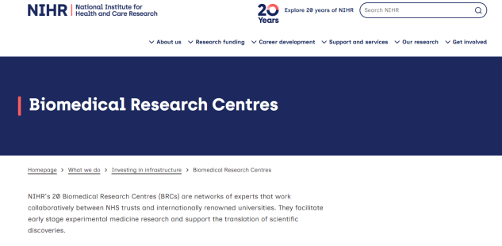
One last thing! In SEL the team involved in our anticipated BRC application are involved in our REN.
Are you a REN in London involved in your BRC? If so, please say hi to Emily and the team!

Slide 10
Thank you, on behalf of the whole SEL REN partnership team rachna.chowla@kcl.ac.uk
Our SEL VCSE Director will be participating in the chat-show later

Slide 11
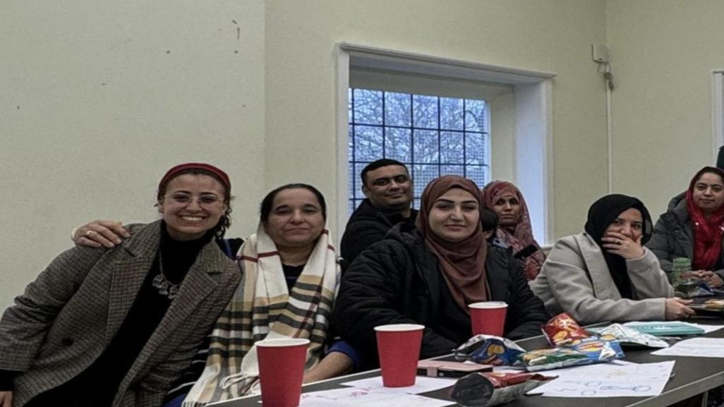
SWL Research Engagement Network
Who are we?
A partnership between the NHS, Voluntary, Community and Social Enterprise (VCSE) sector, and Public Health teams locally as well as South London Health Innovation Network, (formerly) South London Academic Research Collaborative and Big South
Our aims
To improve public involvement from our local communities by empowering local communities and VCSE organisations to better understand and co-produce research
To improve public participation and build trust in research
What have we achieved?
Since 2023, 18 research cafes were undertaken
In 2025-2026, 6 VCSEs and 2 Trusts hosted 8 cafes reaching more than 200 participants
One of the cafes won a nursing award on connecting Afro-Caribbean communities with dementia research
In 2025-2026, we organised 8 research network cafes with on average 20 people attending each café
We hosted our first SWL Research Summit with 400 people attending
What is next?
Continuation of network cafes
Development of community research hubs
Training up of research connectors

