Slide 1
Research Engagement Network
First London Event
Dr Catherine Heffernan, Director of Health Improvement
NHS South West London Integrated Care Board
July 2026

Slide 2
What is a Research Engagement Network?
The Research Engagement Network (REN) programme started in 2023/24 by NHS England
It’s designed to:
  Increase participation in research
  Make research more inclusive
  Make research more accessible and relevant to local communities
Helps bridge the gap between researchers and the public
How the programme works varies by Integrated Care Board (ICB) areas:
  Community spaces for engagement events
  Volunteer Community Research Champions
  Research clubs and cafés
Each ICB bids for funding each year with plans of how they will engage communities, voluntary sector and researchers with quarterly monitoring and annual evaluations

Slide 3
Importance of Taking Part in Research
Every day in the UK, someone receives a diagnosis for a disease or health condition. The treatment, care and support they receive will be shaped by research.
Research provides evidence about what works best. Patients, carers, commissioners and health and social care professionals all use this evidence to make decisions about treatments and care.
More people taking part or being involved means more research being done and this leads to service improvements and better investment in the NHS
Two types of being involved:
  Participation - participating in studies
  Involvement – doing research with researchers
Taking part grows research literacy - e.g. you are much better at sieving through the misinformation on the internet

Slide 4
What Would It Take To Feel Supported In Your Research Journey?
Collaboration
People work together as equals — researchers, communities, NHS staff, and the public all have a voice.
“I want to feel like I’m shaping something, not just being asked questions.”
Accessibility
Information is clear, events are easy to join, and support is there if you need it.
“I want to feel like I don’t need a PhD to take part.”
Inclusivity
Everyone feels welcome and respected, no matter their background, experience, or identity.
“I want to feel like research includes people like me — not just experts. I want to feel like I’m shaping something, not just being asked questions.”
Community-led
Ideas come from real local needs, not top-down. People with lived experience help set the agenda.
“I want to feel like research starts with what matters in my community.”

Slide 5
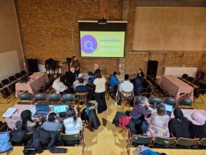
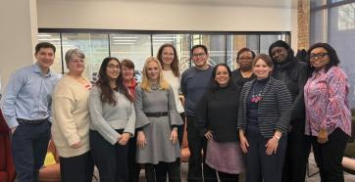

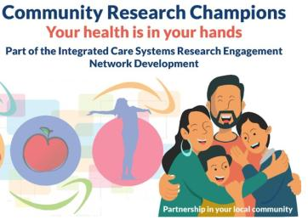
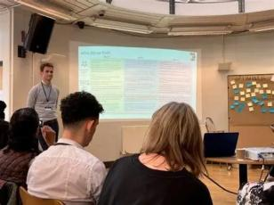
Supporting London’s Local Community

