Slide 1





Research Beyond Boundaries
Network Café

Slide 2
Agenda
13:00 – 13:20 | Welcome and afternoon overview
1
Lunch provided
2
13:20 - 13:35 | Local NHS R&D
13:35 - 14:10 | Funding applications
3
Local R&D support and wider care settings
A mixed perspective
4
14:10 - 14:30 | NIHR Research Delivery Network
14:30 - 14:50 | Leadership in research
5
Updates and what's new - Enabling health and care system research across England
A research leadership journey
6
14:50 - 15:10 | Informal Networking
15:10 - 15:45 | Expert panel
7
Refreshments and connections
Partnerships and collaboration
8
15:45 - 16:00 | Reflections
Building on conversations – REN & KRFT Feedback

Slide 3
Introduction
Setting the stage for collaborative research

Slide 4
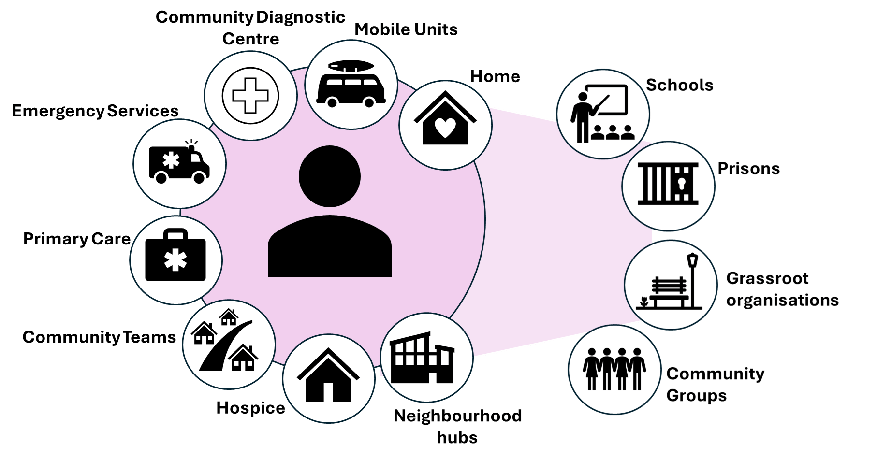
Research beyond boundaries: what do we mean?
Connecting research across the whole health and care pathway
Generating evidence reflecting all real-world settings
Collaborations for that shift

Slide 5

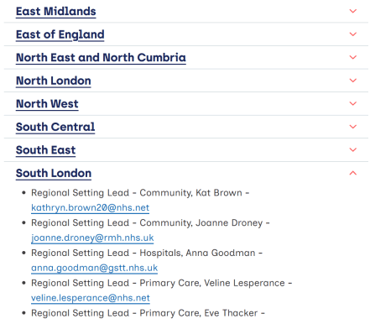

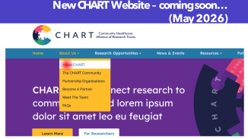

NIHR RDN Community setting Leads: Specialty and Settings Leads by region
62 Organisations
250 Members
To sign up to CHART
Info@chartresearch.nhs.uk
https://rdn.nihr.ac.uk/regional-specialty-and-settings-contact

Slide 6
Research & Development
NHS R&D support and wider care settings

Slide 7


Navigating Research in the NHS:
Local NHS R&D support and wider care settings
Simon Lewis, CLCH NHS Trust
Dr Amanda Davis (Ph.D.) KRFT NHS Trust

Slide 8

Image: craiyon.com

Slide 9
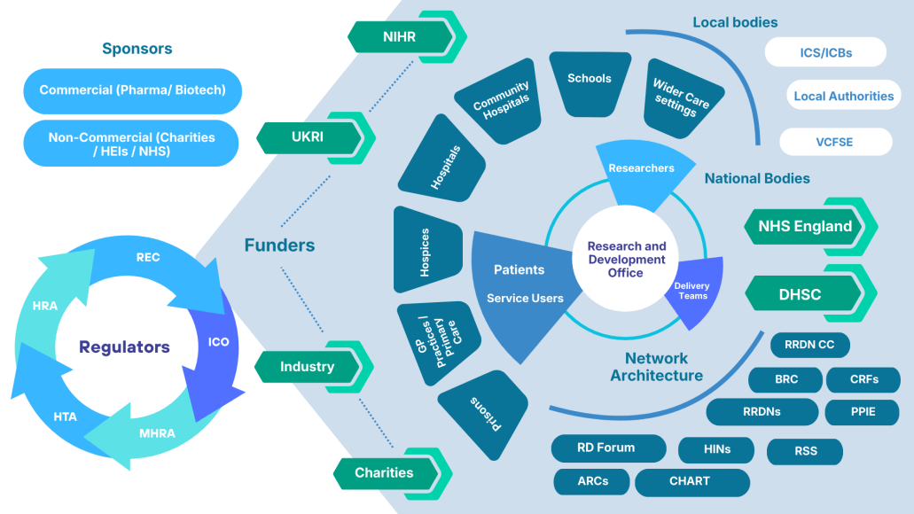

Slide 10
Summary:
Useful tools/links:
HRA decision tool
https://hra-decisiontools.org.uk/research/
Intergrated research application system
https://www.myresearchproject.org.uk/help/hlpsitespecific.aspx
Good Clinical Practice Training in Research (GCP). Gold standard for active participation and delegated duties in clinical research.
https://learn.nihr.ac.uk/ Access the National Institute of Health Research (NIHR) website
Search for Research Studies approved by NIHR
https://rdn.uk.qlikcloud.com
Funding Opportunities
https://www.nihr.ac.uk/funding-opportunities
Health Research Authority
https://www.nihr.ac.uk/funding-opportunities
Contact R&D Offices in the first instance
The NHS R&D Forum Directory- lists all R&D Office Contacts
Wealth of infrastructure, resource and expertise to support you
Build networks and establish collaborations
R&D Contacts Directory - NHS R&D Forum
Contact:
krft.research@nhs.net or clcht.researchanddevelopment@nhs.net
Notes:
.

Slide 11
Contact: krft.research@nhs.net or clcht.researchanddevelopment@nhs.net

Slide 12
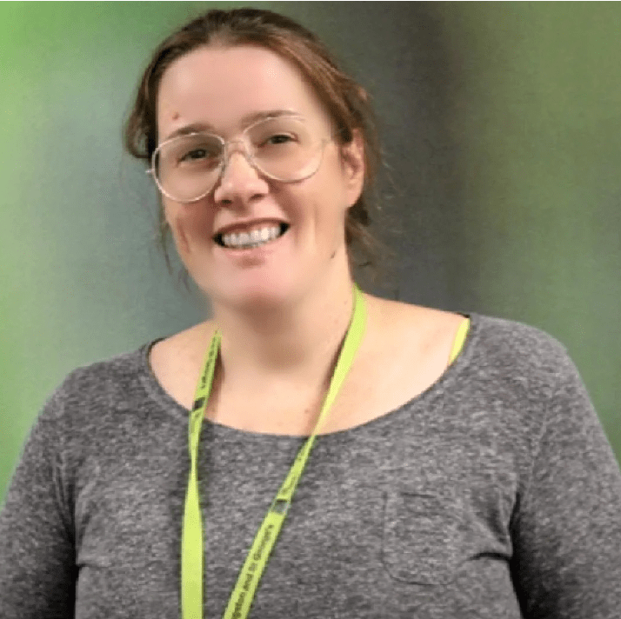

Funding Applications: A Mixed Perspective
Mary Halter, PhD
Dr John Chinegwundoh
Associate Professor
Fac. of Health, Science, Social Care and Education
Consultant Respiratory Physician
Health Equity Trust Lead
Kingston University
Kingston and Richmond NHS Foundation Trust

Slide 13
NIHR Research Delivery Network
Updates and innovations in research delivery

Slide 14
NIHR and the Research Delivery Network
Clare Gillott, Operations Director
Alison Anstead, Head of Research Delivery
& Support for Wider Care Settings

Slide 15
NIHR and the Research Delivery Network
The Research Delivery Network (RDN) is part of the NIHR Coordinating Centre.
The RDN is funded by the Department of Health and Social Care (DHSC).
The RDN contributes to the delivery of NIHR’s areas of strategic focus as detailed in Best Research for Best Health: The Next Chapter.
The NIHR Coordinating Centre to works together to deliver key strategic priorities including:
Research inclusion
Data and digital
Workforce development
Life sciences engagement
Communications
Notes:
Mention the RDN Board - The Research Delivery Network (RDN) Board operates a joint leadership model for the RDN and is made up of:
RDN Coordinating Centre Directors
Network Directors from each of the 12 Regional Research Delivery Networks (RRDNs)
representatives from DHSC
The Board sets the Network’s direction, develops strategies and plans and ensures consistency in their implementation at national and regional level.

Slide 16
Our remit and purpose
The Research Delivery Network enables the health and care system to attract, optimise and deliver research across England. We do this as part of NIHR’s mission to improve the health and the wealth of the nation through research.
This involves:
supporting the delivery of research which has been funded by the NIHR, research charities, other public funders and the life sciences industry
increasing capacity and capability to deliver research for the future
covering 3 different types of research: clinical, public health and social care
across 4 different settings: hospital, primary care, community and residential
(or any of these in combination)
Notes:
Talk around the 3 Government shifts: hospital to community, analogue to digital, sickness to prevention

Slide 17
RDN integrated ways of working
Following widespread consultation, our new integrated ways of working:
Support the entire research delivery process. Includes: study set-up, follow-up, and study closure, in contrast to focusing on recruitment only.
Strategically align with government and NIHR priorities to ensure a nationally coherent approach to research support.
Enable equitable access and delivery across all regions, rather than a regionally segmented model.
Increased focus on delivery across settings and within care pathways. Moving away from concentrating primarily on NHS-based research settings.
Emphasis on intelligence-driven decision making. Includes: making better use of data insights and embedding intelligence gathering.
A clear separation between the RDN and delivery organisations. Ensuring a distinct focus on enabling and supporting the whole RDN portfolio of research. The Network will not duplicate the work of delivery sites or take responsibility for individual studies.
Notes:
These new ways of working are the result of significant and sustained engagement with RDN staff, stakeholders and customers. Stakeholders include: previous and current RDN leadership; the wider NIHR, NHS R&D departments, charities, the life sciences industry, patients and the public.
The process of actively gathering feedback and insight has been a core component of the RDN’s evolution. And as the RDN further develops, the network will continue to engage with stakeholders. By listening and acting on what we hear, we will ensure we continue to learn, improve and respond to the changing needs of the research system.
Is it the role of the RDN to help promote individual studies?
No but we can direct sponsors to resources that can help with recruitment strategies.
Is it the role of the RDN to deliver engagement activities to help with the design of trials?
No, but we can create a network of public partners who are trained, supported and able to help those that are designing trials to make sure that they are public focused and accessible.
Is it the role of the RDN to support single centre studies?
No, but when CIs are ready to expand to a multi centre model or have acquired funding for this, then we will help with portfolio adoption, site selection and support for delivery.

Slide 18
RDN teams and services
Study Support Service
AcoRD / NCVR
Agile Research Delivery Team
Support for wider care settings
Life Sciences Partnership & Growth (includes key accounts and customer engagement)
Workforce Development
Finance (includes funding model and financial management)
Data & Analytics
Planning
Service Management and Architecture, and Business Analysis
Contractual Management including performance framework
Public Engagement
Specialities and Settings
Strategic Development
Study Participation Inclusion
Communications
Stakeholder engagement
Notes:
Lots of opportunities to engage with the RDN - highlight our SSS and ARDT

Slide 19
Specialties and Settings
Notes:
Section separator template using the motifs.

Slide 20
RDN Specialties and Settings
The Specialties and Settings function plays a key leadership role in the ongoing development and performance of the RDN
Led by clinicians and subject matter experts, it provides leadership and advice, supports research delivery, and participation in regional or national projects relating to Specialty or Setting capacity, capability and accessibility for research delivery
Notes:
Activities at regional level will include:
Strategic oversight of the RDN Portfolio
Support funders and sponsors in study design to optimise deliverability, including providing early feedback on protocols
Building capacity and capability for study delivery in their Specialty/Setting
Support the Study Support Service in the planning, placement and performance monitoring of studies, including assisting in the identification of sites and Principal Investigators
Embedding research into the NHS and wider care environment.
Facilitating and promoting cross-specialty and cross-setting collaborations to improve research delivery
Acting as NIHR Ambassadors, including engaging in, and supporting, business development activities.

Slide 21
Expanding research delivery into more settings
Hospitals: meaning NHS acute, mental health and pre-hospital care - including all NHS Trusts except for NHS Community Trusts
Primary care: including settings outside of general practice (for example, ophthalmology, audiology, dental)
Community-based: including, for example, NHS Community Trusts, local authority settings, preventative activities, home-based care, community care teams, schools, social care delivered outside of care homes and hospital settings, and social work services
Residential care: including, for example, care homes and hospices.

Slide 22
Specialties
Ageing
Anaesthesia, Perioperative Medicine and Pain Management
Cancer
Cardiovascular
Children
Critical Care
Dementia and Neurodegeneration
Dermatology
Diabetes, Metabolic and Endocrine
Ear, Nose and Throat
Gastroenterology and Hepatology
General Practice
Haematology
Imaging
Infection
Mental Health
Musculoskeletal and Orthopaedics
Neurological disorders
Ophthalmology
Oral and Dental
Palliative Care
Public Health
Renal
Reproductive Health and Childbirth
Respiratory
Social Care
Stroke
Surgery
Trauma and Emergency Care
29
Research Specialties
Notes:
This slide outlines the 29 specialties that the NIHR RDN covers.

Slide 23
Wider Care Settings Funding Model
Notes:
Section separator template using the motifs.

Slide 24
New for 2026/27: the Wider Care Settings Funding Model
01
Engaged
Increasing level of funding linked to increasing expectations
02
Established
03
Leading
Notes:
Moved from separate regional schemes to a nationally consistent funding scheme.
Provides additional infrastructure to support WCS organisations to take part in research.
Engaged: Wider Care Organisations who are engaged in research receive retrospective payments to cover Study Support Costs (SSCs). Plus a 15% uplift.
Established: Wider Care Organisations in the established band must commit to development activities and at least 1 research study. They receive a fixed payment of £1500, in addition to the retrospective SSCs plus a 15% uplift.
Leading: Wider Care Organisations in the leading band must commit to significant development activities and a portfolio of research studies. They can receive between £2000 and £100,000, in addition to the retrospective SSCs.

Slide 25
NIHR RDN Portfolio Data 2024-2025

Slide 26


Key Statistics 2024-25
Total number
of participants
Recruited by NIHR RDN over the
last 5 years to
39,274 participants recruited to commercial research
1,049,635
participants took part in health and social care research across
England
6,512,924
1,626
223
NHS trusts recruited participants to RDN-supported studies
GP practices recruited to RDN-supported studies
That’s enough people to fill Wembley Stadium more than 11 times over
Notes:
Commercial Collaborative Research involves companies working with a range of other partners. This slide provides a dashboard of key statistics from 2023/24. The dashboard is editable, so the figures can be updated. Participation in CRN-supported research in England was up 10% on the previous financial year. Part of this increase can be attributed to a particularly large commercial study, Discover Me, which recruited 102,925 participants in England.
952,789 participants took part in health and social care research across England – that’s the equivalent of 2,610 per day!
This brings the total number of participants recruited over the last 5 years to 5,235,635.
279,474 participants took part in primary care studies.
32,328 participants took part in commercial studies sponsored by the life sciences industry.

Slide 27


Key Statistics 2024-25
108,415 participants in England recruited to RDN-supported research via GP practices
4,561
223
studies in England recruited participants through the NIHR RDN
32,268 research participants completed the NIHR RDN’s Participant Research Experience Survey
NHS Trusts recruited participants into NIHR RDN portfolio studies
1,180
3,381
25% of GP practices recruited participants to NIHR-supported studies
of these were
commercial
of these were
non-commercial
340 care homes recruited participants to RDN supported studies
Notes:
Over a third of all CRN-supported studies in England were commercial (39%) Of these, 1,765 were commercial contract trials and 626 were commercial collaborative research. This slide provides a dashboard of key statistics from 2023/24. The dashboard is editable, so the figures can be updated.
In 2022/23, 6,318 studies were supported by the NIHR CRN in England, of which 1,757 were commercial studies sponsored by the life sciences industry.
A study is counted as 'supported by NIHR CRN' if it has been open to recruitment (and therefore in receipt of NIHR CRN support) at any point in that financial year, according to the study's Actual Opening and Closure Dates.
Patients from 99.5% of NHS trusts and 44% of GP practices across England took part in NIHR CRN supported research this year.
32,603 research participants completed the NIHR CRN’s Participant Research Experience Survey. 93% said they felt valued by researchers. 91% would consider taking part in research again.

Slide 28
Thank you for listening!
rdn.nihr.ac.uk
nihr.ac.uk
Get in touch with the South London RRDN: sl.rrdn@nihr.ac.uk

Slide 29
Research Beyond Boundaries: Navigating clinical research in the NHS
Leadership in research
Dr Alison Finch MBE
Assistant Chief Nurse, UCLH
NIHR Nursing & Midwifery Senior Research Leader
12 March 2026

Slide 30


Leadership in research
Introduction: a brief background about me
Inspiration: becoming research-active
Process: touchpoints on my journey
Impacts: personal, for patients, my profession & organisation
Signposting: training and development opportunities

Slide 31
Introduction: my nursing career
Cancer Nurse
MSc
NIHR Clinical Doctoral Research Fellowship
PhD
Nursing specialty lead
TYA cancer
Pg Cert
Coaching
Applied health researcher, clinical leader
& clinical academic
TYA nurse
NIHR SRL
(Nursing & Midwifery)
Clinical Leader
Pg Cert Organisational
Development
Assistant Chief Nurse
RN Adult
Diploma in Tropical
Nursing
BSc (Hons)
Clinical Nursing
1990s
2000s
2010s
2020s
Notes:
Finally – a little bit about what I would bring to the fellowship
My career progression has not been linear, I have built a range of experiences that support my aspiration to be an applied health researcher and a leader in nurse-led research. The experience gained in recent years studying OD and qualifying as a coach I believe in particular benefit my facilitation and leadership of this type of participatory health research.

Slide 32
My research leadership journey touchpoints
MSc research: 2003
How do young people experience learning about parental cancer diagnosis?
2019: Young people’s experiences of receiving complex cancer treatment via an ambulatory pathway
Cancer Nurse
MSc
2011-2: Exploring early ambulatory care experiences through appreciative inquiry
PhD
Development of
TYA AC Service
PG Cert
Coaching
TYA Nurse
Clinical Leader
2017: Nurses and midwives revalidation experiences, a mixed methods service evaluation
BSc dissertation
Too elementary to question? Blood pressure recording in clinical practice
Late 1990s
Engaging in research inquiry and supporting others’ research,
Leonard Cheshire Chair of Conflict Recovery, Azerbaijan
Pg Cert Organisational
Development
2012: An evaluation of the service project component of the Leading for Improvement programme, UCLH
Notes:
Finally – a little bit about what I would bring to the fellowship
My career progression has not been linear, I have built a range of experiences that support my aspiration to be an applied health researcher and a leader in nurse-led research. The experience gained in recent years studying OD and qualifying as a coach I believe in particular benefit my facilitation and leadership of this type of participatory health research.

Slide 33

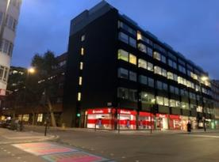


Establishing experiential evidence about young people’s ambulatory cancer care*
*Ambulatory Care in the cancer domain is widely understood as cancer treatment given on an outpatient basis that has traditionally required an inpatient stay.
CCLG Ambulatory Care Special Interest Group, 2022

Slide 34
Developing a clinical academic career
Who I was:
My development:
Who I am becoming:
2019-2022
2023 and beyond
Teenage and Young Adult Cancer Nurse
Clinical Leader
MSc Palliative Care
Accredited Coach Practitioner
Building academic knowledge about an emergent model of cancer care
Developing research discipline via a PhD
Supporting the development of research capacity amongst nurses, midwives and AHPs
a participatory researcher
an applied health researcher
an NIHR Senior Research Leader
a co-applicant on a Wellcome Discovery grant

Slide 35
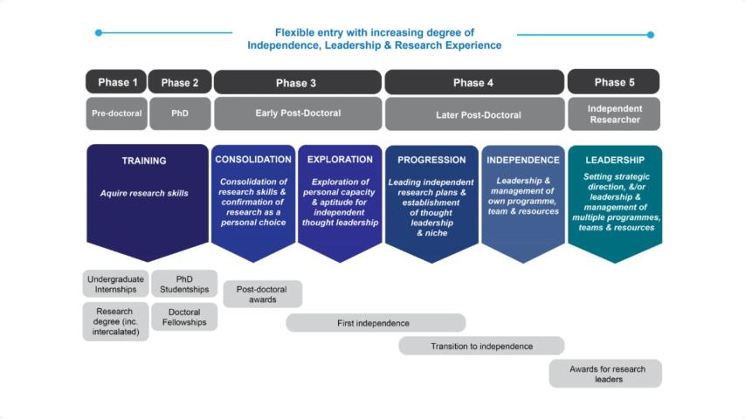
National clinical research career pathway - CATCH

Slide 36
Leading self and leading others
Value the opportunity to work within and across different intersectional spaces
Start small
Look for opportunities to create thinking and planning time
Plan and create a personal development plan
Find mentors and build professional collaborations
Recognise the barriers & focus on the enablers
Look for internship, funding and fellowship opportunities
Develop and sustain links with universities

Slide 37

Part 2: training and development opportunities https://www.nihr.ac.uk/career-development

Slide 38

NIHR: Building Research Capacity and Capabilities
NIHR has research training, development and support opportunities for all health and care professionals:
Career development awards and support
For all health and care professionals including methodologists
Training and Support for practitioner and clinician researchers
For researchers whose main focus is the delivery of healthcare or care in the NHS, primary care, local authorities and charities
Training and Support for research delivery staff
For people who support researchers to deliver high quality research more effectively and efficiently
Notes:
NIHR supports the development of research capacity and capability of people working in health and care from all backgrounds and roles. The range of opportunities caters for those supporting research delivery, those seeking to embed research in their health or care service careers and for those wanting a careers as researchers. The NIHR RDN supports practitioner/clinician researchers - people who embed research within their mainly clinical or care roles.
The NIHR Academy provides a range of awards for people seeking to commit a significant part of their time to research. These awards span all levels from first introduction to research up to full professorial posts.
In addition, research capacity development is embedding across the NIHR system, including Research Programmes and Research Infrastructure

Slide 39

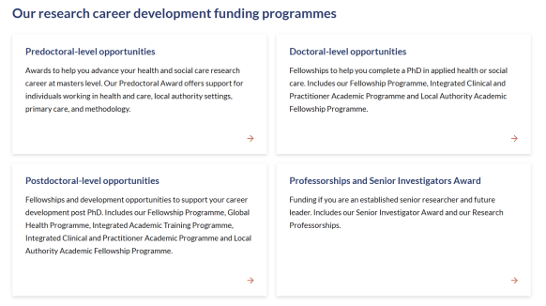

Developing as a clinical academic
Research career funding programmes | NIHR
Notes:
Introduce NIHR clinical academic pathway

Slide 40
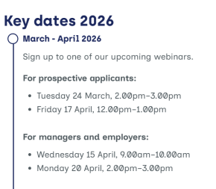

Developing as a clinical academic
The Researcher Development Programme
For nurses who work in social care to improve their research skills and help create a research-friendly culture at work
Researcher Development Programme for Social Care Nurses | NIHR
Notes:
Introduce NIHR clinical academic pathway

Slide 41
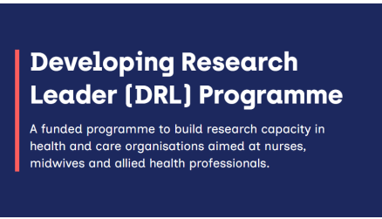
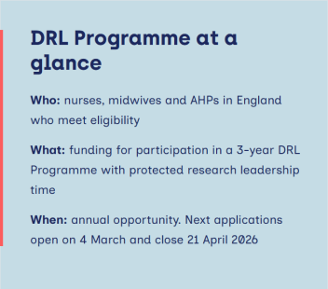
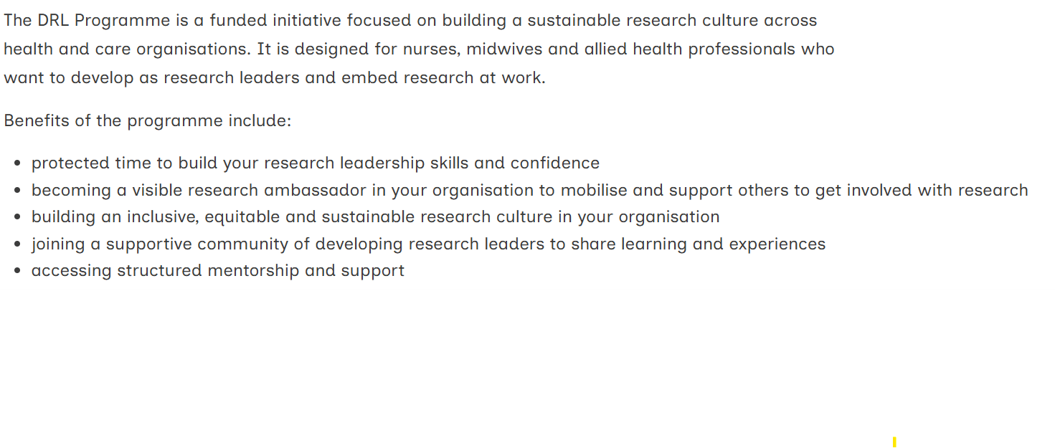



Slide 42
Thank you
alison.finch1@nhs.net
alison.finch@ucl.ac.uk

Slide 43



Refreshments & Networking Session
14:50 - 15:10
Join us for an informal networking break. Connect with colleagues, share ideas, and build collaborative relationships over refreshments.
Light refreshments provided
Open networking opportunity
Coffee, tea and light snacks will be available for attendees during the break.
Meet new colleagues, exchange contact details, and explore potential collaborations.

Slide 44


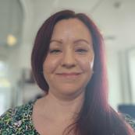
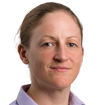

Expert Panel: Partnerships and Collaboration
Dr Catherine Heffernan
Prof Reem Kayyali
Alison Anstead
Clare Gillott
Simon Lewis
Operations Director
Head of R&D
Director of Health Improvement
Consultant in Public Health
South West London ICB
Head of Department of Pharmacy
Head of Research Delivery and Support for Wider Care Settings
South London Regional Research Delivery Network
Kingston University
South London Regional Research Delivery Network
Central London Community Healthcare NHS Trust- CLCH

Slide 45

Reflections and Building on the Conversations
REN & KRFT Feedback
Scan the QR code to provide your valuable feedback

