Slide 1



Co‑design in Practice:
Moving from ‘Tick Box’ to ‘Doing With’
Fiona Jones , City St Georges and Bridges Self-Management

Slide 2
“Alone we can do so little; together we can do so much.”
Helen Keller

Slide 3
What this workshop will cover
1
A reminder from workshop 1 and introducing ‘Doing With’
2
Strengthening relationships with communities (Rebecca and Fi)
  3
Blank sheet model
  4
The coach–creator–challenger model
  5
The concept of co-design and ‘welldoing’
  6
Turning insights into a clear, personalised action plan

Slide 4
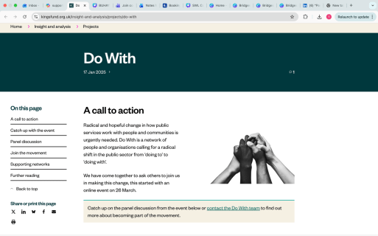
Introducing ‘Doing with’
What it means
  A shift from top‑down, deficit‑based services to partnership with people and communities
  People are equal partners, not passive service users
  Core principles
  Shared power: decisions, resources and priorities shaped together
  Strengths‑based: builds on lived experience, relationships and community assets
  Relational: trust, listening and collaboration are central
  Preventative: acts early to avoid crisis, not just respond to it
  System change: requires new leadership, commissioning and accountability models

Slide 5
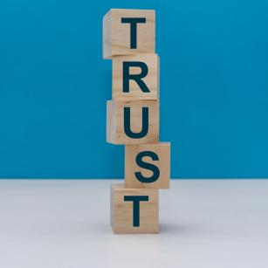
Introducing ‘Doing with’
What it’s not
  Not consultation after decisions are made
  Not shifting responsibility onto communities without support
  Not token engagement or “doing more with less”
Why it matters
  Improves outcomes people care about
  Reduces pressure on stretched services
  Creates fairer, more sustainable public services

Slide 6

Activity 1: “From Tick Box to Trust”
Individually (5 min):
  One example of “doing to” you’ve seen
  One example of “doing with” (even if imperfect)
Group work (10 min)
  Share and cluster notes under Trust / Tokenism / Tension
  Trust – moments that built confidence, credibility, partnership
  Tokenism – moments that felt extractive, performative, or hollow
  Tension – moments that were uncomfortable, messy, or conflicted but honest

Slide 7
A reminder from workshop 1
All the ‘co’ words...
Models and methods...
Power and priviledge...
Conditions for meaningful engagement

Slide 8

  Co-production- equal relationship, work together , design delivery etc
  Co-design- Designing based on experiences and ideas- have influence and involved but might not ‘see it through’
  Engagement- People are given opportunities to express their views and may be able to influence decisions
  Consultation- Asked to fill in a survey, or attend meetings - may not have the power to affect change
  Informing - those responsible tell the people about sercie and how it works- e.g informing about why decisions have been made
  Educating - people helped to understand the service
  Coercion- bottom of the rung - people are passive recipients , views not considered important and not taken into account
https://www.transformationpartners.nhs.uk/co-production-healthcare-by-the-community-for-the-community/

Slide 9
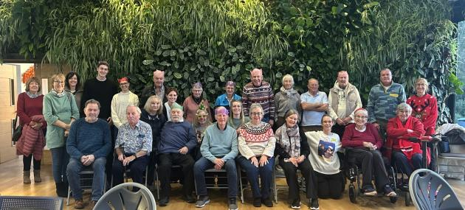
Activity 2: who is your community?

Slide 10

  When we say ‘community’ who are we actually talking about?
  Write your answers on sticky notes (groups of people, roles and identities)
  Be specific not general e.g ‘hard to reach groups’
  Who is here and who is missing?
  How do you currently relate to this community? Transactional?, Consultative?, Relational?

Slide 11

If this is your community what would strengthen the relationship with them
  One thing we should do more of
  One thing we should stop doing or do differently
  One thing we should protect and not lose

Slide 12

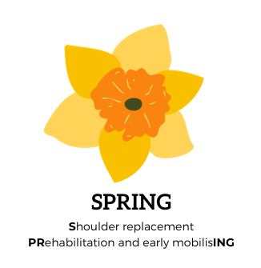




Co-designing interventions for people experiencing total shoulder replacement surgery:
Learnings from the SPRING study.
Dr Fi Leggat
City St Georges, University of London

Slide 13
Overview of the SPRING Study
Funder: NIHR Health Technology Assessment (HTA) Programme.
Call Title: 23/157 Preoperative rehabilitation and early mobilisation for shoulder replacement.
Grant award won: £2.5 million.
Dates: March 2025 – Feb 2029 (48 months).
Link to NIHR website?
Aims:
To co-design prehabilitation and early rehabilitation interventions (phase 1) for people undergoing shoulder replacement (TSR).
To test the clinical and cost-effectiveness (phase 2) of these interventions, in comparison to usual care, in improving function and reducing pain.
These interventions will be designed for anybody who is experiencing total shoulder replacement (TSR; anatomical/reverse), but not people who are receiving a partial replacement.

Slide 14


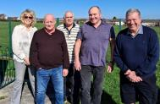

Methods
Design:
Intervention Mapping (IM) approach + Co-Design approach
Using Accelerated Experience Based Co-Design (AEBCD)
Participants
Data Collection
23 People with TSR
5 NHS PIC sites across England, Wales & Northern Ireland
13 HCPs
Data Analysis
Iterative content analysis
Reflected upon topics and findings in bi-monthly meetings with:
Patient advisory group (n=6)
(4 were also co-design participants)
Clinical co-applicants (n=5)
7 Face-to-face meetings
8 Online meetings
15 Narrative interviews
- Telephone, face-to-face & online

Slide 15
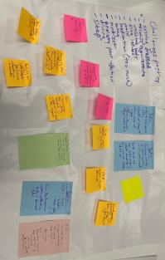
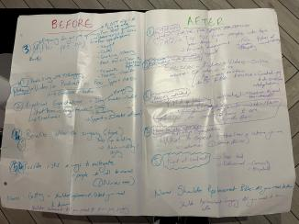
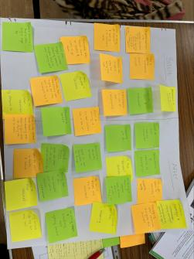
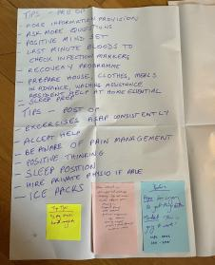
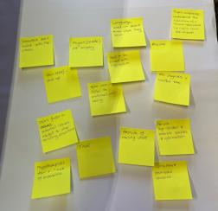
Results:

Slide 16
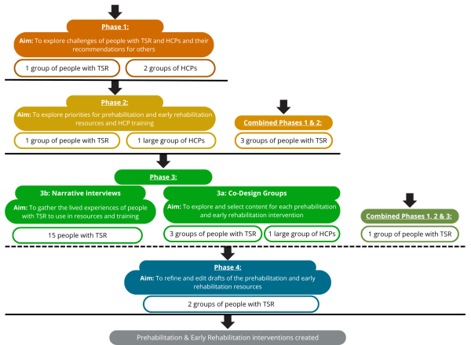
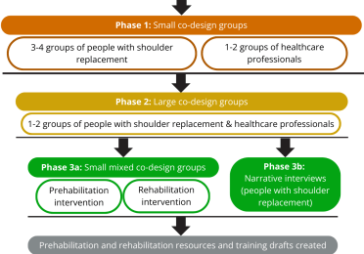
Learnings & Reflections
What we planned:
What happened:

Slide 17
Learnings & Reflections
Created the option to attend face-to-face meetings
Respond to the preferences of your population.
Met people where they’re at
Tailor the process to enable people to join later.
Let people share their experiences even if they join later.
Scheduled buffer time within each session
Build in contingency time to the schedule.
Teas and coffees always take up time but provide valuable space for connection.
Developed small, flexible aims
Decide the most important parts of session and the least important parts and adapt timings for these as you go.
Choose 1 aim for the session, and if you achieve 2+, that’s a bonus.
Balanced patient empowerment with clinical risk
Build in extra time with clinicians to guide on safety concerns.
When including exercises, be cautious but provide info to guide autonomy.

Slide 18


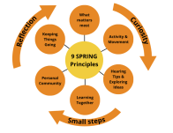
Prehabilitation handbook
Available as physical copy or interactive electronic copy.
Centred upon people’s stories, tips and advice for how to prepare.
Early rehabilitation handbook
Available as physical copy or interactive electronic copy.
Centred upon people’s stories, tips, coping strategies and movements during rehabilitation.
SPRING Prehabilitation Intervention
Surgery
SPRING Early Rehabilitation Intervention
1-1 support sessions with trained HCP*
Between 3-months and 6-weeks before surgery.
Up to 4 sessions, each up to 45-minutes
Face-to-face, telephone or video conferencing software.
1-1 support sessions with trained HCP*
24/48 hours:
1 session, up to 45-minutes
Face-to-face or telephone.
48 hours - 6 weeks:
Up to 3 sessions, each up to 45-minutes
Face-to-face, by telephone or by video conferencing software.
*SPRING HCP Training & Support Package
Support package:
Q&A drop-in sessions
Written and video resources such as crib sheets, exemplar sessions, how-to-guides and recordings.
Training:
8 hours of group or individual interactive training (4 x 2 hours).
Focused on 9 intervention principles.

Slide 19

Activity 3: Starting with a blank sheet
  A core democratic principle of co‑design.
  Doesn’t begin with solutions...begins with people.

Slide 20
Towards your next steps
Starting with a blank sheet , no right answers and no expected outcomes
Group Blank-sheet Mapping
Think about your experience of a service/ condition/research topic
Meaning-Making
Place elements from individual sheets onto a shared sheet, group naturally , dont force categories
Questions; what do you notice here?; What feels most emotional?; What feels most urgent; Whats missing?
We’re not here to fix but here to understand what matters most from your perspective
What feels invisible, frustrating, exhausting?
What feels important but is rarely discussed

Slide 21



This will activity will help to...
  Surface unmet needs, lived experience, and priorities without pre‑defining solutions,
  Reducing professional bias
  Create space for patients, carers, and frontline staff to shape what matters most.
Materials
No structure
Faciliating behaviours
Large blank paper
Thick Markers
Stickie Notes
Consider icons, symbols and stickers to support non-verbal expression
No templates, no prompts, no examples shown
No jumping to conclusions
Researchers / Clinicians listen first
Protect quieter voices, ask ‘what belongs here?’, not ‘what theme is this?’

Slide 22

If we could only take one thing forward from today , what should it be?
  Ask each participant
  Explain next steps clearly
  How insights will be documented
  How participants will stay involved
  What will not be decided today
The hardest part is discipline , do not rush to structure, structure too early and you undo the value of starting with a blank sheet
Don’t Rush.....

Slide 23
Activity 4; Enabling language
“What would ‘good’ look like from your perspective?”
“Can you help me understand how that felt?”
“If this were built around your needs, what would change?”

Slide 24
Language to avoid
“This is what we’re planning—any comments?”
“From a clinical perspective…”
“We’ll capture it but can’t explore it now.”

Slide 25
Over to you...

Slide 26
Activity 5: The coach–creator–challenger model ...and why it matters in co‑design

Slide 27
Using the Empowerment Triangle helps:
  Shift conversations away from blame or dependency
  Support shared ownership of problems and solutions
  Build confidence, trust, and agency during collaboration
  Align practice with doing with, not doing to
  It encourages everyone—professionals and community members—to move fluidly between roles as the work requires.

Slide 28
Empowerment Model for Co‑Design :
Three roles that support shared ownership and better outcomes
Creator
Focus: Imagining and building
In co‑design:
  Brings ideas, experiences, and possibilities
  Turns needs into concepts and solutions
  Asks: “What could we create together?”

Slide 29

Empowerment Model for Co‑Design :
Three roles that support shared ownership and better outcomes
Coach
Focus: Enabling and supporting
In co‑design:
  Builds confidence and trust
  Encourages participation from everyone
  Asks: “What do you need to move forward?”

Slide 30

Empowerment Model for Co‑Design :
Three roles that support shared ownership and better outcomes
Challenger
Focus: Strengthening through questioning
In co‑design:
  Questions assumptions and blind spots
  Brings alternative or overlooked perspectives
  Asks: “What are we missing?”

Slide 31
Activity 6: Move from drama to empowerment
Purpose:
  Take a common statement,
  Rewrite it from each triangle role:
  What would a coach say?
  What would a challenger say?
  What would a creator say?
“The community doesn’t engage”

Slide 32
  Creator: What do we want to enable?
  Coach: What support is missing?
  Challenger: What assumption is hidden?

Slide 33
The Creator role is about agency.
“In co‑design, this means people are supported to shape what matters—defining the problem, generating ideas, and influencing decisions.”
“Creator energy sounds like:
‘What do we want to create together?’”
“When the Creator role is missing, people feel consulted at rather than collaborated with.”
The Coach role is about support without rescue.
“As coaches, we listen longer, create safety, and help others take their own next step rather than stepping in to fix.”
“Coach energy sounds like:
‘What support would help you move this forward?’”
“When coaching is missing, people either disengage—or become dependent on professionals to lead.”
The Challenger role is about respectful truth‑telling.
“This includes questioning assumptions, naming power dynamics, and surfacing ‘what we’re not allowed to say’—with care.”
“Challenger energy sounds like:
‘What assumption might we need to test here?’”
“Without challenge, co‑design can look nice—but change very little.”

Slide 34
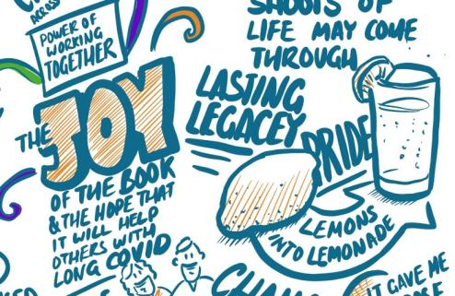
Co-design done well can have a ripple effect on how participants feel

Slide 35
Co-design and Welldoing
  Welldoing draws directly on Manfred Max‑Neef’s Human Scale Development model, which argues that wellbeing comes from how fundamental human needs are met through participation, not from outcomes or resources alone.
  Wellbeing comes from how fundamental human needs are met through lived experience — not from resources, outputs, or growth alone.

Slide 36
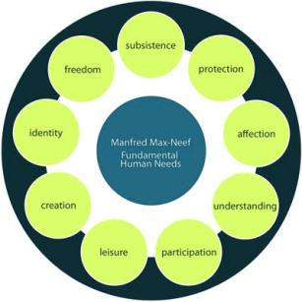
Fundamental Human Needs
Universally interconnected, non‑hierarchical
  Subsistence
  Protection
  Affection
  Understanding
  Participation
  Creation
  Identity
  Freedom
  Leisure

Slide 37
What “Welldoing” Means in Practice
1. Wellbeing is created during the process, not just after
Davis argues that participants can experience:
  Belonging
  Agency
  Meaning
  Respect
While taking part in co‑design—not only through final outcomes
2. Participation itself has value
Traditional evaluations focus on outputs (usability, efficiency, innovation).
“Welldoing” insists we also evaluate:
  How people felt participating
  Whether they experienced autonomy or extraction
  Whether relationships and trust were strengthened
3. Structured around human needs
Davis draws on Manfred Max‑Neef’s Theory of Human Needs, showing how co‑design can satisfy needs such as:
  Participation
  Identity
  Understanding
  Freedom
  Creation
Poorly designed co‑design can frustrate these same needsunisa
4. Facilitation quality matters
“Welldoing” depends heavily on facilitation choices:
  How power is shared
  Whether uncertainty is allowed
  Whether psychological safety is actively supported
  Whether contributions genuinely influence decisionscreativematters
Co‑design done badly can harm trust—even if intentions are good.
5. Co‑design as ethical practice
Davis positions “welldoing” as a moral responsibility, not just a design preference:
  Are people being invited meaningfully?
  Are expectations clear?
  Are contributions valued, not mined?unisa

Slide 38
What “Welldoing” Means in Practice cont...
3. Structured around human needs
  Participation
  Identity
  Understanding
  Freedom
  Creation
Poorly designed co‑design can frustrate these same needs
4. Facilitation quality matters
  How power is shared
  Whether uncertainty is allowed
  Whether psychological safety is actively supported
  Whether contributions genuinely influence decisions
Co‑design done badly can harm trust—even if intentions are good.
5. Co‑design as ethical practice
Davis positions “welldoing” as a moral responsibility, not just a design preference:
  Are people being invited meaningfully?
  Are expectations clear?
  Are contributions valued, not mined?unisa

Slide 39
What “Welldoing” Means in Practice cont...
5. Co‑design as ethical practice
“welldoing” is a moral responsibility, not just a design preference:
  Are people being invited meaningfully?
  Are expectations clear?
  Are contributions valued, not mined?

Slide 40

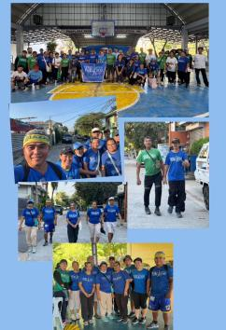
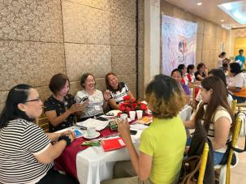
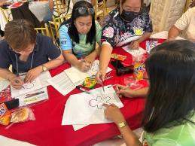
How can you make it fun interesting and enjoyable?

Slide 41

Timeline to elevating the authenticity of your engagement and co-design
Pause and consider whats your first step
Consider how you can create the conditions for people to want to engage
What will you do to understand the context together?
Go ahead and learn and explore together

Slide 42



Planting a garden not filling a form
Growth
Quality builds not a quick fix
Relational

Slide 43
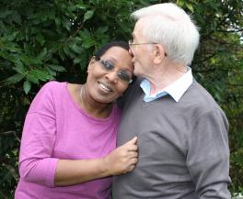
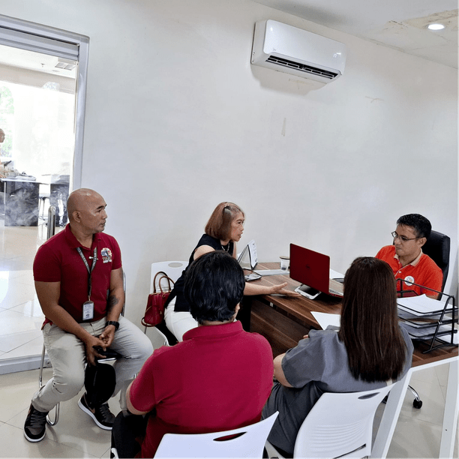

create the conditions for people to feel heard
build close relations
create your circles

Slide 44
  4
Your next small step?
  What one thing you will commit to doing in the next six month to build relationships and conditions for engagement?
  Tell the person next to you
  Write yourself a reminder

Slide 45


Slide 46


Slide 47
Some useful references
  Do With: A Call To Action | The King's Fund
  Co-production: what it is and how to do it - SCIE
  Davis, A., Tuckey, M., Gwilt, I., & Wallace, N. (2023). Understanding co‑design practice as a process of “welldoing”. International Journal of Art & Design Education
  Bødker, S. (1996). Creating conditions for participation: Conflicts and resources in systems development. Human–Computer Interaction, 11(3), 215–236. https://doi.org/10.1207/s15327051hci1103_2
  Cornwall, A. (2008). Unpacking “participation”: Models, meanings and practices. Community Development Journal, 43(3), 269–283. https://doi.org/10.1093/cdj/bsn010
  Sanders, E. B.-N., & Stappers, P. J. (2008). Co‑creation and the new landscapes of design. CoDesign, 4(1), 5–18. https://doi.org/10.1080/15710880701875068
  Steen, M., Manschot, M., & De Koning, N. (2011). Benefits of co‑design in service design projects. International Journal of Design, 5(2), 53–60.
  Zamenopoulos, T., Alexiou, K., Lamb, B., Kelemenci, M., De Sousa, S., Moffat, S., & Phillips, M. (2019). Types, obstacles and sources of empowerment in co‑design: The role of shared material objects and processes. CoDesign, 17(2), 139–158. https://doi.org/10.1080/15710882.2019.1605383 [tandfonline.com]
  Arnstein, S. R. (1969). A ladder of citizen participation. Journal of the American Institute of Planners, 35(4), 216–224. https://doi.org/10.1080/01944366908977225
  Gaventa, J. (2006). Finding the spaces for change: A power analysis. IDS Bulletin, 37(6), 23–33. https://doi.org/10.1111/j.1759-5436.2006.tb00320.x
  Sen, A. (1999). Development as freedom. Oxford: Oxford University Press.

Slide 48




Bridges Webinar: Integrating authentic co-design in health and social care research
Are you a researcher looking to build co-design into your project, or to develop your understanding and confidence?
Sign up for a free Bridges webinar introducing the range of ways the team can support you, including;
  developing proposals grounded in genuine involvement principles
  building your capacity through training in participatory approaches
  hands-on support during your project through co-facilitation, coaching, and output development.
Monday 20th July 2026
1.00pm - 1.45pm
Sign up: bridgesselfmanagement.org.uk/upcoming-events
or scan the QR code
Fiona Jones
CEO and Professor of Rehabilitation Research
Paula Otter
Co-Production and Innovation Lead
Scott Ballard-Ridley
Co-Production and Quality Manager

